Slide 1
Portable Building Applications
WoT Use Case
Gabe Fierro
Colorado School of Mines / NREL
gtfierro@mines.edu https://gtf.fyi

Slide 2
Increasing Amounts of Data Available for Buildings
Large sensor/actuators networks:
thousands, 10s of thousands of data streams and control points
Increasing #s of IoT devices available
Opportunity for wide-scale data-driven analytics and control:
AFDD
Virtual metering
Performance measurement
Automated regulatory reporting
MPC and advanced controls/sequence-of-operations
Demand response
Issue: complex, heterogenous configuration:
Every building is a unique, one-off collection of “data silos”
Implementing software, extracting data, defining control surfaces is site-specific, error-prone and time consuming

Slide 3

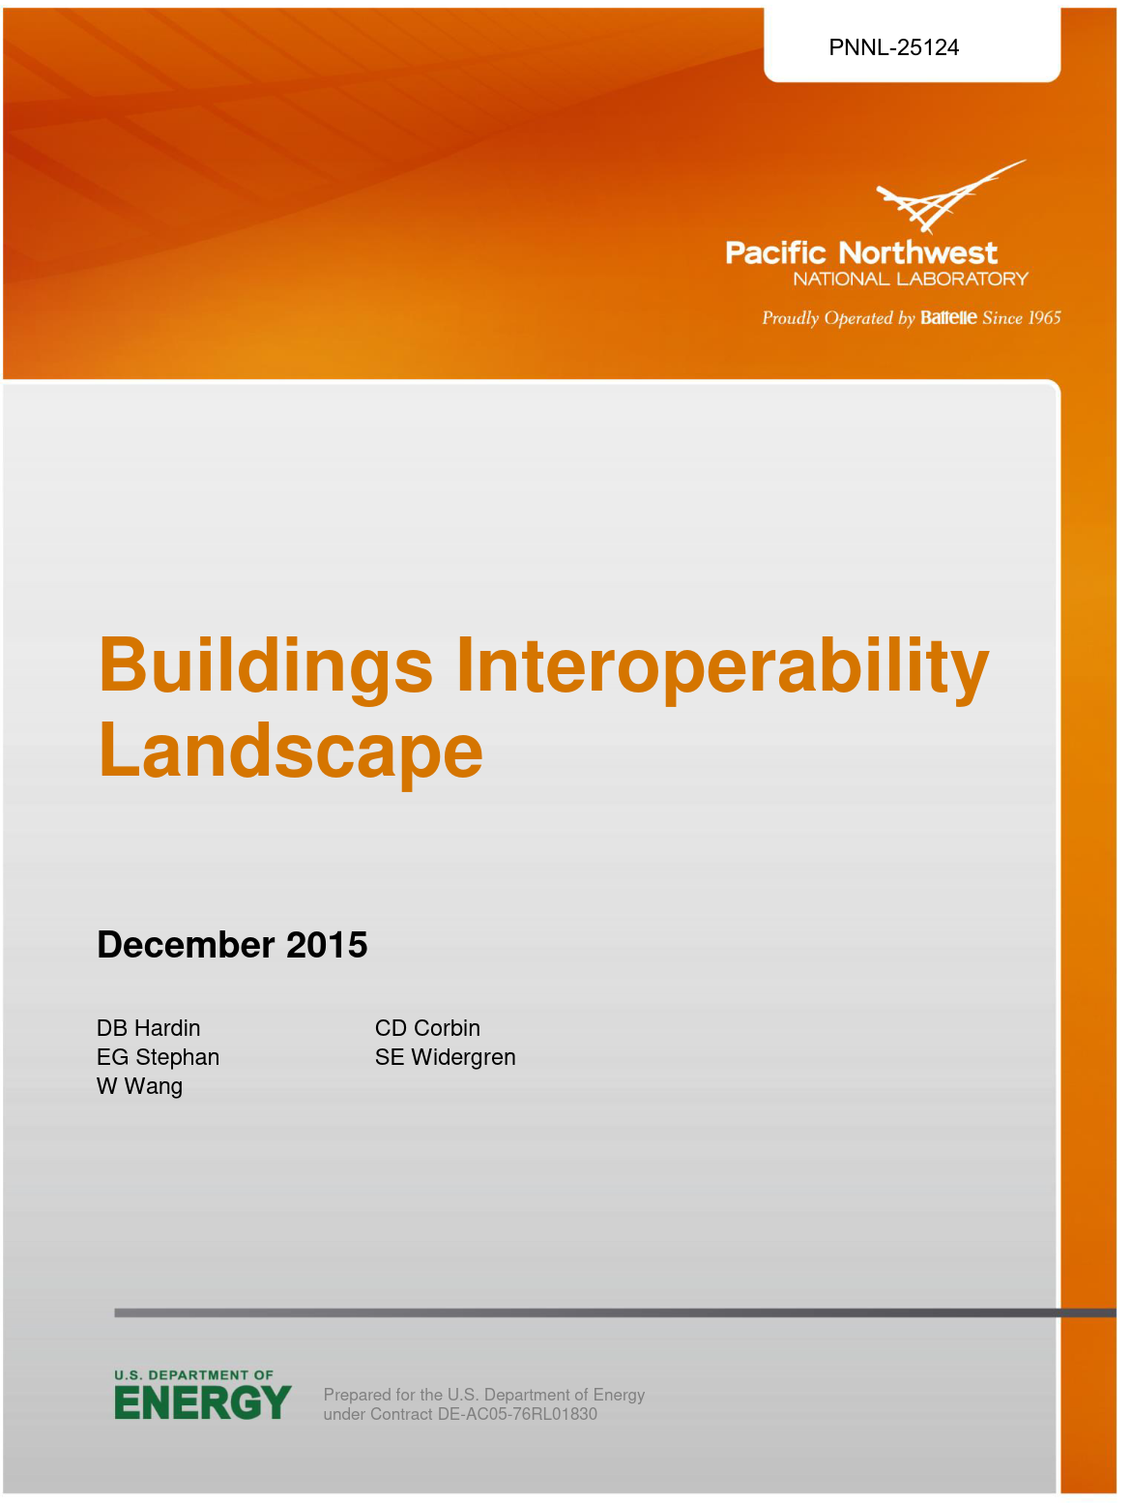
...but that data is increasingly hard to use
“Data-rich but information-poor”
Plenty of phenomena, but none of the context
Understanding this data is a significant bottleneck
~40% of consultant/data-scientist time spent understanding metadata
Manual, time-consuming, error-prone, expensive task
Costs impede adoption of sustainable practices
2004 NIST report estimates lack of interop @ $15.8 billion/year
2016 PNNL report: existing work focuses on connectivity, with data semantics still lacking
2018 study: 70% of commercial buildings have digital controls, but only 4% have automated fault detection
Notes:
“Data-rich but information-poor”
Impedes adoption of data-driven sustainable practices, technologies
Manual configuration of software; site-specific implementations
~40% of consultant/data-scientist time spent understanding metadata
Interoperability costs impede adoption of sustainable practices
2004 NIST report estimates lack of interop @ $15.8 billion/year
2016 PNNL report: existing work focuses on connectivity, with data semantics still lacking

Slide 4
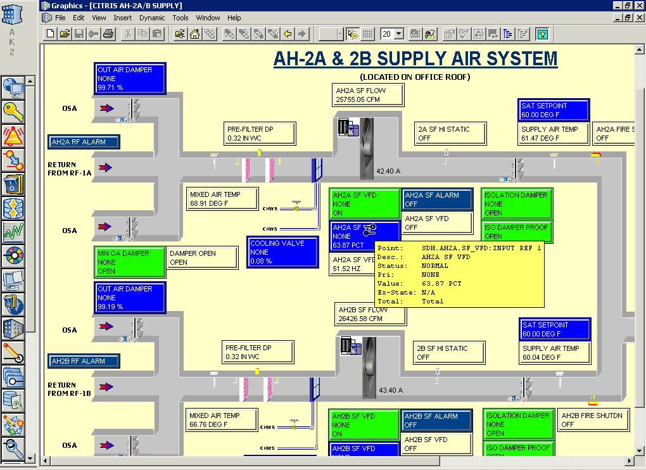
Point: a source of data from a cyber-physical system 10s or 100s of thousands of points in a typical system
Building Management System (BMS): the “operating system” for your building
Notes:
Data sequestered in proprietary data silos speaking proprietary protocols

Slide 5
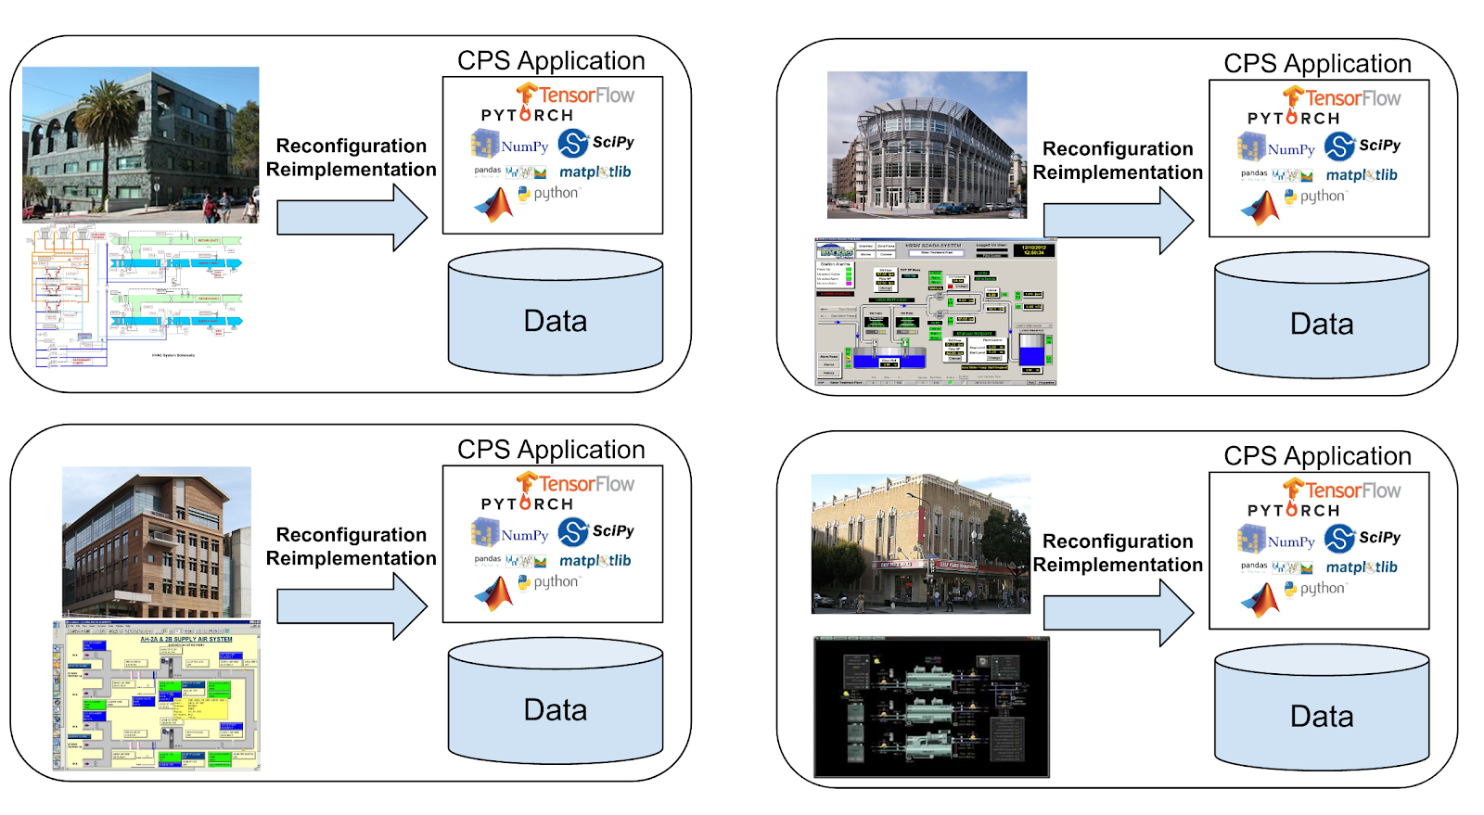
Deploying Cyber-Physical Applications at Scale
Current Practice: manual, time-consuming, error-prone reimplementation for each site

Slide 6
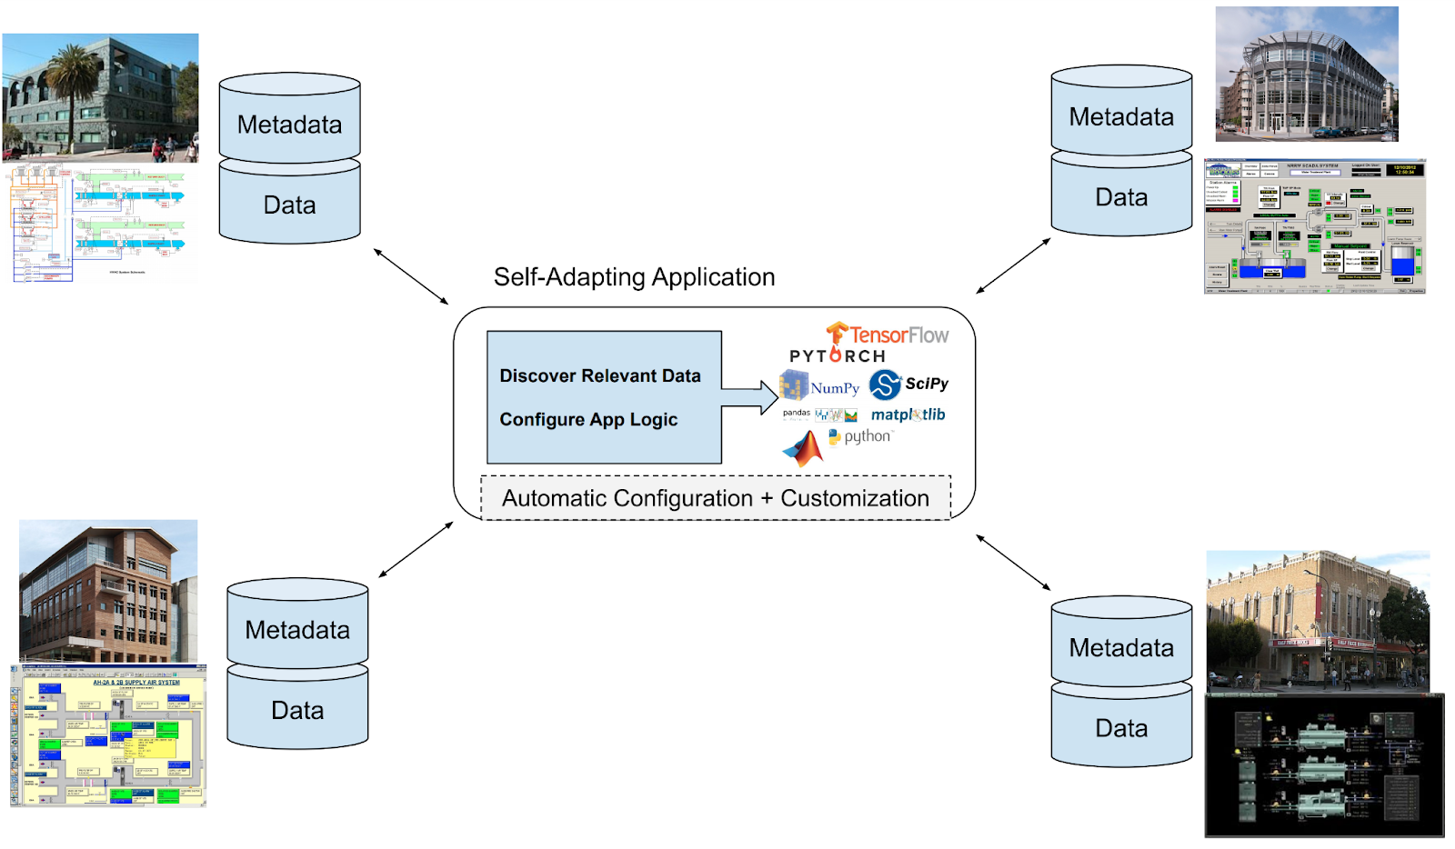
Deploying Cyber-Physical Applications at Scale
Goal: Write one implementation, run it everywhere without any* manual configuration

Slide 7
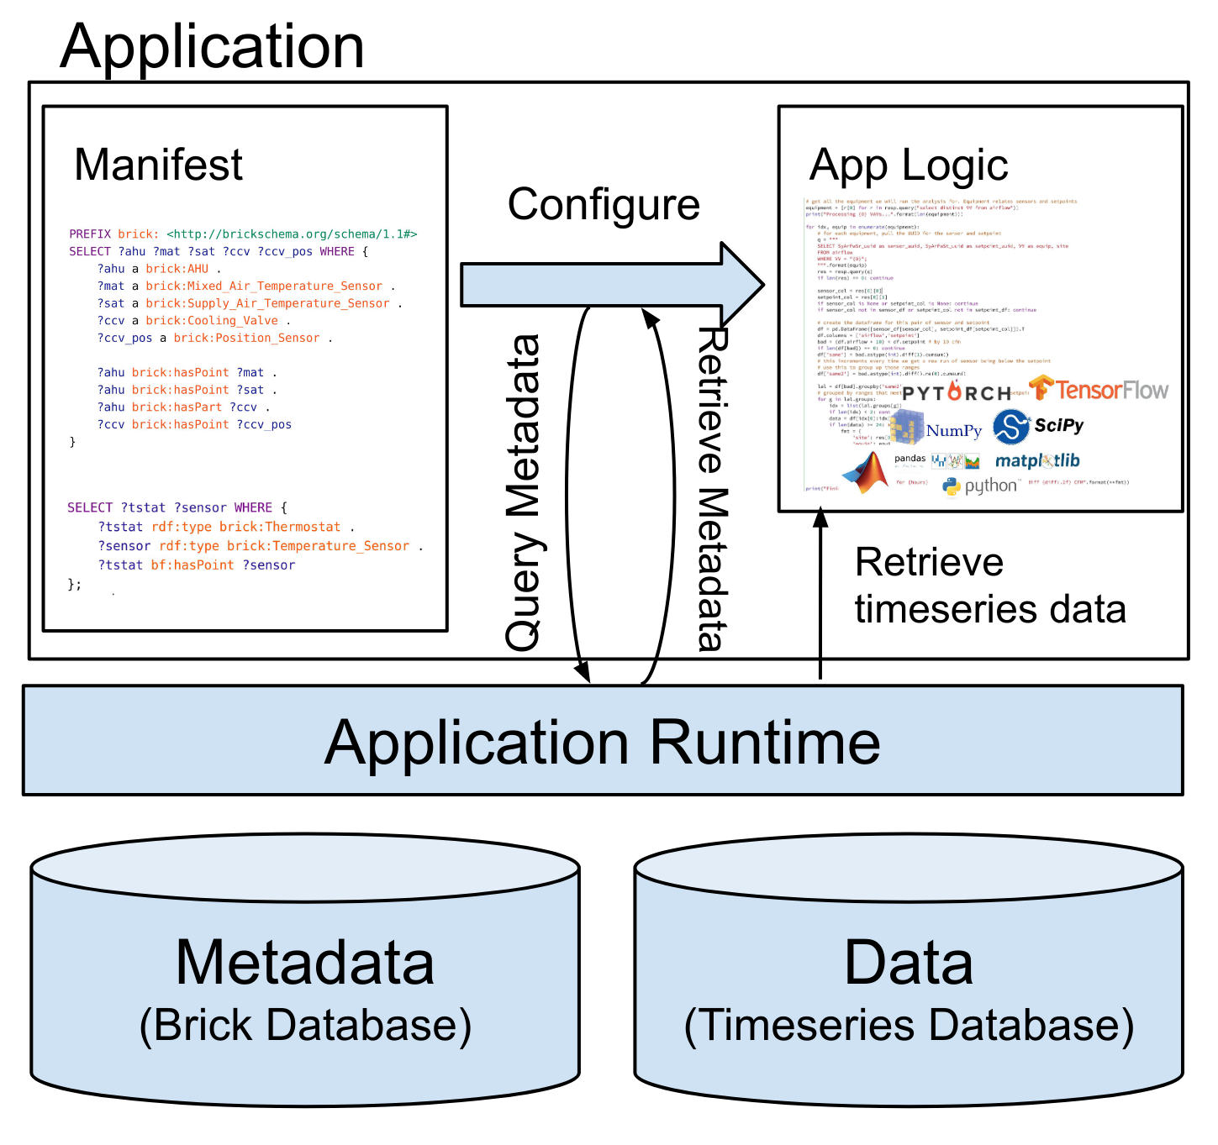
Architecture of a Self-Adapting Application

Slide 8
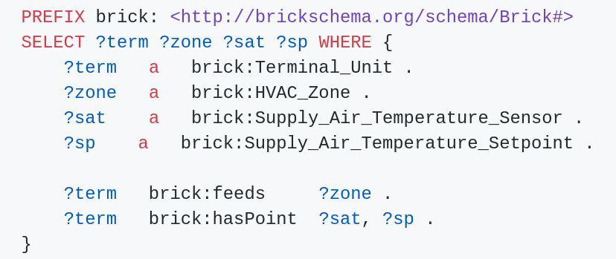
How WoT Fits In
Brick ontology defines the data sources and their context w.r.t. the building subsystem
Assumes the data is already in a regular format
Outsources the “lifting” to the data ingester
Does not handle the discovery of device capability
Assumes this is already modeled

Slide 9
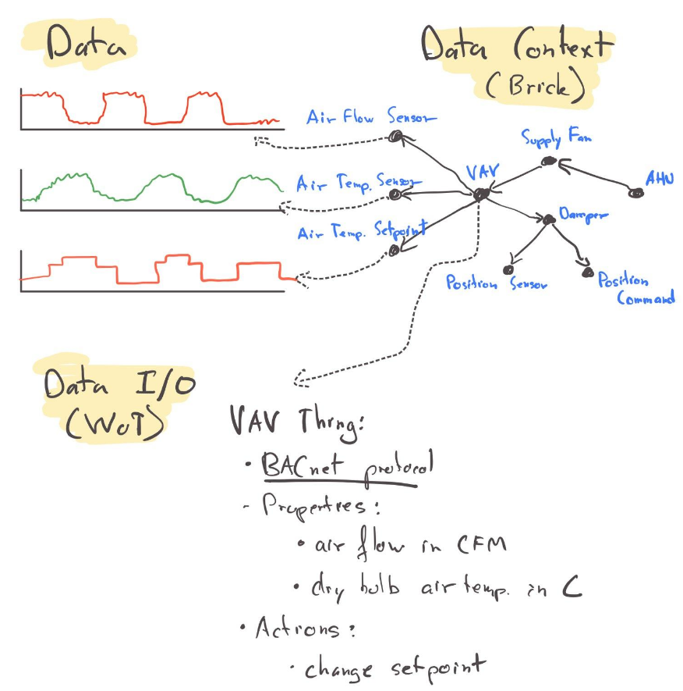
How WoT Fits In
It is not enough to model the capability of a device
Where* is the device?
What is it connected to?
What do its actions affect?
WoT standardizes repr. of/access to the I/O capabilities of the IoT devices providing/receiving data
Abstract over (legacy) industrial control protocols:
BACnet, OPC, LonTalk, Modbus, ...
WoT helps extract data

Slide 10
Future Brick Work? (The work we don’t want to do…)
Starting to think about the “network/instrumentation view”:
How are devices connected; how do they communicate?
Joel Bender (Cornell, BacPypes, ASHRAE, 223P) working on SHACL representation of BACnet objects
Standard enumerations of device properties:
Thermostat modes, staged equipment, etc
Aid in data interpretability
Schedules of operation:
Investigating schema.org-style schedules; RRULE; etc
Want to express device behavior in terms of schedules (nighttime setbacks, etc)

