Slide 1

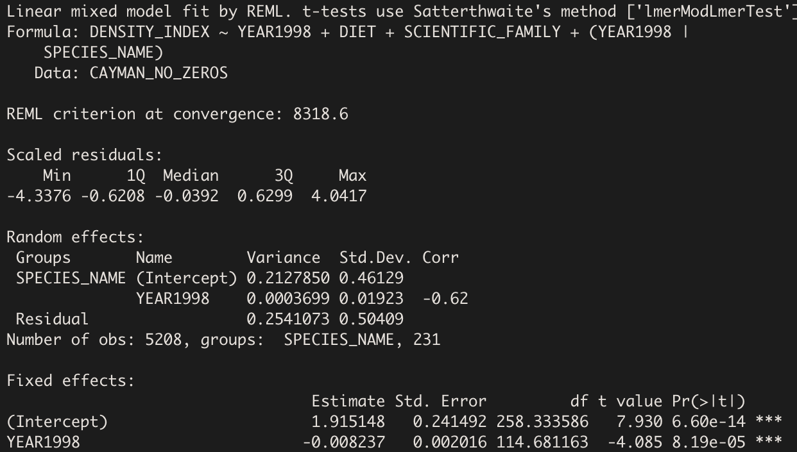
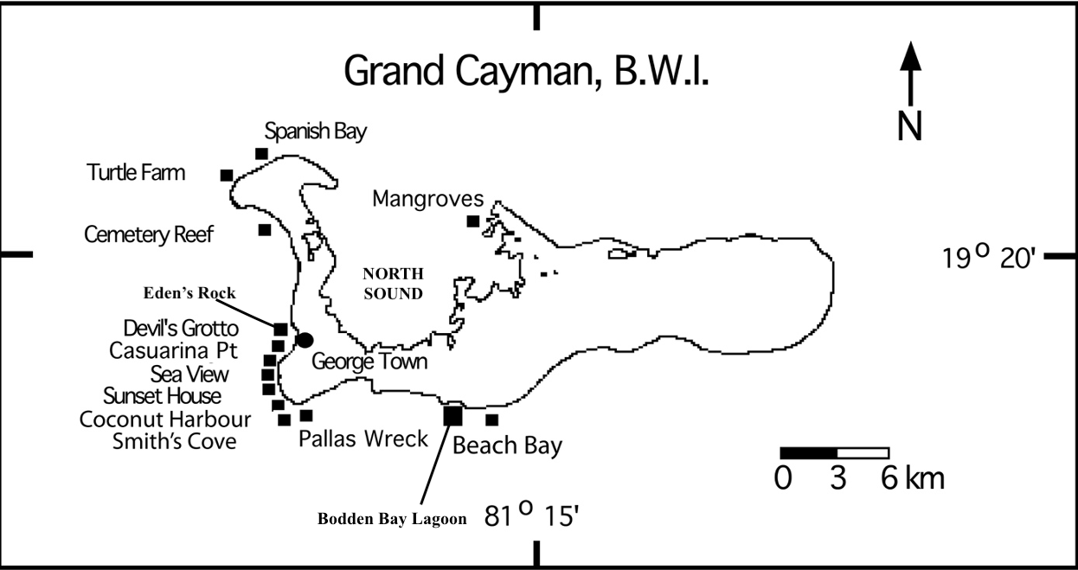
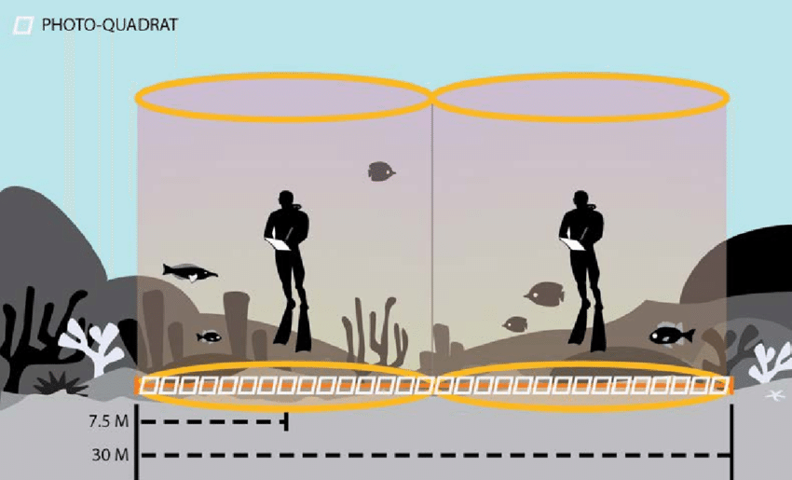
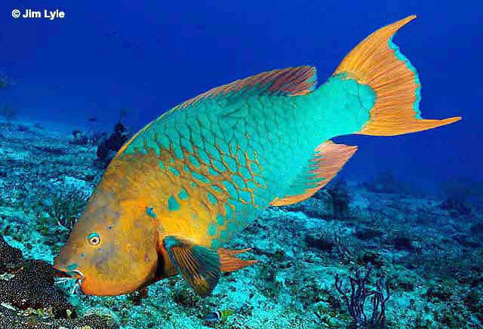
An ecologically based statistical probe into the longitudinal status of reef fish of Grand Cayman Island
Adam Bruce, ’23; Abhishek Chakraborty, PhD; Bart De Stasio, PhD
BACKGROUND
Coral reefs support more species per unit area than any other marine environment in the world (Ogden and Lobel, 1978)
Fish are an integral part of reefs, so their abundance serves as a major indicator of overall reef health
Long-term health is a priority for humans
Lawrence University Marine Program (LUMP)
Grand Cayman Island 1998-2018
Reef Environmental Education Foundation (REEF) roving diver techniques
METHODS & RESULTS
CONCLUSIONS
Human Reliance on Coral Reefs
Medicinal Development
Food Source: Local & Commercial Fishing
Recreational Activities: Swimming & Diving
Coastal Protection: Storms and Erosion
Statistical Techniques
Hypothesis Testing: Levene’s Test, ANOVA, & T-Test
Model Building: Two-Part Approach
Machine Learning: K-Means Clustering
Reef Health in Decline:
Ineffective Marine Protected Areas
Result of lack of continuous habitat (Mosquera et al., 2003)
71% of families in decline are major predators or herbivores
“Phase-Shifts” occurring (Williamson et al., 2014)
Increasing invasive Lionfish densities
Decreasing abundance and biomass of native reef fish (Benkwitt, 2015)
Future Remediation Efforts
Families in Decline:
Predators
Lutjanidae
Serranidae
Holocentridae
Restructuring Marine Protected Areas
Quantifying macroalgae overgrowth
Commercial fishing regulations for predator and herbivore families
Developing community-wide education programs
DATA COLLECTION
Herbivores
Scaridae
Pomacentridae
REFERENCES
Benkwitt, C. E. (2015). Non-linear effects of invasive lionfish density on native coral-reef fish communities. Biological Invasions. 17, 1383-1395.
Mosquera I., Coté, I. M., Jennings S., Reynolds J. D. (2000). Conservation benefits of marine reserves for fish populations. Animal Conservation. 4, 321-332.
Ogden, J. C., and Lobel, P. S. (1978). The role of herbivorous fishes and urchins in coral reef communities. Environmental Biology of Fishes. 3(1), 49-63.
Williamson, D. H., Ceccarelli, D. M., Evans, R. D., Jones, G. P., and Russ, G. R. (2014). Habitat dynamics, marine reserve status, and the decline and recovery of coral reef fish communities. Ecology and Evolution. 4(4), 337-354.

