Slide 1

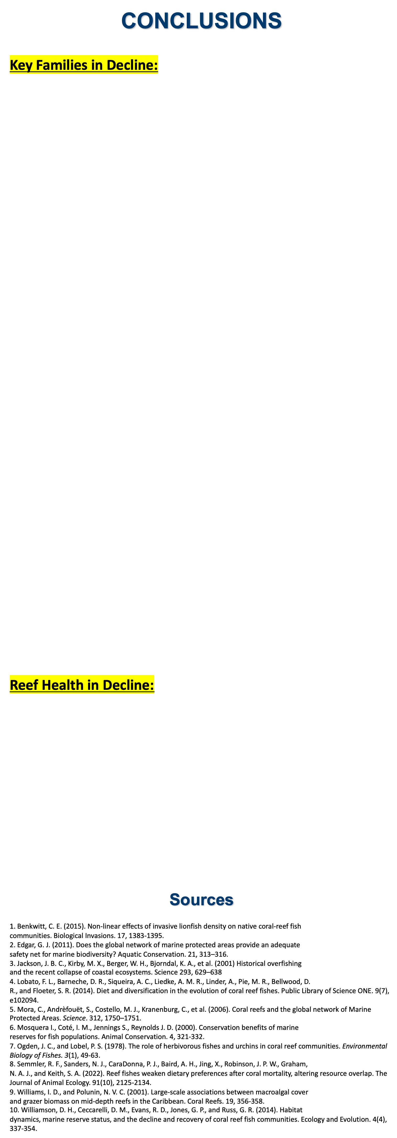
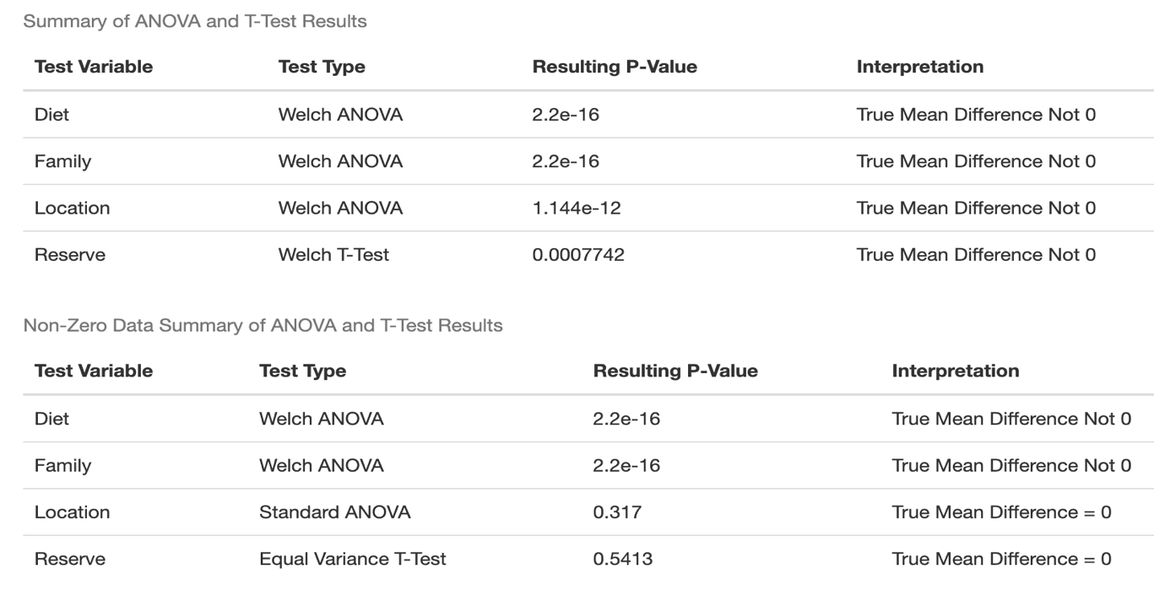
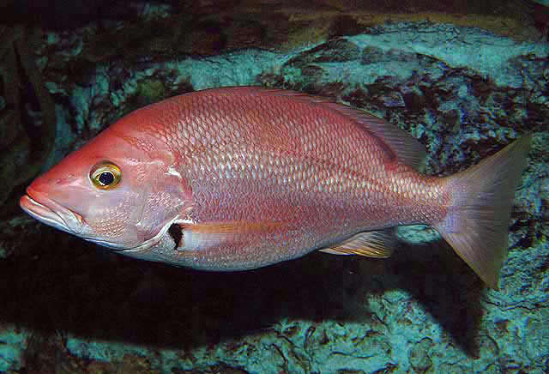
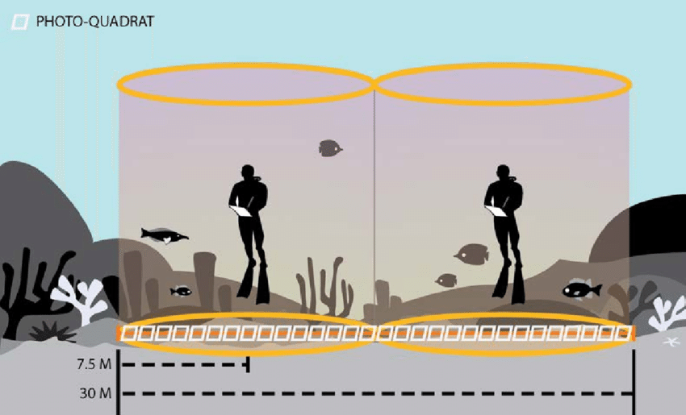
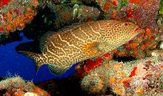
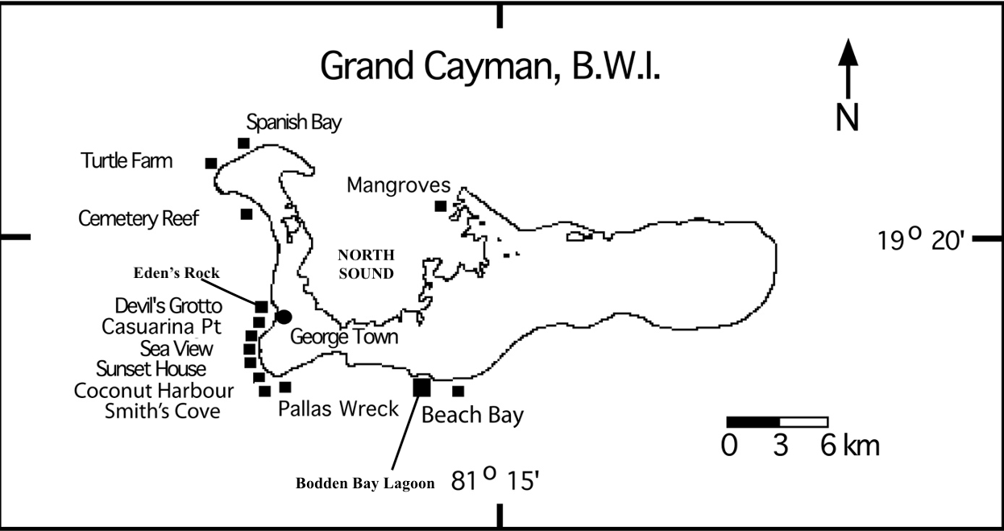
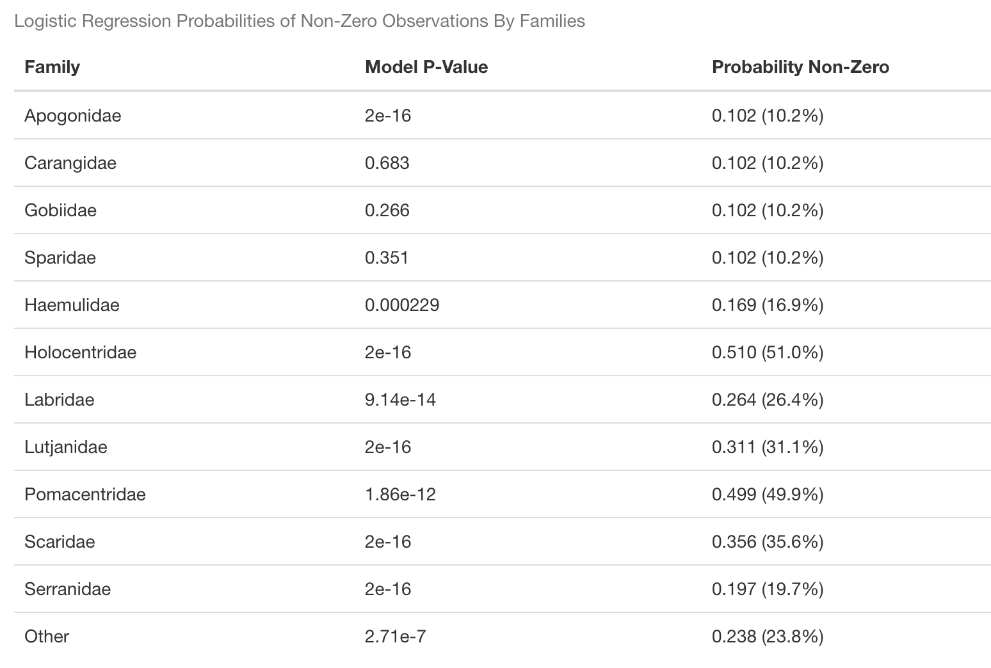
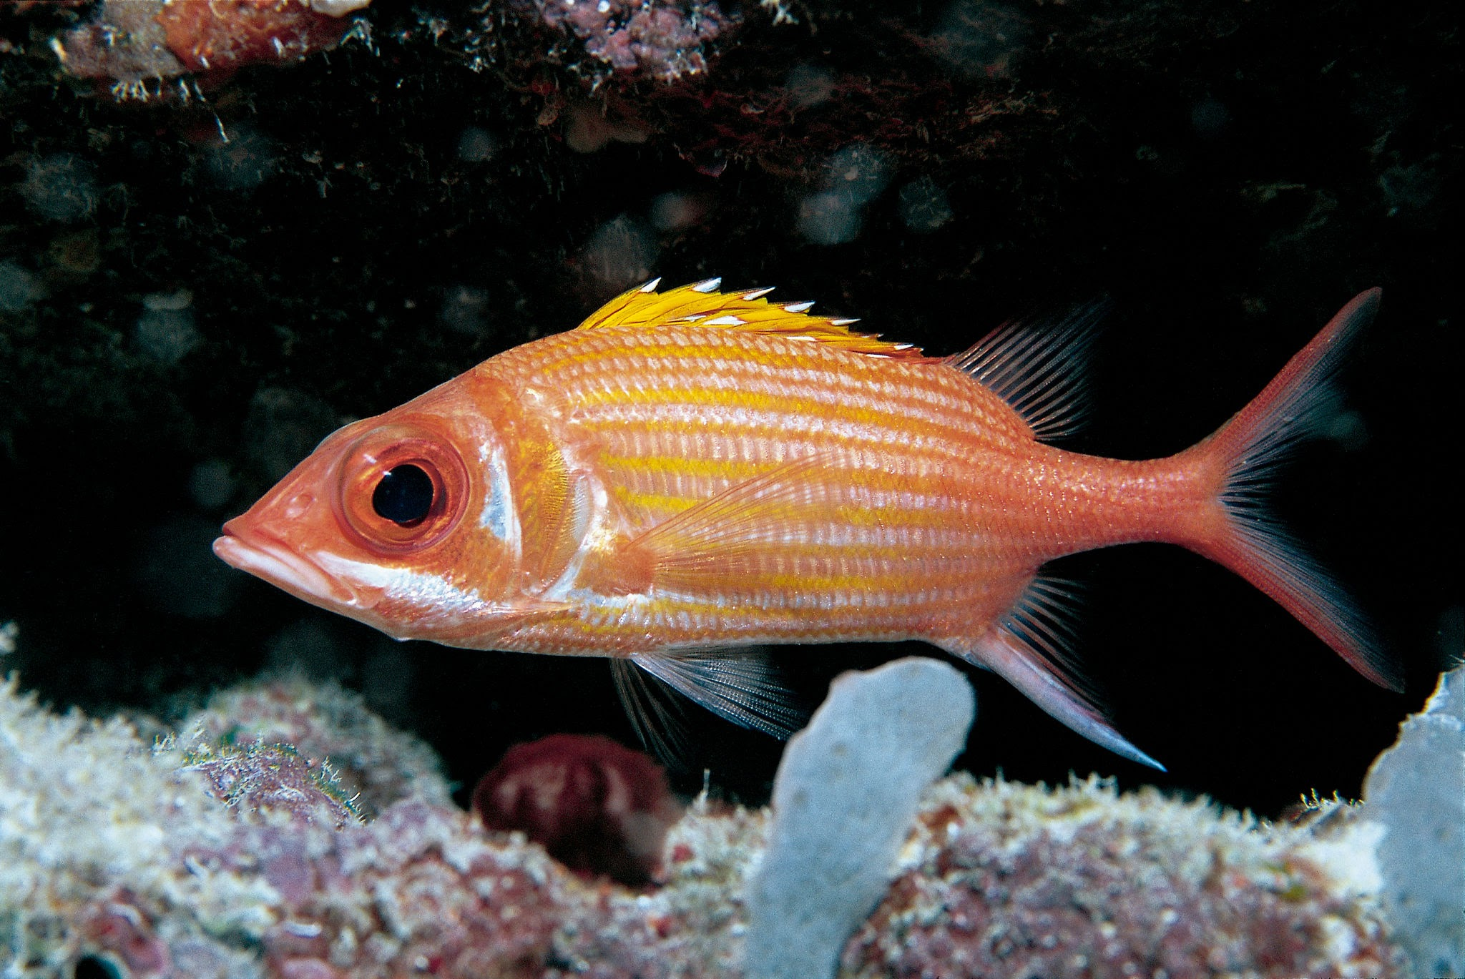
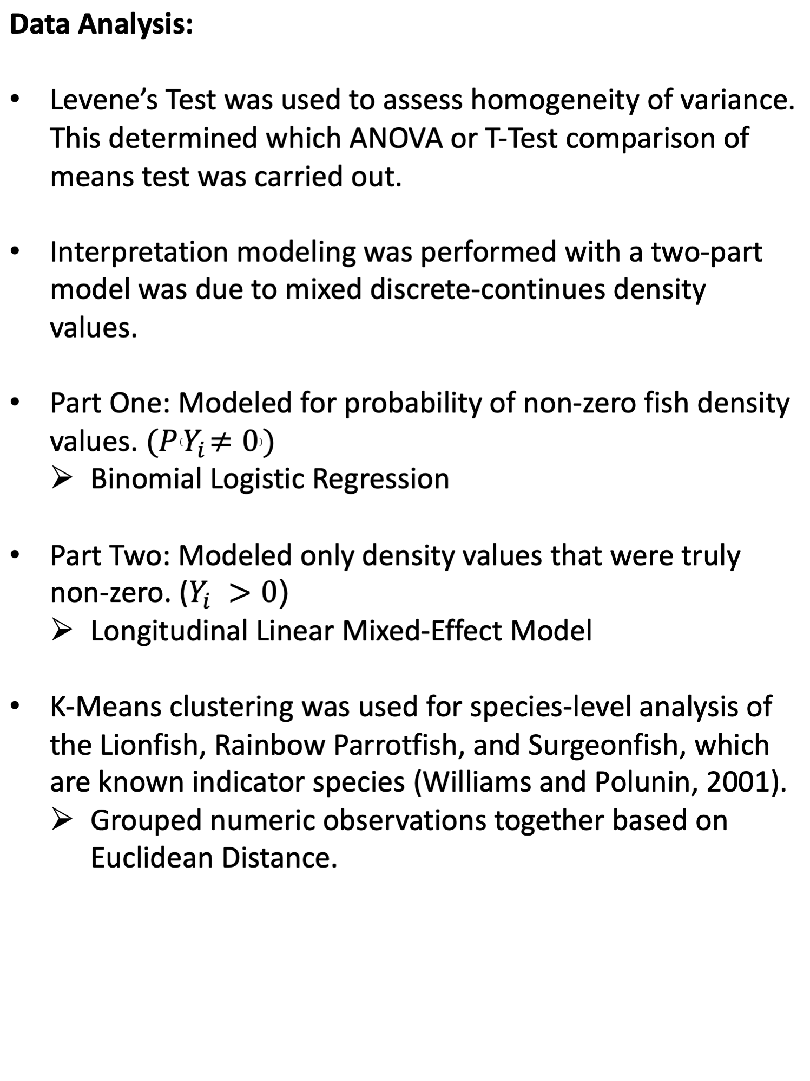
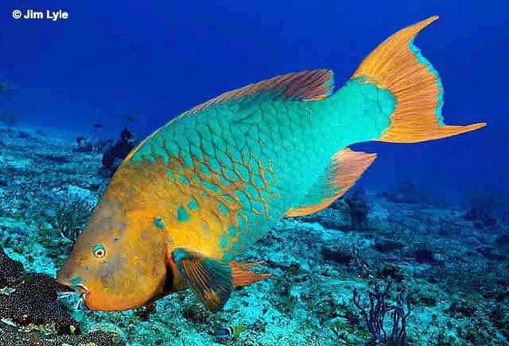
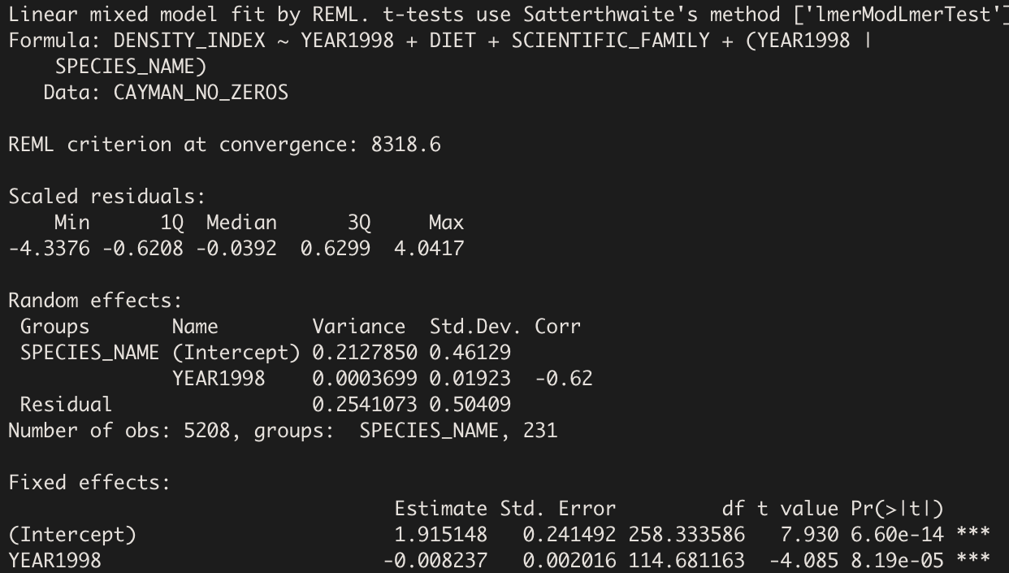
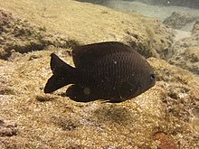
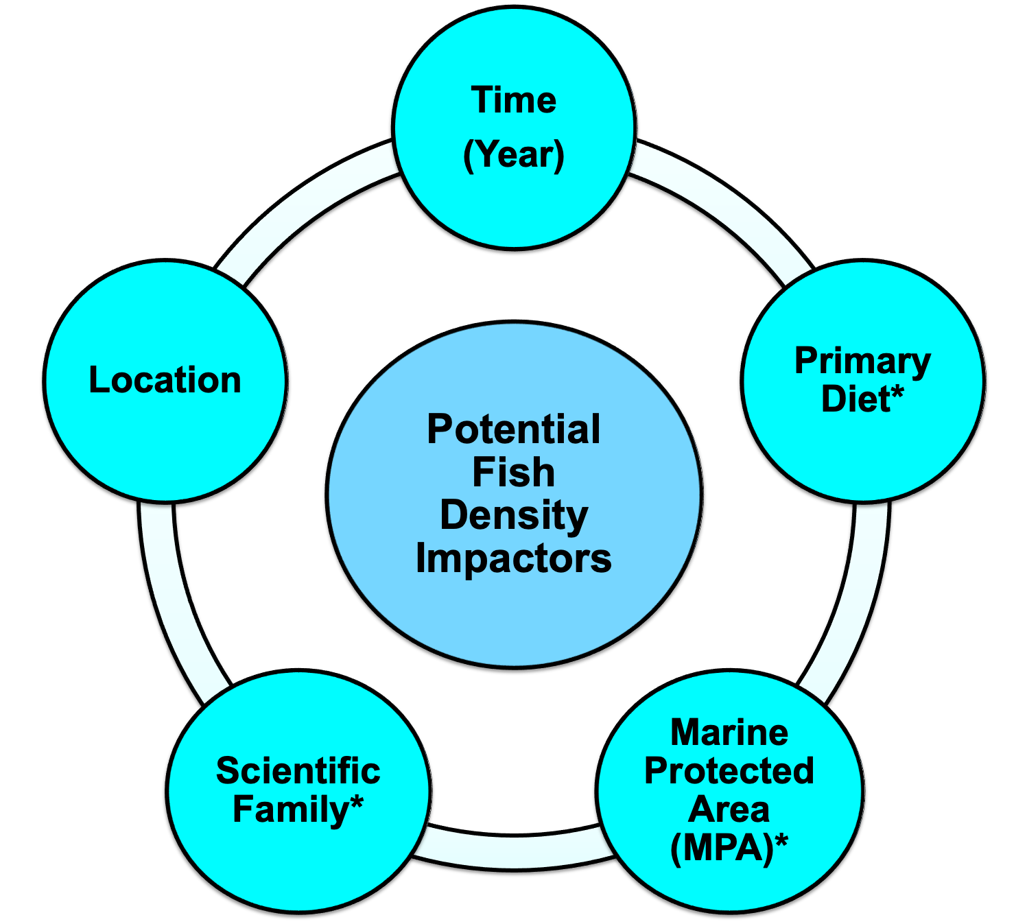
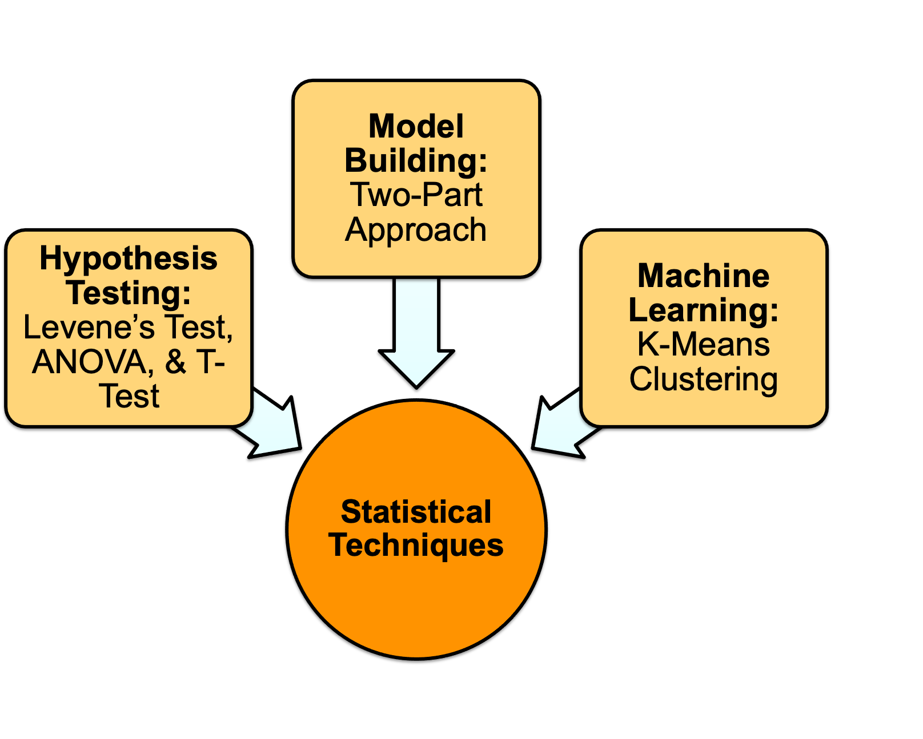
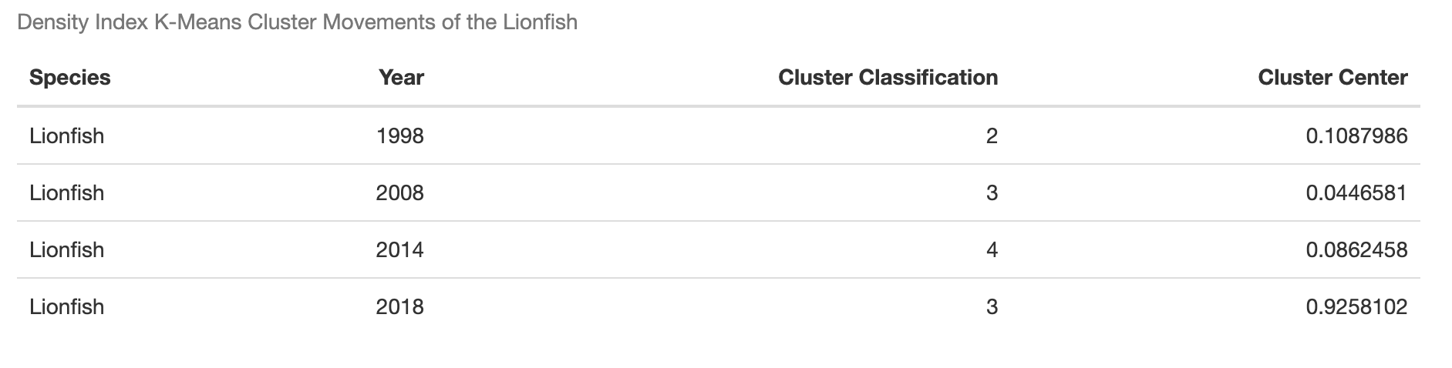
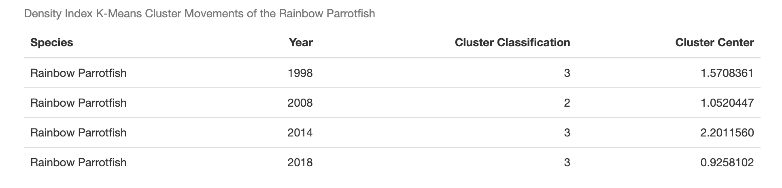
An Ecologically Based Statistical Probe into the Longitudinal Status of Reef Fish of Grand Cayman Island
Adam Bruce, 23’; Abhishek Chakraborty, PhD; Bart De Stasio, PhD
BACKGROUND
Coral reefs support more species per unit area than any other marine environment in the world (Ogden and Lobel, 1978).
Humans rely heavily on reefs for a plethora of health and economic reasons, which makes maintaining their long-term health a priority for many communities.
Between 1998 and 2018, data on reef fish were collected biyearly on Grand Cayman Island by the Lawrence University Marine Program (LUMP).
Fish are an integral part of reef ecosystems, so their abundance serves as a major indicator of overall reef health.
Here, analysis with statistical techniques in R was performed to make inferences about reef fish density changes, and ultimately overall reef health, on Grand Cayman Island.
* = Shown to be negative impactors in other studies
Family (Jackson et al., 2001; Williamson et al., 2014).
MPA’s (Edgar et al., 2006; Mora et al., 2006).
Diet (Lobato et al., 2014; Semmler et al., 2022).
METHODS
RESULTS
LUMP Data Collection:
Students utilized Reef Environmental Education Stationary Underwater Visual Census Techniques (SUVC).
ANOVA or T-Test:
Interpretative Modeling:
Part-One: Binomial Logistic Regression
Part-Two: Longitudinal Linear Mixed-Effect Model
K-Means Clustering:
Lutjanidae – Snappers
Predators
Blackfin Snapper
  Lutjanus Buccanella
Serranidae – Groupers
Predators
Tiger Grouper
  Mycteroperca tigris
Holocentridae – Squirrelfish
Predators
Longjaw Squirrelfish
  Neoniphon marianus
Scaridae – Parrotfishes
Herbivores
Rainbow Parrotfish
  Scarus guacamia
Pomacentridae – Damsel & Clown fishes
Herbivores
Dusky Damselfish
  Stegastes adustus
Ineffective Marine Protected Areas.
  Result of lack of continuous habitat (Mosquera et al., 2003).
71% of families in decline are major predators or herbivores.
  “Phase-Shifts” occurring (Williamson et al., 2014).
Increasing invasive Lionfish densities.
  Decreasing abundance and biomass of native reef fish (Benkwitt, 2015).

