Slide 1
MVC Model-View-Controller
JIM S. JAMERO, MIT
COLLEGE OF ENGINEERING AND TECHNOLOGY
RAMON MAGSAYSAY MEMORIAL COLLEGES

Slide 2
Why PHP framework?
PHP frameworks help to promote rapid application development (RAD), which saves you time, helps build more stable applications, and reduces the amount of repetitive coding for developers.
Without a PHP Framework in place, it gets much more difficult to produce applications since you’ll have to repeatedly code a lot of PHP. You’ll also have to execute the connection between your database and whatever application you develop from scratch. Meanwhile, using a PHP Framework makes it easier for you to ensure this connection.

Slide 3
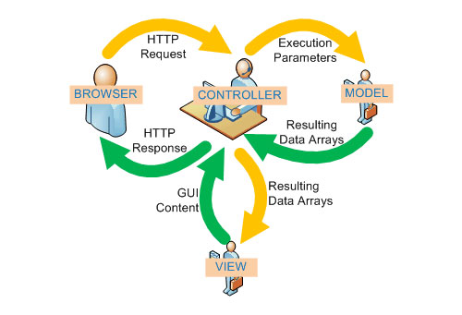
How framework works?

Slide 4
MVC
MVC is an architectural pattern featured in various popular programming languages which breaks apart your domain logic from your user interface.
Now what is domain logic ?
The domain logic is the function that handles information exchange between your database and your user interface.
The M stands for the raw data, the V (view/user interface) represents what’s actually being viewed, and C (controller) is in fact the domain logic as seen above.

Slide 5
PHP Frameworks
Kohana
CodeIgniter
Akelos
CakePHP
Zend Framework
Symfony
Prado
Solar Framework
Yii PHP Framework
Maintainable
Seagull
Fuse
Ajax AC
Phocoa
Limb
Zoop
Blueshoes
Qcodo
Recess
PHPDevShell
Laravel

Slide 6
Frameworks Market Share 2017
Laravel (43.7% Market share)
CodeIgniter (14.9%)
Symfony (13.6%)
Zend (12.5%)
Yii 2(5.1 %)
CakePHP(5.5 %)
Fuel PHP(2.4 %)
FatFree(1.3%)
Aura (0.9 %)

Slide 7


Slide 8
CodeIgniter
CodeIgniter is a powerful PHP framework with a very small footprint, built for developers who need a simple and elegant toolkit to create full-featured web applications. CodeIgniter was created by EllisLab, and is now a project of the British Columbia Institute of Technology.
Codeigniter comes with many built in libraries for unit testing, form validation, email, sessions, and much more! If you can't find a library you're looking for, it's also pretty easy to build your own, and then share it with the community.

Slide 9
CodeIgniter Features
Model-View-Controller Based System
Error Handling
It offers simple user-friendly interfaces that help you to detect error functions throughout the application globally.
Configuration and Customizable
Migration
Developers can manage database schema updates across various web application fields easily with helps of the migration aspect. Migration from one server to another server is simple and hassle-free in CodeIgniter.

Slide 10
CodeIgniter Advantages
It helps web developers to find out the errors in programming codes and fix-up the issues instantly in the web applications.
It provides you user-friendly interface that help developers to create a dynamic, flexible, secure and large web applications effectively in a short span of time.
Web developers can make use of this powerful framework to customize the configuration files easily and it provides hassle-free migration from source to destination service hosting.
The framework helps the programmer to create both front-end and rear-end of a web application effectively and easily in a secured manner.
Programmers can create web applications with additional features and high-end functionalities by using in-built resource and libraries of the CodeIgniter.

Slide 11
CodeIgniter Disadvantages
Its PHP based only and not very object-oriented in some parts.
PHP4 legacy code.
Company-driven instead of community-driven.
Irregular releases.
Framework itself has no built-in ORM (only via 3rd party solutions)

Slide 12
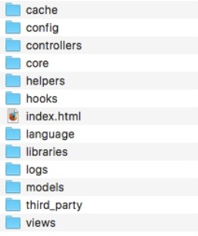
CodeIgniter File Structure
cache: Store Web Application cache file.
controller: Store Application Controller file.
config: Controller: Store Application config file.
helpers: Controller: Store Custom helper function file.
language: Store Language file (if you want to develop application multi language).
libraries: Store custom library file.
logs: Store logging file.

Slide 13
CodeIgniter File Structure
models: Store Application Model file.
third_party: Store party class and function file.
view: Store Application View file.

