Slide 1
Network graph (updated 12/30/2017)
MT
KDM
Kinase
>> cd fluocell-current/app/model/
>> test_pm_model(’test4');
H3K9M
H3S10P
PTP

Slide 2
>> data = model_init_data(‘model2');
>> res = phospho_methyl_model(data, 'b',1, 'show_figure', 1);
Signal Matrix (min⁻¹)
S10p
Kinase
PTP
K9me
MT
KDM
1.7 -1.7
.01
0
-.01
% The state_variable
y(:,i+1) = y(:,i)+dt*signal_matrix*y(:,i) +c
%The initial values of y is given by
data.base_phosphor = 0;
data.base_kinase = 2000;
data.base_phosphotase = data.base_kinase;
data.base_methyltransferase = 100;
data.base_demethylase = 100;
data.min_demethylase = 100;
1.3 -1.3
-5e-3
5e-3
S10p
Kinase
PTP
K9me
MT
KDM
% y is bounded above and below by
y_min = [0; 0; 0; 0; 0; 0];
y_max = [num_histone; max_mol; max_mol; ...
num_histone; max_methyl; max_methyl];

Slide 3
Model Parameters
case 'model4' % Follow the references, 3/2/2017
data.num_histone = 60000; % 60M histone
data.base_methyl = data.num_histone*0.57;
data.max_methyl_enzyme = 1200; % max number of methyltrasferase and KDMS
data.more_methyl = 700; % more methyltransferase binds with h3k9 during mitosis
% Kinase:KDM ratio = 5.9:1
% 7.1M aurora b kinase, max number of kinase and phosphotase
data.max_phosphor_enzyme = data.max_methyl_enzyme*5.9;
data.more_kinase = 2000; % 1000K more kinase binds to h3s10 during mitosis
data.max_time_phospho = 90 * data.num_histone; %num_histone for 60 min
data.time(1) = 40; % min, time to exit mitosis; enter mitosis at 0 min
data.time(2) = 1440; % min, cell cycle duration 24 hrs for HeLa cells
%
data.a(1) = 0.005; % min^(-1) phosphorylation repels methyltransferase
data.a(2) = 0.005; % min^(-1) phosphorylation recruit demethylase
data.b = 1; % the strength of kinase;
%
data.time_step = 1/60; % min

Slide 4
Model Parameters (slide 1)
Description (name) | Value/unit | Reference | Justification
Total number of histone 3 (num_histone) | 60,000K | Alberts et al. 2002 Molecular Biology … | There are ~60 million molecules of each type per human cell.
Basal level of methylated H3K9 at the interphase (base_methyl) | 57% of all histones | Figs. 1c and 1d | Sua -/- decreased 40%; TCP (inhibitor KDM) increased 30%. So 4/7 is about 57%.
Total number of MTs/KDMs (max_methyl_enzyme) | 1,200K | Biggin MD 2011 Dev Cell http://proteineatlas.org | Estimated based on the RNAseq copy number in HeLa cells, for KDM4C relative to H3F3A and H3F3B. KDM4D was negligible.
Increase of MTs at the entrance of mitosis (more_methyl) | 700K | Aagaard L et al. 2000 JCS | ~50% of max_methyl. SUV39H1 increases collocalization with chromosomes and centromers at the prometaphase
Total number of serine kinases and PTPs (max_phospho_enzyme) | 7100K | http://proteineatlas.org | The RNAseq data showed that the ratio aurora kinase B:KDM4C is ~5.9:1.
Increase of kinases at the entrance of mitosis (more_phospho) | 2000K | Dominguez D et al. 2016 Elife | 30% of max_phospho_enzyme. The expression of auroraB increases at mitosis.
Threshold to exist mitosis | 90 min *num_histone | Santamaria D et al 2007 Nature | Kinase is the master regulator of cell cycle.

Slide 5
Model Parameters (slide 2)
Description (name) | Value/unit | Justification
Basal level of H3S10P at interphase | 0
Basal level of Serine kinase | 2000K
Basal level of PTP | 2000K
Basal level of MTs | 100K
Basal level of KDMs | 100K
Signal Matrix | Min⁻¹ | Based on kinetics in Fig. 2
Earliest time to exist mitosis (dt(1)) | 40 min | Based on kinetics in Fig. 2
Duration of a cell cycle (dt(2)) | 1440 min | Based on kinetics in Fig. 2

Slide 6
Control of three states between interphase and mitosis
Time (min)
State: 0 1 2 0
State: 0 1 2 0
Descript | Enter mitosis (0/1) | Exit mitosis (1/2) | Enter interphase (2/0)
Switch | T= 0 min | Cumulative phosphor >= threshold | Methylation increases to the basal level
Phenom | Both kinase and MT increase. | Kinase decrease | Kinase and MT reset to basal levels.

Slide 7
>> data = model_init_data('model2');
>> res = phospho_methyl_model(data, 'b',1, 'show_figure', 1);
(18.5, 6e+4)
(36.85, 0)

Slide 8
Model3: S10P recruiting KDMs is crucial for fast demethylation at mitotic entrance, while S10P repelling MTs plays an assisting role
Network graph
x
MT
KDM
Kinase
x
H3K9M
H3S10P
PTP
>> test_pm_model(’test3');

Slide 9
Model2: MT did not increase at the entrance of Mitosis
>> test_pm_model('test2');

Slide 10
Signal Matrix (min⁻¹)
>> data = model_init_data('model2');
>> res = phospho_methyl_model(data, 'b',1, 'show_figure', 1);
S10p
Kinase
PTP
K9me
MT
KDM
1.7 -1.7
.01
0
-.01
1.3 -1.3
-5e-3
5e-3
S10p
Kinase
PTP
K9me
MT
KDM

Slide 11
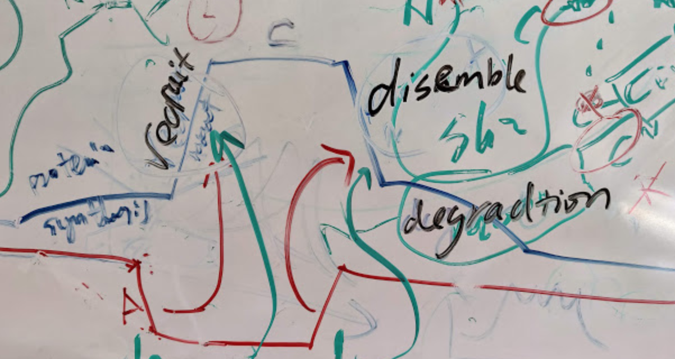
In the image, 1. slow phosphor ; 2. demethylation ; 3. phosphor increase (due to envelope melt and increase of kinase).
We need to add an additional trigger into this model. Trigger 1 causes demethylation; trigger 2 causes fast phosphorylation; 3. coming down in 2 phases.

