Slide 1
In the revision on 8/28/2018, the model is expanded to include the 2-phase phosphorylation and its interaction with K9 methylation.

Slide 2
Network graph (updated 8/28/2018)
>> data = model_init_data('model5');
>> res = phospho_methyl_model(data, 'b',1, 'show_figure', 1);
MT
KDM
Kinase
Signal Matrix (min⁻¹)
S10p
Kinase
PTP
K9me
MT
KDM
1.7 -1.7
.01
0
-.01
H3K9M
H3S10P
PTP
1.3 -1.3
-5e-3
5e-3
S10p
Kinase
PTP
K9me
MT
KDM
Change in the updated model: from state 0.9 to state 1.1, fast KDM increase was controlled by a H3S10P phosphorylation in a threshold behavior instead of linearly dependent on H3S10P concentration in the previous model.

Slide 3
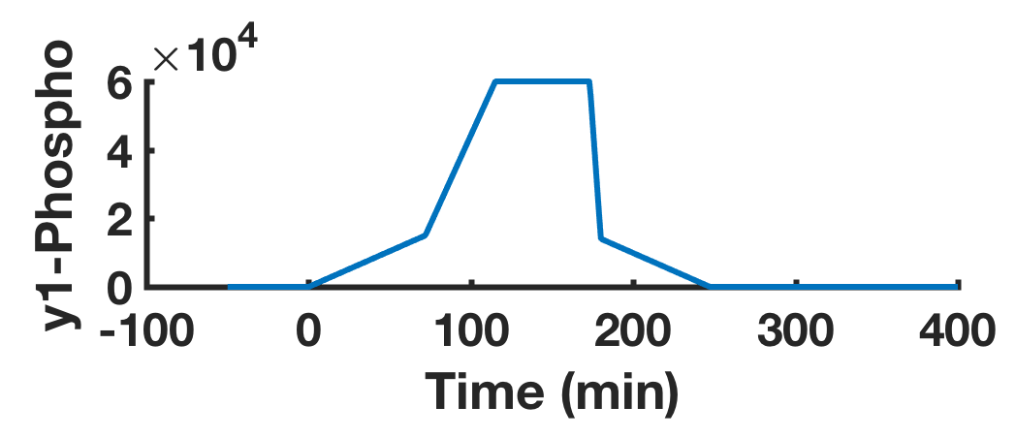
Control of states between interphase and mitosis
Description: Enter Late G2 (0→0.1)
Switch: T = 0 min
Phenomenon: Both kinase and MT increase by synthesis
Recruit demethylase (0.1→0.2)
Phosphorylation > threshold 1
Entering mitosis, fast KDM increase
Recruit kinase (0.2→1.0)
Phosphorylation > threshold 2
Fast kinase increase
H3S10 Phosphor
Time (min)
State: 0 1 2 0
KDM and kinase dissociate (1.0→1.1)
Accumulative Phosphorylation > threshold
Fast kinase decrease and PTP increase
Fast MT increase and KDM decrease
Exit mitosis
Degrade kinase (1.1→2.0)
Phosphorylation < threshold 2
Slow decrease of kinase
Entering interphase (2.0→2.1)
Phosphorylation <= base_level
Stabilize all enzymes

Slide 4
>> data = model_init_data('model5');
>> res = phospho_methyl_model(data, 'b',1, 'show_figure', 1);

Slide 5
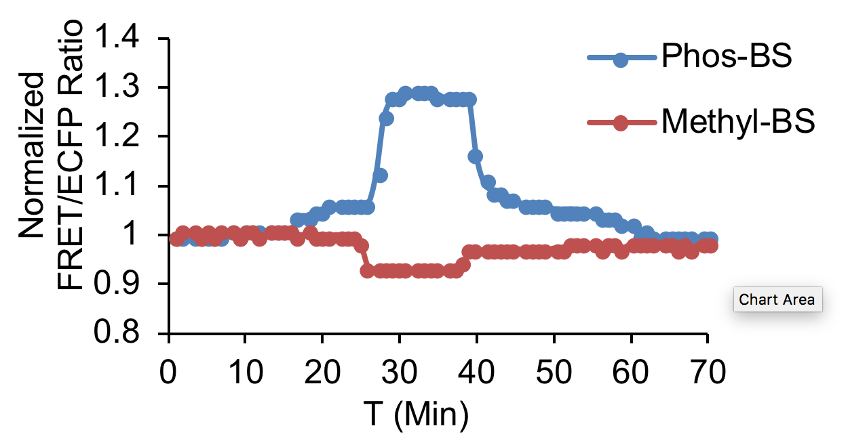
Figure 3E.
recruit
disassemble
synthesis
degrade

Slide 6
>> test_pm_model('test7');
No Increase of Methyltransferase when entering State 0.7
Model_state.m , line 46
Set more_methyl_1 = 0

Slide 7
Model3: S10P recruiting KDMs is crucial for fast demethylation at mitotic entrance, while S10P repelling MTs plays an assisting role
Network graph
x
MT
KDM
Kinase
x
H3K9M
H3S10P
PTP
>> test_pm_model(’test8');

Slide 8
Supplementary Table 1. Model parameters crucial for the simulation results and predictions of the phosphor-methyl model.
Description (name) | Value/unit | Justification/reference
Total number of histones (num_histone) | 60,000K molecules | There are ~60 million molecules of each type per human cell [Ref: Alberts B et al. 2002 Molecular Biology of the Cell, 4th Ed].
Basal level of methylated H3K9 at the interphase (base_methyl) | 57% of all histones | The signals decreased 40% in sua-/- cells, and increased 30% when KDMs were inhibited by TCP (Figures 1C and 1D). So 4/7 is about 57%.
Total number of MTs/KDMs (max_methyl_enzyme) | 1,200K molecules | Estimated based on the RNAseq copy number in HeLa cells, for KDM4C relative to H3F3A and H3F3B [Refs: Biggin MD 2011 Dev Cell; Petryszak R et al 2016 NAR]. KDM4D was negligible.
Total number of serine kinases and PTPs (max_phospho_enzyme) | 7100K molecules | The RNAseq data showed that the ratio aurora kinase B:KDM4C is ~5.9:1 [Ref: Petryszak R et al 2016 NAR].
Increase of kinases at late G2 phase (more_kinase_1) | 125K molecules | Estimated to be ~25% of more_kinase. The expression of auroraB increases at prometaphase [Ref: Dominguez D et al. 2016 Elife; Experimental kinetics in Figure 3E].
Increase of MTs at late G2 phase (more_methyl_1) | 350K molecules | Estimated to be ~50% of more_methyl. SUV39H1 increases collocalization with chromosomes and centromers at the prometaphase [Aagaard L et al. 2000 JCS; Experimental kinetics in Figure 4A].
Threshold 1 to start demethylation (phosphor_th1) | 10,000K more histone phosphorylated | Estimated to be 2/3 of phosphor_th2 based on the experimental kinetics in Figure 3E. Kinase is the master regulator of cell cycle [Ref: Santamaria D et al. 2007 Nature].
Increase of demethylase at threshold 1 (more_methyl) | 700K molecules | Based on the experimental kinetics in Figure 3E.
Threshold 2 to switch between synthesis and recruitment states (phosphor_th2) | 15,000K more histones phosphorylated | Estimated to be 25% of all histones based on the experimental kinetics in Figure 3E.
Increase of kinase due to recruitment at threshold 2 (more_kinase) | 500K molecules | Estimated to be ~30% of max_phospho_enzyme. The expression of auroraB increases at mitosis [Ref: Dominguez D et al. 2016 Elife; Watrin et al. 2015 Mol Cel Biol].
Threshold to exist mitosis | 90 min *num_histone | Kinase is the master regulator of cell cycle [Ref: Santamaria D et al. 2007 Nature].
Duration of a cell cycle (time) | 1440 min | Based on experimental kinetics in Figure 2.
Stoichiometric Matrix | min⁻¹ | Based on experimental kinetics in Figure 2.

Slide 9
Supplementary Table 2. Other phosphor-methyl model parameters.
Description (name) | Value/Unit (molecule)
Basal level of H3S10P at interphase | 0
Basal level of Serine kinase | 2000K
Basal level of PTP | 2000K
Basal level of MTs | 100K
Basal level of KDMs | 100K

