Slide 1
The OPT_PDE package
% test_case: decide which test case to run
% 1 -- spot diffusion
% 2 -- layered diffusion
% 3 -- tensor diffusion
% 4 -- tensor cross diffusion
% 5 -- mem17 diffusion

Slide 2
4/4/2019: all five test cases seem to work fine.
>> test('test_case', 1, 'init_u_tag', 2, ...
'enable_normalize', 0, 'enable_damp_newton', 0);
gamma = 1.00e-05
>> test('test_case', 1, 'init_u_tag', 2, ...
'enable_normalize', 1, 'enable_damp_newton', 0);
gamma = 1.00e-05
>> test('test_case', 1, 'init_u_tag', 2, ...
'enable_normalize', 1, 'enable_damp_newton', 1);
gamma = 1.00e-05
Notes:
>> help test
>> cd opt_pde/app
>> test(‘test_case’, 1);

Slide 3
>> test('test_case', 1, 'init_u_tag', 1, 'enable_normalize', 0, ...
'enable_damp_newton', 0);
gamma = 1.00e-05
>> test('test_case', 1, 'init_u_tag’, 1, 'enable_normalize’, 1, …
'enable_damp_newton', 0);
gamma = 1.00e-05
>> test('test_case', 1, 'init_u_tag’, 1, 'enable_normalize', 1, …
'enable_damp_newton', 1);
gamma = 1.00e-05

Slide 4
>> test('test_case', 2, 'init_u_tag', 2, ...
'enable_normalize', 0, 'enable_damp_newton', 0);
gamma = 1.00e-05
>> test('test_case', 2, 'init_u_tag', 1, ...
'enable_normalize', 0, 'enable_damp_newton', 0, 'init_d', 10);
gamma = 1.00e-05
>> test('test_case', 2, 'init_u_tag', 1, ...
'enable_normalize', 1, 'enable_damp_newton', 1, 'init_d', 10);
gamma = 1.00e-05

Slide 5
>> test('test_case', 3, 'init_u_tag', 2, ...
'enable_normalize', 0, 'enable_damp_newton', 0);
gamma = 1.00e-05
>> test('test_case’, 3, 'init_u_tag’, 1, ...
'enable_normalize', 0, 'enable_damp_newton', 0);
gamma = 1.00e-05
>> test('test_case’, 3, 'init_u_tag’, 1, ...
'enable_normalize’, 1, 'enable_damp_newton’, 1);
gamma = 1.00e-05
>> test('test_case', 3, 'init_u_tag', 1, ...
'enable_normalize', 1, 'enable_damp_newton', 0);
gamma = 1.00e-05
Normalization is also essential.
It is very interesting that u and d take turns to converge.

Slide 6
Init_d = 30 also converges
>> test('test_case', 3, 'init_u_tag', 1, ...
'enable_normalize', 1, 'enable_damp_newton', 1, 'gamma', 1, 'init_d', 30);
Obj Func Norm J Damping Residual Diffusion Coefficients
0.087 66.35781 0.00e+00 2.80e+01 13.1322 0 3.9469
0.043 14.14141 1.00e+00 6.55e+00 12.5678 4.93051 4.0643
0.042 13.21211 6.60e-02 6.27e+00 12.1197 6.55575 3.82267
0.039 12.26461 7.04e-02 5.99e+00 6.4001 5.4447 0.61298
0.009 2.30990 1.00e+00 3.75e+00 5.70635 10.0593 1.49386
-0.007 0.73785 1.00e+00 4.23e+00 5.7089 9.9985 1.4848
-0.007 0.73693 1.35e-03 4.24e+00 5.7115 9.9367 1.4756
-0.007 0.73602 1.36e-03 4.25e+00 5.7142 9.8737 1.4663
-0.007 0.73512 1.36e-03 4.25e+00 5.7169 9.8093 1.4567
-0.007 0.73422 1.36e-03 4.26e+00 5.7197 9.7434 1.4469
Number of newton steps: 10
########################
Obj Func Norm J Damping Residual Diffusion Coefficients
0.087 8.92968 0.00e+00 2.80e+01 5.67067 15.9884 1.67094
0.070 8.08045 1.01e-01 2.52e+01 5.61724 23.3071 1.92828
0.055 7.23462 1.10e-01 2.24e+01 5.15591 89.4784 4.21064
-0.000 2.83729 1.00e+00 7.62e-01 5.004983 100.4428 4.932074
-0.000 0.32205 1.00e+00 6.33e-02 5.00012 99.8469 5.0002
-0.000 0.00152 1.00e+00 2.45e-03 5.00005 99.8192 5.00156
Number of newton steps: 6
########################
Obj Func Norm J Damping Residual Diffusion Coefficients
0.087 4.52669 0.00e+00 2.80e+01 5.00001 99.9646 5.00025
-0.000 0.00690 1.00e+00 7.40e-04 5 100 5
0.000 0.00000 1.00e+00 5.65e-07 5 100 5
Number of newton steps: 3
########################
Elapsed time is 6.777432 seconds.

Slide 7
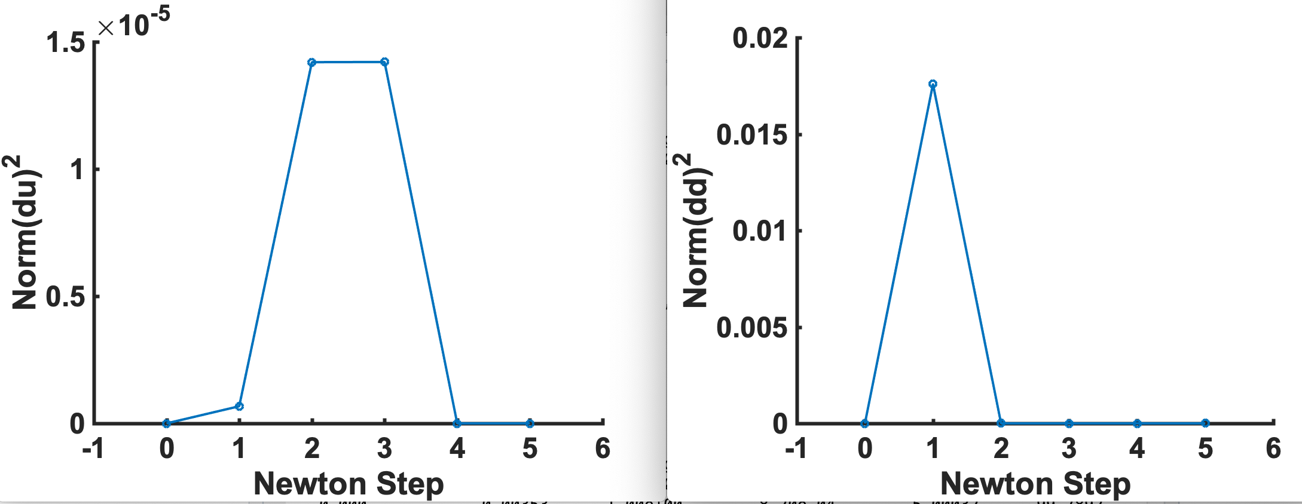
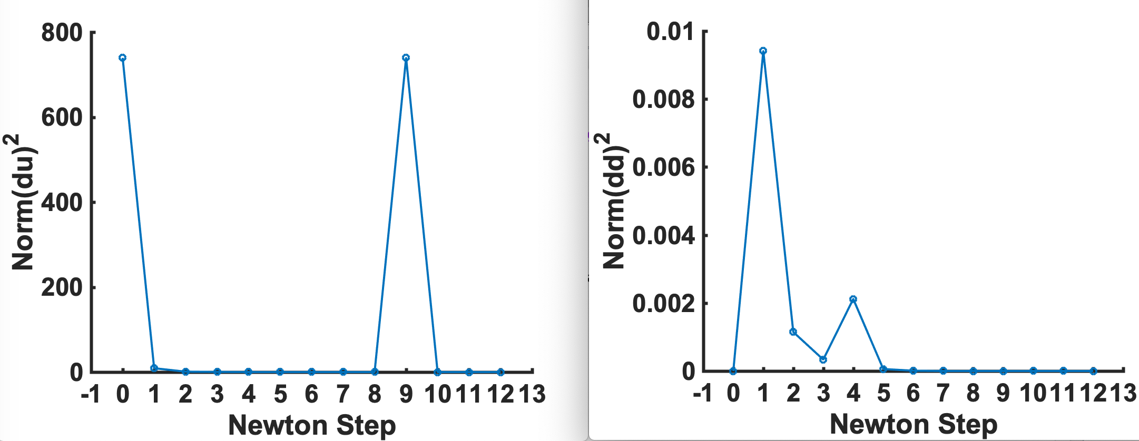
Let u0 = u2, test_case = 4, with normalization and damping. Converged with 2 outer iterations.
U0 = u1, test_case = 4, also converged with 2 outer iterations with normalization and damping.

Slide 8
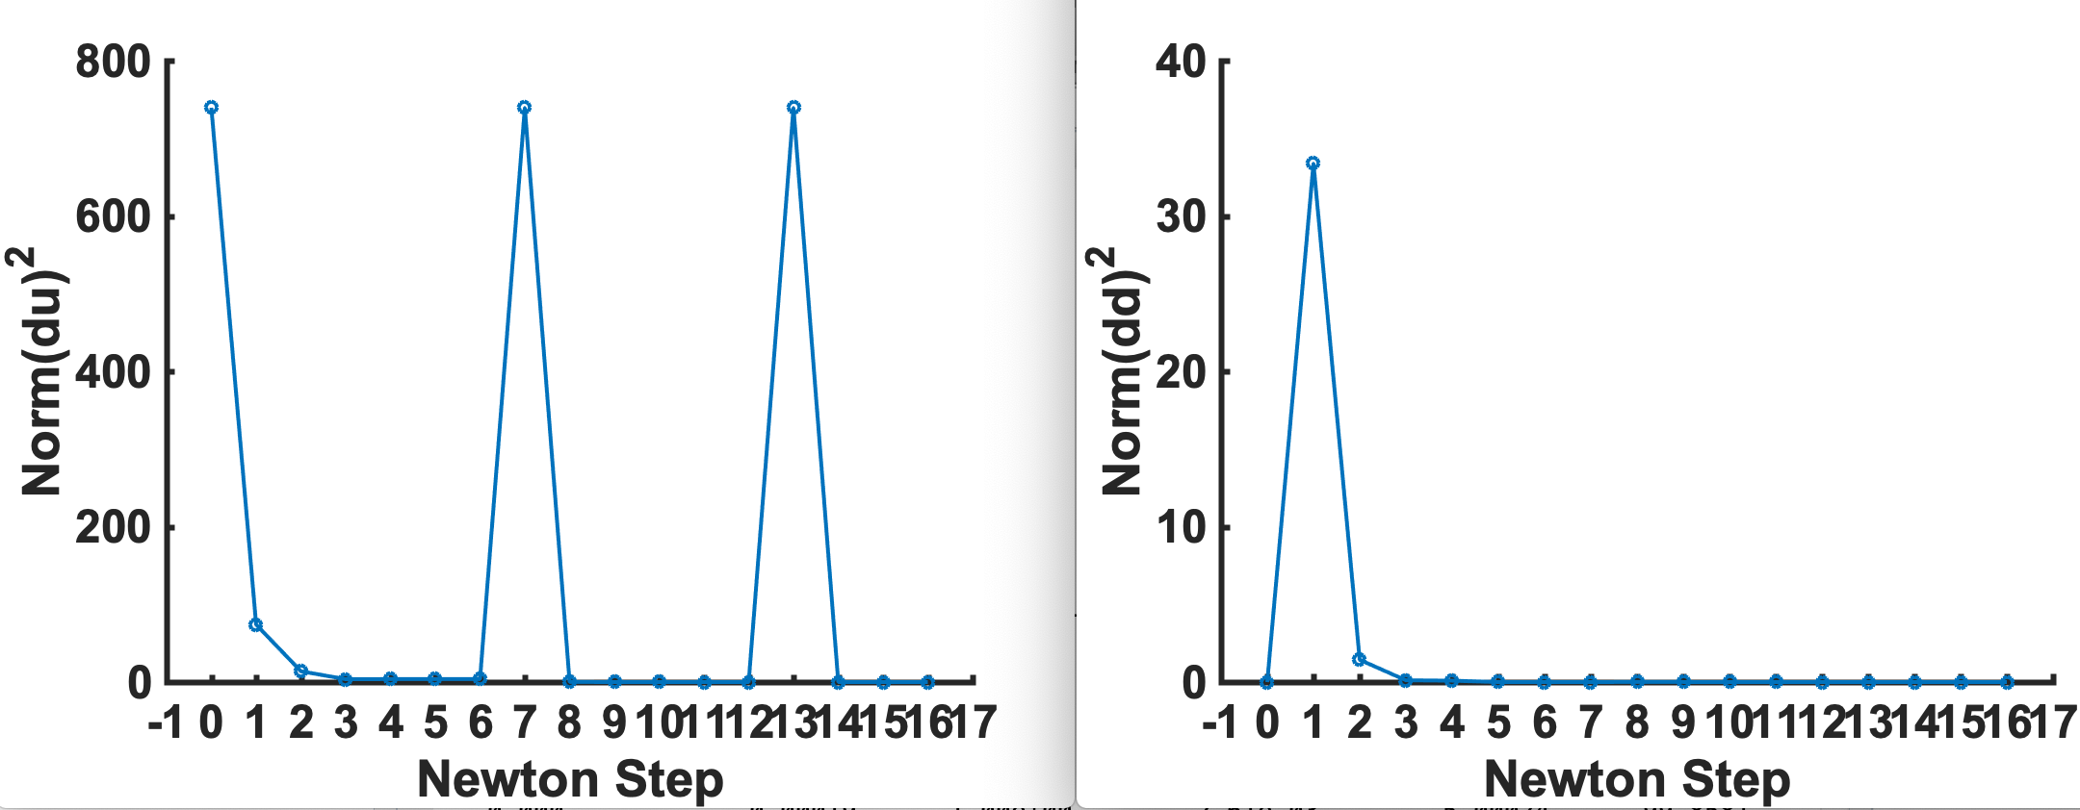
Test_case = 4, U0 = u1, d0 = 30, gamma = 1.0e-5 does not converge. Need to set gamma = 1.0
Converged with 4 outer iterations with normalization and damping.
>> test('test_case', 4, 'init_u_tag', 1, 'enable_normalize', 1, 'enable_damp_newton', 1, 'init_d', 30, 'gamma', 1);
Function test() parameters:
test_case = 4
init_u_tag = 1
enable_normalize = 1
enable_damp_newton = 1
gamma = 1.00e+00
init_d = 30.00
Obj Func Norm J Damping Residual Diffusion Coefficients
0.085 71.23824 0.00e+00 2.72e+01 12.8899 44.0956 0
0.055 13.93405 1.00e+00 8.60e+00 5.99444 41.3649 2.15328
0.034 1.76657 1.00e+00 3.73e+00 5.40165 40.5445 4.07839
0.013 0.16749 1.00e+00 1.93e+00 5.45193 38.6196 4.12796
0.014 0.00842 1.00e+00 1.95e+00 5.45498 38.49 4.12299
0.014 0.00007 1.00e+00 1.97e+00 5.45501 38.4869 4.12294
Number of newton steps: 6
……
Number of newton steps: 5
########################
Obj Func Norm J Damping Residual Diffusion Coefficients
0.085 4.52342 0.00e+00 2.72e+01 5.0001 99.9404 4.99997
0.000 0.00417 1.00e+00 3.20e-04 5 99.9999 5
0.000 0.00000 1.00e+00 1.07e-06 5 99.9999 5
Number of newton steps: 3
########################
Elapsed time is 4.622054 seconds.

Slide 9
Compare with other solvers (Matrices A, M, and H are sparse)
Let u0 = u1, test_case = 1, no normalization, no damping, gamma = 1e-5
My_du: 1.66 sec
GMRES: 190 sec
GMRES with ILU preconditioners: 58 sec
Direct solver: 280 sec

Slide 10
Works for the mem17 problem
>> test('test_case', 5, 'init_u_tag', 2, 'enable_normalize', 0, 'enable_damp_newton', 0, 'init_d', 10);
Function test() parameters:
test_case = 5
init_u_tag = 2
enable_normalize = 0
enable_damp_newton = 0
gamma = 1.00e-05
init_d = 10.00
Obj Func Norm J Damping Param Residual Diffusion Coefficients
0.000 0.67901 0.00e+00 0.00e+00 0.1586
1.384 0.01003 1.00e+00 3.65e-01 0.14654
1.339 0.00781 1.00e+00 4.57e-01 0.15343
1.376 0.00010 1.00e+00 4.63e-01 0.15357
Number of newton steps: 4
########################
Obj Func Norm J Damping Param Residual Diffusion Coefficients
0.000 0.01009 0.00e+00 0.00e+00 0.14628
1.336 0.00854 1.00e+00 4.60e-01 0.15334
1.375 0.00006 1.00e+00 4.63e-01 0.15345
Number of newton steps: 3
########################
Elapsed time is 1.482838 seconds.
Strange here
Converged to 0.1535 um^2/s, while it was 0.11 um^2/s in the paper. 1/16 pixel/um was used. (Now 1/6.4 pixel/um)

Slide 11
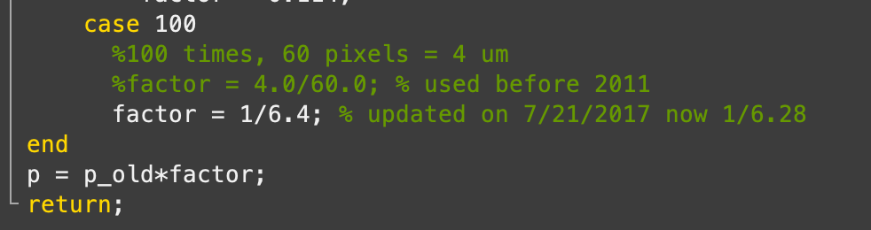
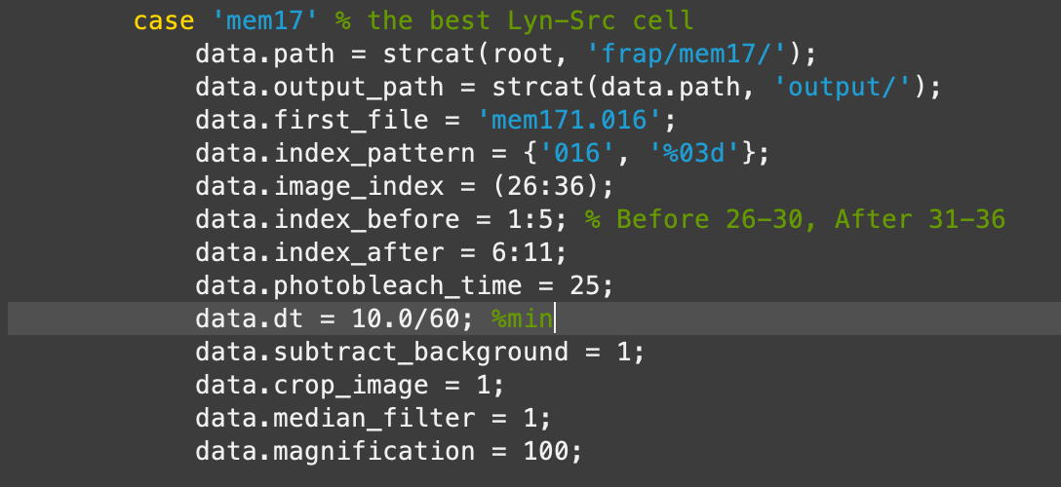
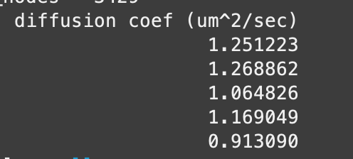
04/12/19: For mem17, scale p by magnification: 1/6.4
>> test('test_case', 5, 'init_u_tag', 2, ...
'enable_normalize', 1, 'enable_damp_newton', 1, 'gamma', 1.0e-5, 'init_d', 10);
scale_by_magnification(p_old, magnification)

Slide 12
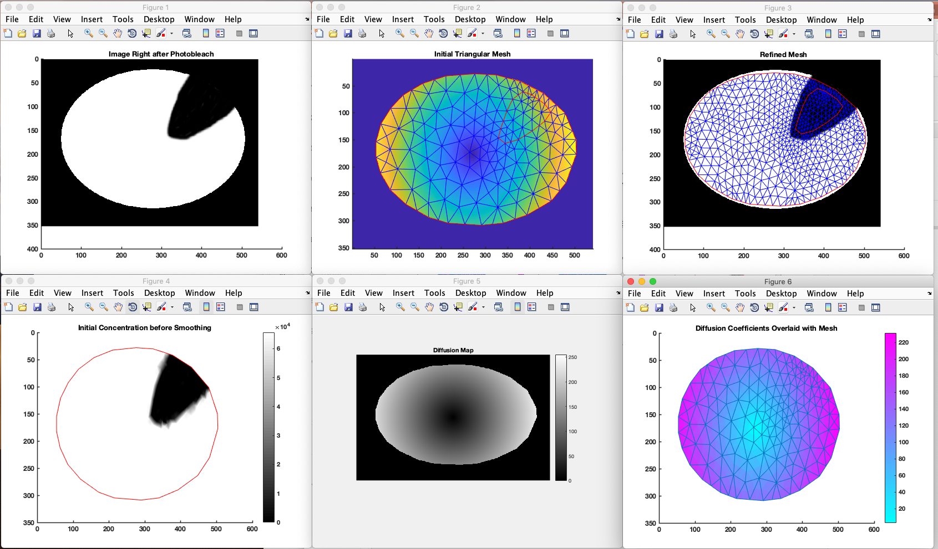
Generate new simulation with continuous diffusion coefficients using the diffusion_analysis package and the input data in “simulation/layered_diffusion_general”
>> cell_name = 'layered_diffusion_general';
>> data = sample_diffusion_init_data(cell_name);
>> computer_simulation(data);

Slide 13
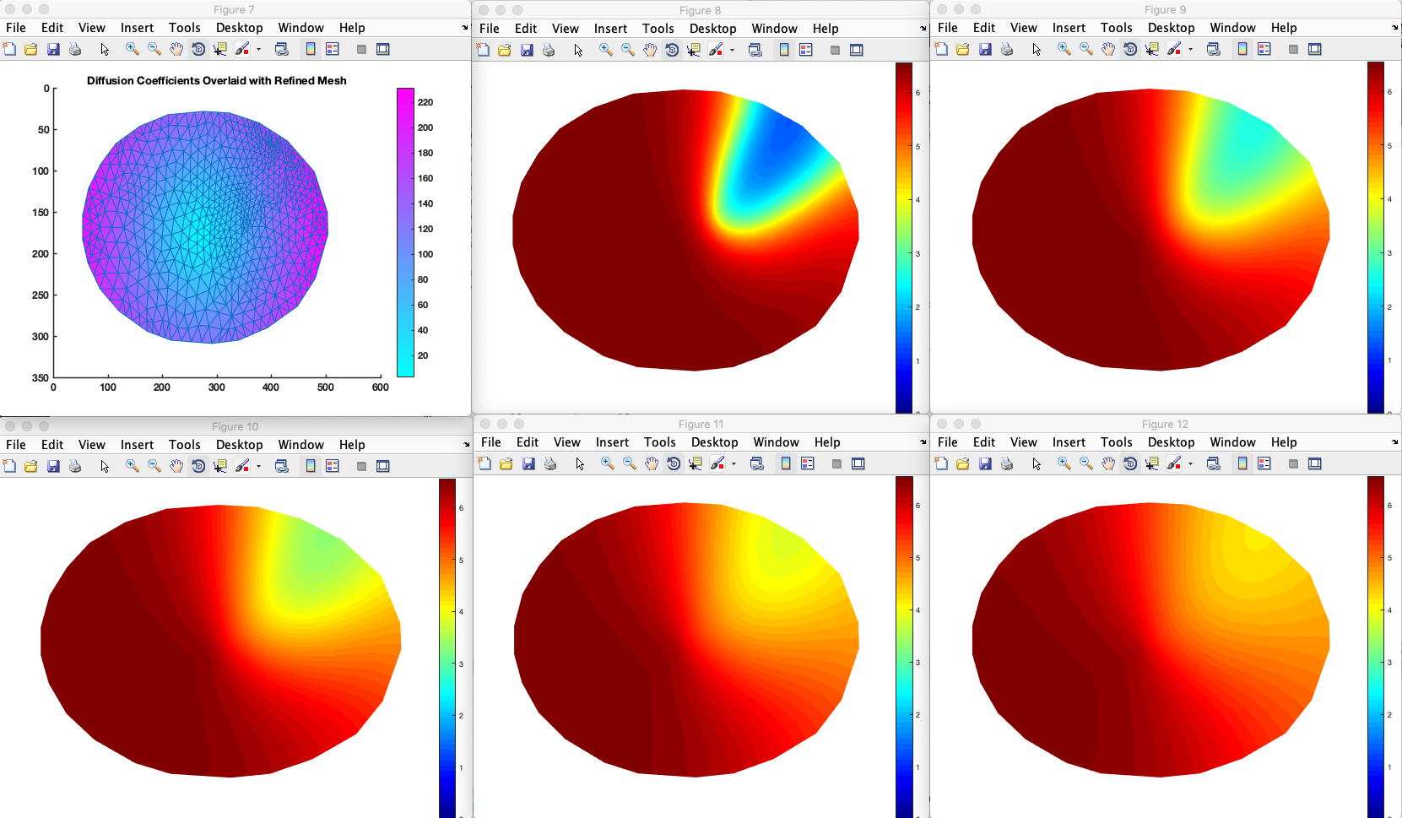
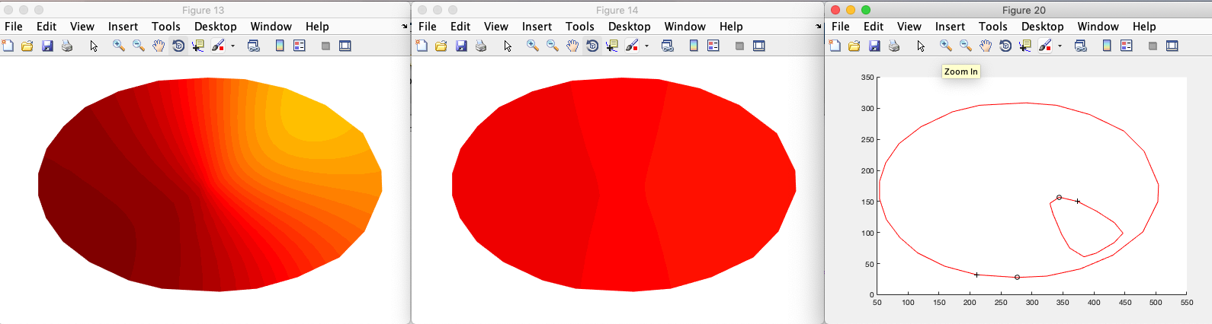

Slide 14
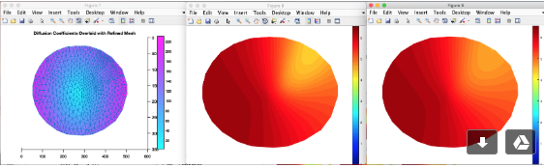
Something is wrong here when setting
Data.diff_const = [4.0 3.0 2.0 1.0].
The results changed:

Slide 15
The simulation results should be saved in the file “output/layered_diffusion_general_5_refined.mat” and then used as the input for the optimization programs.
We are testing this in opt_pde/app/test.m 8/7/2019
Need to incorporate opt_init_data()
Mem17, h3k9me, and general diffusion all do not work.

