Slide 1
The OPT_PDE package
% test_case: decide which test case to run
% 1 -- spot diffusion
% 2 -- layered diffusion
% 3 -- tensor diffusion
% 4 -- tensor cross diffusion
% 5 -- mem17 diffusion

Slide 2
4/4/2019: all five test cases seem to work fine.
>> test('spot211');
Function test() parameters:
test_case = 1
init_u_tag = 2
enable_normalize = 1
enable_damp_newton = 1
gamma = 1.00e-05
init_d = 10.00
Notes:
>> help test
>> cd opt_pde/app
>> test(‘test_case’, 1);

Slide 3
>> test('spot');
Function test() parameters:
test_case = 1
init_u_tag = 1
enable_normalize = 0
enable_damp_newton = 0
gamma = 1.00e-05
init_d = 10.00
Function test(): Set update_option = 2 ---
>> test('spot111');
Function test() parameters:
test_case = 1
init_u_tag = 1
enable_normalize = 1
enable_damp_newton = 1
gamma = 1.00e-05
init_d = 10.00
Function test(): Set update_option = 2 ---

Slide 4
>> test('layer200');
Function test() parameters:
test_case = 1
init_u_tag = 2
enable_normalize = 0
enable_damp_newton = 0
gamma = 1.00e-05
init_d = 10.00
Function test(): Set update_option = 2 ---
>> test('layer');
Function test() parameters:
test_case = 1
init_u_tag = 1
enable_normalize = 1
enable_damp_newton = 1
gamma = 1.00e-05
init_d = 10.00
Function test(): Set update_option = 2 ---

Slide 5
>> test('tensor200');
>> test('tensor');
>> test('tensor110');
Normalization is also essential before damping.
It is very interesting that u and d take turns to converge.

Slide 6
Init_d = 30 also converged, need to set gamma = 1 and update_option = 1 converges faster
>> test('tensord30');
Function test() parameters:
test_case = 1
init_u_tag = 1
enable_normalize = 1
enable_damp_newton = 1
gamma = 1.00e+00
init_d = 30.00
Function test(): Set update_option = 1 ---
Obj Func Norm J Damping Residual Diffusion Coefficients
8.706e-02 6.636e+01 0.00e+00 2.80e+01 13.1276 23.1206 5.0261
5.241e-02 1.303e+01 1.00e+00 6.51e+00 5.84684 66.062 2.60439
2.934e-02 3.223e+00 1.00e+00 2.80e+00 5.23573 42.0027 4.2913
8.205e-03 1.238e+00 1.00e+00 1.36e+00 5.27793 44.0763 4.92953
9.777e-03 8.895e-02 1.00e+00 1.60e+00 5.27559 43.2328 5.0394
9.832e-03 1.791e-03 1.00e+00 1.63e+00 5.27522 43.2846 5.04322
9.840e-03 4.625e-06 1.00e+00 1.63e+00 5.27523 43.2818 5.0432
Number of newton steps: 7
########################
……
Obj Func Norm J Damping Residual Diffusion Coefficients
8.706e-02 4.527e+00 0.00e+00 2.80e+01 5.00001 99.9836 5.00012
-7.285e-07 3.191e-03 1.00e+00 3.40e-04 5 100 5
Number of newton steps: 2
########################
Elapsed time is 3.862001 seconds.

Slide 7
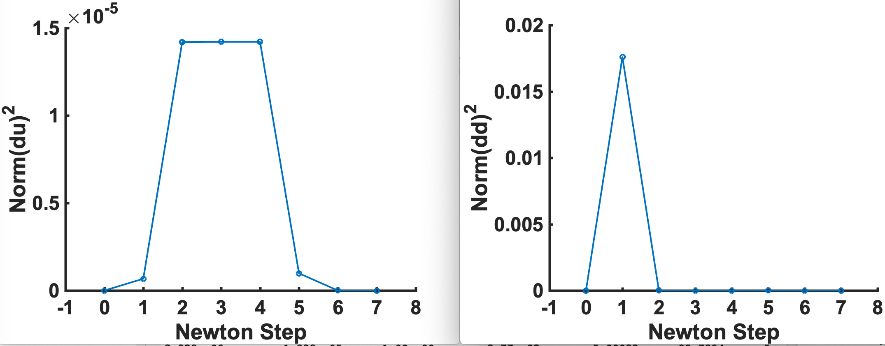
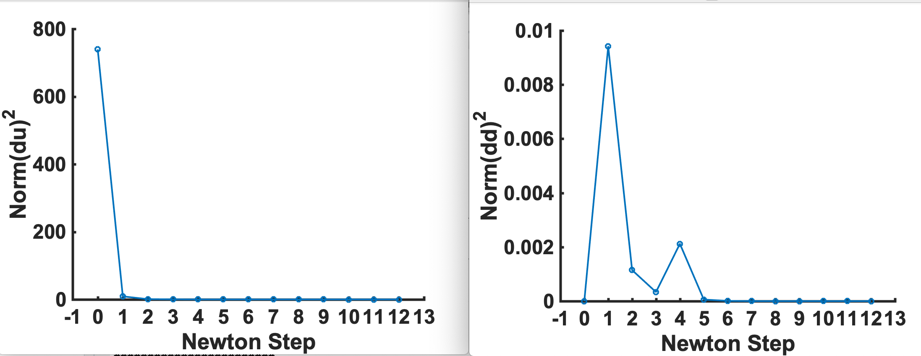
>> test('tensor_cross211');
>> test('tensor_cross');
Function test() parameters:
test_case = 1
init_u_tag = 1
enable_normalize = 1
enable_damp_newton = 1
gamma = 1.00e-05
init_d = 10.00
Function test(): Set update_option = 2 ---

Slide 8
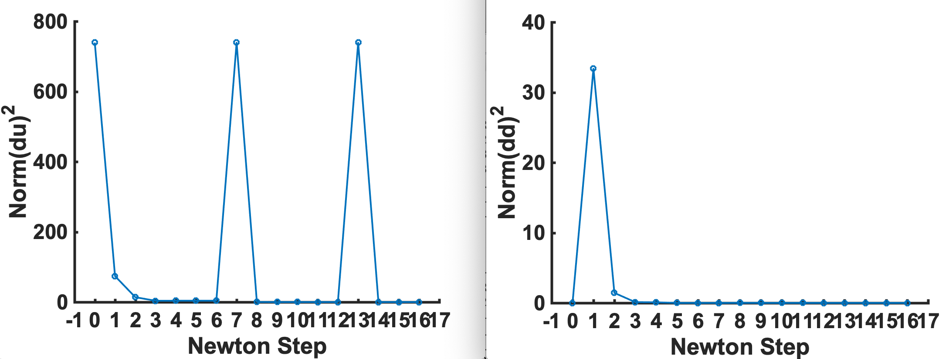
Test_case = 4, U0 = u1, d0 = 30, gamma = 1.0e-5 does not converge. Need to set gamma = 1.0 and update_option = 2
Converged with 4 outer iterations with normalization and damping.
>> test('tensor_crossd30');
Function test() parameters:
test_case = 4
init_u_tag = 1
enable_normalize = 1
enable_damp_newton = 1
gamma = 1.00e+00
init_d = 30.00
Function test(): Set update_option = 1 ---
Function test(): Set data.has_constraint = 1 ---
Obj Func Norm J Damping Residual Diffusion Coefficients
8.524e-02 7.124e+01 0.00e+00 2.72e+01 30 30 30
5.524e-02 1.393e+01 1.00e+00 8.60e+00 12.8899 44.0956 0
3.446e-02 1.767e+00 1.00e+00 3.73e+00 5.99444 41.3649 2.15328
1.316e-02 1.675e-01 1.00e+00 1.93e+00 5.40165 40.5445 4.07839
1.444e-02 8.415e-03 1.00e+00 1.95e+00 5.45193 38.6196 4.12796
……
Number of newton steps: 5
########################
Obj Func Norm J Damping Residual Diffusion Coefficients
8.524e-02 4.523e+00 0.00e+00 2.72e+01 5.00024 99.8581 5.00035
1.790e-06 4.172e-03 1.00e+00 3.20e-04 5.0001 99.9404 4.99997
9.921e-10 1.192e-06 1.00e+00 1.07e-06 5 99.9999 5
9.040e-10 5.591e-12 1.00e+00 9.00e-07 5 99.9999 5
Number of newton steps: 3
########################
Elapsed time is 5.023084 seconds.

Slide 9
Compare with other solvers (Matrices A, M, and H are sparse)
Let u0 = u1, test_case = 1, no normalization, no damping, gamma = 1e-5
My_du: 1.66 sec
GMRES: 190 sec
GMRES with ILU preconditioners: 58 sec
Direct solver: 280 sec

Slide 10
Works for the mem17 problem
>> test('mem17');
Function test() parameters:
test_case = 5
init_u_tag = 2
enable_normalize = 1
enable_damp_newton = 1
gamma = 1.00e-05
init_d = 30.00
Function test(): Set update_option = 2 ---
--- test case 5: scale_by_magnification of 98. ---
Obj Func Norm J Damping Residual Diffusion Coefficients
0.000e+00 4.265e+01 0.00e+00 0.00e+00 0.15558
1.722e+00 2.080e-01 1.00e+00 7.63e+00 0.14611
1.664e+00 1.537e-02 1.00e+00 9.59e+00 0.15332
1.713e+00 5.948e-04 1.00e+00 9.68e+00 0.15344
Number of newton steps: 4
########################
Obj Func Norm J Damping Residual Diffusion Coefficients
1.713e+00 4.798e-07 0.00e+00 9.68e+00 0.15344
Number of newton steps: 1
########################
Elapsed time is 1.039142 seconds.
Initial obj is zero because of the initial guess.
Updating u, v, and d in outer iterations increase stability.
Converged to 0.1544 um^2/s, while it was 0.11 um^2/s in the paper. 1/16 pixel/um was used. (Now 1/6.4 pixel/um)

Slide 11
H3K9me converged to very small diffusion coefficients.
>> test('h3k9’);
Function test() parameters:
test_case = 6
init_u_tag = 2
enable_normalize = 1
enable_damp_newton = 1
gamma = 1.00e+00
init_d = 10.00
Function test(): Set update_option = 2 ---
Function test(): Set magnification = 99 ---
Obj Func Norm J Damping Residual Diffusion Coefficients
0.000e+00 3.100e+04 0.00e+00 0.00e+00 0.0057696 0.015168
-1.565e+01 4.324e+01 1.00e+00 1.06e+01 0 0
-2.375e+01 6.373e-02 1.00e+00 2.97e+01 0 8.4781e-08
-2.382e+01 5.118e-02 1.36e-01 2.97e+01 0 9.5158e-08
-2.383e+01 5.028e-02 1.92e-02 2.97e+01 0 1.0552e-07
-2.384e+01 4.936e-02 1.95e-02 2.97e+01 0 1.1586e-07
……
Number of newton steps: 10
########################
……
Obj Func Norm J Damping Residual Diffusion Coefficients
Function compute_objective(): abs(dd)<=eps, do not normalize ---
-2.428e+01 1.075e-02 0.00e+00 3.01e+01 0 6.2966e-07
Number of newton steps: 1
########################
Elapsed time is 11.216736 seconds.

Slide 12
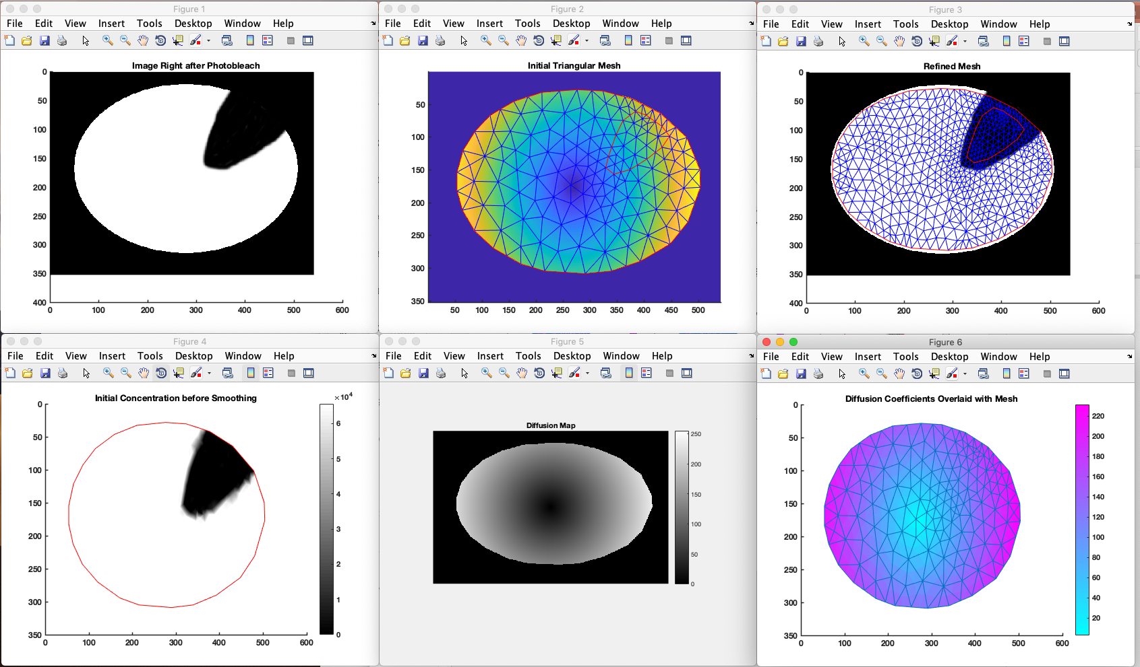
Generate new simulation with continuous diffusion coefficients using the diffusion_analysis package and the input data in “simulation/layered_diffusion_general”
>> cell_name = 'layered_diffusion_general';
>> data = sample_diffusion_init_data(cell_name);
>> computer_simulation(data);

Slide 13
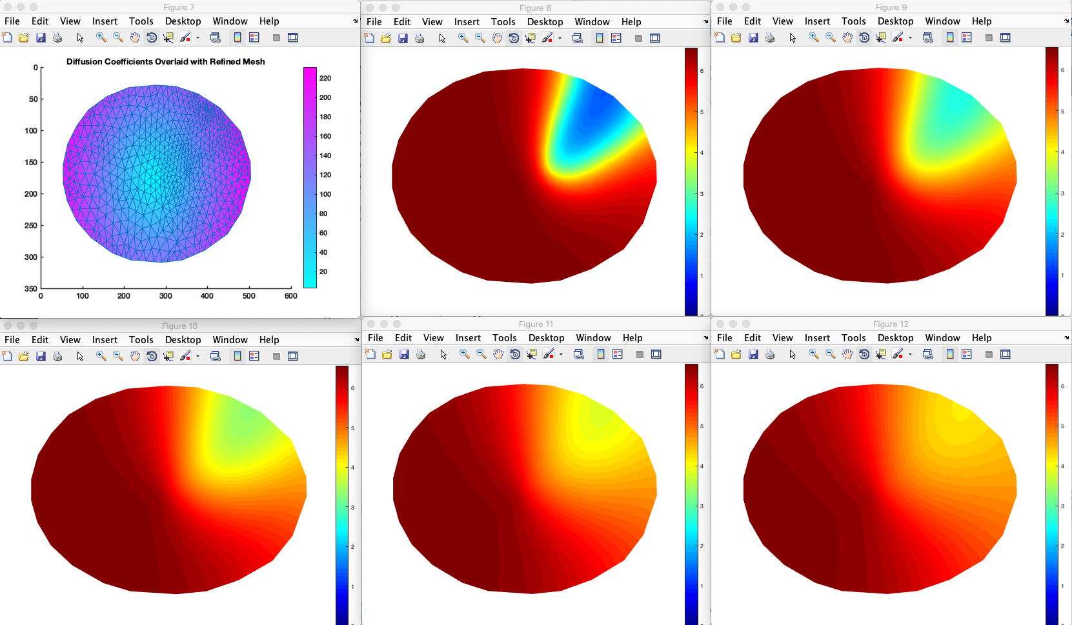
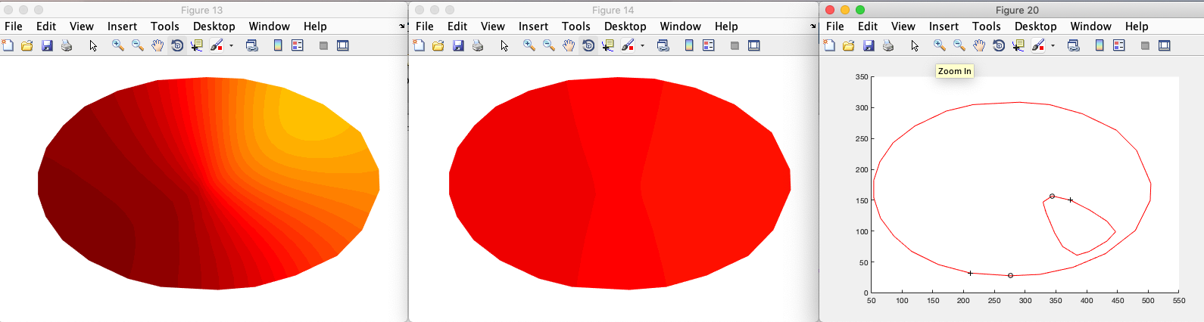

Slide 14
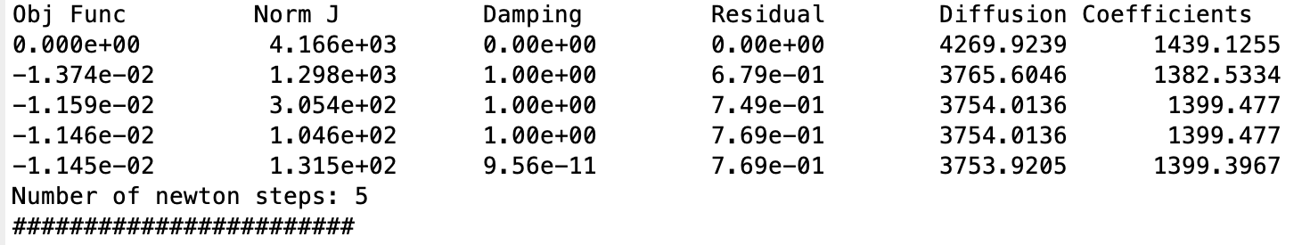
The simulation results should be saved in the file “output/layered_diffusion_general_5_refined.mat” and then used as the input for the optimization programs.
We are testing this in opt_pde/app/test.m
Need to incorporate opt_init_data()
Mem17, h3k9me, and general diffusion all do not work.
>> test('general');
Function test() parameters:
init_u_tag = 2
enable_normalize = 1
enable_damp_newton = 1
gamma = 1.00e-05
init_d = 10.00
Function test(): Set update_option = 2 ---
……

Slide 15
Non constraint optimization also works
>> test(1);
Function test() parameters:
init_u_tag = 1
enable_normalize = 0
enable_damp_newton = 0
gamma = 1.00e-05
init_d = 10.00
Function test(): Set update_option = 1 ---
Obj Func Norm J Damping Residual x_0
6.900e+01 1.600e+01 0.00e+00 1.00e+01 10
5.000e+00 0.000e+00 1.00e+00 0.00e+00 2
Number of newton steps: 1
########################
Elapsed time is 0.011152 seconds.

Slide 16
>> test(5)
Function test() parameters:
init_u_tag = 1
enable_normalize = 0
enable_damp_newton = 0
gamma = 1.00e-05
init_d = 0.00
Function test(): Set update_option = 1 ---
Function test(): Set data.has_constraint = 0 ---
Obj Func Norm J Damping Residual x
5.667e+02 1.344e+02 0.00e+00 1.41e+01 10 10
4.397e+01 3.191e+01 1.00e+00 0.00e+00 5.25 5.25
-1.113e+01 6.530e+00 1.00e+00 0.00e+00 3.1012 3.1012
-1.484e+01 7.838e-01 1.00e+00 0.00e+00 2.3567 2.3567
-1.491e+01 1.955e-02 1.00e+00 0.00e+00 2.2392 2.2392
-1.491e+01 1.348e-05 1.00e+00 0.00e+00 2.2361 2.2361
-1.491e+01 6.424e-12 1.00e+00 0.00e+00 2.2361 2.2361
Number of newton steps: 6
########################
Elapsed time is 0.018400 seconds.

