Slide 1
How to Advance Tasks Efficiently
with kander
Author: dualface

Slide 2
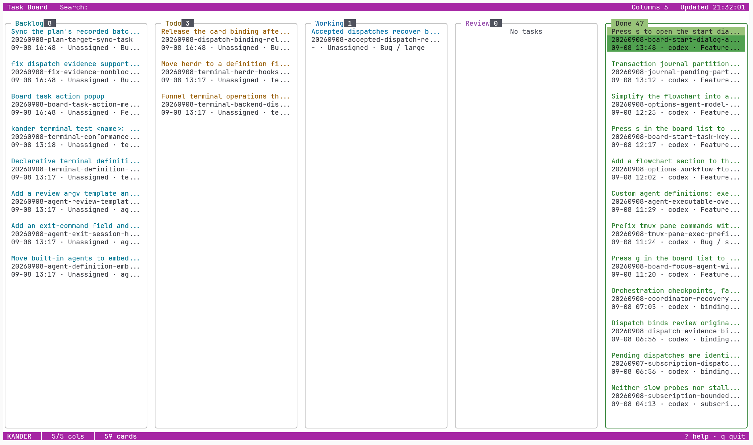
What is kander?
A task card system defined in Markdown.
A rule-driven task orchestration system.
Plus an easy-to-use TUI.

Slide 3
How to Install
Download the latest release from https://github.com/dualface/kander
Run kander install
Run kander init in your project to create the ./kanban/ directory structure.

Slide 4
Where Do Task Cards Come From?
The user discusses requirements with the Agent, or asks the Agent to look at a GitHub issue.
The user and the Agent agree on the task to be done.
The user asks the Agent to create a task card.

Slide 5
What's in a Task Card?
Depending on task complexity, a task card consists of one or more Markdown files.
All task cards are stored under the project's ./kanban/ directory.
The Markdown contains everything needed to complete the task:
Task description
Task checklist
Acceptance checklist

Slide 6
How to Start a Task Card?
The Agent usually asks proactively whether to start the task card.
The user can also explicitly tell the Agent to start it.

Slide 7
How Is a Task Card Executed?
Following the rules, the Agent runs kander start to launch an Agent that executes the task described in the card.
The user can run kander to open the TUI and view the status of all tasks.

Slide 8
TUI

Slide 9
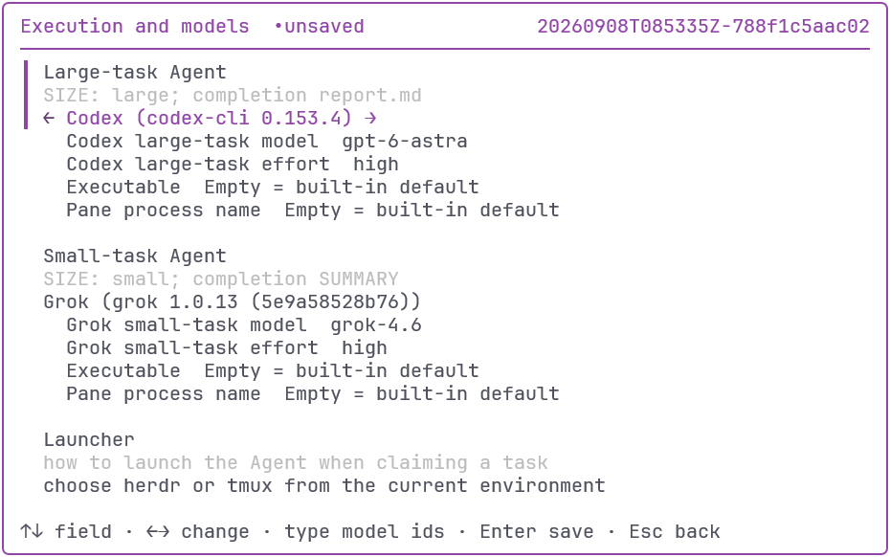
Tune the Executing Agent
Assign different Agents and models to tasks of different sizes.
Balance quality and cost.

Slide 10
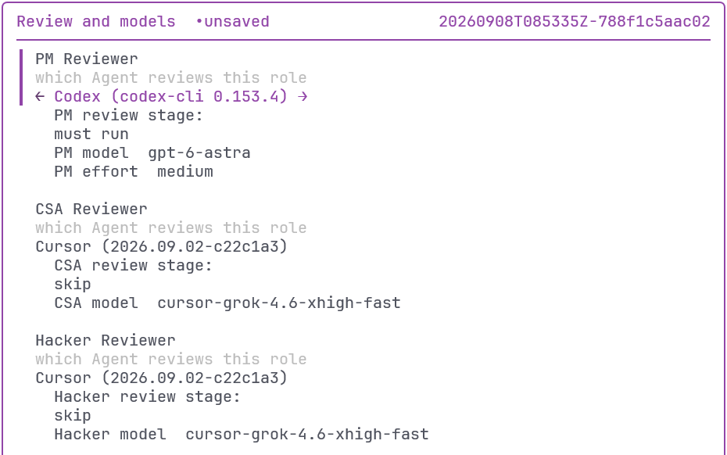
Tune the Review Agents
Assign different Agents and models to each review role.
Cross-review gives better results.

Slide 11
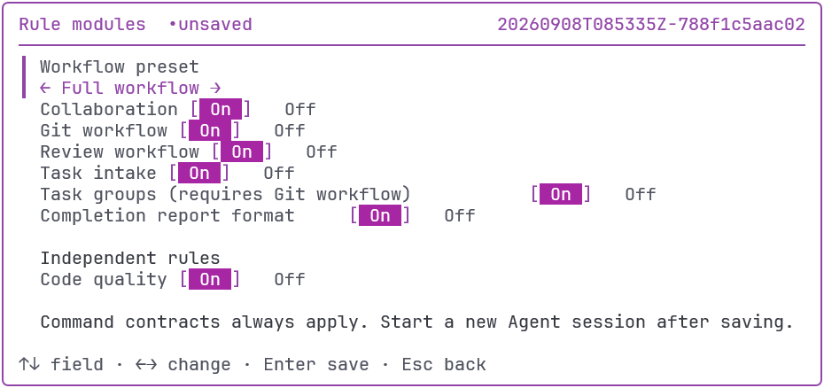
Customize Rule Modules as Needed
The full workflow yields the highest quality.
Unneeded rule modules can be disabled.

Slide 12
Open Source, Auditable, Customizable
Audit the rule definitions thoroughly.
Custom rules take higher priority.
Disable kander's rule modules and replace them with your own.

Slide 13
Thank You
https://github.com/dualface/kander
Please give it a Star ;-)

