Slide 1
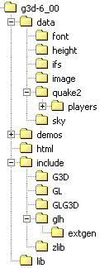




A Map of G3D::
Application Framework
GApp, GApplet, MD2Model, IFSModel, PosedModel, PosedModelWrapper, GMaterial, Sky, beginMarkShadows, markShadows, endMarkShadows
User Input
Rendering Abstraction
UserInput, prompt, msgBox, FPCameraController
RenderDevice, Texture, Draw, VAR, GFont, GCamera, GLight, PixelProgram, VertexProgram, tesselateComplexPolygon, reflectionMatrix, GWindow, TextureManager, LightingParameters
G3D Version 6.03
http://graphics3d.com
OpenGL Helpers
Network
getOpenGLState, GLenumToString, debugAssertGLOK, glVertex, glNormal, glColor, glTexCoord, gl{Load|Mult}[Inv]Matrix, sizeOfGLFormat, glFormatOf, glGetProcAddress, glToScreen, glGetMatrix, glGetInteger, glGetBoolean, glGetDouble, glGetFloat, glGetCurrentContext, GLCaps
NetworkDevice, DiscoveryAdvertisement, DiscoverySettings, DiscoveryServer, DiscoveryClient, ReliableConduit, LightweightConduit, NetAddress, NetListener

Slide 2
Geometry, Files & Data Structures
Geometry
AABox, Box, Sphere, Capsule, Triangle, Ray, ConvexPolygon, ConvexPolyhedron, Plane, Line, Cone, CollisionDetection, MeshAlg, Matrix{3|4}, Color{2|3|4}[uint8], Vector{2|3|4}[[u]int{8|16}], CoordinateFrame
Data Structures
Array, AABSPTree, Table, Set, Queue, ReferenceCountedObject, ReferenceCountedPointer
Debugging
debugAssert[M], alwaysAssertM, debugPrintf, isValidPointer, isValidHeapPointer, Log
Strings
beginsWith, endsWith, stringSplit, stringJoin, format, vformat, wordWrap, stringCompare, stringPtrCompare, toUpper, toLower, NEWLINE, trimWhitespace
Image Formats
GImage, flipRGBVertical, RGBtoARGB, RGBtoBGR, RGBtoBGRA, RGBtoRGBA, RGBxRGBtoRGBA
File & System
System, BinaryInput, BinaryOutput, copyFile, createDirectory, createTempFile, fileExists, fileLength, filenameBaseExt, filenameExt, G3DEndian, getFiles, getDirs, parseFilename, readFileAsString, resolveFilename, TextInput, Token, writeStringToFile
© 2003 Morgan McGuire http://graphics3d.com

Slide 3
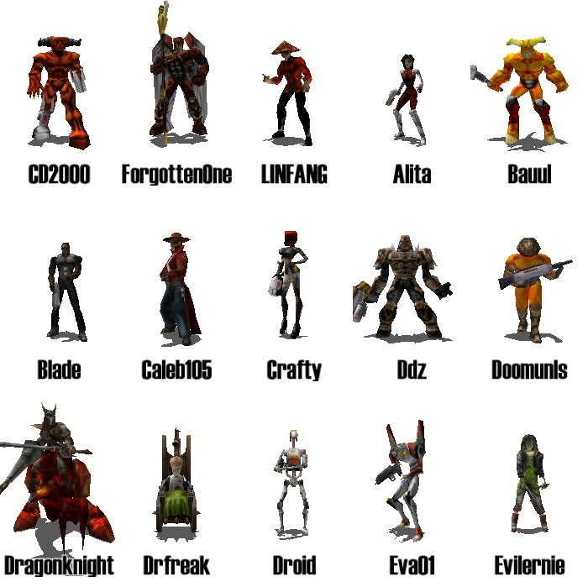
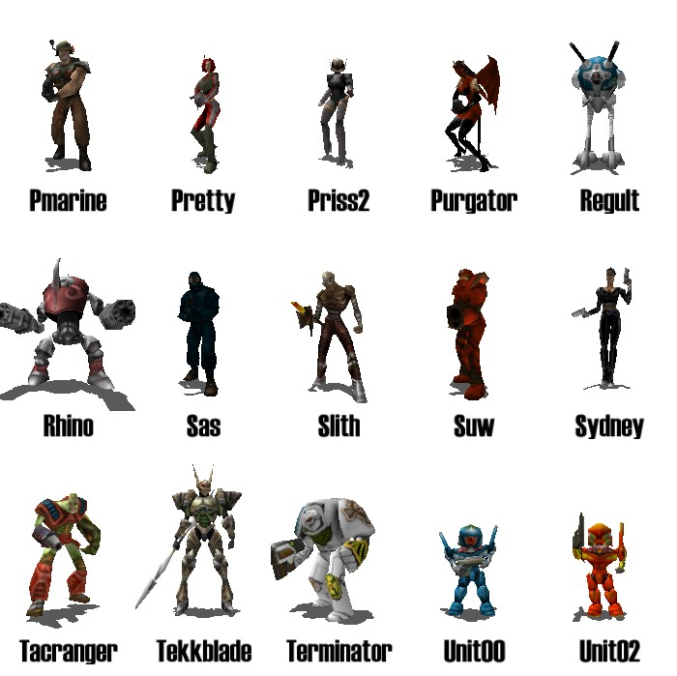
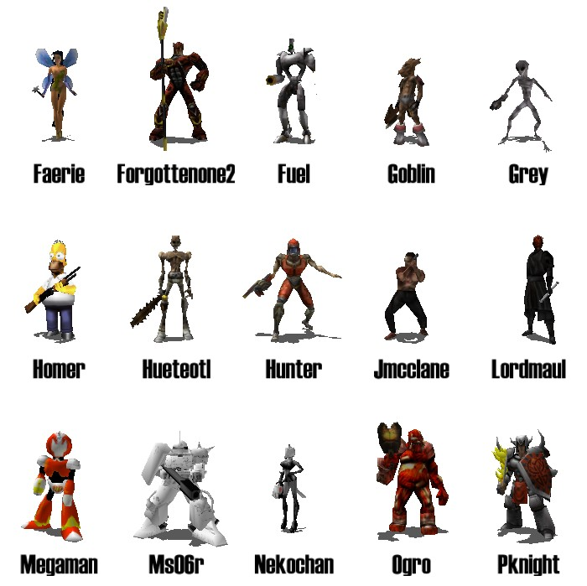
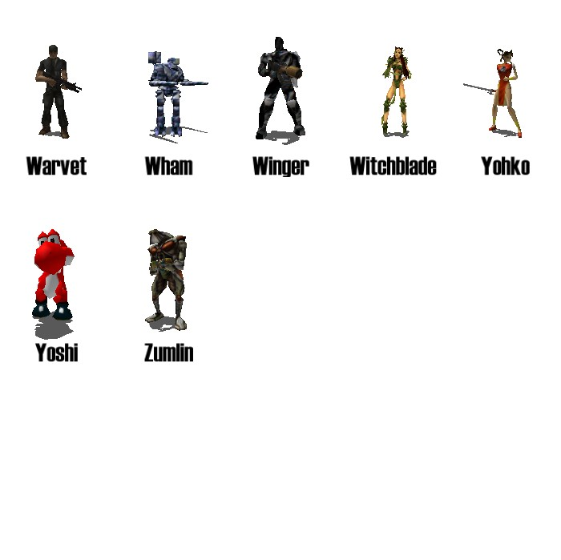
g3d-6_00/data/quake2/players
© 2003 Morgan McGuire http://graphics3d.com

Slide 4
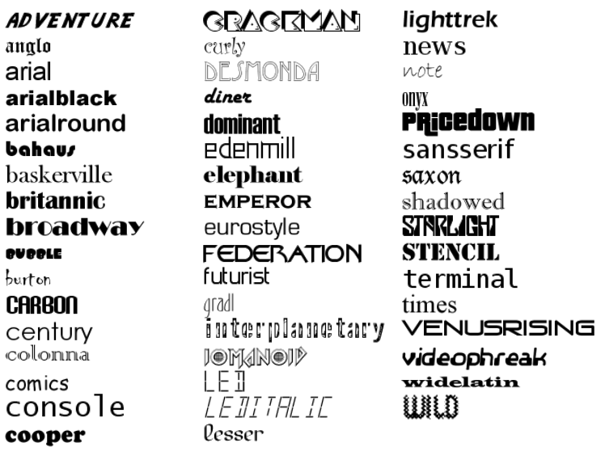
g3d-6_00/data/font
© 2003 Morgan McGuire http://graphics3d.com

