Slide 1
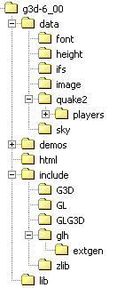



A Map of G3D::
Application Framework
GApp, GApplet, MD2Model, IFSModel, PosedModel, PosedModelWrapper, Sky, beginMarkShadows, markShadows, endMarkShadows
User Input
Rendering Abstraction
UserInput, prompt, msgBox, ManualCameraController
RenderDevice, Texture, Draw, VAR, GFont, GCamera, GLight, PixelProgram, VertexProgram, tesselateComplexPolygon, reflectionMatrix, TextureManager, LightingParameters
G3D Version 6.00
http://graphics3d.com
OpenGL Helpers
Network
getOpenGLState, GLenumToString, debugAssertGLOK, glVertex, glNormal, glColor, glTexCoord, gl{Load|Mult}[Inv]Matrix, sizeOfGLFormat, glFormatOf, glGetProcAddress, glToScreen, glGetMatrix, glGetInteger, glGetBoolean, glGetDouble, glGetFloat
NetworkDevice, DiscoveryAdvertisement, DiscoverySettings, DiscoveryServer, DiscoveryClient, ReliableConduit, LightweightConduit, NetAddress, NetListener

Slide 2
Geometry, Files & Data Structures
Data Structures
Array, Table, Set, Queue, ReferenceCountedObject, ReferenceCountedPointer
Geometry
Box, Sphere, Capsule, Triangle, Ray, ConvexPolygon, ConvexPolyhedron, Plane, Line, Cone, CollisionDetection, MeshAlg, Matrix{3|4}, Color{2|3|4}[uint8], Vector{2|3|4}[[u]int{8|16}], CoordinateFrame
Debugging
debugAssert[M], alwaysAssertM, debugPrintf, isValidPointer, isValidHeapPointer, Log
Strings
beginsWith, endsWith, stringSplit, stringJoin, format, vformat, wordWrap, stringCompare, stringPtrCompare, toUpper, toLower, NEWLINE, trimWhitespace
Image Formats
GImage, flipRGBVertical, RGBtoARGB, RGBtoBGR, RGBtoBGRA, RGBtoRGBA, RGBxRGBtoRGBA
File & System
System, BinaryInput, BinaryOutput, copyFile, createDirectory, createTempFile, fileExists, fileLength, filenameBaseExt, filenameExt, G3DEndian, getFiles, getDirs, parseFilename, readFileAsString, resolveFilename, TextInput, Token, writeStringToFile
© 2003 Morgan McGuire http://graphics3d.com

Slide 3
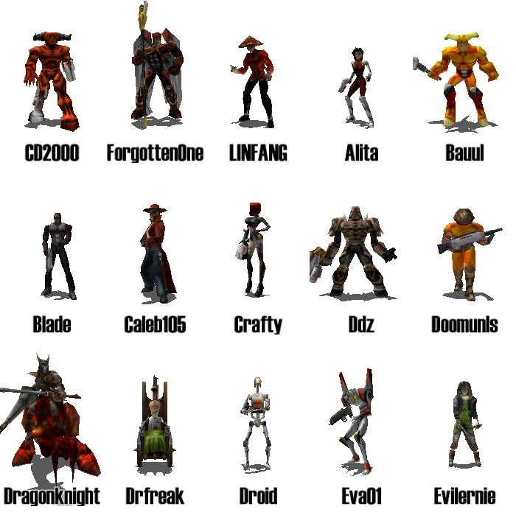
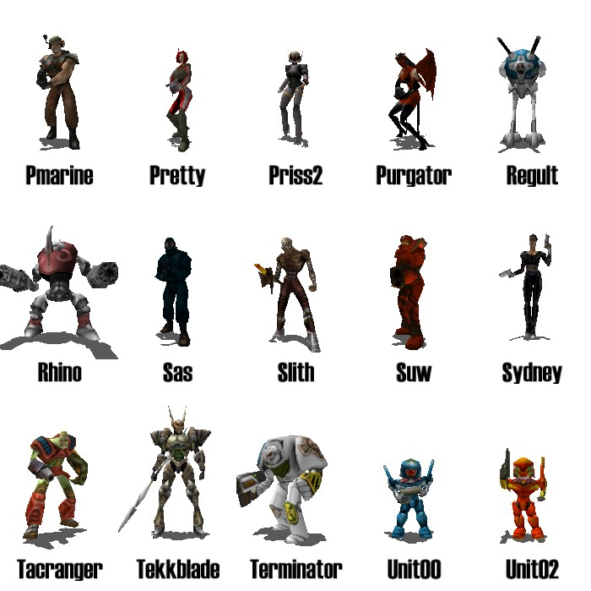
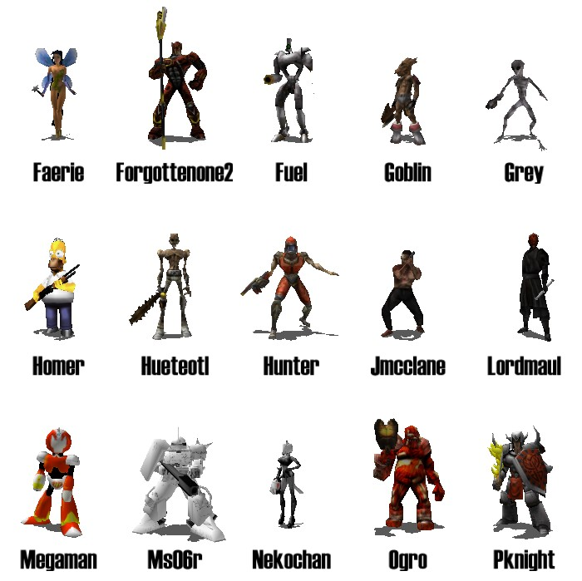
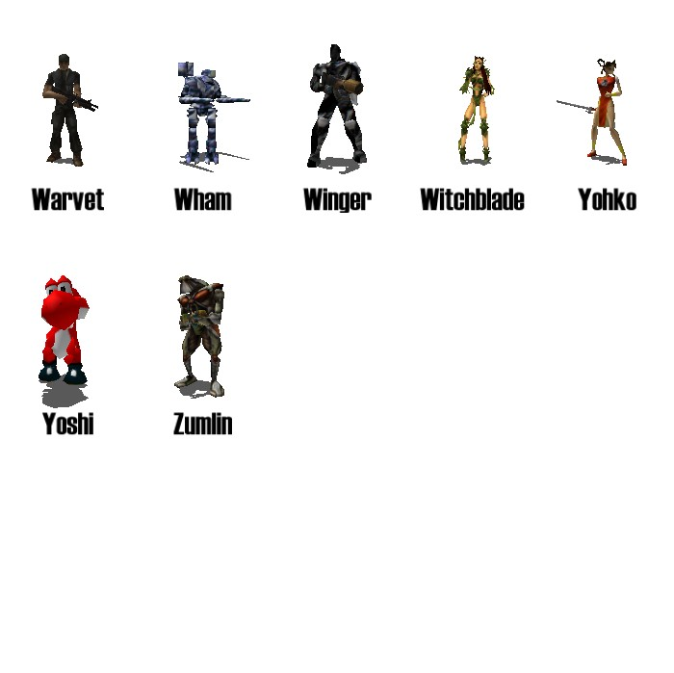
g3d-6_00/data/quake2/players
© 2003 Morgan McGuire http://graphics3d.com

Slide 4
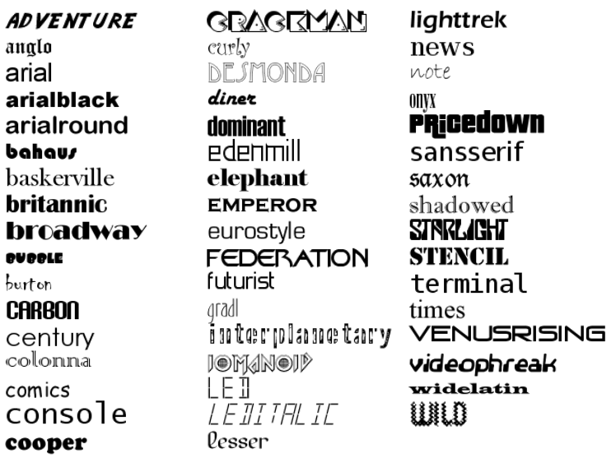
g3d-6_00/data/font
© 2003 Morgan McGuire http://graphics3d.com

