Slide 1
carModel
File created on: 12/19/2022 11:15:42 AM

Slide 2
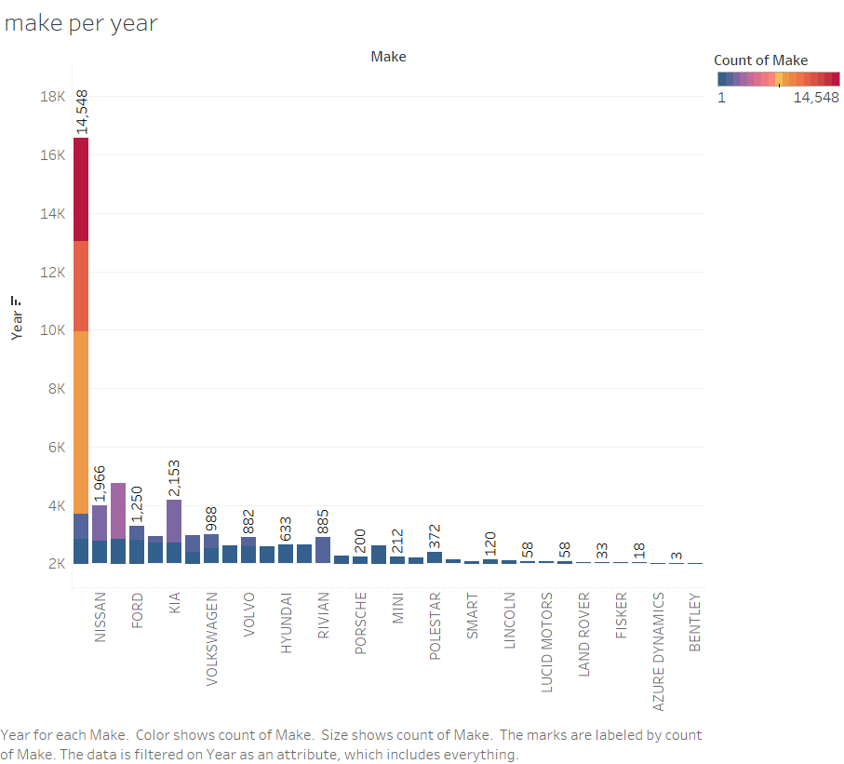

Slide 3
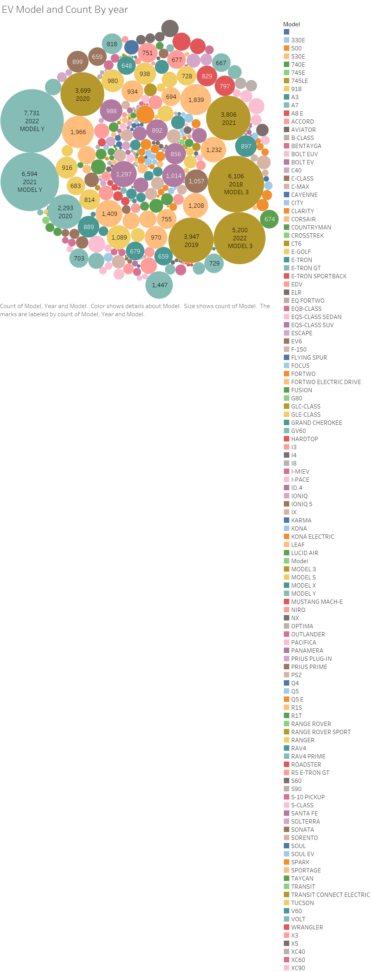

Slide 4
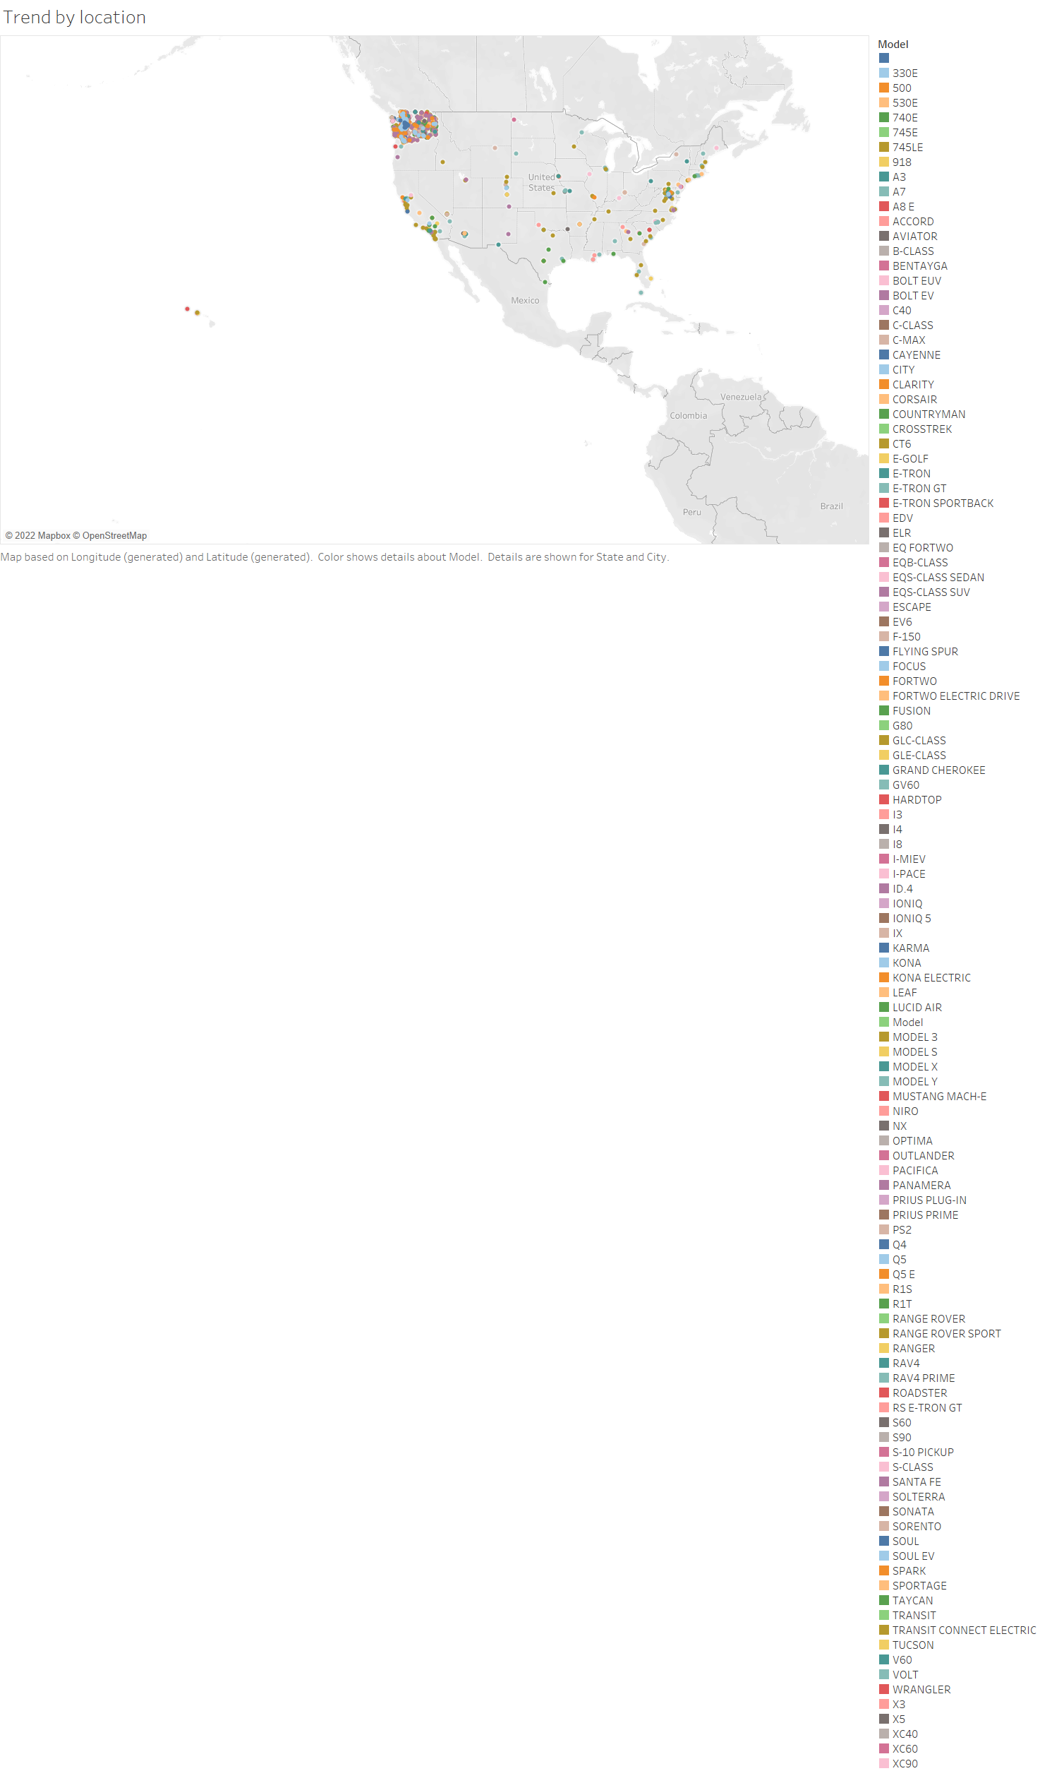

Slide 5
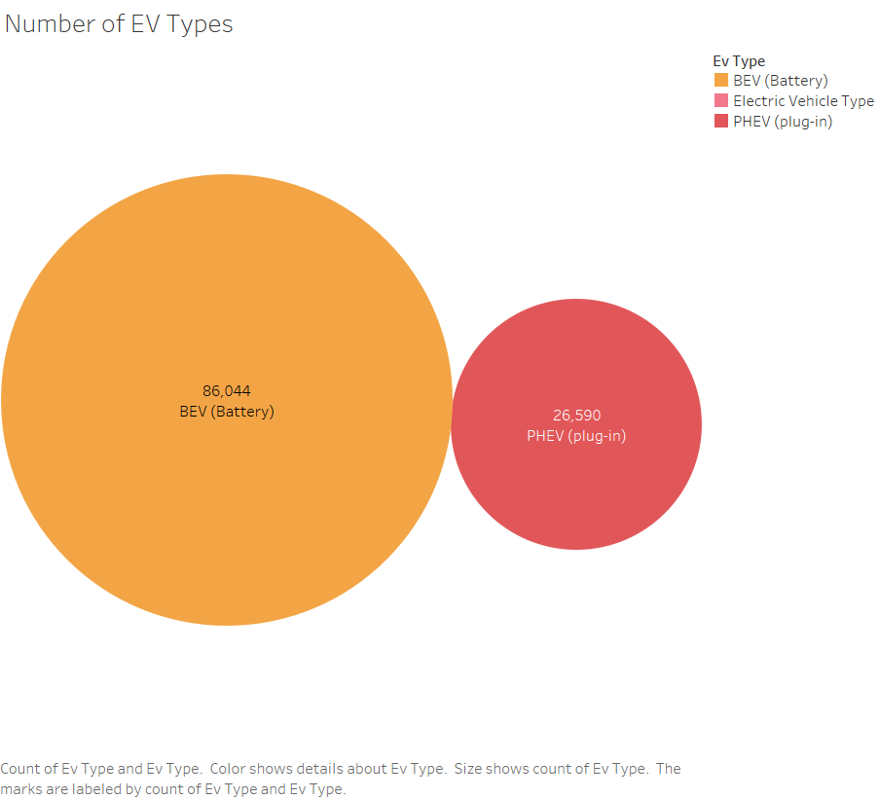

Slide 6
