Slide 1
Exploratory research on the Yelp Dataset
A extensive data-mining in reviews, businesses, users, tips, and check-in data
Tianqi Luan, Song Jiang
Apr. 14th 2020

Slide 2


Outline
Introduction to the Yelp Dataset
Proposed procedure
Main challenges
Exploratory data analysis (EDA)
Modeling
Reference

Slide 3
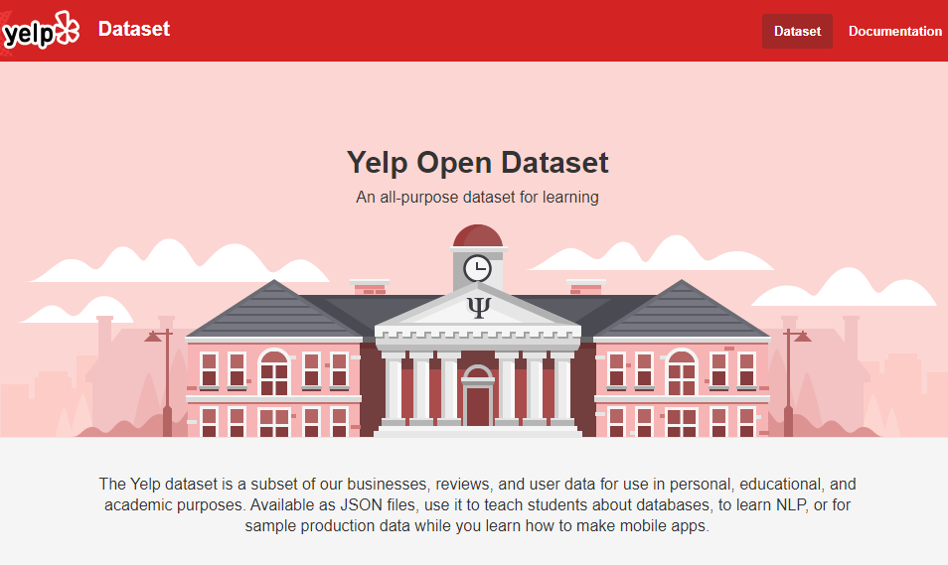
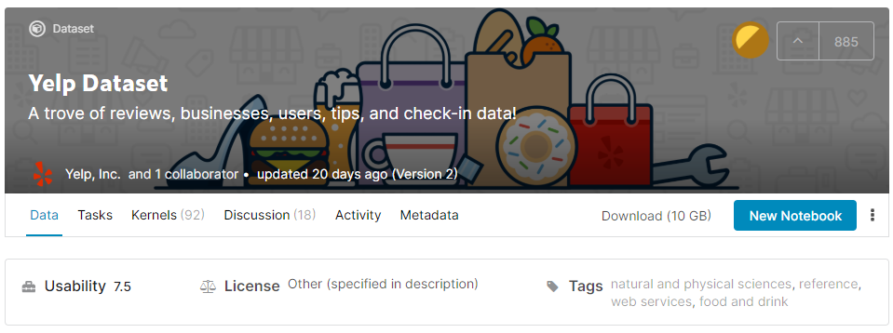
Introduction to the Yelp Dataset
Yelp in a company founded in San Francisco, CA whose major businesses includes Local search, business ratings and reviews, online food delivery.
The Yelp Dataset is generate by Yelp. The dataset itself conclude data collected from 8,021,122 reviews and 209,393 businesses located in 10 major metropolitan areas.

Slide 4
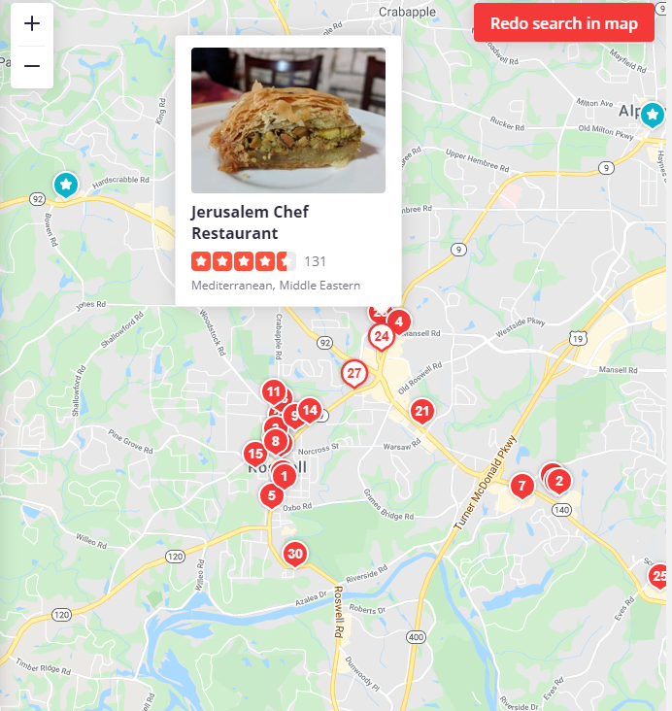
Proposed procedure
Procedure for EDA
Convert .json data to .csv data for further analysis
Data clean-ups: since the data is collected from yelp.com and the yelp mobile app, we’re not likely to get many faulty input data from user. More cleaning work is going to be focused on junk data and replicates.
EDA will be carried out first on the business and check-in datasets. For example, what’s the density of business in various area, etc.
1
2
3

Slide 5
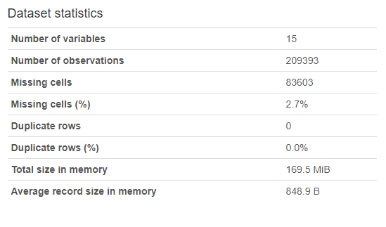
Main challenges
Missing cells counts 2.7% in the business dataset
No duplicate rows.

Slide 6
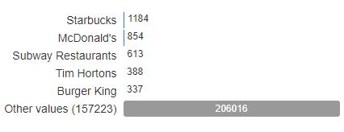
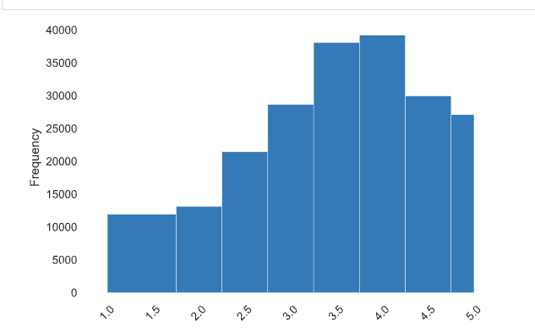
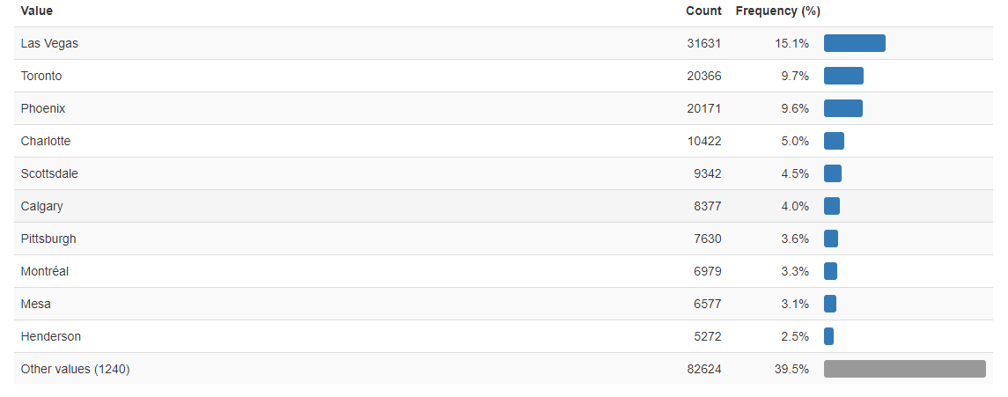
Exploratory data analysis (EDA)

Slide 7
References
https://www.kaggle.com/yelp-dataset/yelp-dataset
https://www.yelp.com/dataset/documentation/main
https://www.yelp.com/search?find_desc=Restaurants&find_loc=Roswell%2C+GA&ns=1

Slide 8

More questions about this project?
tluan1@student.gsu.edu
sjiang11@student.gsu.edu
?

