Slide 1
JavaScript Class Notes
Tianqi Luan

Slide 2
Function/purpose
Change HTML content
Modify HTML attribute values
Change HTML styles
Hide/show HTML elements

Slide 3
Variable types
Can be claimed by var xxx(name of variable)
String
Numeric
Boolen (1/0)

Slide 4
Common syntax
var x, y, z; // Declare Variables x = 5; y = 6; // Assign Values z = x + y; // Compute Values
"John" + " " + "Doe“ //Evaluate Values

Slide 5
Variables
Can be set use either let or const
The const keyword to define a variable that cannot be reassigned, and the let keyword to define a variable with restricted scope.

Slide 6
Objects
JavaScript is a object oriented language
Objects have properties/methods/events
Object: dog
Property: fluffy, 3yrs old
Method: bark(), walk(), eat()

Slide 7
Add properties/methods
Dog=new Object();
Dog.name=“kitty”;
Dog.age=3;
Dog.bark=bark;

Slide 8
Objects can be used in
The Date object can obtain the current time and date, which can be useful for certain purpose
Math object allows higher level calculation like square root/ power/ absolute value

Slide 9
Array elements
Like HTML, array can be created and called by their id
Elements in an array can be called by ArrayName[index]
Array can exist inside another array

Slide 10
JS loop
For loop
Syntax for (initiate; condition; execute){
}
A good example: generate a Fibonacci series
For (var in var) loop go through properties of an object

Slide 11
JS loop
while (condition) {
// code block to be executed
}
do {
// code block to be executed
}
while (condition);

Slide 12
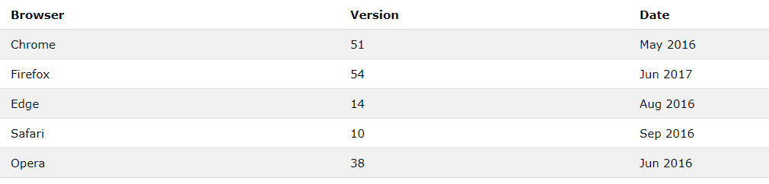
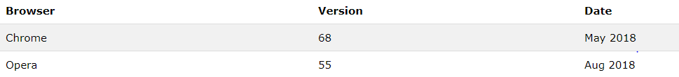
Browser support
ES6
ES7

Slide 13
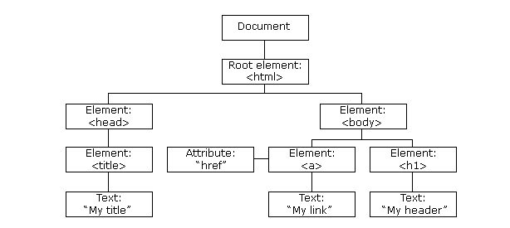
Browser support
DOM version
When a web page is loaded, the browser creates a Document Object Model(DOM) of the page.

Slide 14
Cookies
Variables stored in local, so web pages can get access to the data
But can be disabled by settings in browsers so can’t rely on just cookies

