Slide 1
Sixteen Team Kick-off
October 1st, 2018

Slide 2
OBJECTIVES
Gaining an understanding of the group's purpose
Determining how the team will be organized and who will be responsible for what
Outlining general group rules

Slide 3
WHO SHOULD PARTICIPATE?
Entire Team – all team members, Product Owner
Key stakeholders
Development Team (Sixteen Team) | Trần Ngọc Luân Phạm Thủy Tiên Nguyễn Vũ Đăng Khánh Lê Quốc Duy Quang Nguyễn Tiến Hưng
Technical Mentor & Product Owner | Đào Chính Trực
Agile Coach | Huỳnh Thiện Khiêm
Other stakeholder (Coordinator) | Nguyễn Thị Hà Phương

Slide 4
WHAT WILL WE DO?
State the purpose of the workshop (5-10 minutes)
Get to know each other (30-60 minutes)
Team Identity Creation [optional]
Review Agile mindset, Scrum or Kanban core practices (10-15 minutes)
Determine Agile ingredients to be used (15-20 minutes)
Agree on practical stuffs (60-90 minutes)

Slide 5
GET TO KNOW EACH OTHER
Purpose:
Get team members to discover shared values and philosophies, this sets the stage for self-organization and cross-functional working.
Instructions:
Individuals draw the journey lines of their careers and/or private lives such as name, experience, key competency, main skills, hoppy …

Slide 6
Agile mindset, Scrum or Kanban core practices
This part is NOT to provide a complete presentation about Agile frameworks that people should have been trained in advanced. We are going to spend 10-15 minutes to refocus on Agile mindset and core practices and values of Scrum and Kanban.

Slide 7
Agile mindset
An agile mindset is the set of attitudes supporting an agile working environment. These include respect, collaboration, improvement and learning cycles, pride in ownership, focus on delivering value, and the ability to adapt to change. This mindset is necessary to cultivate high-performing teams, who in turn deliver amazing value for their customers.

Slide 8
SCRUM ROLES/ SCRUM EVENTS/ SCRUM ARTIFACTS
Product Owner
Scrum Master
Development Team
Sprint Planning
Daily Scrum
Sprint Review
Sprint Retrospective
Product Backlog
Sprint Backlog
Increment
Scrum Team
Jeff Sutherland and Ken Schwaber - Scrum Guide 2017

Slide 9
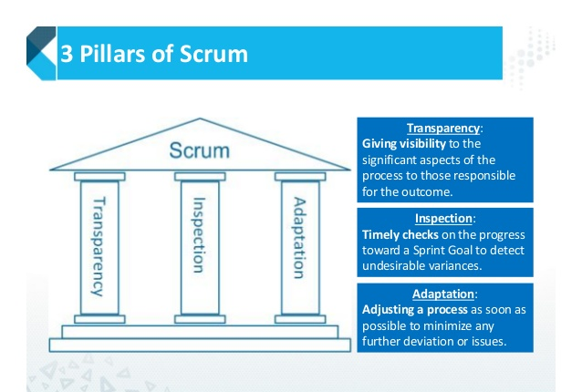

Slide 10
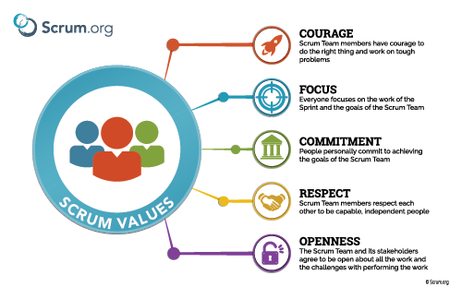

Slide 11
THE KANBAN CORE PRACTICES
1. Visualize (the work, workflow and business risks)
2. Limit WIP
3. Manage Flow
4. Make Process Explicit
5. Implement Feedback Loops (new, updated in 2014)
6. Improve Collaboratively, Evolve Experimentally (using models & the scientific method)
Notes:
Visualize
This practice started as “Visualize the workflow” and the obvious manifestation of this is the card wall. In the lean-agile software world this card wall is called a “Kanban Board”, although strictly speaking this is only true if the board has WIP limits and is a pull system. The point of the Kanban Board is to visualize the workflow of the team and where the work is within the workflow. Often that means mapping the value stream to find the workflow.
Limit WIP
Work in Progress (WIP) is the sum of all parts in the workflow. Less is better. When WIP is low Lead Time is shorter and Throughput is higher. So not surprising The Kanban Method is keen on limiting WIP. The practice that enables the team to limit WIP is the “pull” aspect of the approach. Participants in downstream steps in the workflow “pull” completed cards from the upstream steps, but only when they have capacity.
Manage workflow
The flow of work items through each state in the workflow should be monitored and reported - often referred to as Measuring Flow. By flow we mean movement. We are interested in the speed of movement and the smoothness of that movement. Ideally we want fast smooth flow. Fast smooth flow means our system is both creating value quickly, which is minimizing risk and avoiding (opportunity) cost of delay, and is also doing so in a predictable fashion.
Make Process Explicit
Without an explicit understanding of how things work and how work is actually done, any discussion of problems tends to be emotional, anecdotal and subjective. With an explicit understanding it is possible to move to a more rational, empirical, objective discussion of issues. This is more likely to facilitate consensus around improvement suggestions.
Implement Feedback Loops
The “Implement Feedback Loops” practice is the new one of the six, the one added in the Sep 2014 update to the list on The Principles & General Practices of The Kanban Method. Actually adding it to the list of core practices just acknowledges some stuff that was already happening.
An evolutionary process cannot work without feedback loops. When implemented at a service delivery level in organizations, Kanban, uses four specific practices for feedback: the standup meeting; the service delivery review; the operations review; and the risk review.
The purpose of feedback loops is to be able to compare expected outcomes with actual outcomes and make adjustments. Specifically, we want to make process and policy adjustments as a result of the feedback and understanding the current outcomes in comparison with our expectations or desires.
Improve Collaboratively, Evolve Experimentally (using models/scientific method)
It is the WIP limit that ultimately stimulates conversations about process problems. Things which impede flow, or introduce perturbations that mean flow is inconsistent or ragged, often result in a challenge to the WIP limit. The team has the option to break the limit, ignore the problem and carry on, or to face up to the issue, discuss it and suggest a change.
When teams have a shared understanding of theories about work, workflow, process, and risk, they are more likely to be able to build a shared comprehension of a problem and suggest improvement actions which can be agreed by consensus.

Slide 12
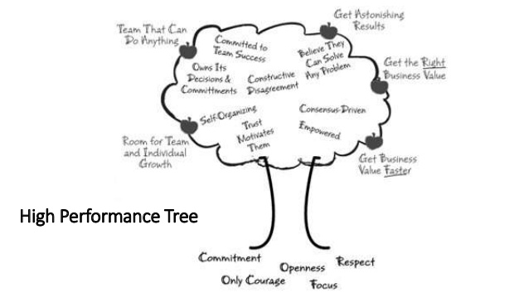
Notes:
Visualize
This practice started as “Visualize the workflow” and the obvious manifestation of this is the card wall. In the lean-agile software world this card wall is called a “Kanban Board”, although strictly speaking this is only true if the board has WIP limits and is a pull system. The point of the Kanban Board is to visualize the workflow of the team and where the work is within the workflow. Often that means mapping the value stream to find the workflow.
Limit WIP
Work in Progress (WIP) is the sum of all parts in the workflow. Less is better. When WIP is low Lead Time is shorter and Throughput is higher. So not surprising The Kanban Method is keen on limiting WIP. The practice that enables the team to limit WIP is the “pull” aspect of the approach. Participants in downstream steps in the workflow “pull” completed cards from the upstream steps, but only when they have capacity.
Manage workflow
The flow of work items through each state in the workflow should be monitored and reported - often referred to as Measuring Flow. By flow we mean movement. We are interested in the speed of movement and the smoothness of that movement. Ideally we want fast smooth flow. Fast smooth flow means our system is both creating value quickly, which is minimizing risk and avoiding (opportunity) cost of delay, and is also doing so in a predictable fashion.
Make Process Explicit
Without an explicit understanding of how things work and how work is actually done, any discussion of problems tends to be emotional, anecdotal and subjective. With an explicit understanding it is possible to move to a more rational, empirical, objective discussion of issues. This is more likely to facilitate consensus around improvement suggestions.
Implement Feedback Loops
The “Implement Feedback Loops” practice is the new one of the six, the one added in the Sep 2014 update to the list on The Principles & General Practices of The Kanban Method. Actually adding it to the list of core practices just acknowledges some stuff that was already happening.
An evolutionary process cannot work without feedback loops. When implemented at a service delivery level in organizations, Kanban, uses four specific practices for feedback: the standup meeting; the service delivery review; the operations review; and the risk review.
The purpose of feedback loops is to be able to compare expected outcomes with actual outcomes and make adjustments. Specifically, we want to make process and policy adjustments as a result of the feedback and understanding the current outcomes in comparison with our expectations or desires.
Improve Collaboratively, Evolve Experimentally (using models/scientific method)
It is the WIP limit that ultimately stimulates conversations about process problems. Things which impede flow, or introduce perturbations that mean flow is inconsistent or ragged, often result in a challenge to the WIP limit. The team has the option to break the limit, ignore the problem and carry on, or to face up to the issue, discuss it and suggest a change.
When teams have a shared understanding of theories about work, workflow, process, and risk, they are more likely to be able to build a shared comprehension of a problem and suggest improvement actions which can be agreed by consensus.

Slide 13
DETERMINE AGILE INGREDIENTS TO BE USED
Example of Agile ingredients that will be gone through and discussed by Team
Sprints (if so, how long)
Kanban workflow
Explicitly limit WIP
Daily standup
Retrospectives?
Visual workspace
Measure/track velocity? cycle time? lead time?
Planning: Sprint planning? On demand or on a regular basis?
Team discusses to make decision about use/don’t use/introduce later

Slide 14
DETERMINE AGILE INGREDIENTS TO BE USED
Example of Agile ingredients that will be gone through and discussed by Team
Backlog Refinement sessions
Definition of Done
Forecasting, product burnup charts, burndown charts
Demos
Product Owner collaboration: sit together? when? how?
TDD, Specification by example
Co-ordination with other squads: Scrum of Scrums?
Have an Agile coach?
Team discusses to make decision about use/don’t use/introduce later

Slide 15
AGREE ON PRACTICAL STUFFS
Team vision: Who are we as a Team?
Agile framework to use, i.e. Scrum/Kanban, Sprint length if Scrum…
Shared values to uphold, i.e. Team’s core value
Rules for living together: i.e. core hours, Team working space,
Schedules, i.e. when/how often, of daily stand-up, sprint planning, retrospective meeting, sprint demo, backlog grooming, burndown chart/CFD chart update, how long to remove tasks done.
Tools to use, such as communication tools, task boards,
Collaboration with PO/Customer such as the availability of PO, what do we do when PO is not available.
How to coordinate works with other Teams
Definition of Done, Definition of Ready

Slide 16
* Summary of agreements:
1 | Team name | Sixteen
2 | Team’s value | Respect, Responsibility, Team-work, Creativity
3 | Core hours | 10:00 – 17:00
4 | Team working space | I.e. rules/agreements to help team focus on works.
5 | Schedules | Daily: 10:00
 |  | Sprint Planning: Monday/Friday every 2 weeks
 |  | Sprint Review: Friday every two weeks
 |  | Sprint Retrospective: Friday/Monday every 2 weeks
 |  | Backlog refinement: On purpose
6 | Tools to use | Physical task board, F2F, Skype, email …
7 | Collaboration | Team with Technical Mentor/PO: PO will join Daily Scrum (optional), Sprint Review, Sprint planning, backlog refinement meetings. Team will informal chat with PO to agree on the meeting time and send meeting events at least 1 day in advanced.
 |  | In Team: F2F is primary communication way, verbal communication for technical issues, …
8 | Definition of Done | US DoD: (TBD in the first Sprint Planning with PO)
* Team should have the Team Charter based on the above agreements

