Slide 1

Bike-Share Study Case
Presented by: Luan Ferreira Araujo
Last updated: August 29th, 2025

Slide 2
Context
Cyclistic is a fictional bike-share company located in Chicago. The bikes can be unlocked from one station and returned to any other station in the system anytime.
The company offers flexible pricing plans:
Customers who purchase single-ride or full-day passes are referred to as casual riders.
Customers who purchase annual memberships are Cyclistic members.
Cyclistic’s finance analysts have concluded that annual members are much more profitable than casual riders. Thus, they believe that maximizing the number of annual members will be key to future growth - which includes converting casual users into members.

Slide 3
Objective
How do annual members (“members”, orange) and casual riders (“casuals”, blue) use Cyclistic bikes differently?
Data from June 2024 until May 2025 (1 year).

Slide 4
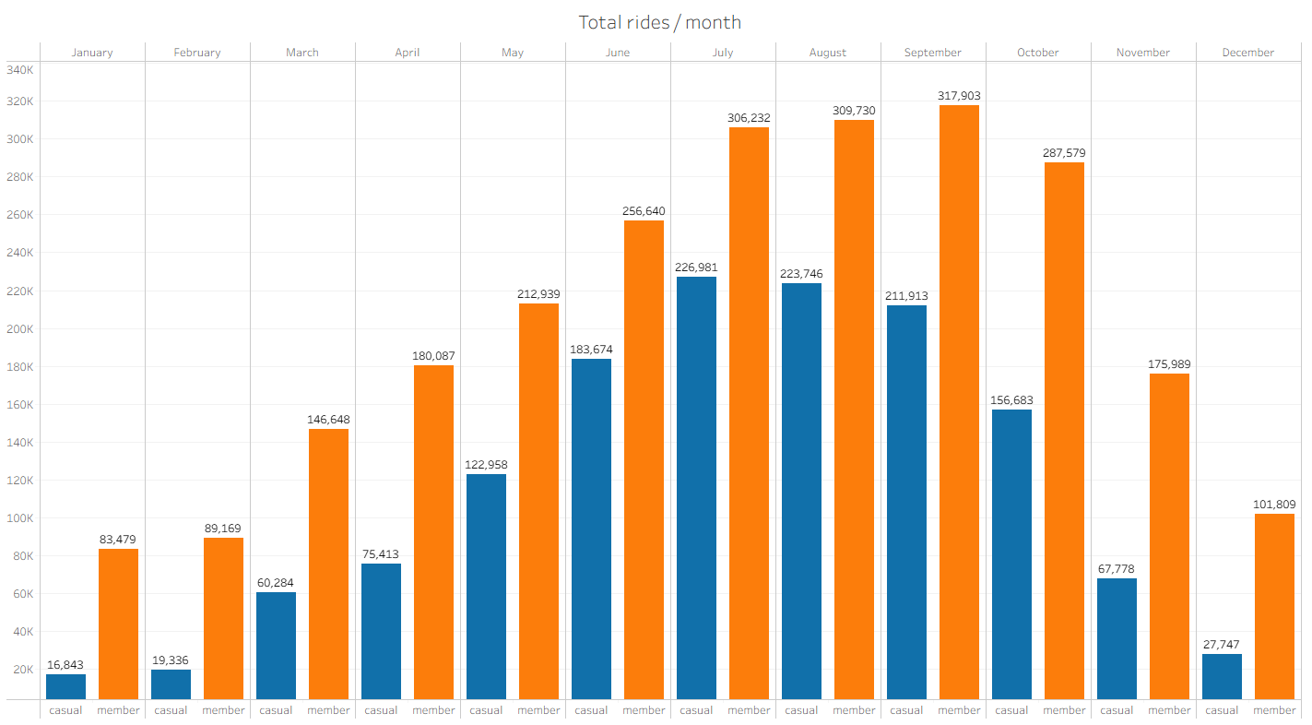
Number of rides per month
In general, members ride more than casuals.
Casuals: 1,393,356 (≈36%) rides.
Members: 2,468,204 (≈64%) rides.

Slide 5
Number of rides per month
Casuals: 1,393,356 (≈36%) rides.
Members: 2,468,204 (≈64%) rides.
≈64% of total rides happen in the period between June and Oct.

Slide 6
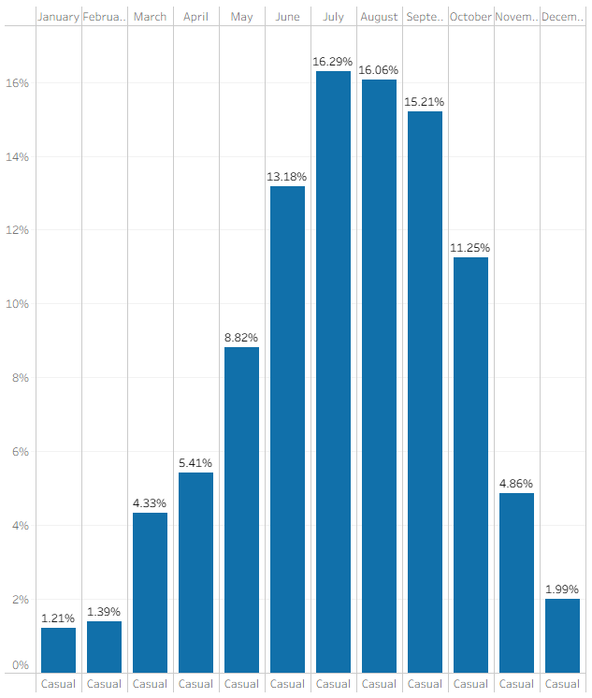
Focus: % of rides by casuals
in June - September
71.98% of trips by casuals are done in this June-Oct. period.
Preference for hot seasons: most casuals ride for leisure/tourism.

Slide 7
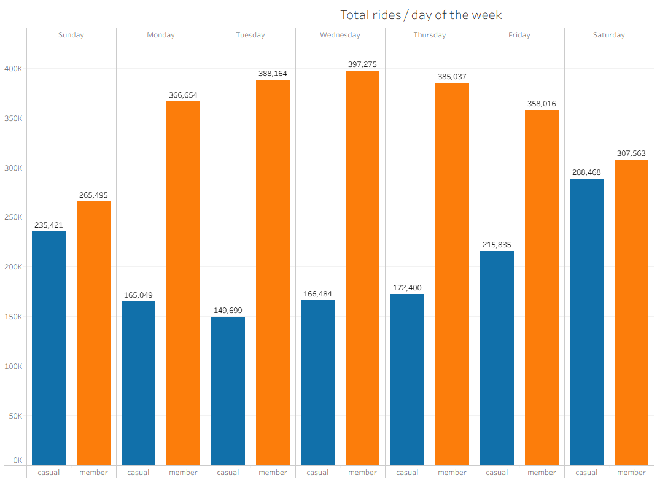
Number of rides per day of the week
Members ride more often during weekdays – commuters.
…while casual riders are more active on weekends – leisure/tourism.

Slide 8
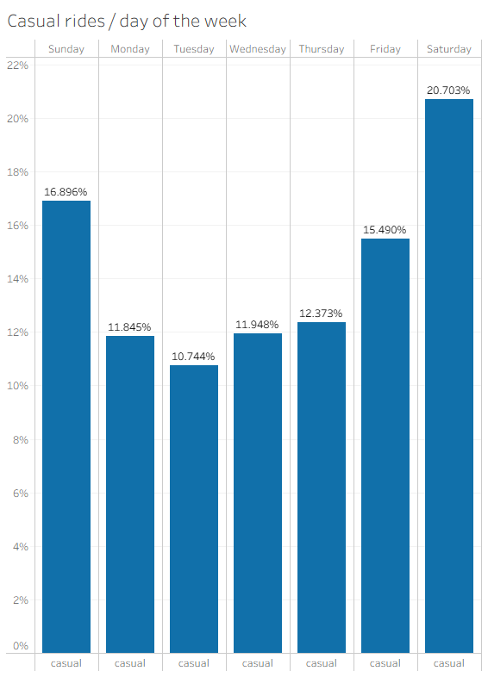
Focus: % of rides by casuals
per day of the week
≈37.5% of the trips by casuals are done during the weekend.
For members, this number is ≈23%.
More than half of the trips (≈53%) done by casuals happen on Friday, Saturday and Sunday.
≈38% for members.

Slide 9
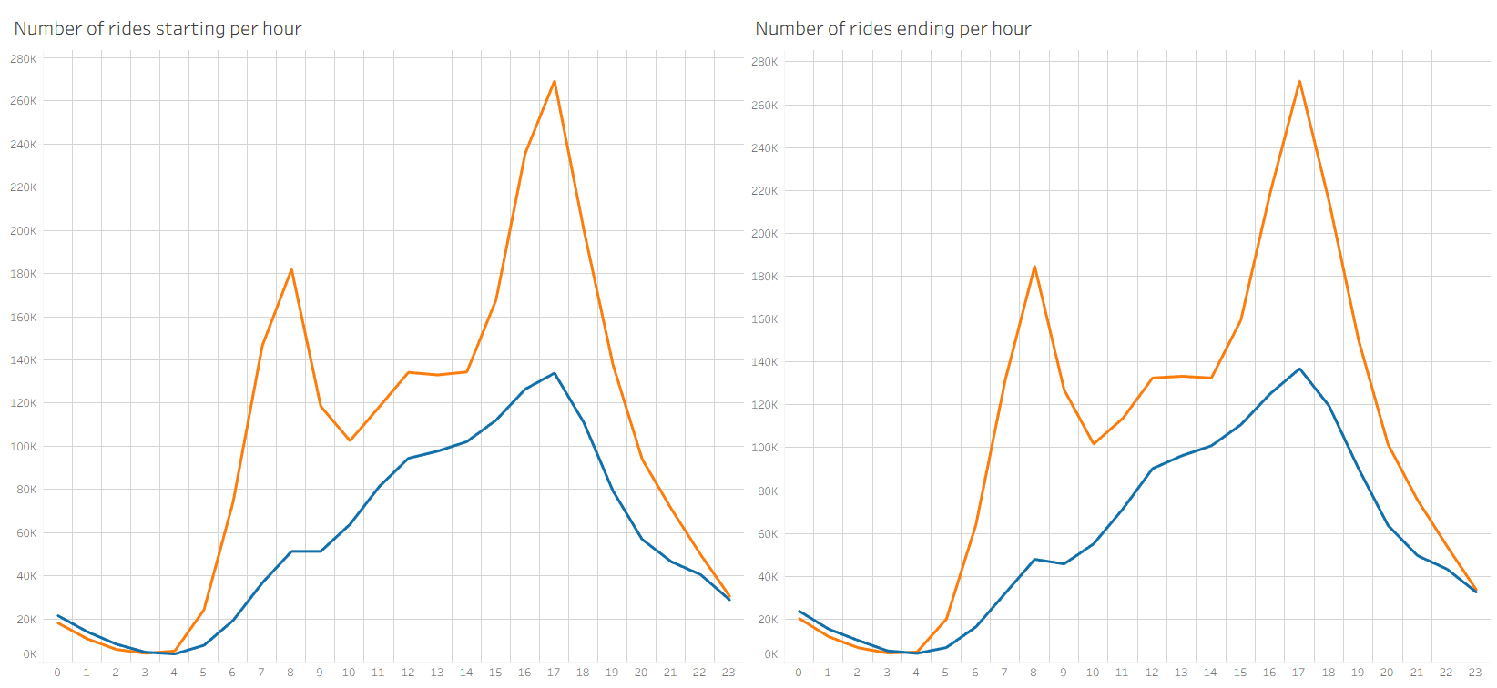
Number of rides starting/ending per hour
Members have a spike of rides starting and ending at 8 a.m...

Slide 10
Number of rides starting/ending per hour
Members have a spike of rides starting and ending at 8 a.m...
...while casual ridership is low in the morning, steadily increasing until peaking at 5 p.m.

Slide 11
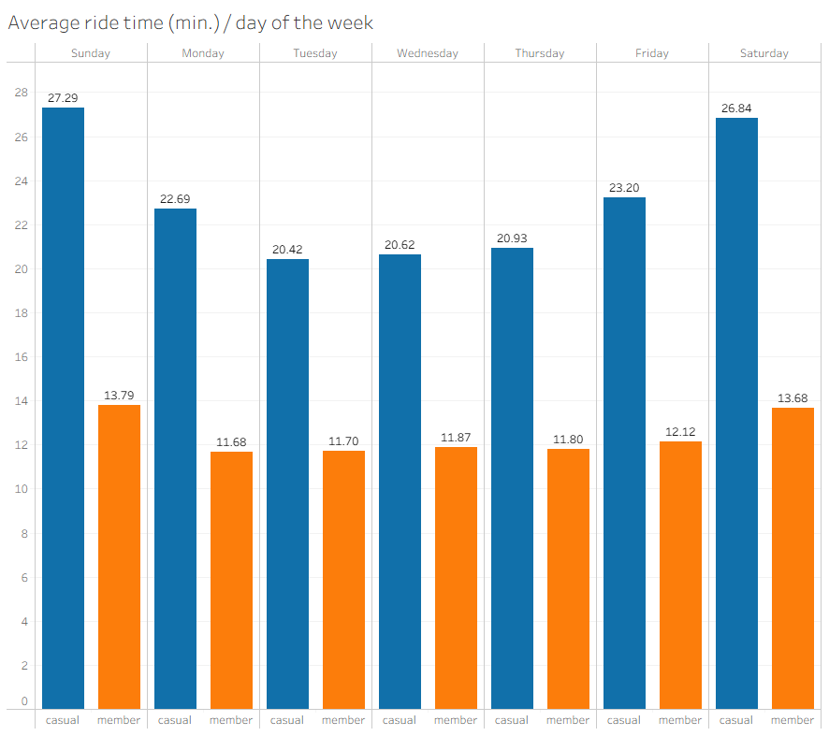
Average ride time per day of the week
Casuals take longer rides than members – especially on weekends.
Shorter rides indicate commuting behavior by members.
Longer rides may indicate cycling for sport/leisure.

Slide 12
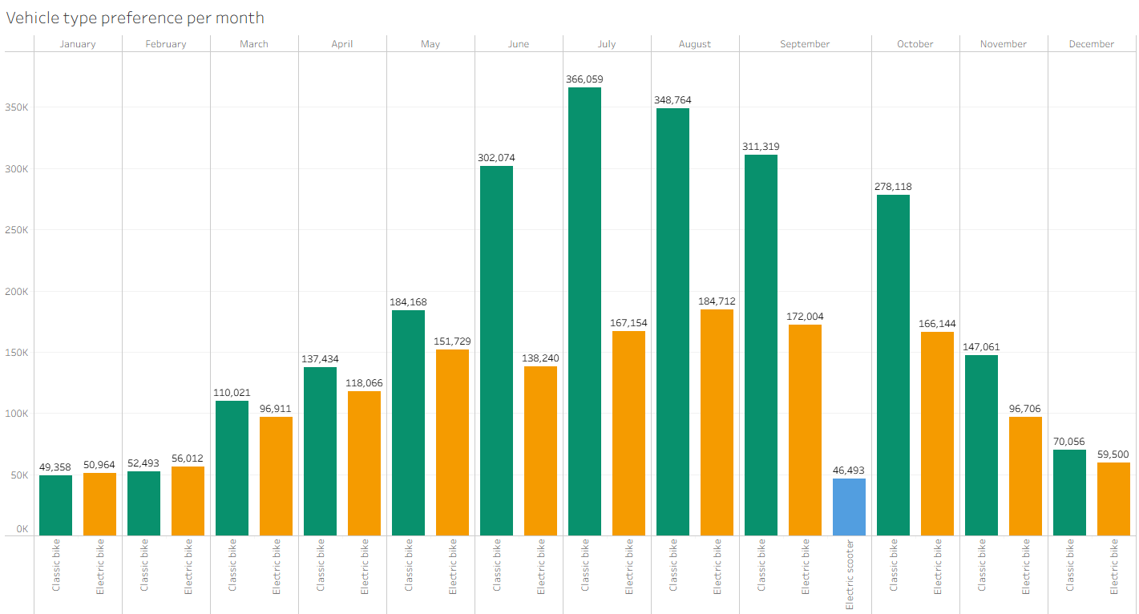
Number of rides per type of vehicle
Classic bikes are generally preferred over other types.

Slide 13
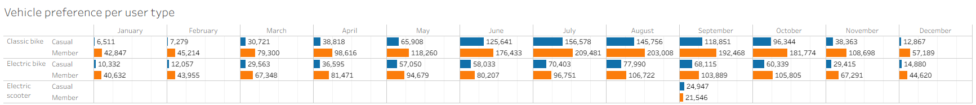
Vehicle type preference
Both casuals and members prefer classic bikes.

Slide 14
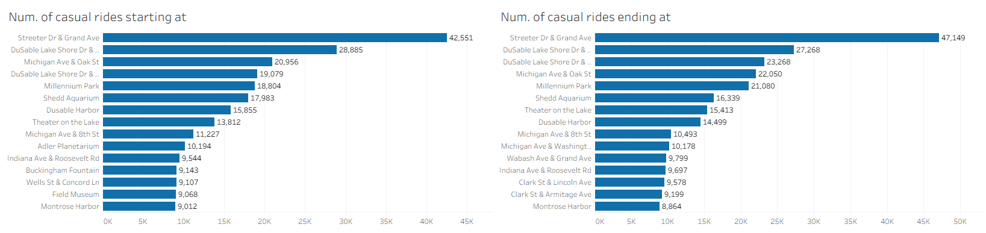
Station preference
Casuals start and end their rides in touristic or leisure spots.
Casual-preferred stations are named after the attractions that neighbor them.
These are located next to parks, hotels, malls, museums, and/or bodies of water.

Slide 15
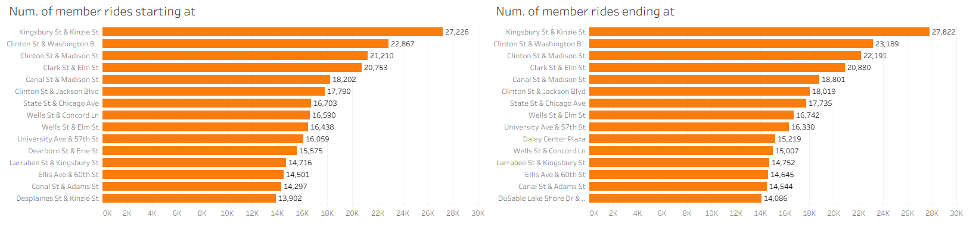
Station preference
Members’ rides are more spread out.
Very little overlap between the top 15 stations for casuals and the top 15 stations for members.
Stations named after intersections, mostly located in high-density mixed-use zoning areas, where apartment buildings are the norm.
This suggests that casuals use Cyclistic for everyday commuting.

Slide 17
Conclusions
 | Members | Casuals
Months | Majority of rides in June-Oct. period | Vast majority of rides in June-Oct. period
Days of the week | Preference for weekdays | Strong preference for weekends
Time | Spikes at 8 a.m. and 5 p.m. | Strong preference for afternoon
Avg. duration | Shorter average ride duration | Longer average ride duration
Vehicle preference | Classic bikes | Classic bikes
Station preference | High-density mixed-use neighborhoods | Touristic/leisure areas, waterfront
Result | Use Cyclistc bikes for everyday activities: work, shopping, study | Use Cyclistic bikes for tourism, leisure, sport

Slide 18
Suggestions
1. Concentrate marketing efforts from June to October
Most casual rides are done during in this period.
Allows for efficiency: reaching the highest number of casual riders while spending less resources.
In-app ads targeted at casuals should be sent around this timeframe.
Outdoor advertisements aiming for conversion should only be used in this period.

Slide 19
Suggestions
2. In-person marketing should be concentrated on specific spots
Company should place kiosks and staff in casual-preferred stations.
To further reduce costs without presumably sacrificing a great deal of efficiency, the company can elect to only do so during the weekend.

Slide 20
Suggestions
3. Offer discounts on memberships at the start of summer
Offer a discounted annual membership to those who sign up during May or June.
This discount could be a 1, 2 or 3-month free trial period, incentivizing casual users to commit to an annual plan without upfront financial pressure.
By experiencing the reduced costs and convenience of membership during the most active months, the newly-converted members are more likely to retain their membership.

Slide 21
Suggestions
Concentrate marketing efforts from June to October
In-person marketing should be concentrated on specific spots
Offer discounts on memberships at the start of summer

Slide 22
Thank you!
Email: ferreiraaraujoluan@gmail.com
LinkedIn: https://www.linkedin.com/in/luanfaraujo/

