Slide 1
SCHOOL MANAGEMENT SYSTEM
GROUP:
Faculty:
530
Miss. Thu Hien Nguyen Thi

Slide 2









Department
Position
Staff
Mark
Extra
Curricular
Batch
Student
Subject

Slide 3






DISADVANCE
Time wasting
Difficult
Not exactly
Difficulty in backup
Insecure

Slide 4


COMPUTERIZATIPON
BENEFITS
Faster
Easier
More exact.
Saver
Easy to backup and move

Slide 5



USERS OF SYSTEM
STAFF MANAGER
ADMIN
STUDENT MANAGER

Slide 6
ADMINSTRATOR
FUNCTIONS
Login, Logout, Change their account infomation
Manage User account

Slide 7
STAFF MANAGER
FUNCTIONS
Login, Logout, Change their account infomation
Manage Staf
Manage Department
Manage Position

Slide 8
STUDENT MANAGER
FUNCTIONS
Login, Logout, Change their account infomation
Manage Student
Manage Batch
Manage Subject
Manage Mark
Manage Extra Curricular

Slide 9
Architecture & Design of Project

Slide 10
DATA FLOW DIAGRAM

Slide 11
DFD LEVEL 0

Slide 12
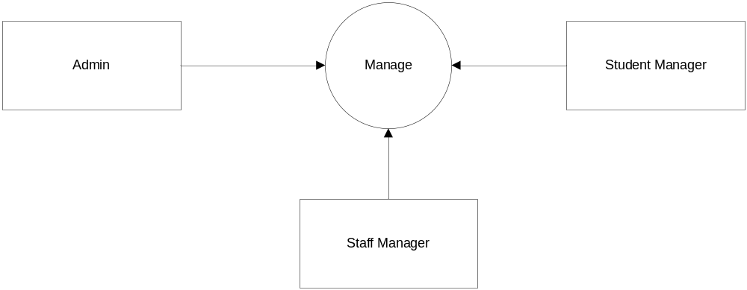

Slide 13
DFD LEVEL 1

Slide 14
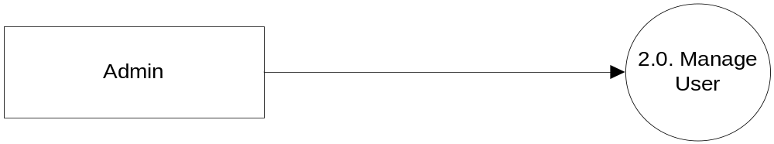
ADMIN

Slide 15
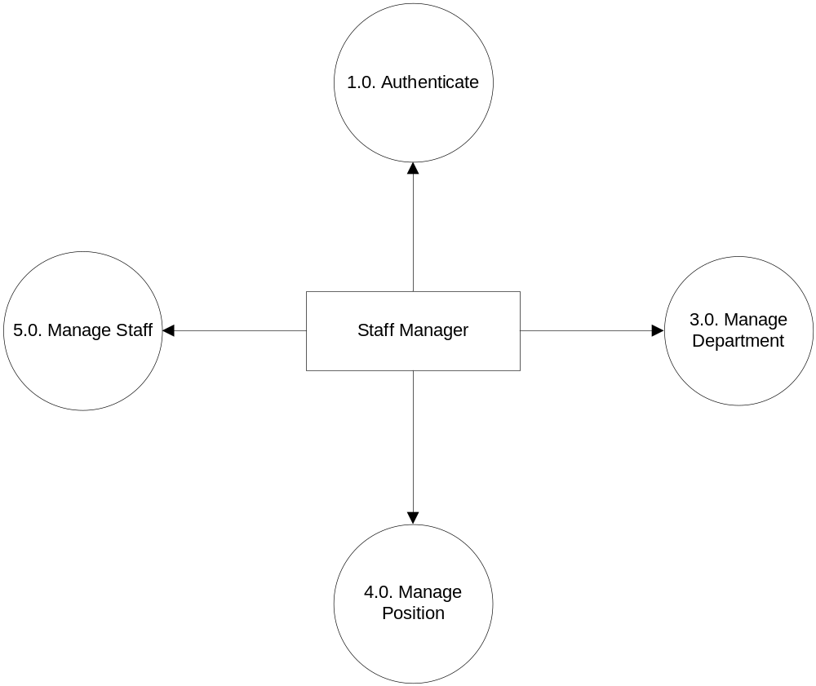
STAFF MANAGER

Slide 16
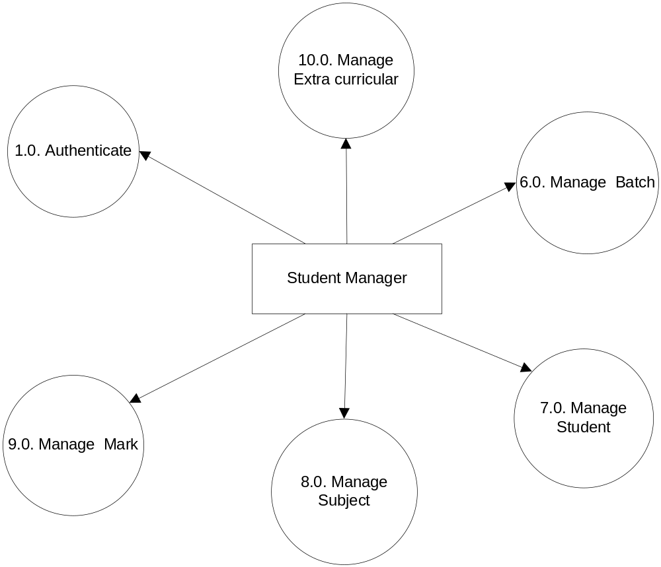
STUDENT MANAGER

Slide 17
DFD LEVEL 2

Slide 18
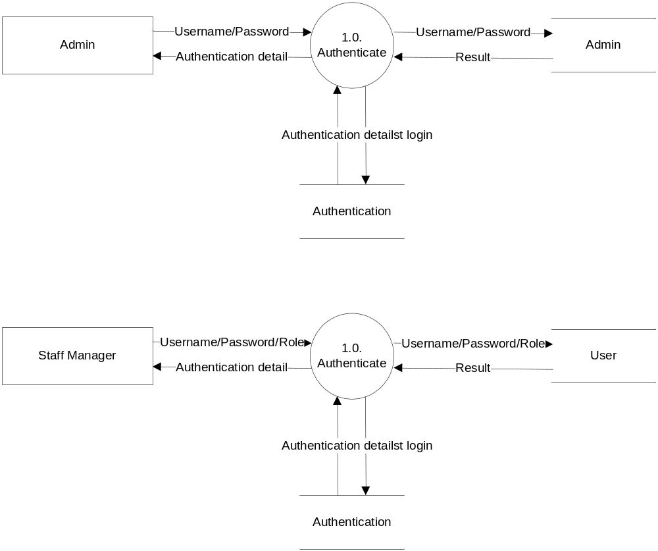
1. AUTHENTICATION

Slide 19
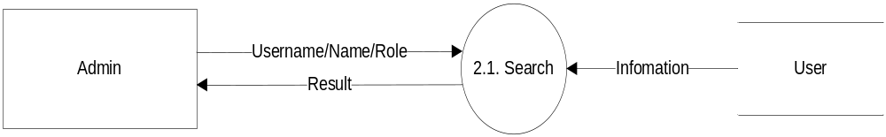
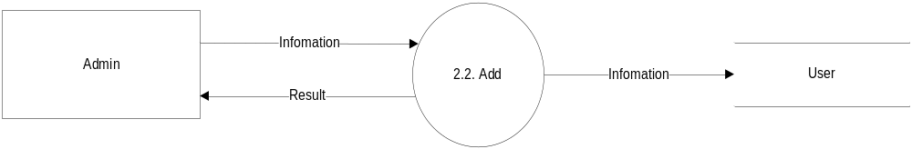
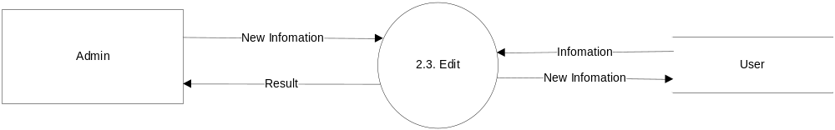
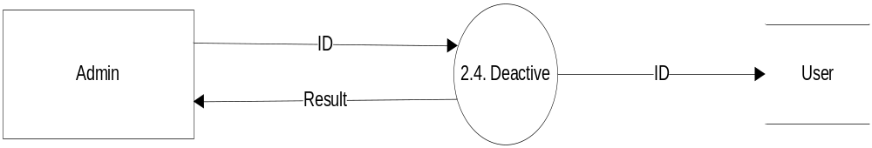
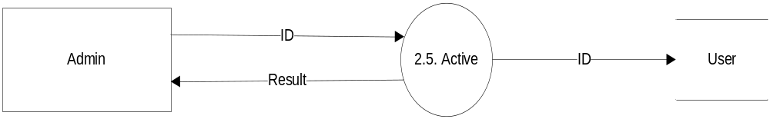
2. Manage User Account

Slide 20
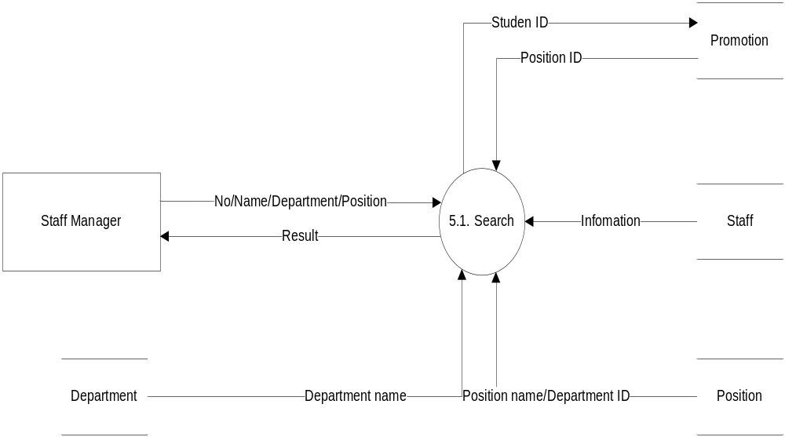
5. MANAGE STAFF

Slide 21
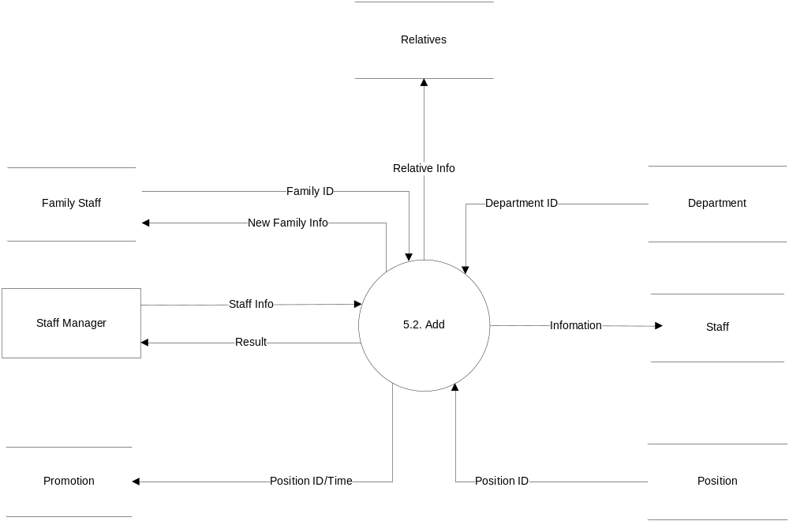
5. MANAGE STAFF

Slide 22
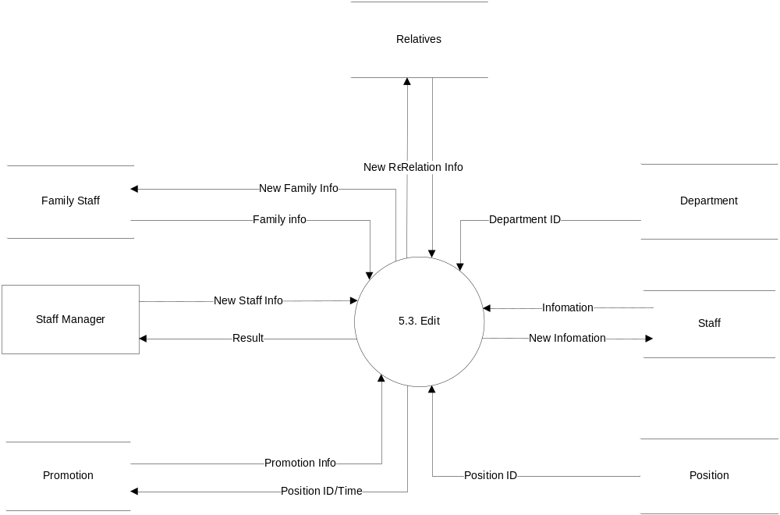
5. MANAGE STAFF

Slide 23
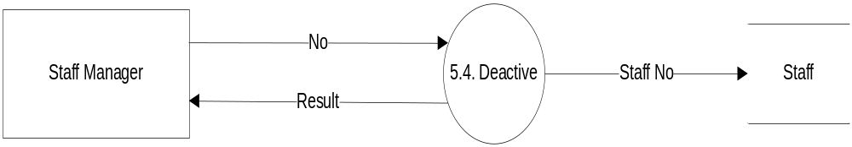
5. MANAGE STAFF

Slide 24
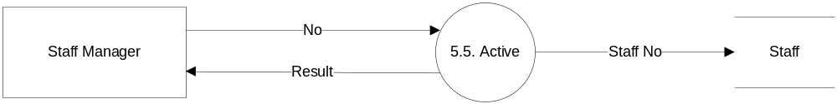
5. MANAGE STAFF

Slide 25
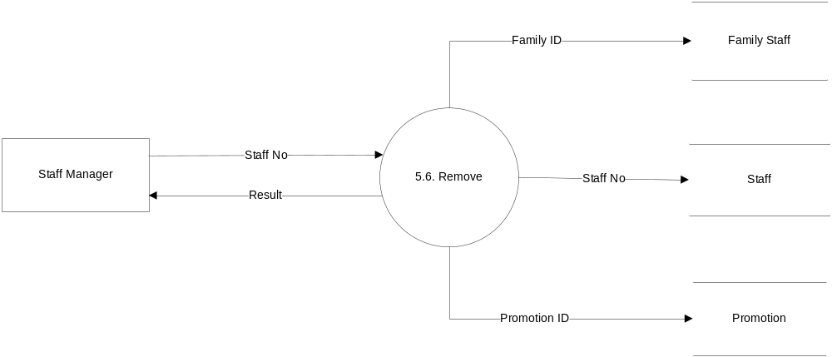
5. MANAGE STAFF

Slide 26
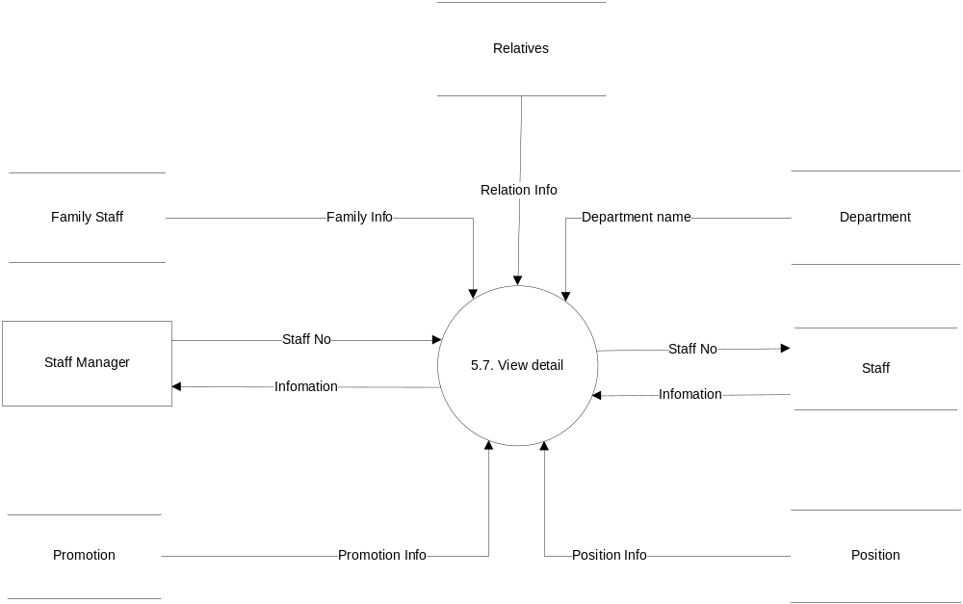
5. MANAGE STAFF

Slide 27
ENTITY RELATIONSHIP DIAGRAM

Slide 28
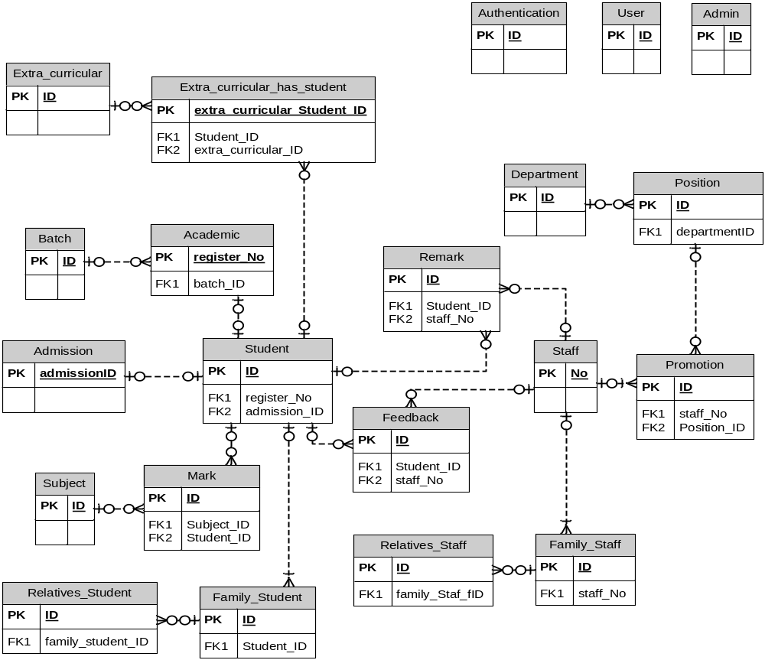
ENTITY RELATIONSHIP DIAGRAM

Slide 29
TABLE DIAGRAM

Slide 30
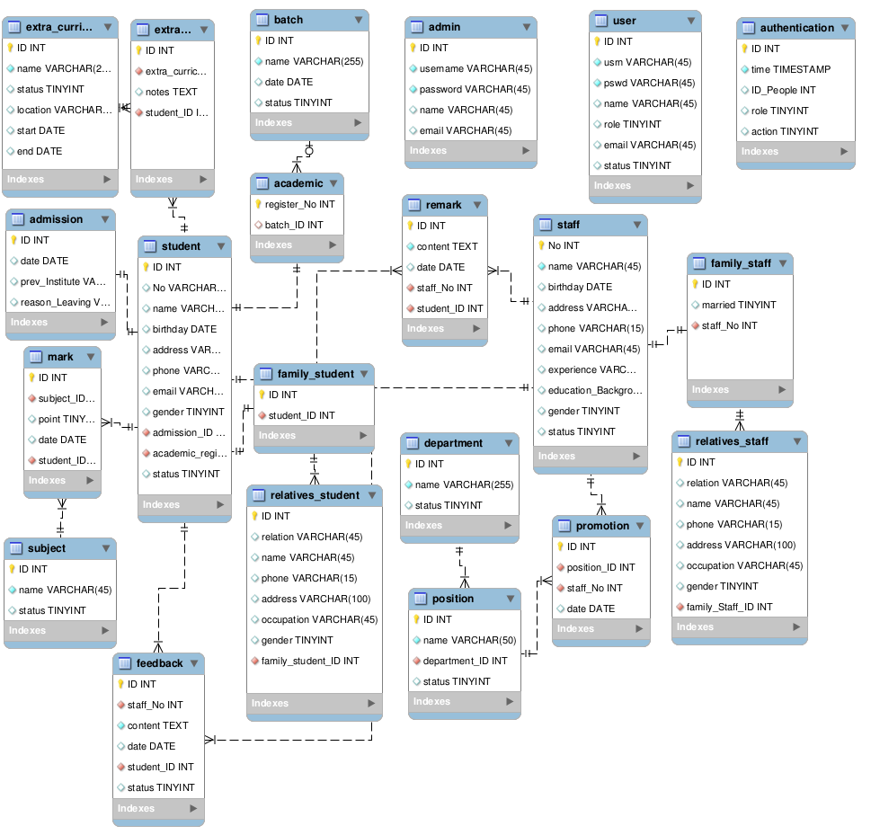
TABLE DIAGRAM

Slide 31

CHÂN THÀNH CẢM ƠN!

