Slide 1
CPE4400
Luanne Seaman and Dr. Kihei

Slide 2
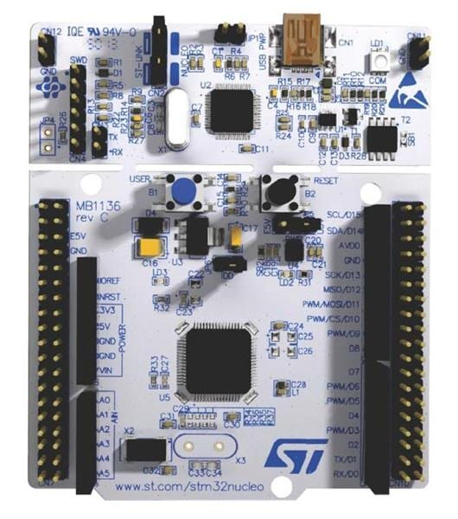
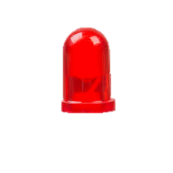
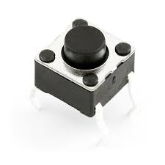
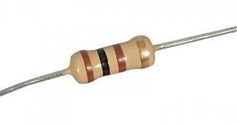
Delay Button Game
This uses buttons to simulate the Arduinos.
PB6 and PA4 are pulled down internally.
This is to verify that PB6 and PA4 are configured correctly.
PC10 is configured as a static output (voltage source for the buttons)
PC10
D10 (PB6)
A2 (PA4)
Press Red Button
Then Press Blue Button
IDE Console Displays the delay in microseconds and milliseconds.
Systick is configured for 1us
3.3V
10k
2.2k
10k
2.2k
GND

Slide 3
Delay Button Game (main code)
We do not use interrupts.
while(1){
if(theSTATE==STDBY){
if((GPIOB->IDR & GPIO_IDR_ID6)==GPIO_IDR_ID6){
theSTATE=USER_BUTTON_FIRST_TIME;
button1ticks=usTicks;
}
}
if(theSTATE==USER_BUTTON_FIRST_TIME){
if((GPIOA->IDR & GPIO_IDR_ID4)==GPIO_IDR_ID4){
delay=usTicks-button1ticks;
if (delay>1){
printf("Delay: %lu us\n",delay);
printf("Delay: %lu ms\n",delay/1000);
}
theSTATE=STDBY;
}
}
}

Slide 4
Next is the actual calibration setup with two arduinos (A1 and A2)
PB6 and PA4 are no pull up no pull down (the Arduinos will set pin low and high).
This is to calibrate our delay logic.
PC10 does not matter anymore.

Slide 5
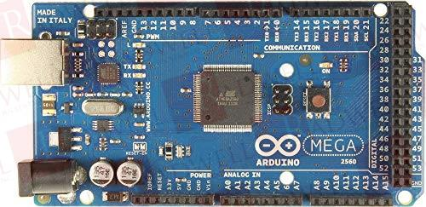
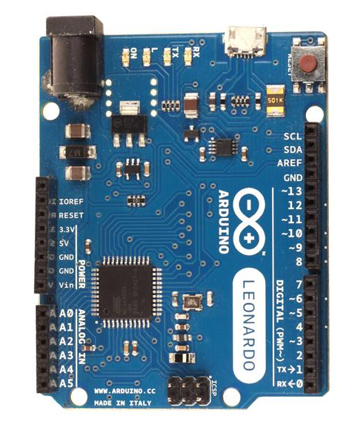
Arduino 2
PC10
D10 (PB6)
A2 (PA4)
Arduino 1
3.3V
10k
2.2k
10k
2.2k
GND

Slide 6
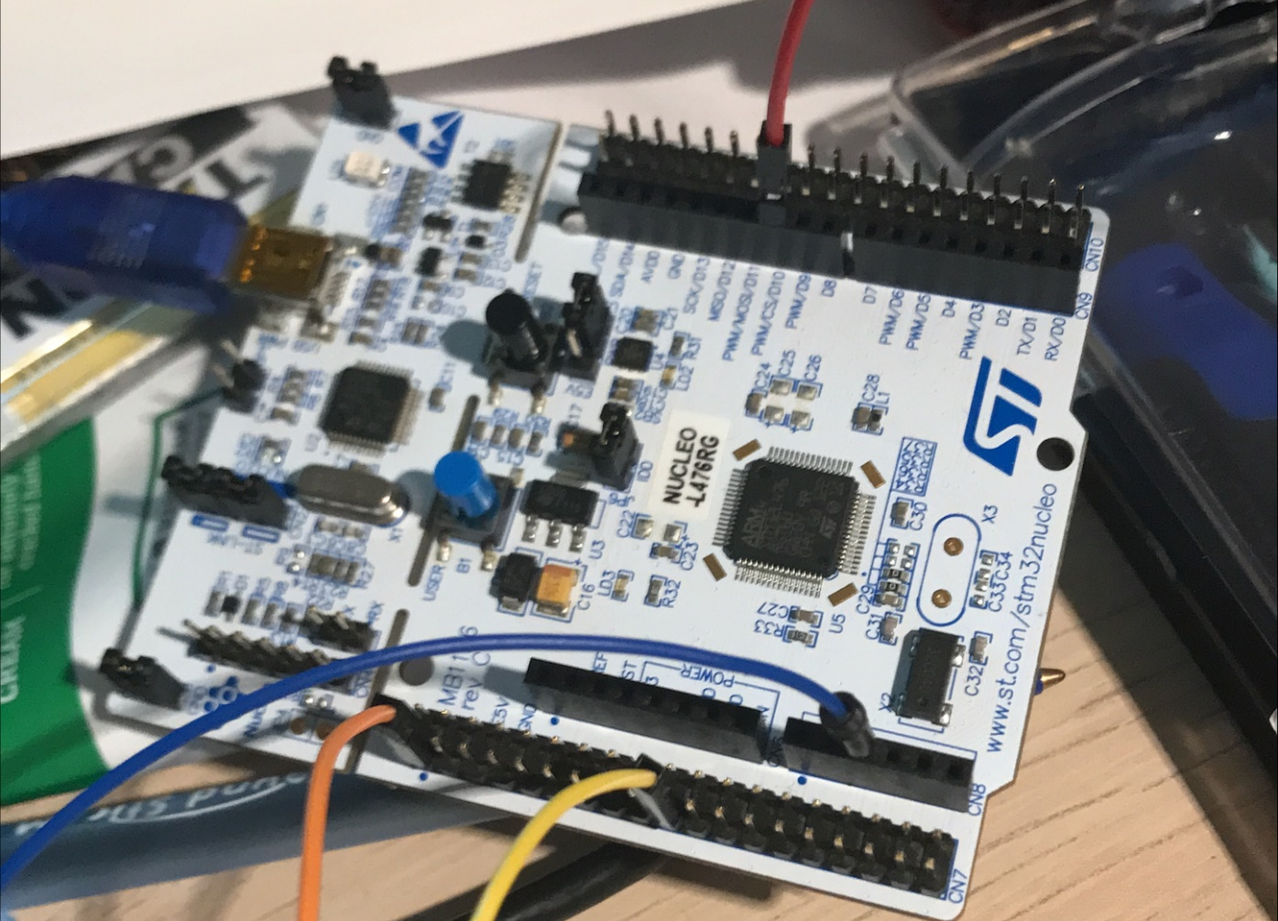
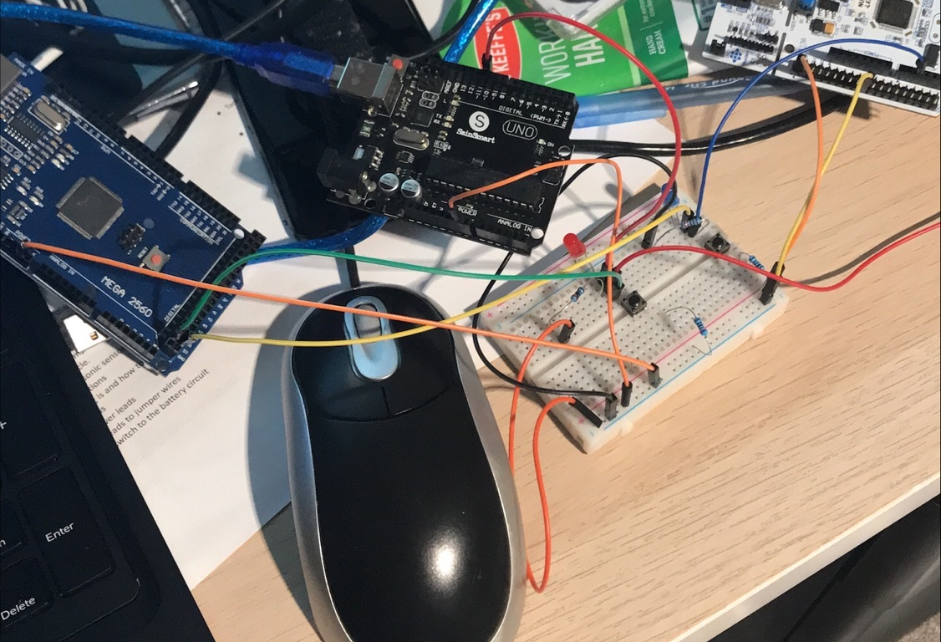
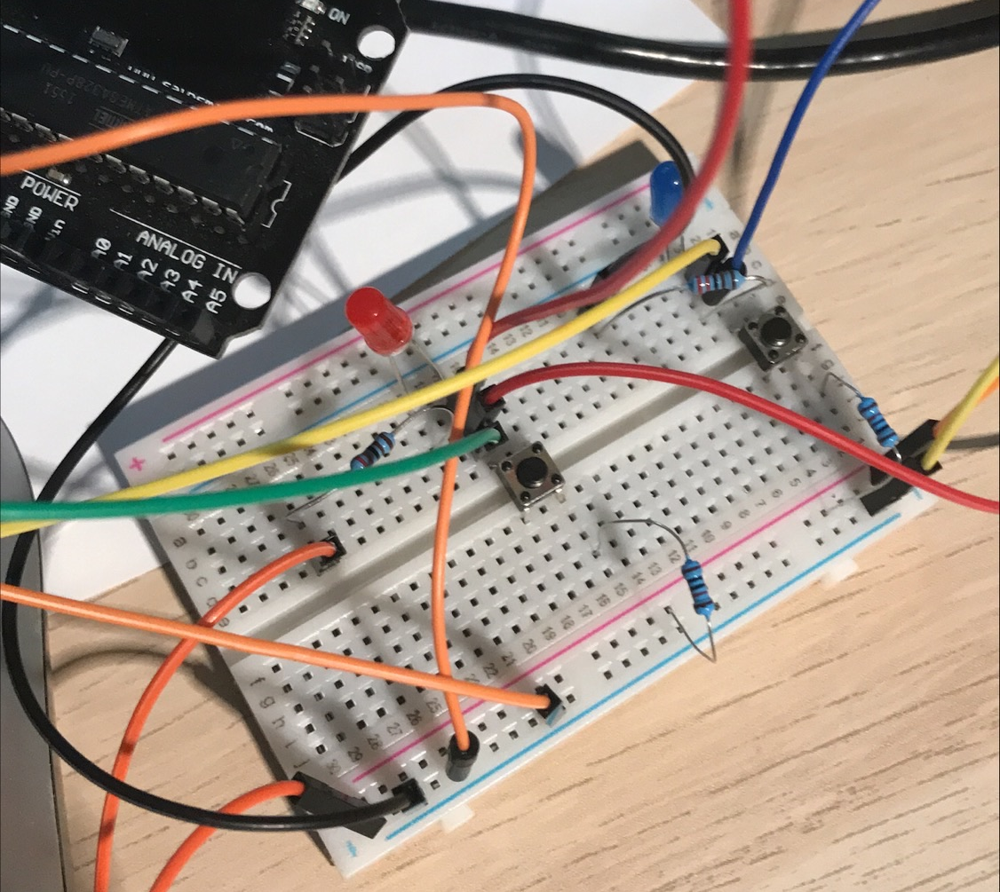

Slide 7
Arduino 1
Arduino 2
const int pinLED = 53;
void setup() {
pinMode(pinLED,OUTPUT);
}
void loop() {
digitalWrite(pinLED,HIGH);
delay(500);
digitalWrite(pinLED,LOW);
delay(500);
}
//set up interrupt receiver for Arduino MEGA 2560
int input_pin = 52; //initialize pins
int output_pin = 53;
int val=0;
void setup() {
pinMode(input_pin, INPUT);
pinMode(output_pin, OUTPUT);
}
void loop() {
val=digitalRead(input_pin);
//delayMicroseconds(1000); //delay us
delay(100); //delay ms
digitalWrite(output_pin, val);
}

Slide 8
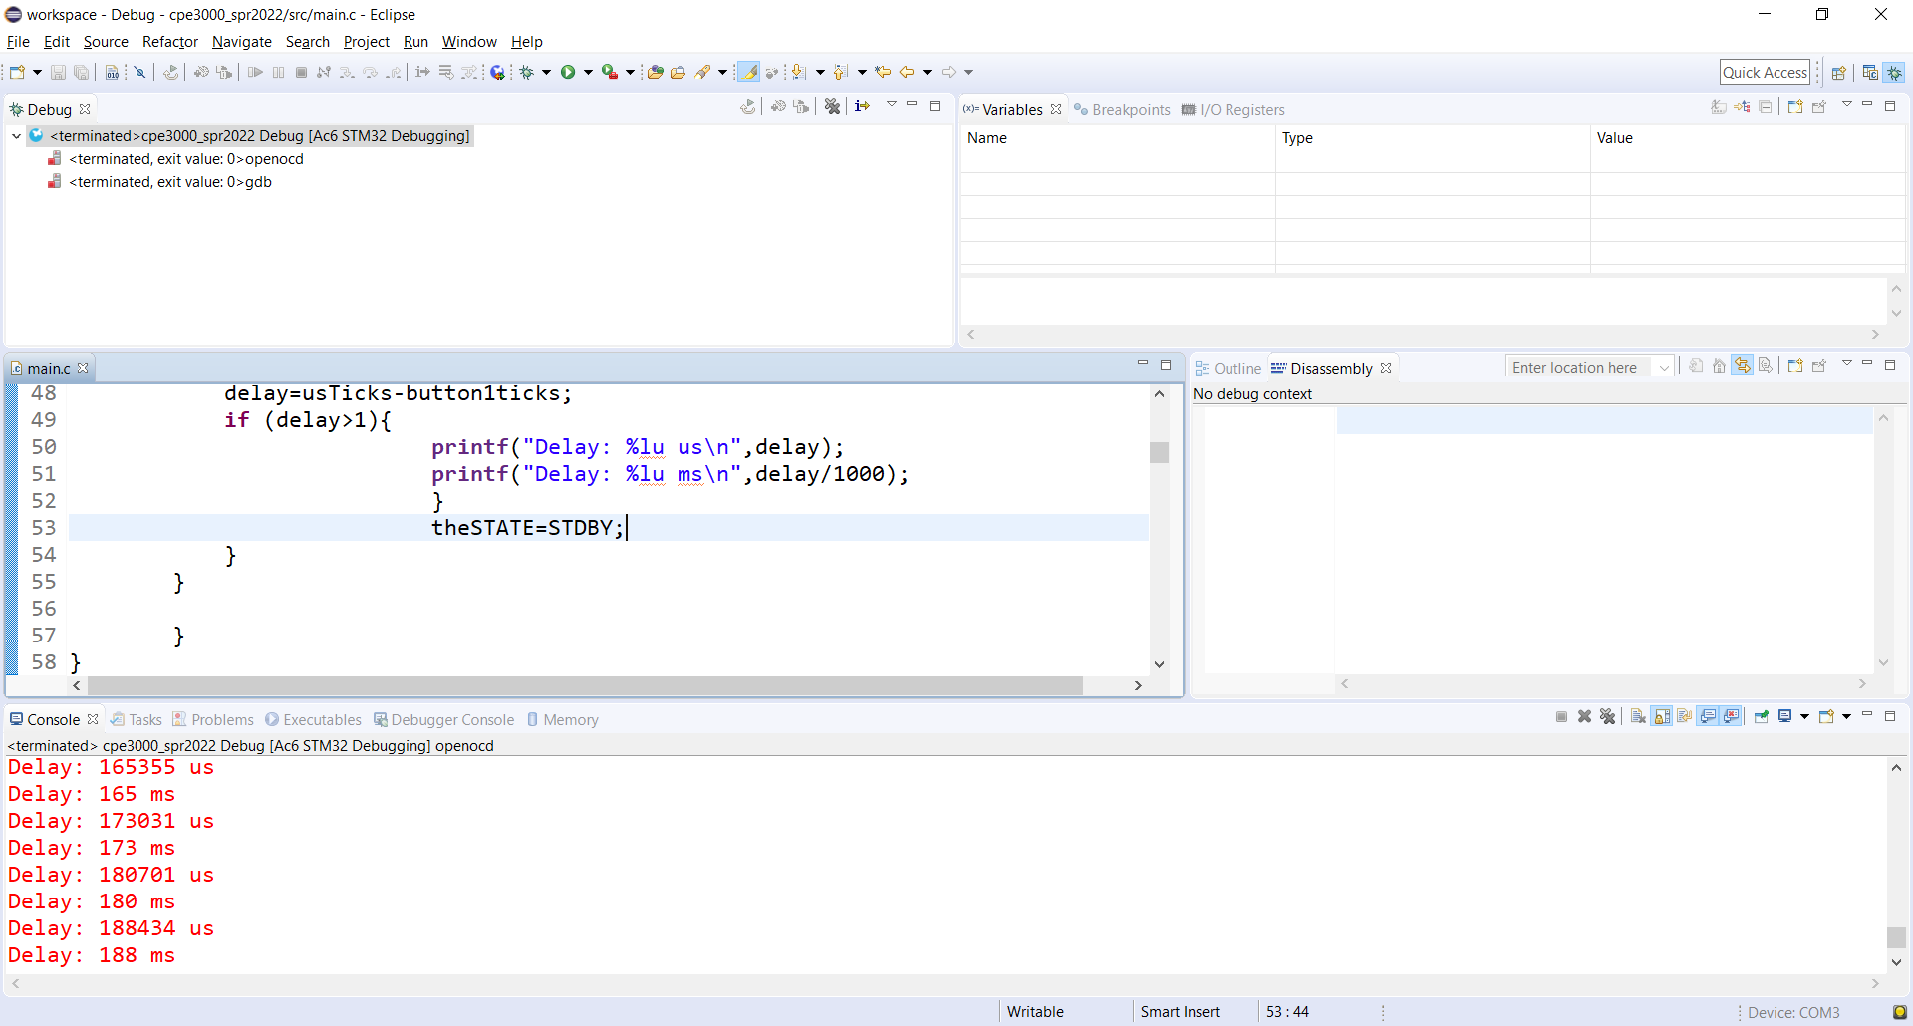
The output is correct, though not accurate.

