Slide 1
You work for a pharmaceutical company. Traditionally, you use Oracle Clinical to store data from clinical trials of new drugs.
They recently hired a new CIO (Chief Information Officer). She has mandated that all studies will use Mongo & python going forward.

Slide 2
Eventually, the study data will be submitted to the FDA (Food and Drug Administration, fda.gov) for approval.
To accomplish this, all pharmaceutical companies must use a standard format/schema.
CDISC = clinical data interchange standards consortium; see cdisc.org.
Clinical Data Acquisition Standards Harmonization (CDASH)
Study Data Tabulation Model (SDTM)

Slide 3
Collections
From the SDTM, we’ll need the following collections:
DM (demographics)
CO (comments)
SV (subject visits)
Only support those elements that are highlighted in yellow.

Slide 4
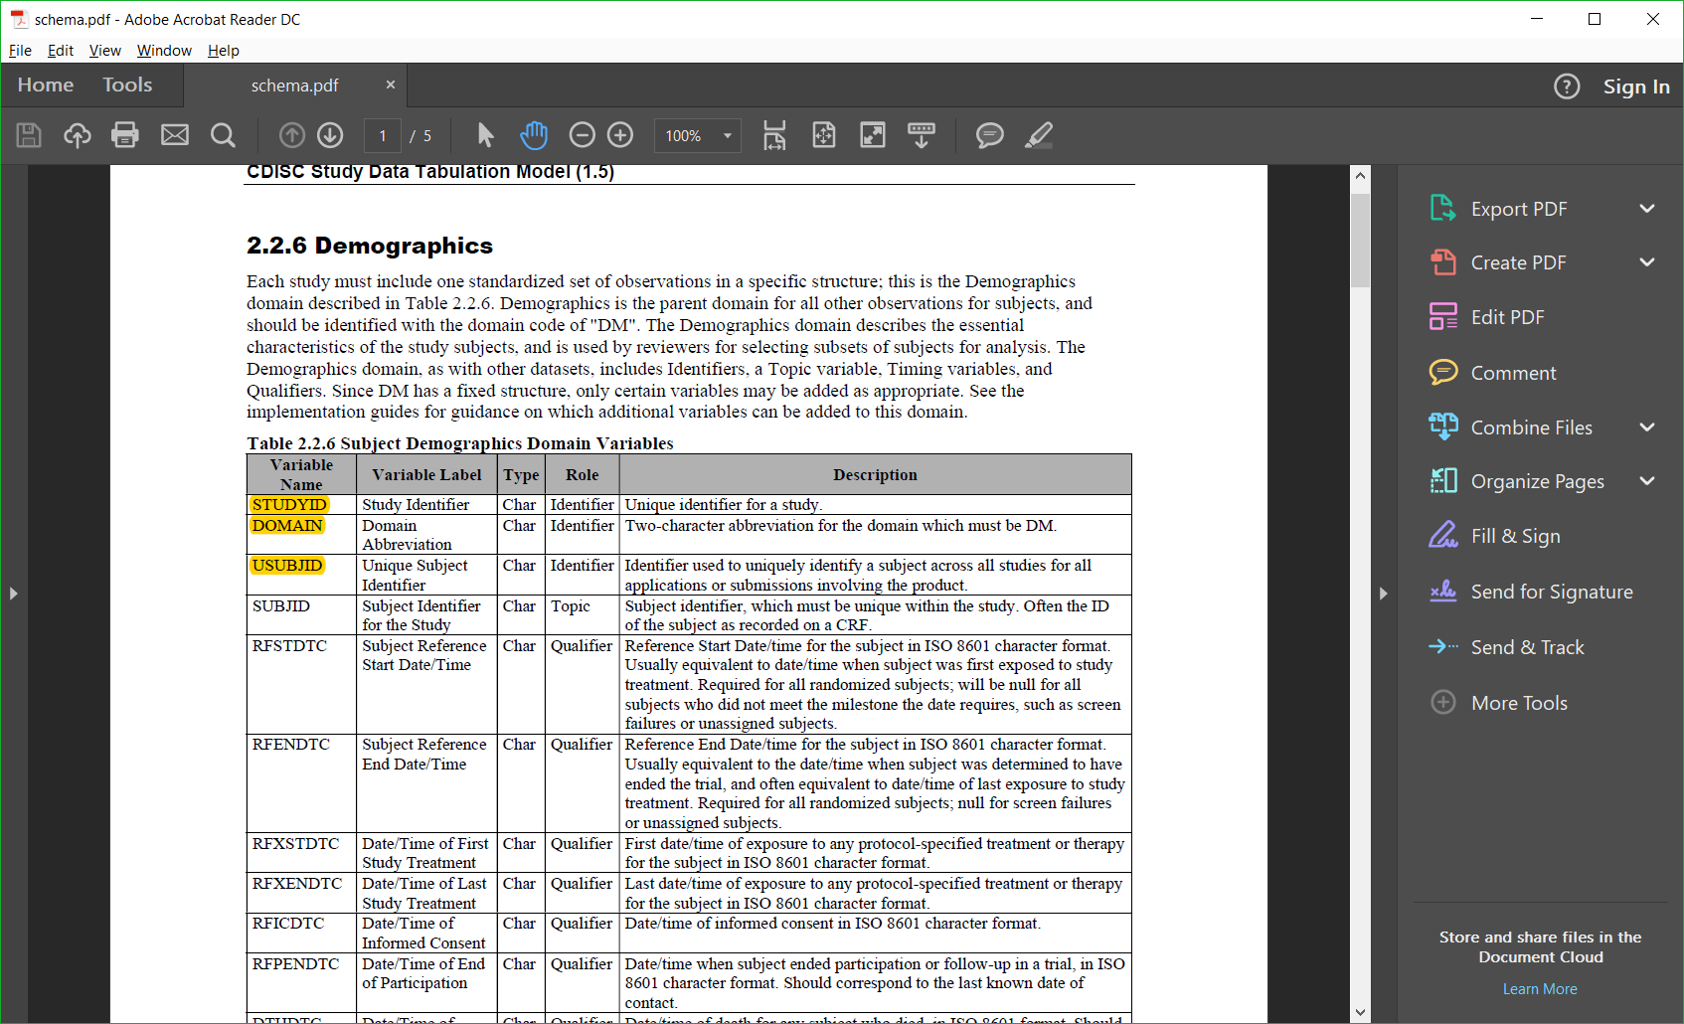

Slide 5
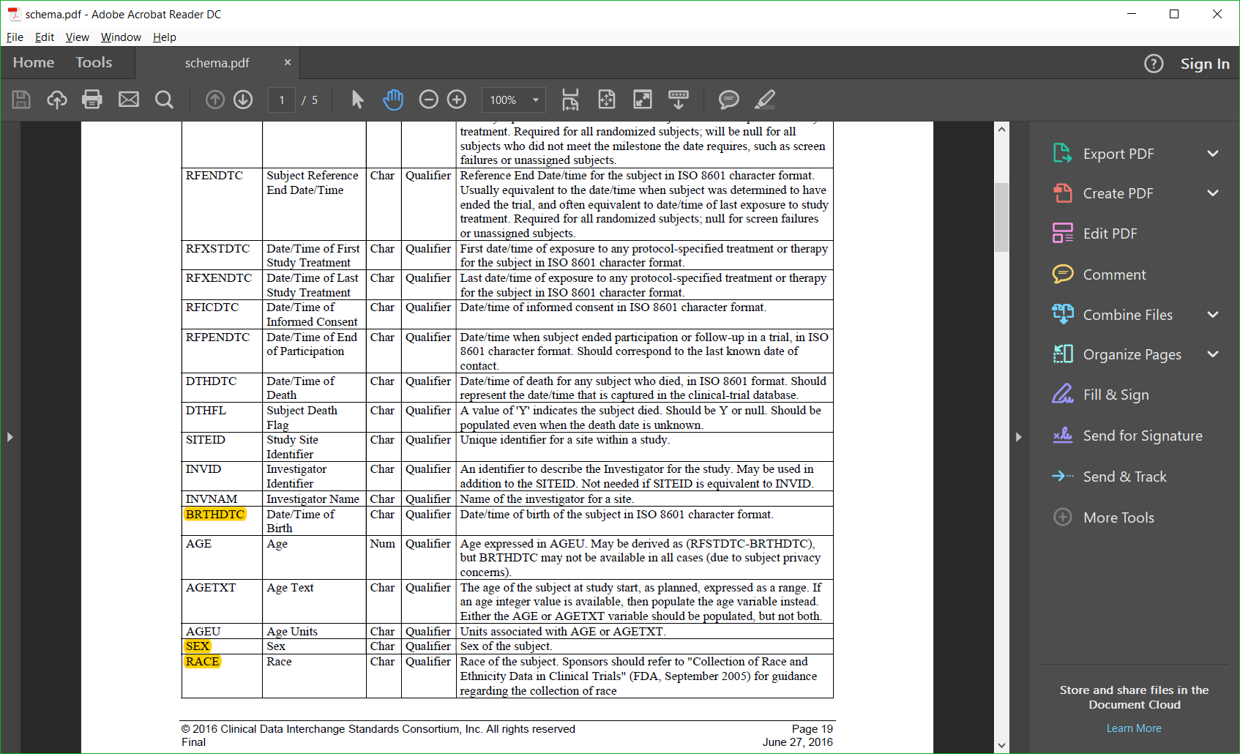

Slide 6
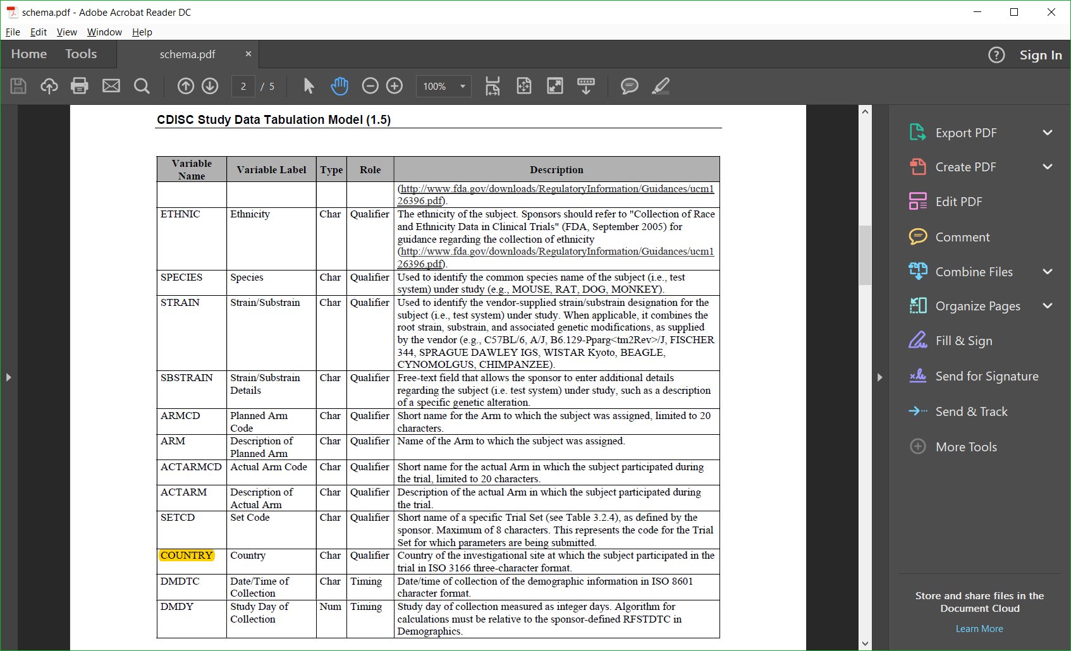

Slide 7
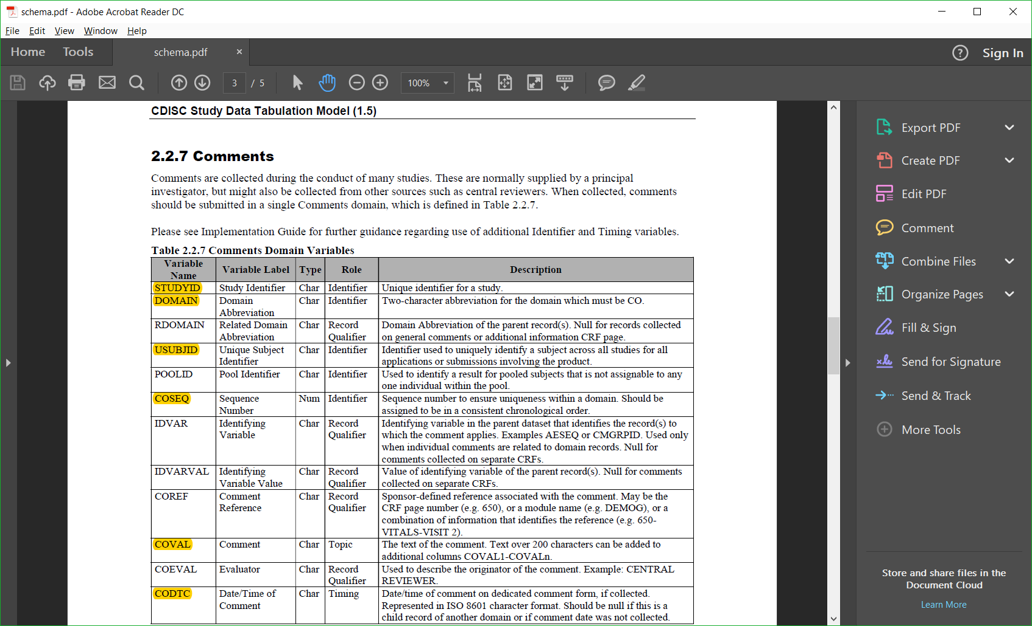
Ignore 200 char limitation for COVAL.

Slide 8
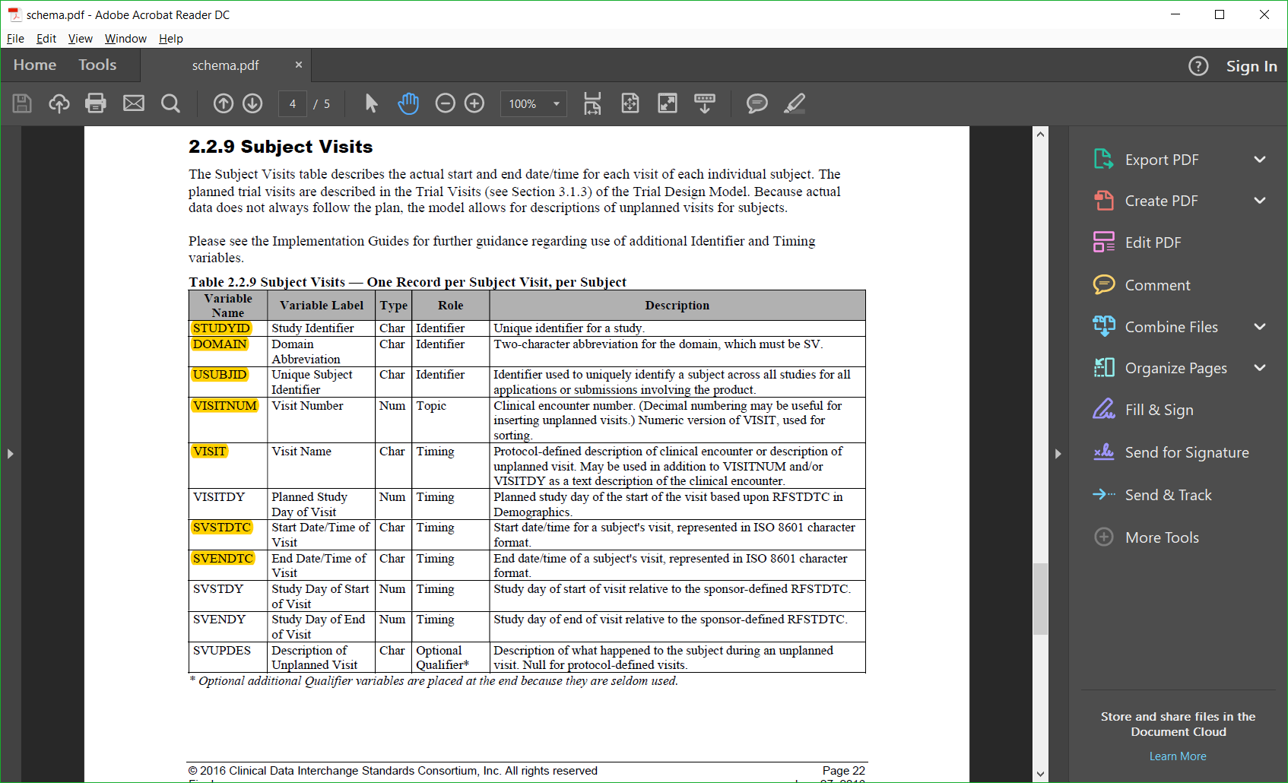

Slide 9
Assignment
Using python and mongo, create a web interface that provides:
A study page (studyA.py) that lists all of the subjects (one per line) in the database.
A page (addB.py) that allows the user to add a new subject.
A subject page (subjectC.py) that lists all of the subject information from DM (demographics) for one subject.
A comment page (commentD.py) that lists all of the CO information for a particular subject.
A subject visit page (visitE.py) that lists all of the SV information for a particular subject.
Note: A-E are five different random six-digit numbers that you should generate that are part of the file names for your python programs.

Slide 10
Assignment (cont’d.)
Using python and mongo, create a web interface that provides:
1. A study page (studyA.py) that lists all of the subjects (one per line) in the database.
Each line should be a link to an individual subject (subjectC.py).
Limit the number of subjects displayed per web page (say n=10, but make it a variable in your code).
Provide next and prev(ious) buttons at the top, if n is exceeded.
Provide a link to a page (addB.py) that allows one to enter a new subject.
Of course you will also use HTML. You may also use CSS, JavaScript and/or Ajax if you wish (but no PHP or SQL).
Anchors should not have any underlines.

Slide 11
Assignment (cont’d.)
Using python and mongo, create a web interface that provides:
2. An add subject page (addB.py) that allows one to add one subject to the database.
Of course you will also use HTML. You may also use CSS, JavaScript and/or Ajax if you wish (but no PHP or SQL).
Anchors should not have any underlines.

Slide 12
Assignment (cont’d.)
Using python and mongo, create a web interface that provides:
3. A subject page (subjectC.py) that lists all of the subject information from DM (demographics) for one subject.
The page should also contain a link to CO (comments) for this subject.
The page should also contain a link to SV (study visits) for this subject.
Provide a mechanism on this page to update and save DM information for this subject.
Provide a mechanism on this page to delete this subject from the database.
This delete should “cascade” (meaning that is should also delete CO and SV information for this subject as well).
Of course you will also use HTML. You may also use CSS, JavaScript and/or Ajax if you wish (but no PHP or SQL).
Anchors should not have any underlines.

Slide 13
Assignment (cont’d.)
Using python and mongo, create a web interface that provides:
4. A comment page (commentD.py) that lists all of the comment information from CO (comments) for one subject.
Limit the number of comments displayed per web page (say n=10, but make it a variable in your code).
Provide a mechanism on this page to add and save a new comment for this subject.
Of course you will also use HTML. You may also use CSS, JavaScript and/or Ajax if you wish (but no PHP or SQL).
Anchors should not have any underlines.

Slide 14
Assignment (cont’d.)
Using python and mongo, create a web interface that provides:
5. A subject visit page (visitE.py) that lists all of the visit information from SV (subject visits) for one subject.
Limit the number of visits displayed per web page (say n=10, but make it a variable in your code).
Provide a mechanism on this page to add and save a new visit for this subject.
Of course you will also use HTML. You may also use CSS, JavaScript and/or Ajax if you wish (but no PHP or SQL).
Anchors should not have any underlines.

Slide 15
Assignment (cont’d.)
Additionally, provide the following:
Provide a delete page (deleteF.py) that deletes all documents in all collections.
Provide an insert page (insertG.py) that populates all of the collections with documents.
It should insert at least 12 subject, 18 comments, and 20 visits.
anything you wish
use it to exercise your code

Slide 16
Assignment (cont’d.)
That’s a total of 7 different web pages:
studyA.py
addB.py
subjectC.py
commentD.py
visitE.py
deleteF.py
insertG.py

