Slide 1
Task 2 VerVeBridge DATA ANALYtics INTERNSHIP - By ANSHIKA SINGH

Slide 2
Project- big Game CENSUS Data Visualisation
Data Cleaning – Excel
Analysis and Visualization – Power BI
The goal of this dashboard is to provide insights into player characteristics such as birthplaces, age distribution, and positions for better game strategy analysis.
The data was cleaned by removing missing values, handling numeric and categorical values using means and modes, and removing duplicates.

Slide 3

DASHBOARD

Slide 4
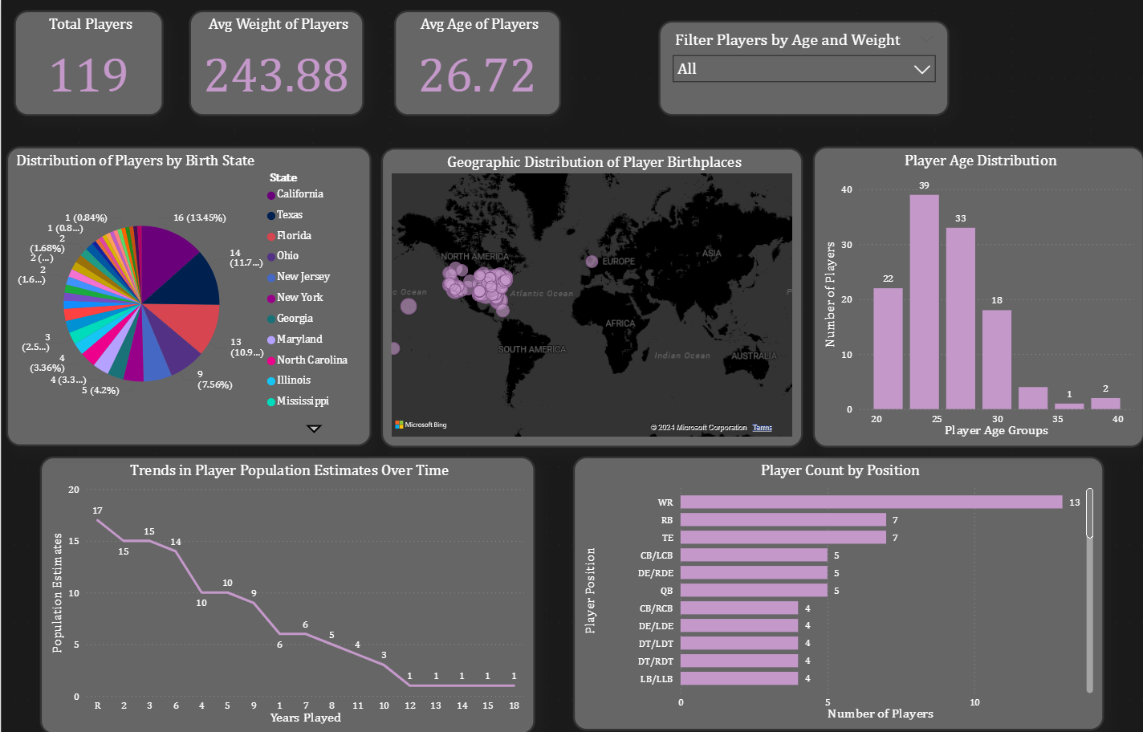

Slide 5
Insights

Slide 6
Visualization: Cards displaying total player count, average player weight, and average player age.
Insights:
There are 119 players in total, with an average weight of 243.88 lbs and an average age of 26.72 years.
These statistics provide a quick snapshot of key metrics, helping teams understand general player characteristics at a glance.
Visualization: Pie chart displaying the distribution of players based on their birth state.
Insights:
The majority of players come from California (13.45%), followed by Texas (11.7%) and Florida (9.66%).
These states are critical player talent pools, which could indicate geographic advantages or stronger development programs.

Slide 7
Visualization: Line chart displaying player population trends based on the number of years played.
Insights:
1. The number of players decreases sharply after the 3rd year of play, reflecting possible burnout, injuries, or other factors leading to career shifts.
2. By the 10th year of play, only a handful of players remain active.
Visualization: Bar chart showing the number of players by position.
Insights:
1. Wide receivers (WR) dominate the dataset, with 13 players, followed by running backs (RB) and tight ends (TE).
2. Defensive ends and linebackers (LB) are underrepresented, possibly indicating greater competition for certain positions.

Slide 8
Visualization: Histogram displaying the distribution of players across different age groups.
Insights:
1. Players between 25 and 29 years old form the largest age group (39 players), indicating that teams rely heavily on mid-career athletes.
2. Few players are in the 35-40 age bracket, suggesting early retirements or shorter career spans.

Slide 9
Thank you

