Slide 1







AWS Cloud
Availability Zone 1
Availability Zone 2
VPC
Internet gateway
Public subnet 1
Public subnet 2
Amazon S3 bucket
EC2 instance
EC2 instance
10.0.0.0/24
10.0.1.0/24
10.0.0.0/16
Website files

Slide 2
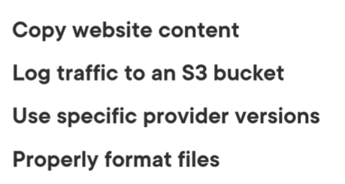
AWS us-east-1.
VPC: 10.0.0.0/16.
Public subnet: 10.0.0.0/24 and 10.0.1.0/24
Security group: Nginx
Instance: t2.micro
Ami: amzn2-ami-hvm-x86_64-gp2

