Slide 1
Project 1 Findings
Sam, Lin Jie, Brian, Paul

Slide 2
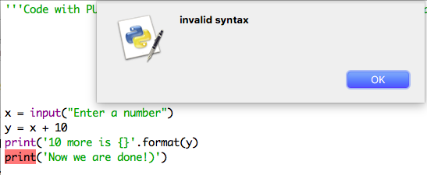
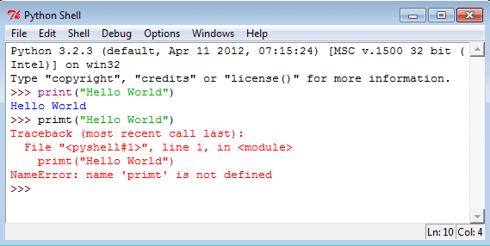
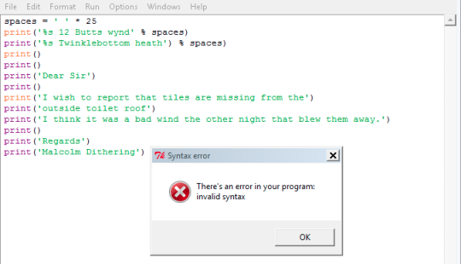
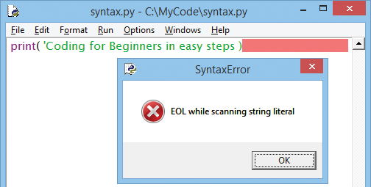
Most Common Errors

Slide 3
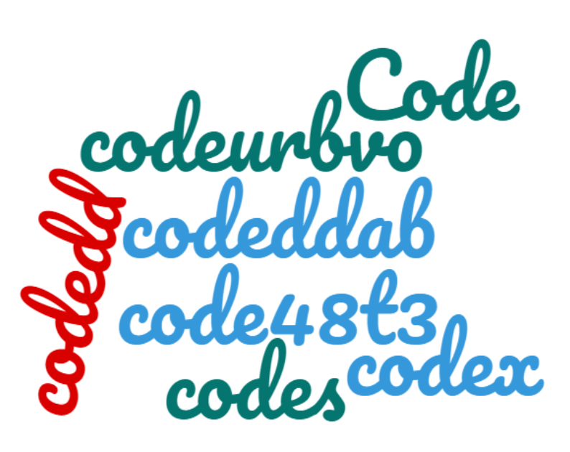
Breaking down the issue to ‘baby’ steps
Always ’print’ when there’s multiple loops
Lesson Learnt
Complex Code
Heavenly Code
Always PRINT TO CHECK!!!
,

Slide 4
Breaking down the issue to ‘baby’ steps
Always ’print’ when there’s multiple loops
Tips
CHEATSHEET!
+
PRE-PYTHON COURSE

Slide 5
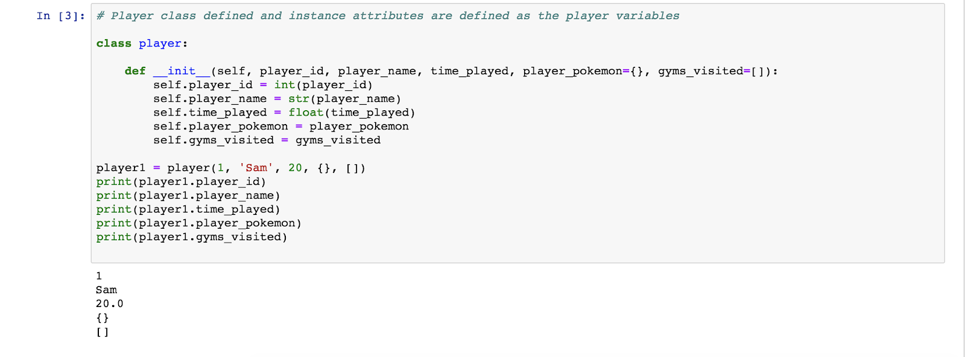
Classes

Slide 6
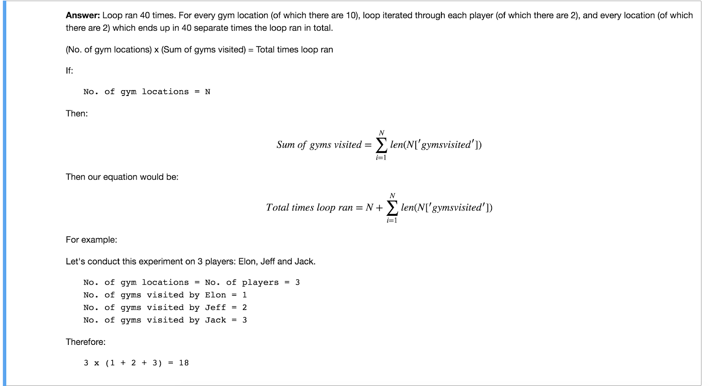
Q. 6.2 N ways

Slide 7
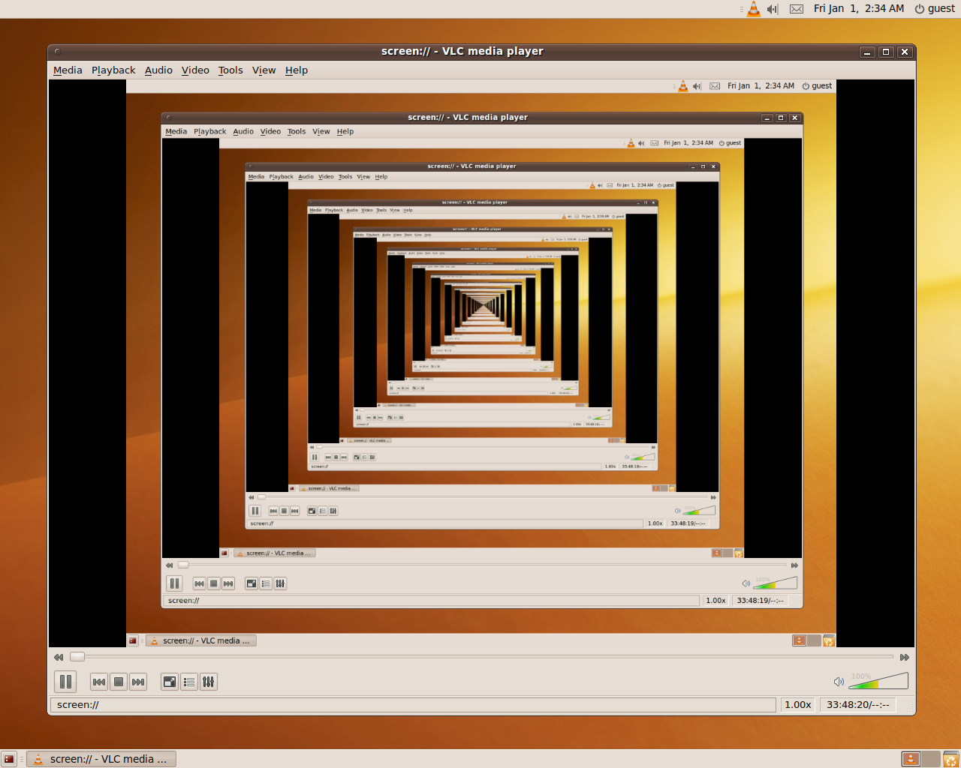
Q10 Use Recursion

Slide 8
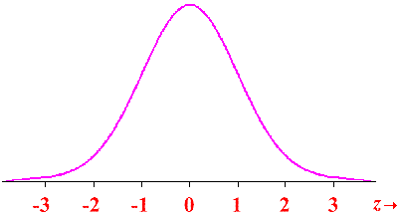
Q10 Shifting Probability
Total Power
Normal Distribution
Pokemon ID | 1
Player Level | 20
Total Power
Mean based on Lv
Normal Distribution
Pokemon ID | 1
Player Level | 1
Mean based on Lv

