Slide 1

Biomedical Image Processing - Researching Interpolation in Images
Paul Vu 301169550 January 19th 2017

Slide 2
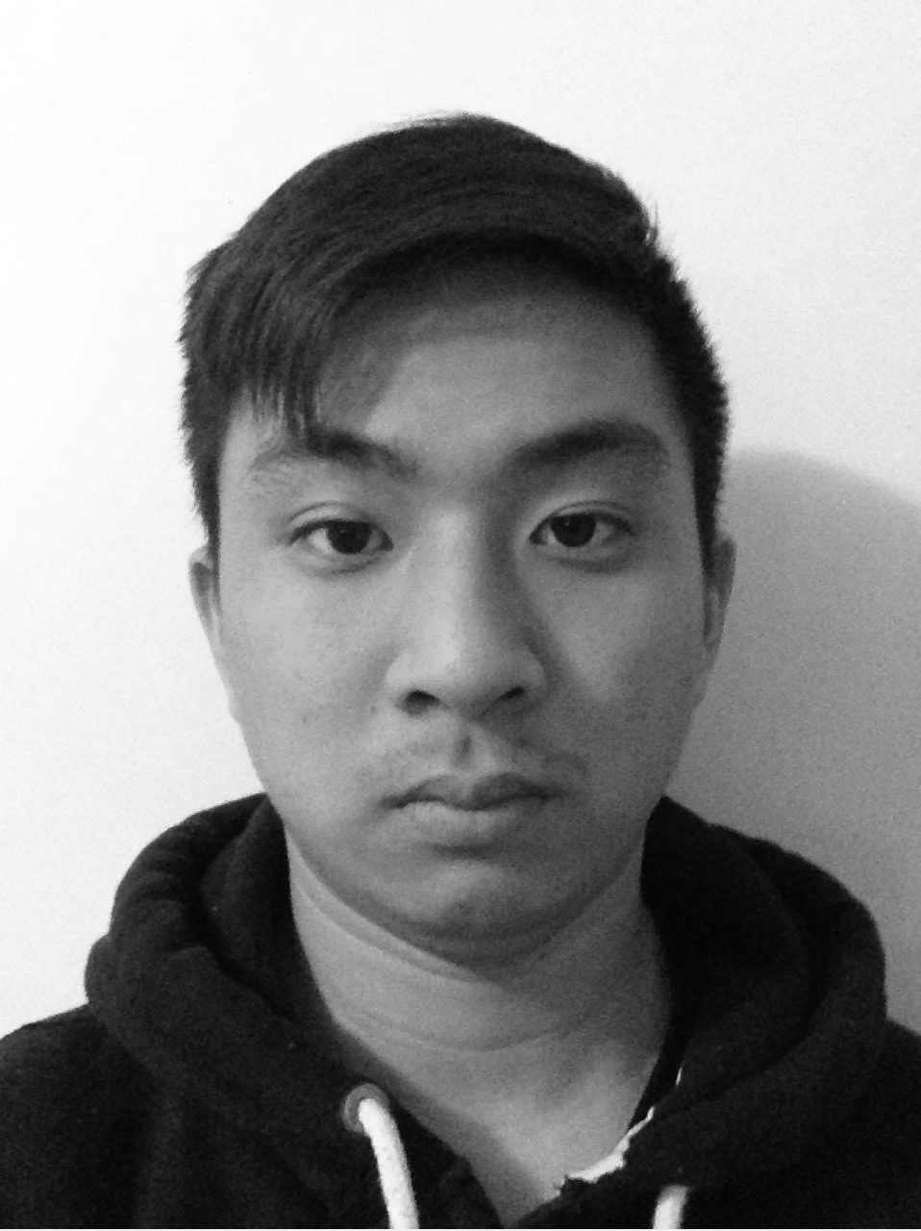

Project Overview
In this project I implemented a program that can take in a coloured MxN image, convert it to grayscale and scale the image to a user defined aMxbN sized image while preserving the FOV.
To execute the function run the Ass2_main script, or to test a unique aMxbN solution run:
output = scale_MN(grayScaleImg, a, b);
Figure1: Original Mugshot photo (1280x960 )
Figure 2: Mugshot image scaled to 640x1920

Slide 3

Scale 1: Mugshot (384x288)
MxN = 1280x960
a = 0.3 | Δm = 1/a = 3.33
b = 0.3 | Δn = 1/b = 3.33
aMxbN = 384x 288
Figure1: Original Mugshot photo (1280x960 )
Figure 3 Mugshot image scaled by a = 0.3 b = 0.3

Slide 4

Scale 2: Mugshot (1152x384)
MxN = 1280x960
a = 0.9| Δm = 1/a = 1.11
b = 0.4 | Δn = 1/b = 2.5
aMxbN = 1152x384
Figure1: Original Mugshot photo (1280x960 )
Figure 4 Mugshot image scaled by a = 0.9 b = 0.4

Slide 5
Scale 3: Mugshot (128x9600)
MxN = 1280x960
a = 0.1 | Δm = 1/a = 10
b = 10 | Δn = 1/b = 0.1
aMxbN = 128x9600
Figure1: Original Mugshot photo (1280x960 )
Figure 5 Mugshot image scaled by a = 0.1 b = 10

Slide 6

Scale 4: Mugshot (2560x1920)
MxN = 1280x960
a = 2| Δm = 1/a = 0.5
b = 2 | Δn = 1/b = 0.5
aMxbN = 2560x1920
Figure1: Original Mugshot photo (1280x960 )
Figure 6 Mugshot image scaled by a = 2 b = 2

Slide 7
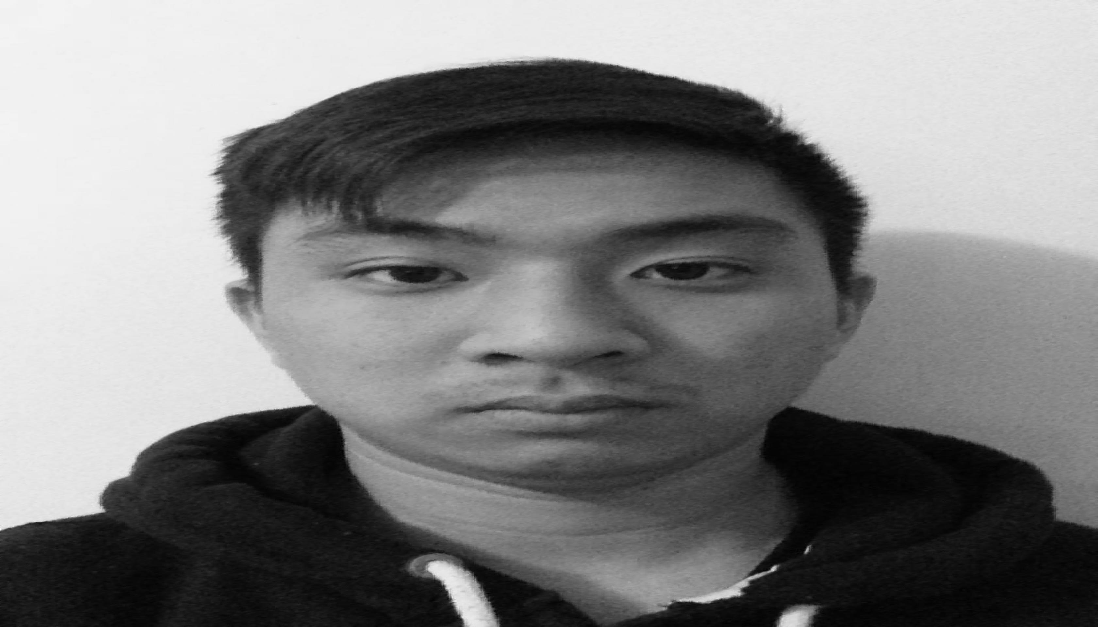
Scale 5: Mugshot (1920x3360)
MxN = 1280x960
a = 1.5 | Δm = 1/a = 0.66
b = 3.5 | Δn = 1/b = 0.29
aMxbN = 1920x3360
Figure1: Original Mugshot photo (1280x960 )
Figure 7 Mugshot image scaled by a = 1.5 b = 3.5

Slide 8
Scale 6: Mugshot (12800x960)
MxN = 1280x960
a = 10| Δm = 1/a =0.1
b = 1 | Δn = 1/b =1
aMxbN = 12800x960
Figure1: Original Mugshot photo (1280x960 )
Figure 8 Mugshot image scaled by a = 10 b = 1

