Slide 1
Design Pattern Final Project
Luay M. Assidmi
September 29, 2026
Ontology and Intel Analysis
Revised October 17, 2026: proposal re-examined against course material

Slide 2
Proposed Final Project Topic
Meeting

Slide 3
Why Meetings?
Meeting presentations and meeting minutes are our main target.
  They are abundance,
  they are engineered knowledge for humans to consume,
  they proved context, and provenance, and traceability
Goal:
  Our aim is to build institutional knowledge extracting pipeline that accumulates future intelligence and connect, archive and retrieve legacy tacit knowledge.
How:
  we want to engineer that presentation and meeting minutes (which concretize meta data and action speak [mandate]) for machines to consume.
Ensuring:
  Data quality while extracting intelligence
  Data interoperability between projects, initiatives, and programs across the organization

Slide 4
Design process method
Step 1: My own definition in words (no BFO/CCO lenses)
Step 2: Build BPMN map
Following steps are Co-authored with Design Pattern Assistant(1) (AI)
Step 3: Apply rules of Thumb
Step 4: Lookup BFO/CCO lenses on to build Design pattern
Step 5: Pattern Design workshop Mermaid Draw
(1) Design Pattern Assistant is an agent that is trained on BFO and CCO, it’s job it identify and re-use entity classification and relationships. A sample of their assistant will be provided in markdown files

Slide 5
Step 1: My own definition, tested
v1: A Meeting is a type of human gathering (online/in person) for a determined period of time to address a topic(s) and make decisions (mandates)
Test (Military Intelligence Pt. 1) | Counterexample | Result
Term true, definition false (sl. 5) | A status briefing where nothing is decided | Fails: "make decisions" isn't true of every meeting
Term true, definition false (sl. 5) | An unscheduled 5-minute corridor huddle | Fails: "a determined period of time" isn't either
Definition true, term false (sl. 5) | A family at dinner deciding on a holiday | Too broad: nothing requires a planned act or common purpose
Avoid negative language (sl. 12–27) | — | Passes. Keep it that way: define a subtype, not a "non-decision meeting"
Word-to-world (sl. 30–32) | "make decisions (mandates)" | Conflates an act (deciding) with its output (the mandate)
A definition is a pair <T, E>: T is true of a domain just in case E is (Military Intelligence Part 1, slide 4).

Slide 6
Step 1 revised: v2 definitions
Meeting =def an act of association in which two or more persons, sharing a place or connected through a communication artifact, communicate about one or more topics for a common purpose
Decision meeting =def a meeting that has as part an act of directive communication, by a person bearing an authority role, whose output is a mandate
Mandate =def a process regulation that is the output of an act of directive communication in a meeting
Case | Meeting? | Decision mtg?
Status briefing, nothing decided | ✓ | ✗ (correct)
Corridor huddle that settles an issue | ✓ | ✓
Family dinner deciding a holiday | ✗ | —
Board meeting, chair issues a directive | ✓ | ✓
What changed: genus from CCO Act of Meeting ("…assemble for some common purpose"). "Determined period" dropped: every meeting takes time, but not every one is scheduled. Deciding moved to a subtype, so the class is split from the inside with no negative definition (sl. 21–24).
Open: "common purpose" carries a lot of weight.

Slide 7
Step 2: Build BPMN map (two acts, not one)
Speech act
Creates the obligation. Felicity condition: the chair bears the authority (Document Acts, pp. 9–10)
Document act
Makes the obligation official and lasting, beyond the memory of those in the room (Document Acts, pp. 6, 9)

Slide 8
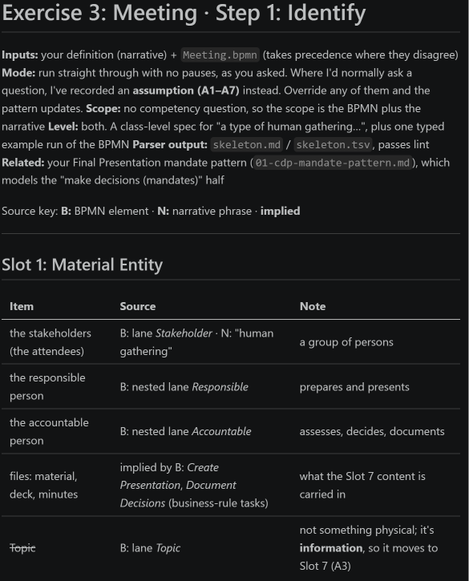
Step 3: Apply rules of Thumb
Slot 1: Material Entity
Slot 2: Quality
Slot 3: Process
Slot 4: Realizable Entity
Slot 5: Where
Slot 6: When
Slot 7: Information

Slide 9
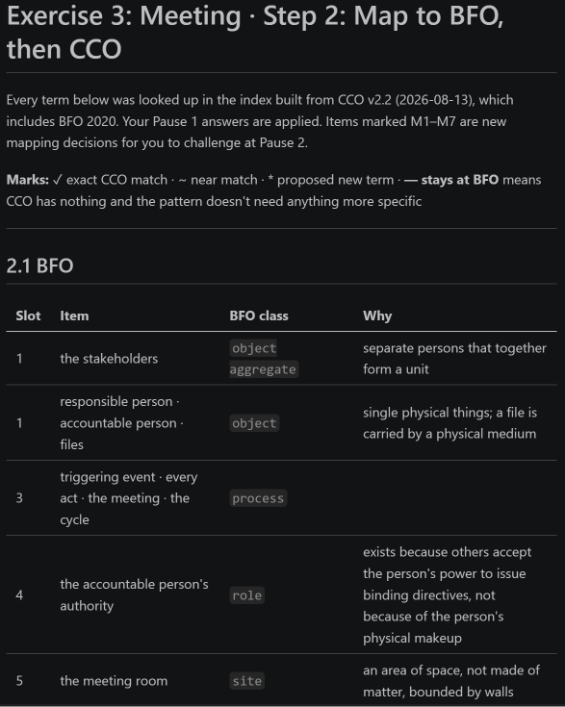
Step 4: Lookup BFO/CCO lenses on to build Design pattern
Every term below was looked up in the index built from CCO v2.2 (2026-08-13), which includes BFO 2020.
Marks: ✓ exact CCO match · ~ near match ·
  proposed new term · — stays at BFO means CCO has nothing and the pattern doesn't need anything more specific

Slide 10
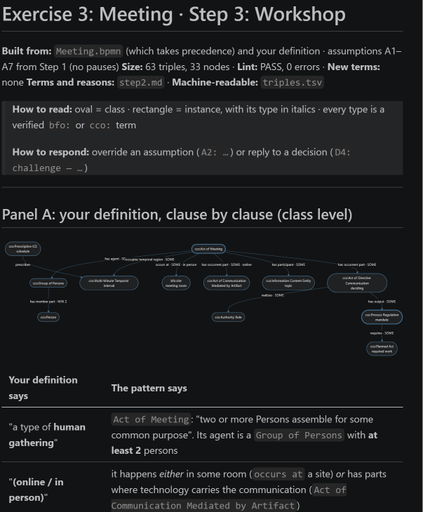
Steps 5 the workshop
We (DPA and I) take the inputs from Steps 3, 4
Conduct a workshop to build the design pattern

Slide 11
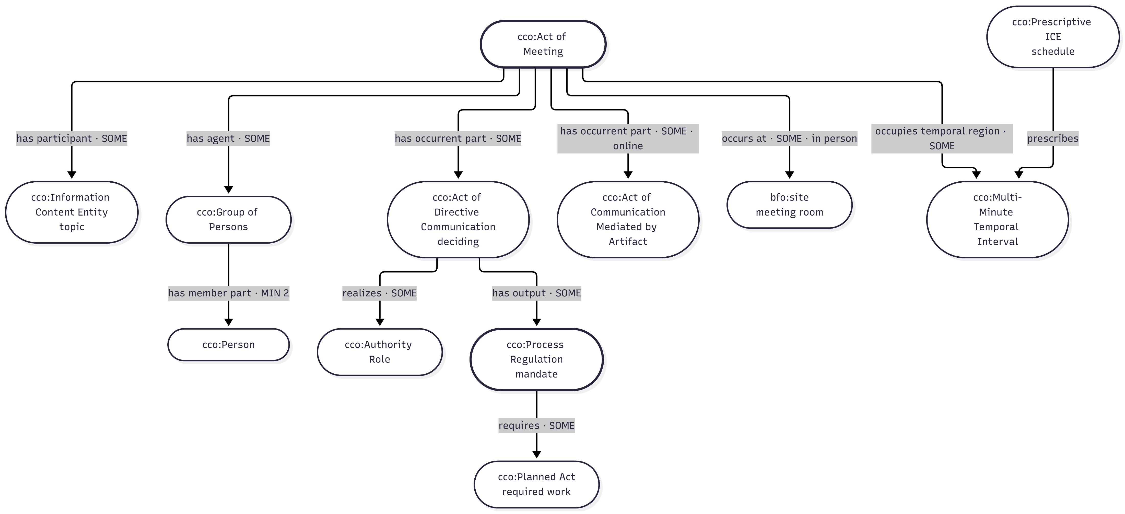
Steps 5 Workshop result: Mermaid (v1)

Slide 12
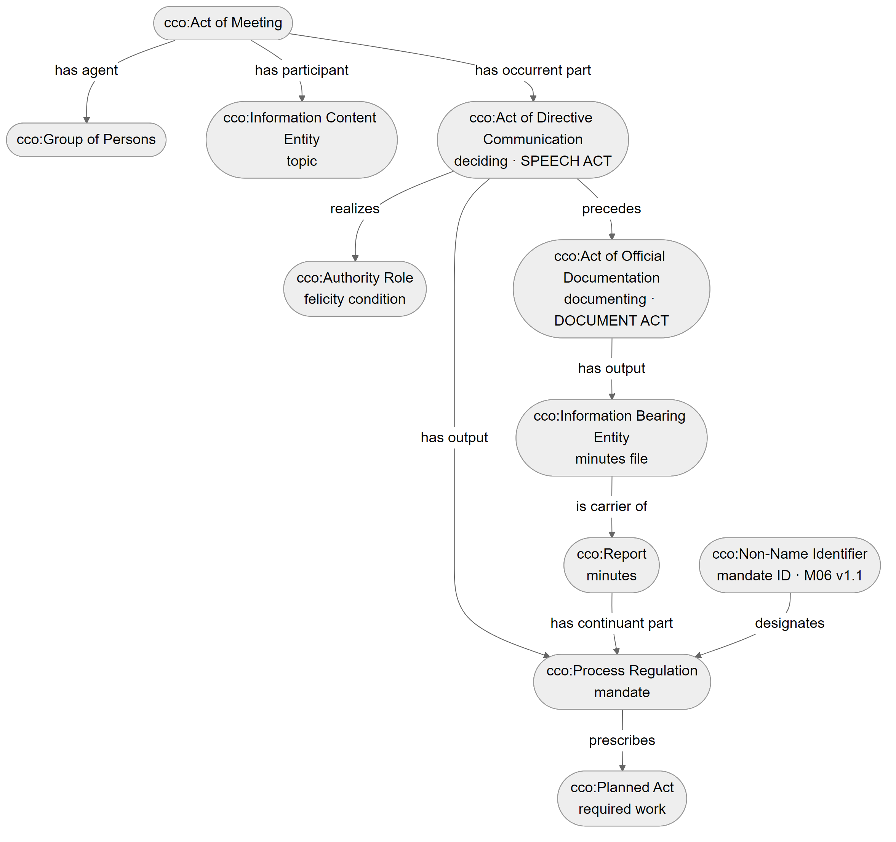
Step 5 revisited: speech act vs. document act
v1 problem: one node, "deciding", did two jobs. The BPMN already had two tasks
Speech act: cco:Act of Directive Communication realizes the Authority Role and outputs the mandate
Document act: cco:Act of Official Documentation outputs the minutes file, which carries the minutes; the mandate is part of them
Identifier: "M06 v1.1" designates the mandate, and the same ID links minutes, letters and trackers (Document Acts, p. 10)
Lint: PASS, 0 errors, 3 warnings (justified)

Slide 13
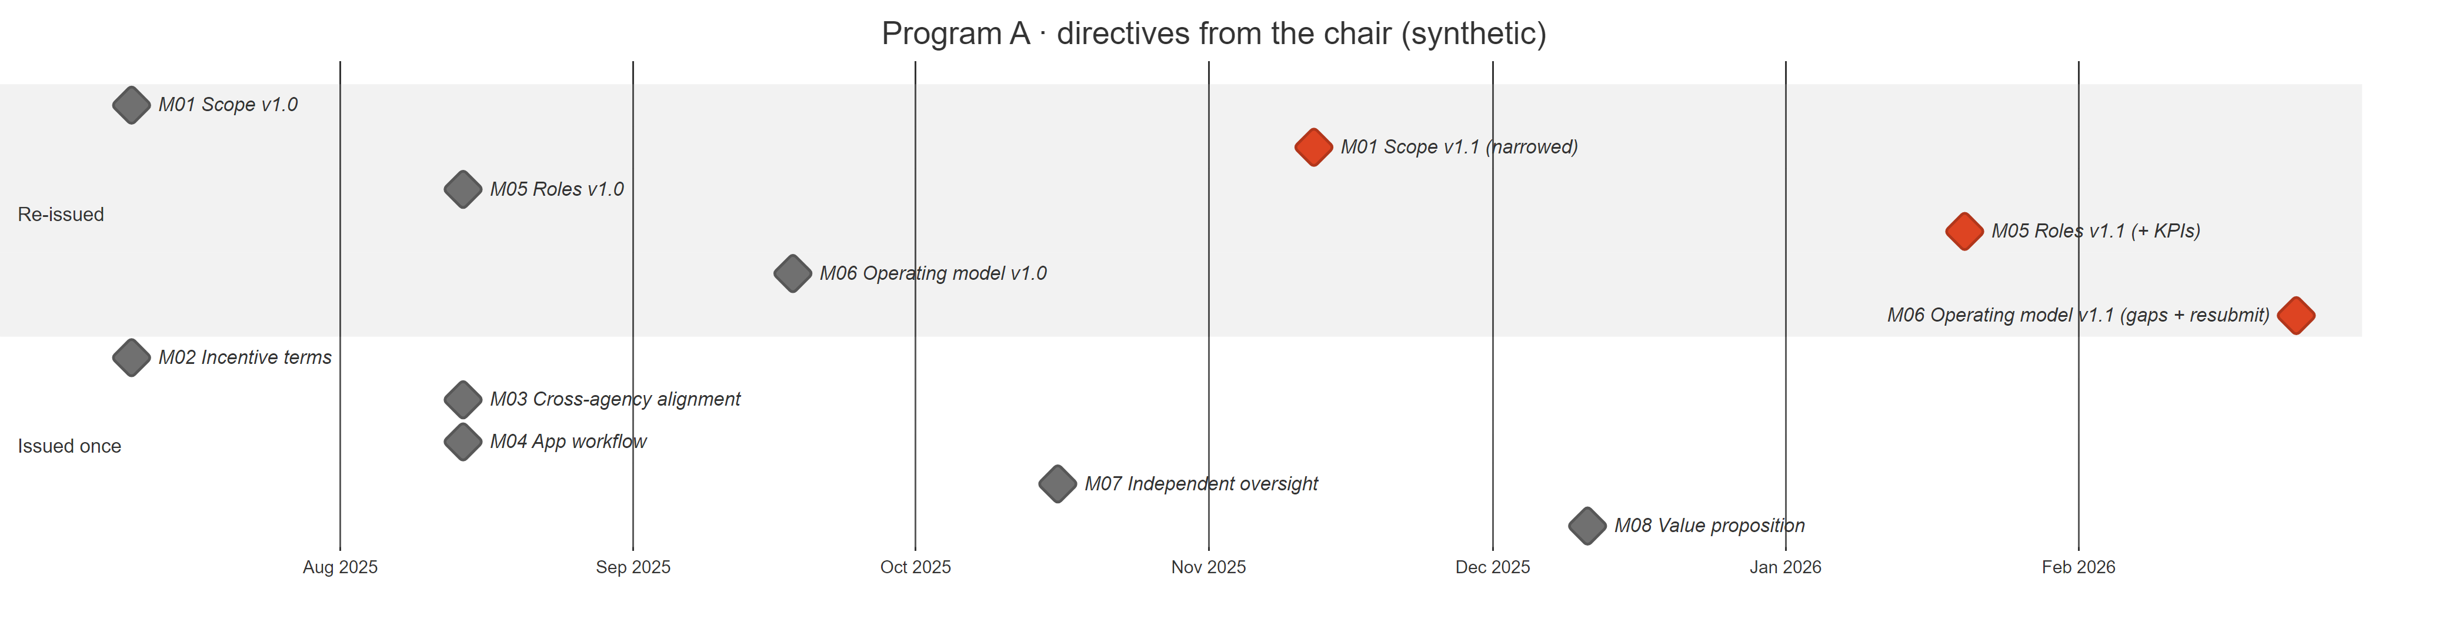
Identifiers reveal recurrence
Document Acts (p. 10) | In this pattern
Tracking numbers and VINs create "virtual attachment between documents via cross-referencing" | A mandate ID (M06) appears in the minutes, a follow-up letter and a tracker: three documents, one mandate
The document's identifiers support knowledge by comparison | Comparing M06 v1.0 with v1.1 shows the chair raised it twice, with more asked the second time. Each version is a distinct mandate, linked by precedes
Synthetic data. The real programme file is internal and is not published.

Slide 14
File Engineering aligned to IAO
CCO is imported; IAO is aligned (skos:closeMatch), not imported, so there is never a second "document" class. Following IAO-Intel, each file type is populated downward from IAO.
File element | Source label | IAO class (aligned) | CCO class (used)
Priority file (dossier) | ملف | document IAO_0000310 | Information Content Entity
Meeting presentation | عرض | document IAO_0000310 | Document Content Entity
Minutes | محضر | report IAO_0000088 (exact) | Report
Official letter | خطاب | document IAO_0000310 | Document Content Entity
Directive / mandate | توجيه | directive information entity IAO_0000033 | Process Regulation
Recording the decision | توثيق | documenting IAO_0000572 | Act of Official Documentation
Mandate ID + version | M06 v1.1 | identifier IAO_0020000 | Non-Name Identifier
Executive priority | أولوية | objective specification IAO_0000005 | Objective
People stay in CCO (IAO covers information only). IAO's version number is defined for manufactured products, so versions are part of the identifier instead. Precedent: IAO-Intel sets Intelligence Report under IAO Report (Smith et al., Table 1).

Slide 15
Course material applied in this revision
Beverley, Intelligence Analysis: Military Intelligence Part 1: definitions as <T, E>, two-way counterexample tests, negative language, word-to-world fit → Step 1
Smith, Document Acts (week 3): "to record" (p. 6); felicity conditions and documents as enduring deontic power (pp. 9–10); identifiers and knowledge by comparison (p. 10) → Steps 2 and 5
Smith et al., IAO-Intel (week 3): downward population from document typologies; incremental coverage → File Engineering alignment
CCO v2.2 and IAO: every term checked against the source files, with IRIs in the repository write-up
Next: implement the pattern in OWL (.ttl), test it with the reasoner and the competency questions

