Slide 1


Classification of Skin Lesion Images as Benign or Malignant
By Luay Matalka

Slide 2

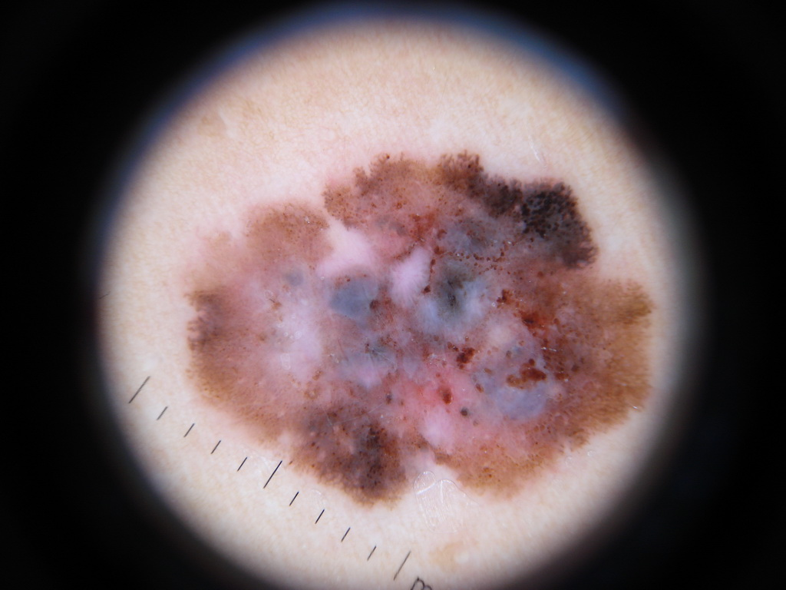
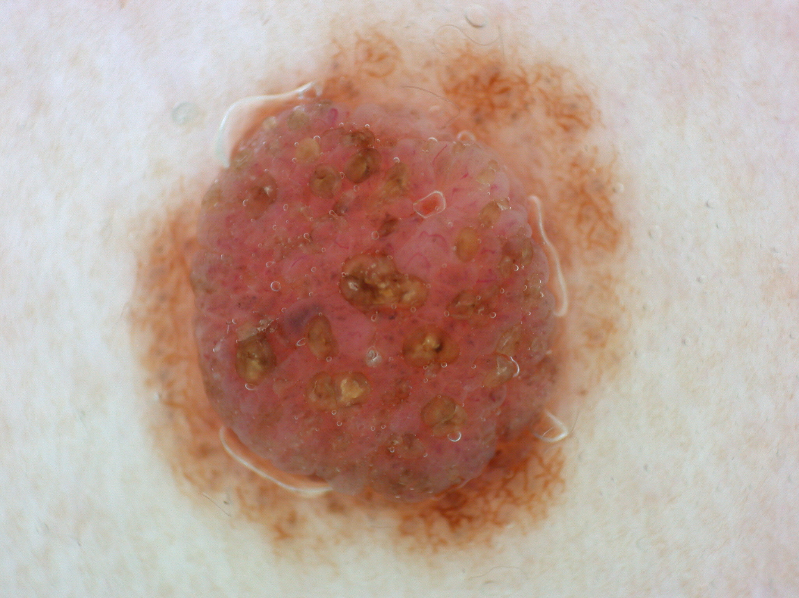
But Why?
Melanoma is the deadliest type of skin cancer. (> 9000 Americans die of melanoma each year).
The incidence of cutaneous melanoma has risen every year since 1979.
Melanoma is readily curable when diagnosed early through simple excision.
Methods to improve early melanoma diagnosis are needed to reduce deaths in addition to unnecessary biopsies and subsequent excisions of benign lesions.

Slide 3
The Data
The International Skin Imaging Collaboration, or ISIC, contains a public archive of clinical and dermoscopic images of skin lesions.
Provides images for the purpose of automated diagnostic system development.
Used their API to gather 4570 images of skin lesions. Half of the images were benign, and the other half were malignant.
Types of cancer include: squamous cell carcinoma, basal cell carcinoma, and melanoma (the majority being melanoma).

Slide 4
Goal
A 2018 study of 58 international dermatologists classifying 100 dermosopic images as benign or melanoma found that they diagnosed 86.6% of melanomas and 71.3% of benign moles on average.
The goal was to develop and train a convolutional neural network that at least matches or even exceeds these percentages.

Slide 5
Methodology
Convolutional neural networks will be trained on the images.
Transfer learning will also be utilized by fine-tuning pre-trained models such as VGG16, VGG19, and Inception V3.
Image preprocessing techniques will be employed, such as image augmentation, scaling, and normalization techniques.
Hyperparameters will be tuned.
Evaluation metrics such as accuracy and recall/sensitivity for the malignant class will be focused on.

Slide 6
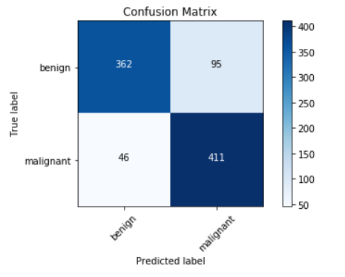
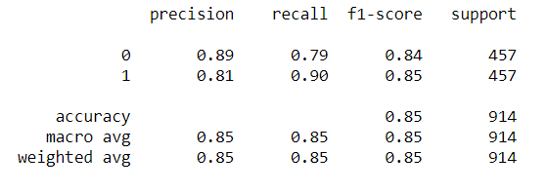
Results
The model with the best results was the VGG16 model.
Overall accuracy of 85%.
Recall/sensitivity of malignant class: 90%.
Recall/sensitivity of benign class: 79%.

Slide 7
Conclusion
With limited computing power, deep learning achieved higher recall rates than the 58 dermatologists mentioned in the 2018 study.
90% recall in malignant class (as compared to 86.6%).
79% recall in benign class (as compared to 71.3%).

Slide 8
Recommendations
Recommend that the VGG16 model is used to assist primary-care physicians and dermatologists (front line in melanoma detection) in diagnosis of malignant skin cancers.
The high recall/sensitivity score decreases the probability of a false negative test.

Slide 9
Next Steps
To improve the model’s accuracy and recall scores by:
Hyperparameter tuning via gridsearch cross-validation (with larger computing power).
Usage of more images for training.
Deploying the model via mobile devices to increase access.

Slide 10
Thank You!
Any questions?

Slide 11
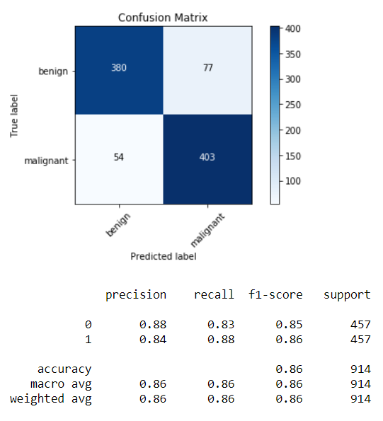
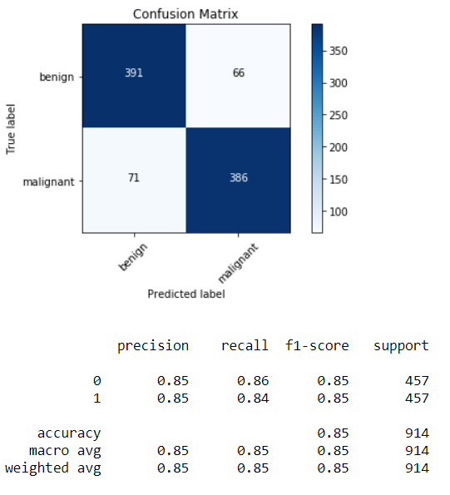
Appendix

