Slide 1
Module 2: Final Project
Conducted data analysis to provide insights to people interested in maximizing profit when selling their home in King County.
Does renovation raise the value of a house?
Does the number of bathrooms and/or bedrooms affect the value of a house?
Is the living sqft of a house correlated with its price?
Does being on the water increase the value of a house?

Slide 2
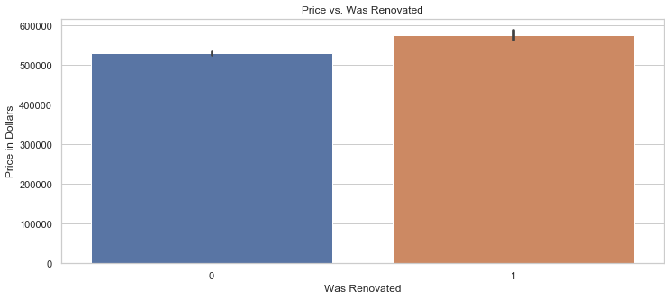
Price vs. Was Renovated
According to the Price vs. Was Renovated bar graph, renovation alone does slightly increase the average price of a house. However, the increase is not substantial enough to definitively support renovation before selling a house, unless that renovation increases the condition rating of the house.

Slide 3
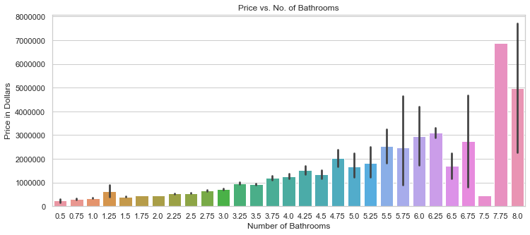
According to the Price vs. No. of Bathrooms bar graph, the greater the number of bathrooms in a house, the higher the price. Therefore, if the house is being sold, it may be a good idea to add bathrooms to increase the value of the house.

Slide 4
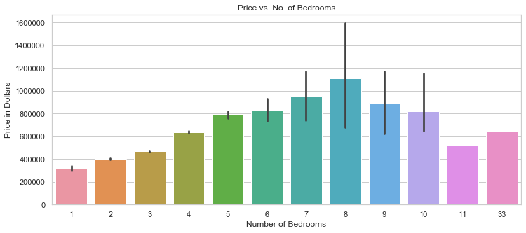
According to the Price vs. No. of Bedrooms bar graph, the greater the number of bedrooms (up until 8), the greater the price. So adding bedrooms could also increase the value of the house if it is being sold.

Slide 5
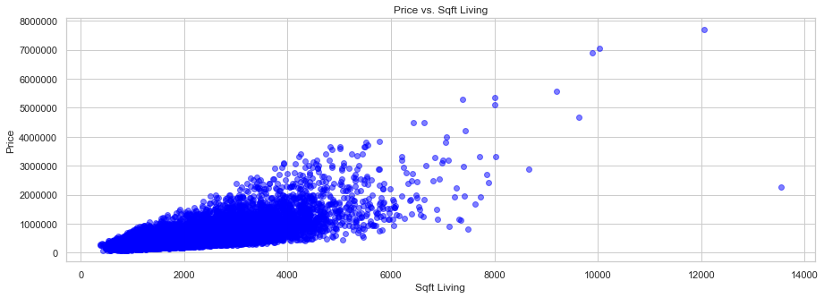
According to the Price vs. Sqft Living scatter plot, there is a positive correlation between the living sqft of a house and its price.

Slide 6
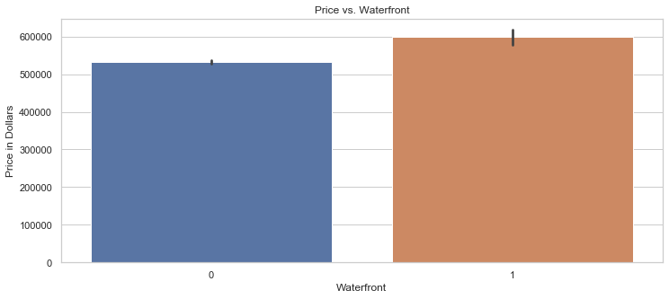
According to the Price vs. Waterfront bar graph, a house on the water has a higher average price than a house that is not on the water. However, there is not a significant difference between them.

Slide 7
Conclusion
Renovation does increase the value of a house.
Having a waterfront does increase the value of a house.
It is recommended that:
Renovation increases the sqft living of the house.
Renovation increases the number of bathrooms.
Renovation increases the number of bedrooms (if < 8).
Renovation increases the condition rating of the house.

Slide 8
Next Steps
Gathering data on the cost of renovation, including cost to add bathrooms and/or bedrooms.
Find what the condition rating depends on and some cost-effective ways to increase it.
To find the ROI of renovation based on the work being done, including dollar made per dollar spent.

Slide 9
Thank you
Luay Matalka

