Slide 1
Project 3: Tanzanian Water Well Data
By: Luay Matalka

Slide 2
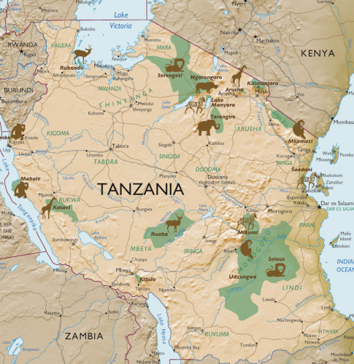
Purpose:
Develop a classification model to help the user identify which water wells will likely need repairs to proactively attempt to repair them, thus maintain the availability of potable water in Tanzania.

Slide 3
Data Collected:
Data was provided on 59,400 water wells in Tanzania.
This information was used to develop various machine learning models in an effort to predict whether a water well is likely to need repairs.
This knowledge can be used to focus attention and resources on repairing the wells likely to experience mechanical failure or issues.

Slide 4
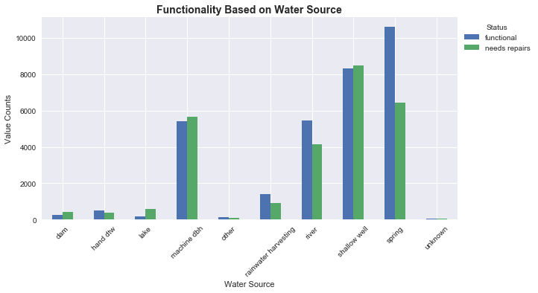
Does The Water Source Matter?

Slide 5
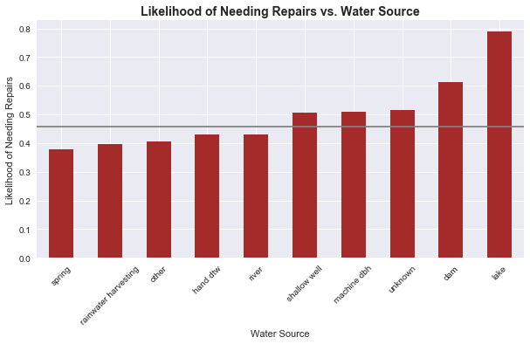
The water sources that increase the likelihood for needing
repairs above the average are,
in ascending order: Shallow
wells, Machine dbh, Unknown, Dams, and Lakes.

Slide 6
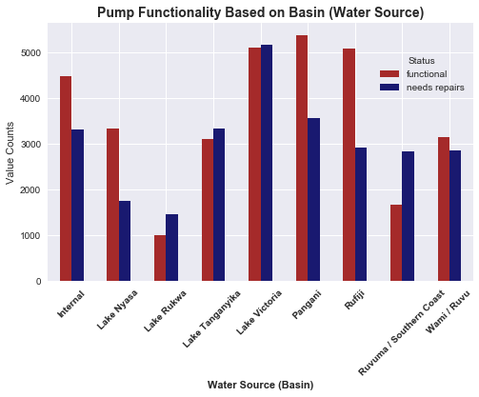
Does The Basin Matter?

Slide 7
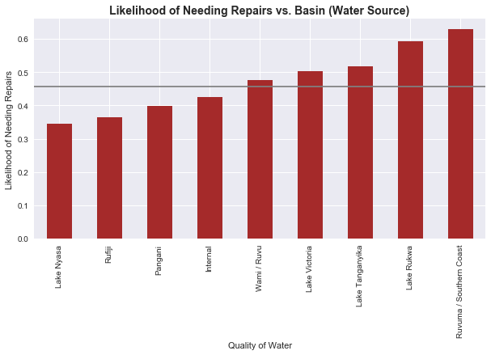
The bodies of water that
increase the likelihood for
needing repairs above the
average are, in ascending order: Wami/Ruvu, Lake Victoria,
Lake Tanganyika, Lake Rukwa, and Ruvuvuma/Southern Coast.

Slide 8
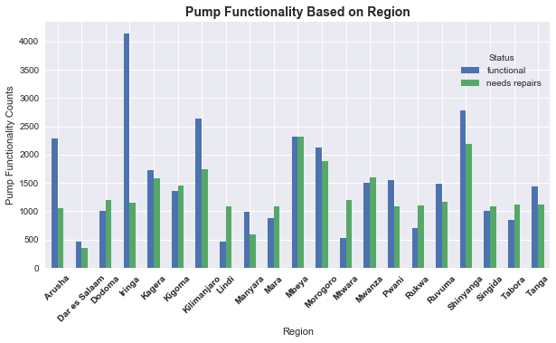
Does The Region Matter?

Slide 9
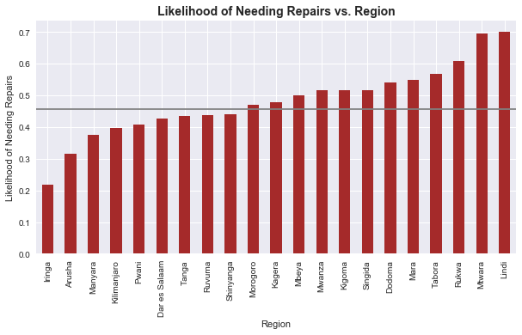
The regions that increase the
likelihood of needing repairs
above the average, in ascending
order, are: Morogoro, Kagera,
Mbeya, Mwanza, Kigoma,
Singida, Dodoma, Mara, Tabora, Rukwa, Mtwara, and Lindi.

Slide 10
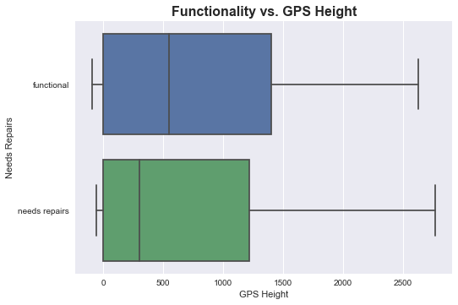
Does The GPS Height Matter?

Slide 11
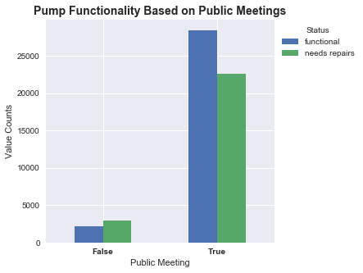
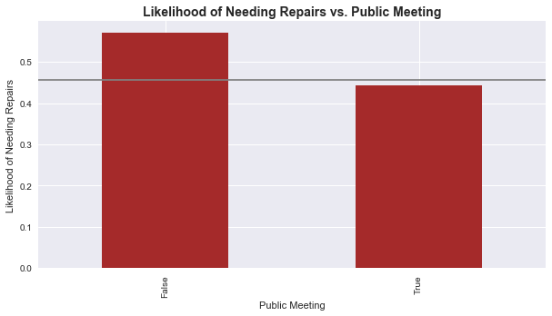
Do Public Meetings Matter?

Slide 12
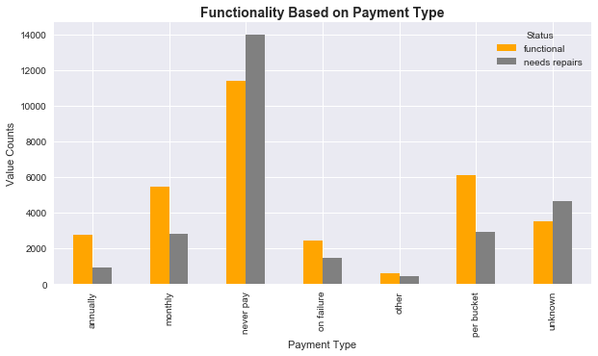
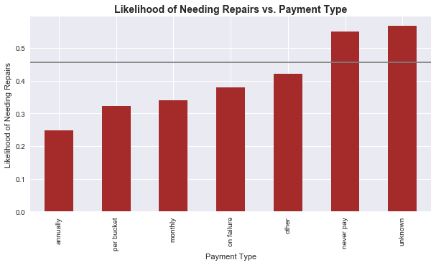
Does Payment Type Matter?

Slide 13
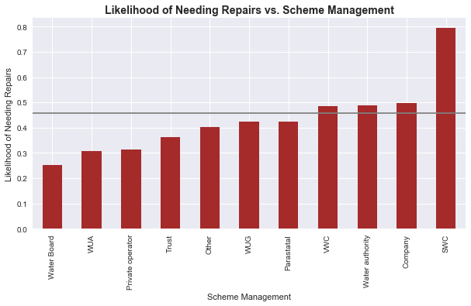
Does Scheme Management Matter?

Slide 14
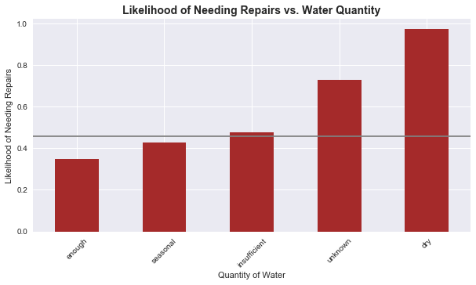
Does Water Quantity Matter?

Slide 15
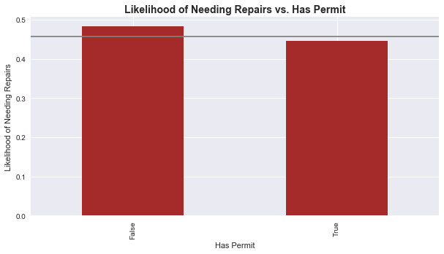
Does Having A Permit Matter?

Slide 16
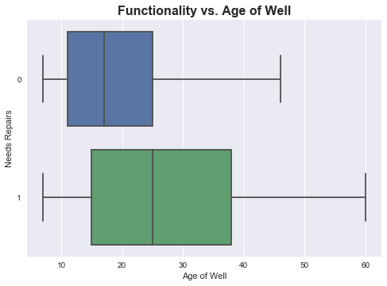
Does The Age of The Well Matter?

Slide 17
XGBoost Model Results
Using the data available, an XGBoost model was created that predicted whether a well needs repair with an accuracy of 83%.
Precision of 83%.
Recall of 83%.

Slide 18
Conclusion
There are multiple factors that affect the likelihood of a water well needing repair. These include:
Age of Well
Water Source and Basin
Public Meetings
Permit
Etc…

Slide 19
Next Steps
Gather data on the approximately 14 thousand remaining water wells in Tanzania in hopes of increasing the model accuracy.
Implement the latitude and longitude in the model to investigate any associations that exist.
Attempt further pre-processing on the data in an attempt to increase model accuracy.

Slide 20
Thank You! Luay Matalka

