Slide 1
Module 1: Final Project
Conducted data analysis to provide insights to Microsoft to facilitate entry into the movie industry.
Where is the bulk of the profit coming from (international vs domestic)?
Which genres generate the highest worldwide profit?
Which months generate the highest worldwide profit?
What are the top 5 profit genres for each month?

Slide 2
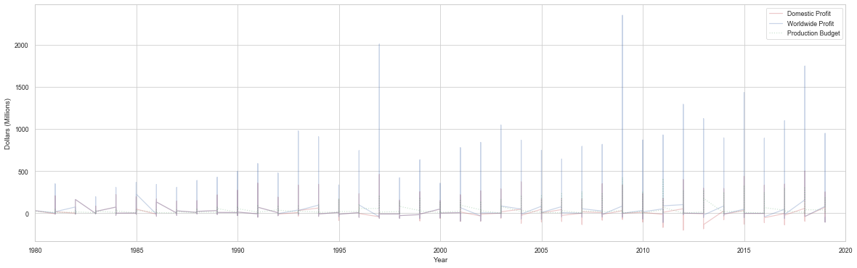
Domestic and Worldwide Profit vs. Time
According to the above plot, over the past 40 years, profit due to the international market has been growing at a faster rate than the domestic market without a proportional increase in overall production budget. This growth of the international market relative to the domestic market could be explained by saturation of US and Canadian markets (an adequate supply of tickets for the available demand), an increase in global marketing (perhaps promotion via social media), and/or the reduction of restrictions on which movies can be seen in a particular region or country, such as China.

Slide 3
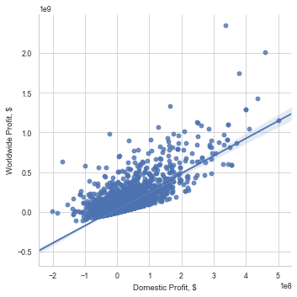
Worldwide Profit vs. Domestic Profit
This is further shown in the Worldwide Profit vs. Domestic Profit scatter plot which shows a positive relationship between domestic profit and worldwide profit with a slope greater than 1.

Slide 4
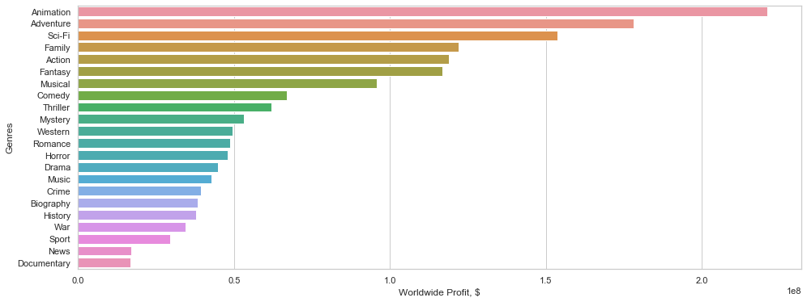
Worldwide Profit vs. Genres
According to the above bar plot, Worldwide Profit vs Genres, the five genres with the highest worldwide profit, in order, are: Animation, Adventure, Sci-Fi, Family, and Action.

Slide 5
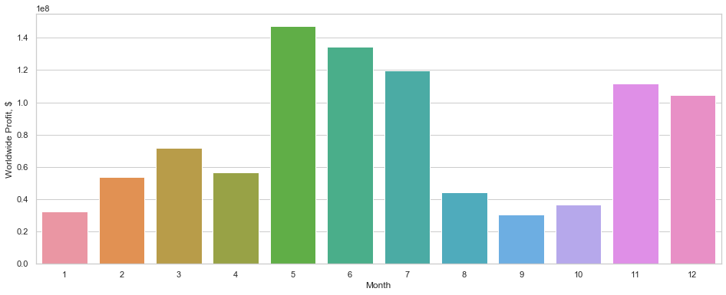
Worldwide Profit vs. Month
According to the above bar plot, Month vs Worldwide Profit, the five months that generate the highest worldwide profit, in order, are: May, June, July, November, and December.

Slide 6
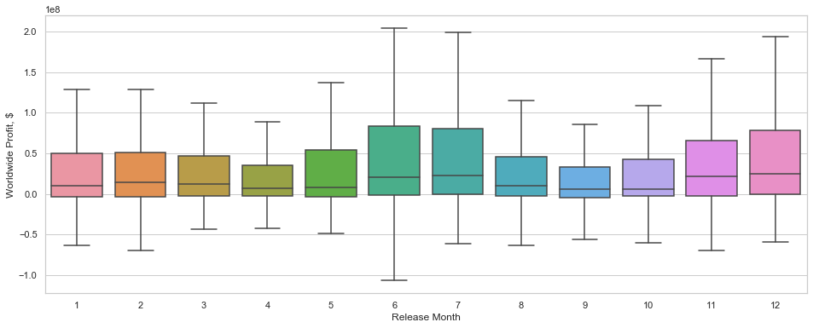
Worldwide Profit vs Release Month Box Plot
Shows a boxplot of the previous graph. Still shows May, June, July, November, and December as months with the highest worldwide profits.

Slide 7
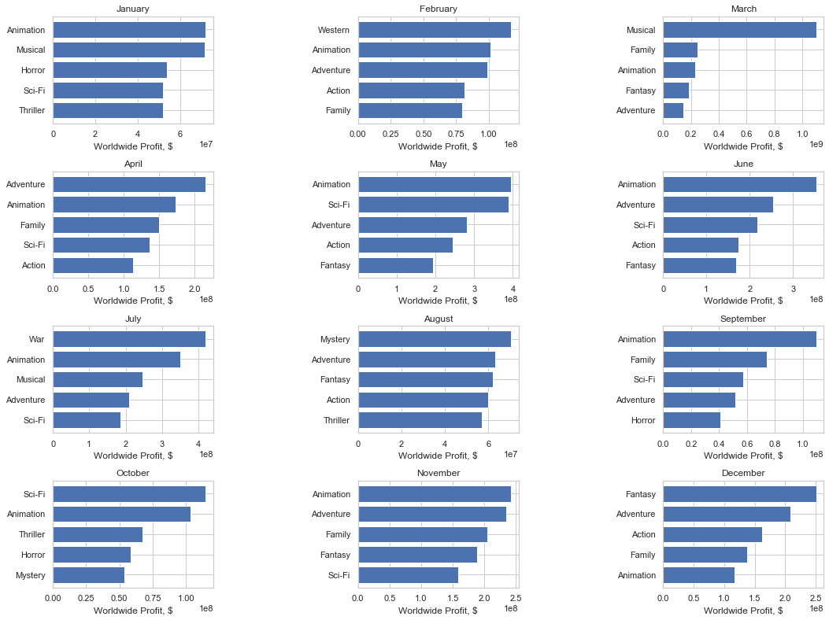
Top 5 Genres per Month based on Worldwide Profit:

Slide 8
Conclusion
Special emphasis should be given to the international market due to its rapid growth compared with the domestic market. This can be done with a greater allocation of overall marketing budget towards that market, with the utilization of social media, along with focusing on stories, characters, and ideas that are of interest to other countries and regions.
Release movies during one of these months in one or more of these genres:
May: Animation, Sci-Fi, and/or Adventure.
June: Animation, Adventure, and/or Sci-Fi.
July: War, Animation, and/or Musical.
November: Animation, Adventure, and/or Family.
December: Fantasy, Adventure, and/or Action.
If the release month cannot be predetermined, then focus on the following genres:
Animation, Adventure, Sci-Fi, Family, and/or Action.

Slide 9
Next Steps
Gathering data to show the relationship between domestic and global marketing budgets to domestic and global profits.
To find which genres and storylines are most appealing to growing international markets, such as China.
To find which directors, actors, and actresses are most popular in those international markets as well.
To find which movie lengths generate the most worldwide profits per genre.
To generate a model that predicts the ROI with specific marketing budgets, genres and directors.

Slide 10
Thank you
Luay Matalka

