Slide 1
Module 1: Final Project
Conducted data analysis to provide insights to Microsoft to facilitate entry into the movie industry.
Which genres generate the highest worldwide profit?
Which months generate the highest worldwide profit?
What are the top 5 profit genres for each month?

Slide 2
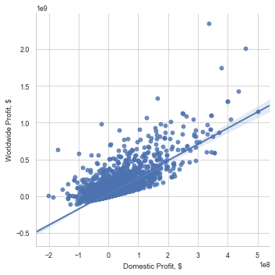
Worldwide Profit vs. Domestic Profit
According to the above line plot, there is a positive relationship between domestic profit and worldwide profit with a slope greater than 1.

Slide 3
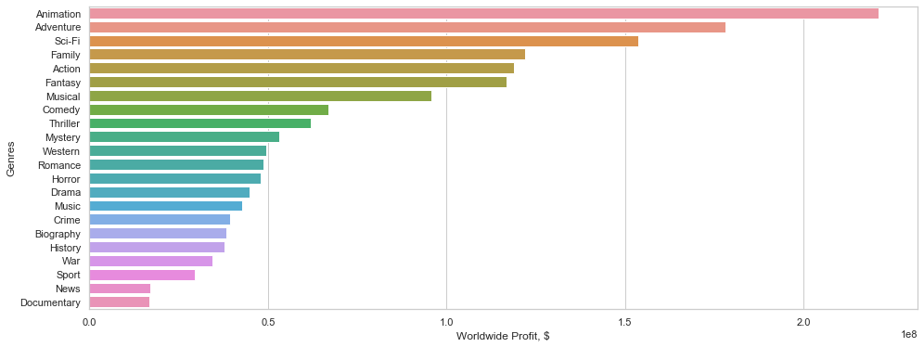
Worldwide Profit vs. Genres
According to the above bar plot, Worldwide Profit vs Genres, the five genres with the highest worldwide profit, in order, are: Animation, Adventure, Sci-Fi, Family, and Action.

Slide 4
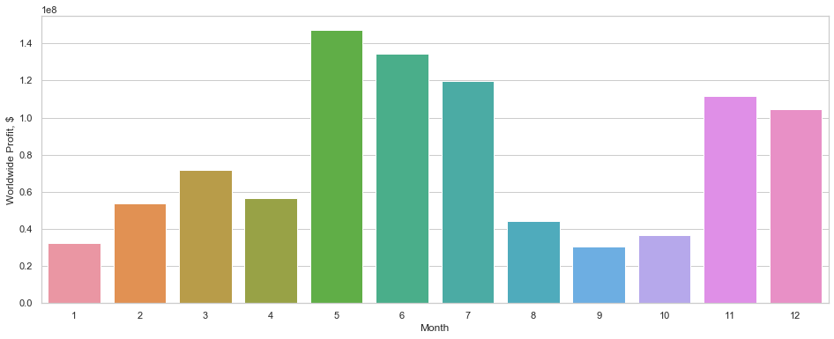
Worldwide Profit vs. Month
According to the above bar plot, Month vs Worldwide Profit, the five months that generate the highest worldwide profit, in order, are: May, June, July, November, and December.

Slide 5
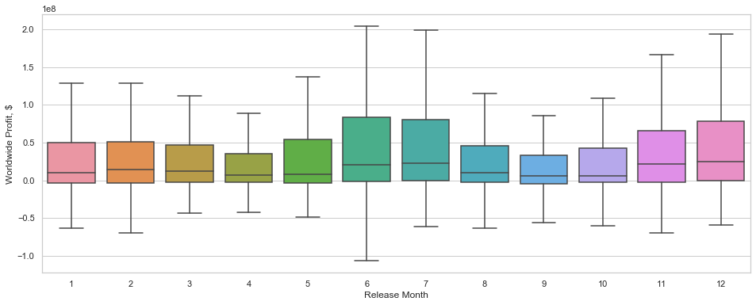
Worldwide Profit vs Release Month Box Plot
Shows a boxplot of the previous graph. Still shows May, June, July, November, and December as months with the highest worldwide profits.

Slide 6
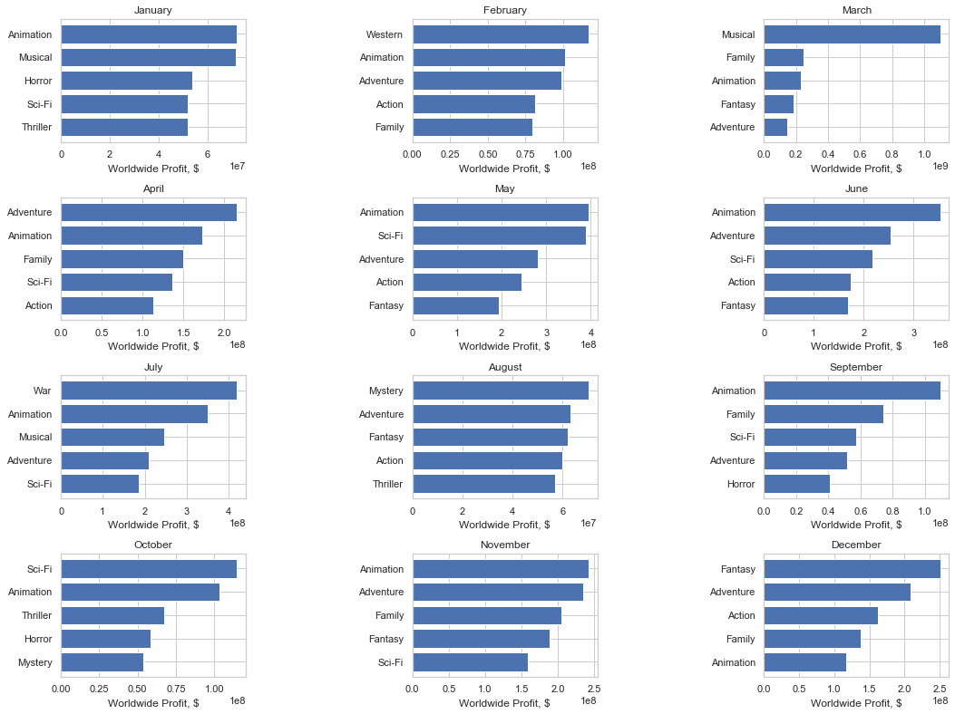
Top 5 Genres per Month based on Worldwide Profit:

Slide 7
Next Steps
To find which actors, actresses, and directors generate the most worldwide profits per genre.
To find which movie lengths generate the most worldwide profits per genre.
To generate a model that predicts the ROI with specific genres and directors.

Slide 8
Thank you
Luay Matalka

