Slide 1
Chest X-Ray Pneumonia
Detection
Luay Matalka & Maria Galdina

Slide 2
Contents
Introduction
Research Goal
Data Gathering
Data Pre-Processing
Results

Slide 3
Introduction
Radiology is a branch of medicine where the disease is diagnosed by examining X-ray images
To reduce human error and the time required for a diagnosis, medical centers implement computer-aided systems
Machine learning techniques have shown great results with image recognition in diagnostics
In this project we attempt to diagnose pneumonia from X-rays using deep learning

Slide 4
Research
Question
Can we create a deep learning model that can classify x-ray images as having pneumonia with a 100% sensitivity/recall?

Slide 5
Data
Gathering
Data for this project is extracted from a Kaggle prepared dataset
There are 5,856 X-Ray images in two categories (Pneumonia/Normal = 4273/1583 )
Images are in JPEG format with different sizes

Slide 6
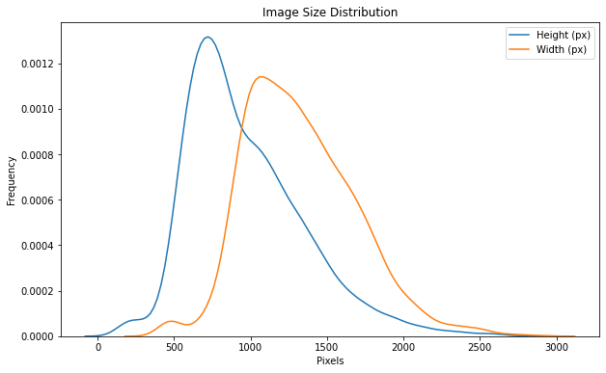
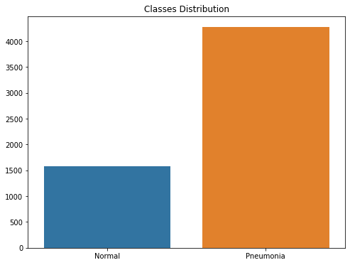
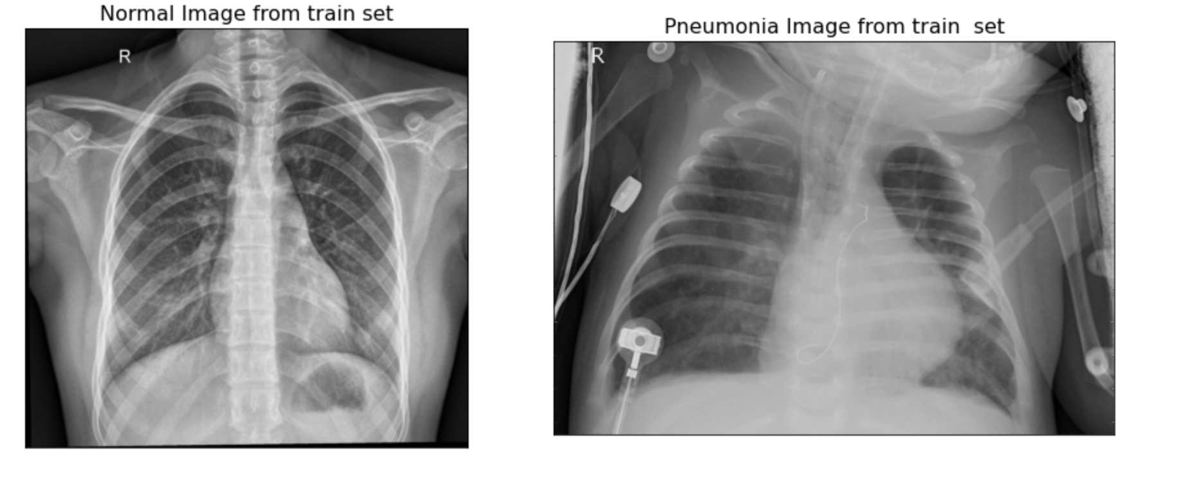

Slide 7
Data
Preprocessing
Rescaling: divided each image by 255
Resizing: all images sized to 224x224 pixels
10 degrees range for random rotations
Also used: shearing transformations, zooming and horizontal flipping
Subtracted the mean RGB value from each pixel (VGG16)

Slide 8
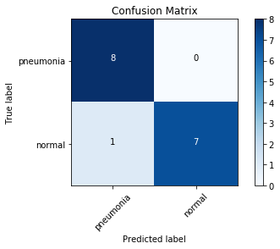
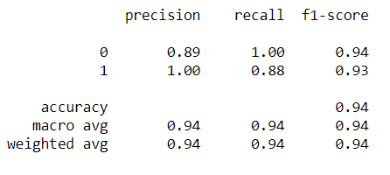
Results
94% overall accuracy
100% recall/sensitivity for the pneumonia class

Slide 9
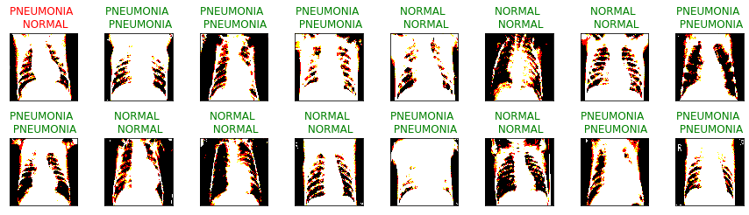

Slide 10
Conclusion
With a 100% sensitivity/recall, if a patient tests negative with this CNN model, it is highly likely that they do not have pneumonia.
Thus, this model can be used to quickly screen patients without pneumonia.
If a patient tests positive, a doctor needs to examine the x-rays and determine if it is a false positive, although the false positive rate is low with this model.

Slide 11
Recommendations
Using the model to quickly screen patients without pneumonia, especially when resources are low and/or time is limited
Integrate this model into medical apps for easy screening in different settings

Slide 12
Further
Research
Further categorization of pneumonia X-rays into bacterial, viral, or other culprits
Identifying other respiratory illnesses using X-rays and MLT
Use GridSearch on GPU for better hyperparameter optimization
Gather more normal X-rays to improve overall accuracy and precision scores

Slide 13
THANK YOU!
Questions?

Slide 14
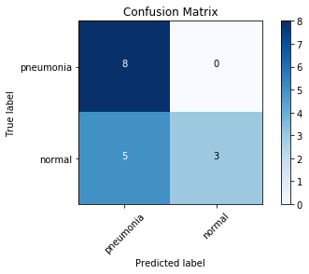
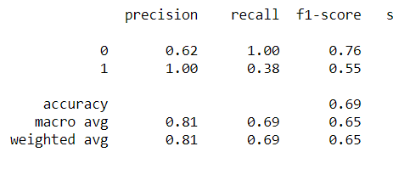
Appendix

Slide 15
