Slide 1
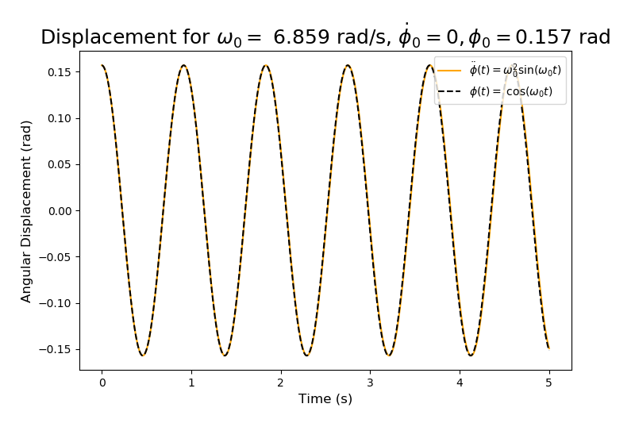
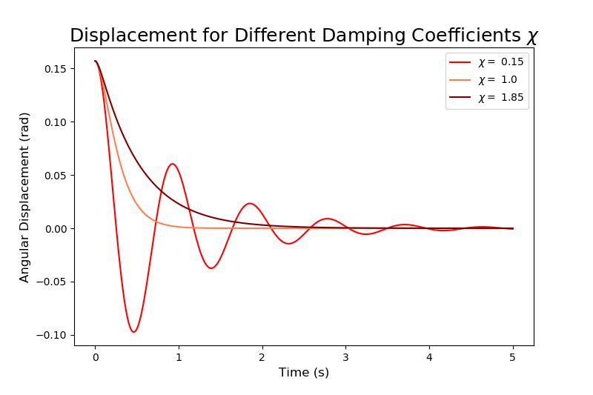
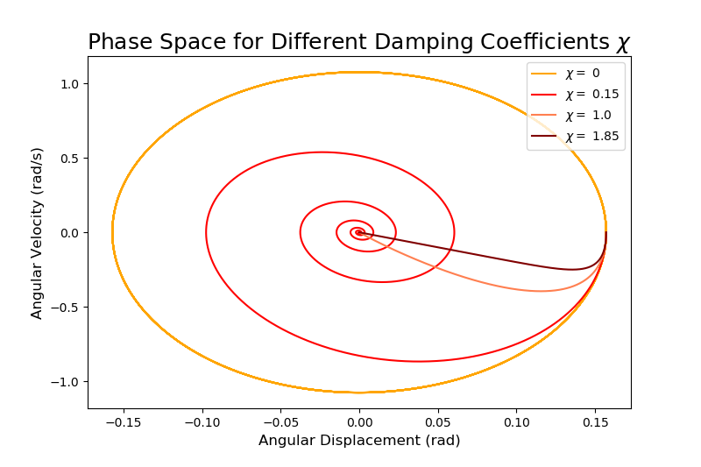
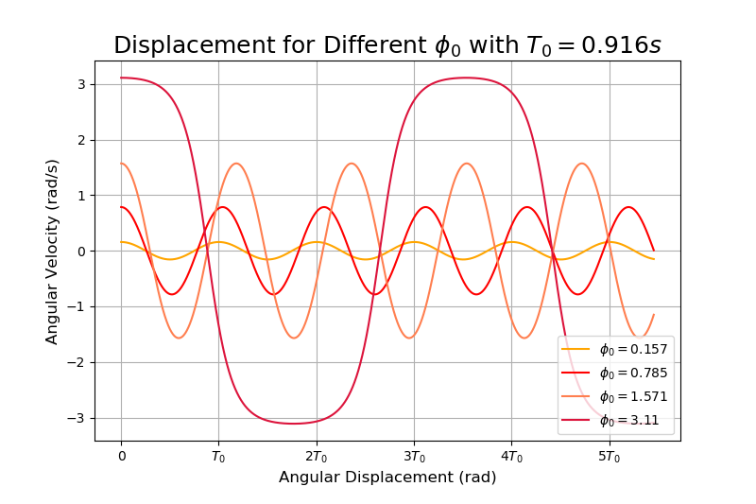
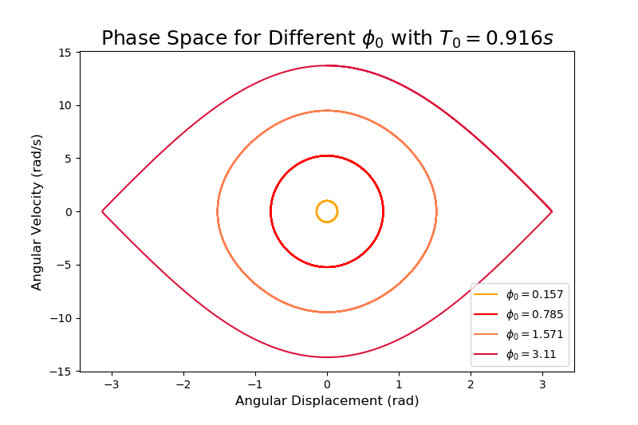
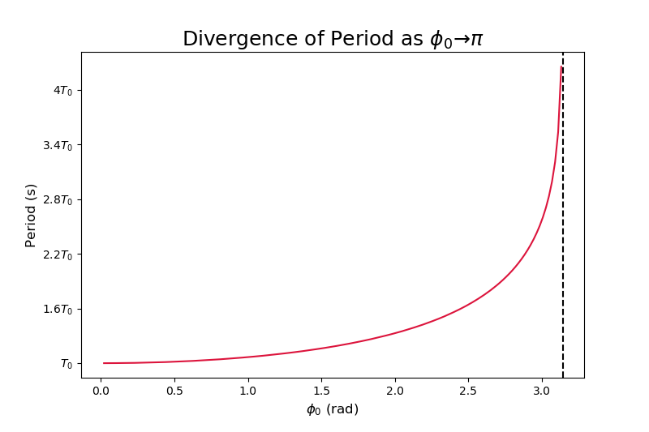
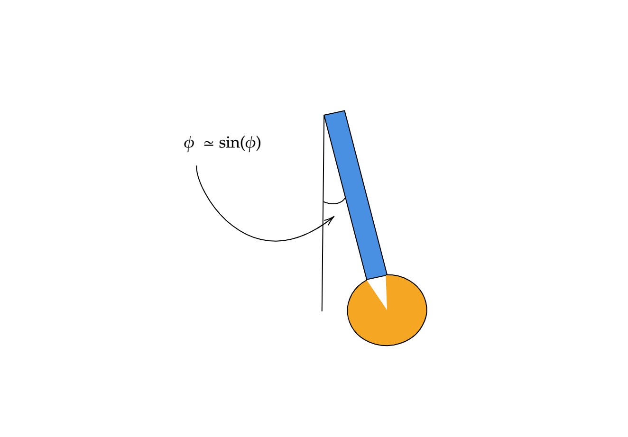
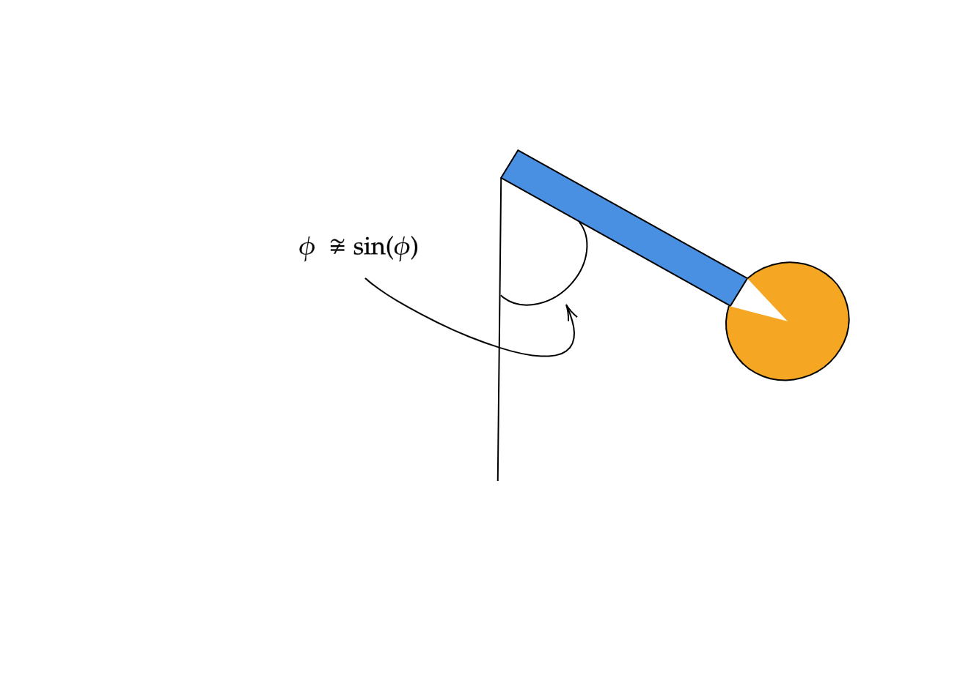
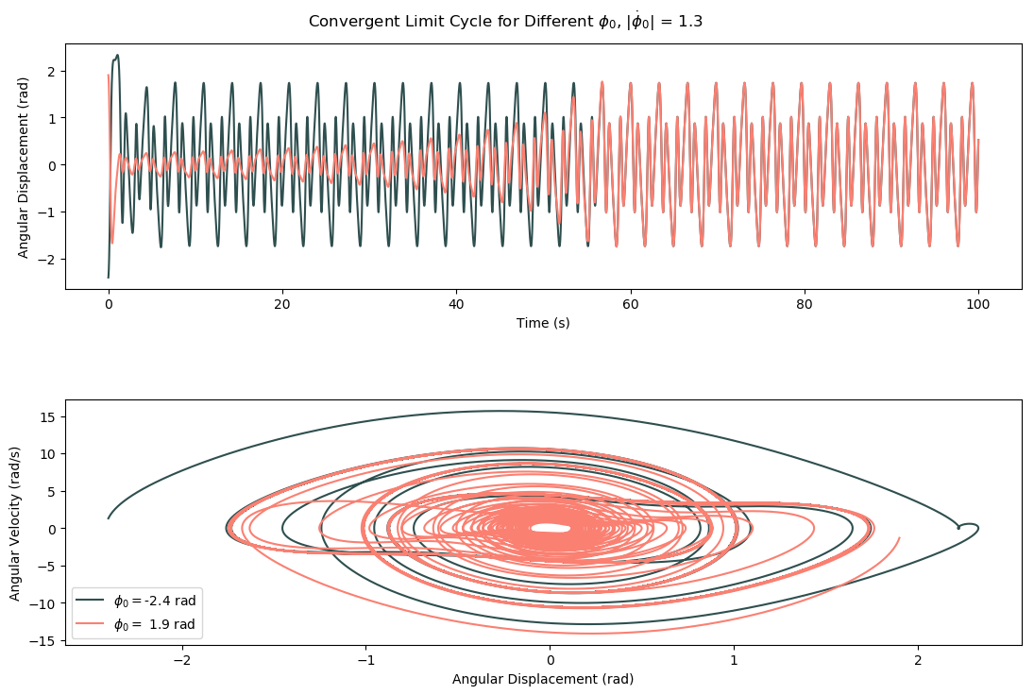
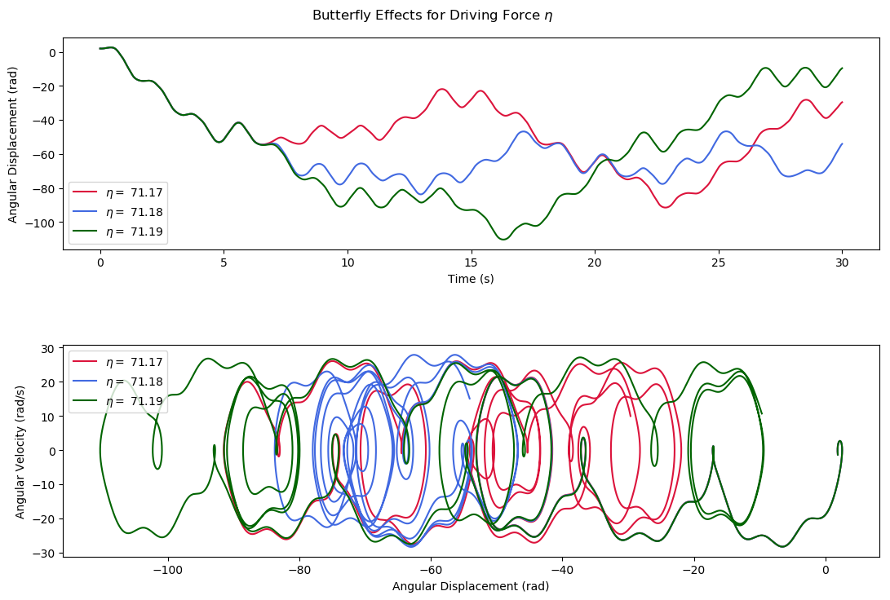
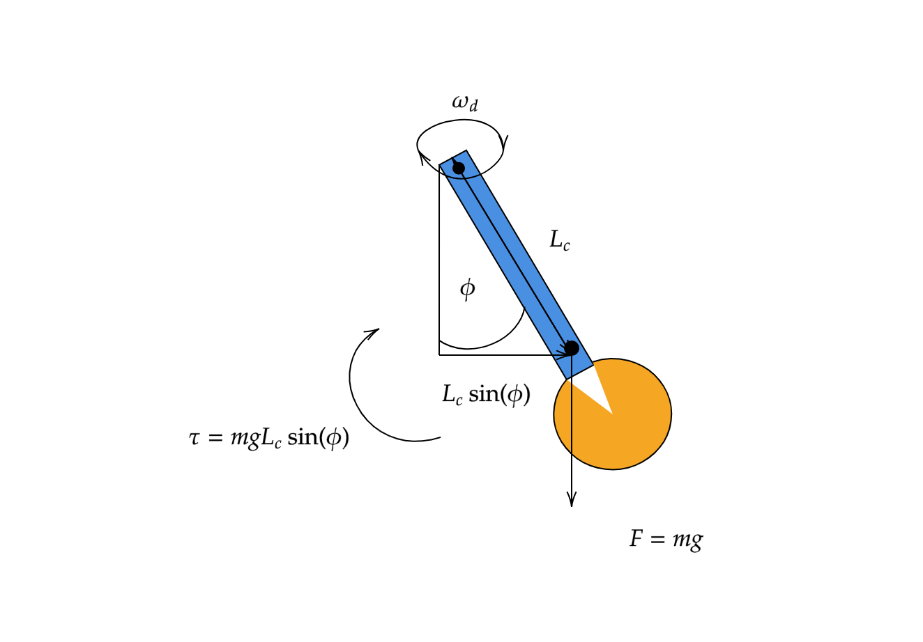

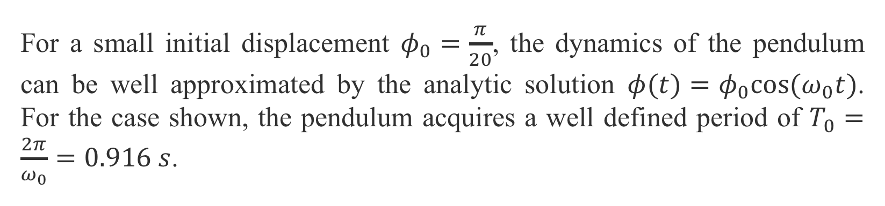
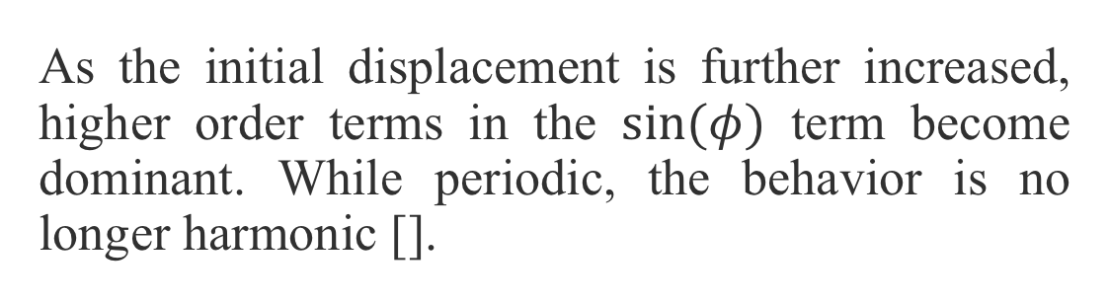

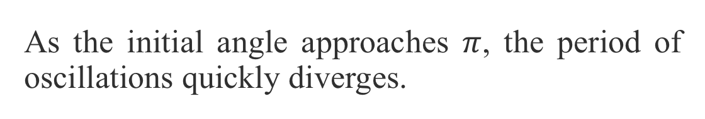
Dynamics of a Pendulum: From Harmony to Chaos
Lucas Baralt Nazario
Department of Physics, The University of Chicago
Introduction
The Simple Harmonic Oscillator
How Chaos Develops
The equation of motion for the pendulum
$$\ddot{φ}=−ω_{0}^{2}\text{sin}\left(φ\right) −2ω_{0}χ\dot{φ}+η\text{cos}(ω_{d}t+δ)$$
For a small initial displacement $φ_{0}=\frac{π}{20}$, the dynamics of the pendulum can be well approximated by the analytic solution $φ(t)=φ_{0}\text{cos}(ω_{0}t)$. For the case shown, the pendulum acquires a well defined period of $T_{0}=\frac{2π}{ω_{0}}=0.916 s$.
Elliptical phase space orbits indicate harmonic pendulum oscillations. Adding a damping force to the system causes the orbits to converge to a single point.
Three Main Cases
The Anharmonic Oscillator
In this project, I will explore how anharmonic and chaotic behavior progressively arises in pendulum dynamics by simulating the above differential equation by implementing a fourth order Runge-Kutta method in Python. The time step for each simulation was set to 0.001 s.
By manipulating the frictional and driving force parameters, $χ, η, \text{and} ω_{d}$ for a fixed $ω_{0}$, we can study three main cases of oscillatiors:
Simple Harmonic Oscillator:
$$\ddot{φ}=−ω_{0}^{2}φ−2ω_{0}χ\dot{φ} \left(1\right)$$
Anharmonic Oscillator:
$$\ddot{φ}=−ω_{0}^{2}\text{sin}\left(φ\right)−2ω_{0}χ\dot{φ} \left(2\right)$$
Chaotic Oscillator:
$$\ddot{φ}=−\text{sin}\left(φ\right)\left(ω_{0}^{2}+η\text{cos}\left(ω_{d}t+δ\right)\right)−2ω_{0}χ\dot{φ} (3)$$
As the initial displacement is further increased, higher order terms in the $\text{sin}(φ)$ term become dominant. While periodic, the behavior is no longer harmonic [].
The phase space orbits now become pointed ellipses, indicating an elongation of the period.
As the initial angle approaches $π$, the period of oscillations quickly diverges.
The Chaotic Oscillator

