Slide 1
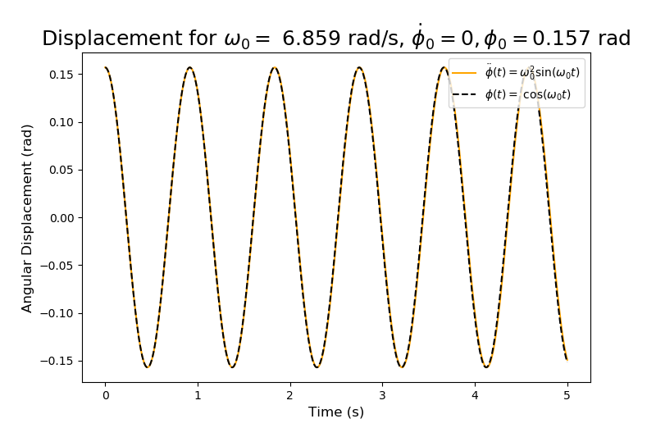
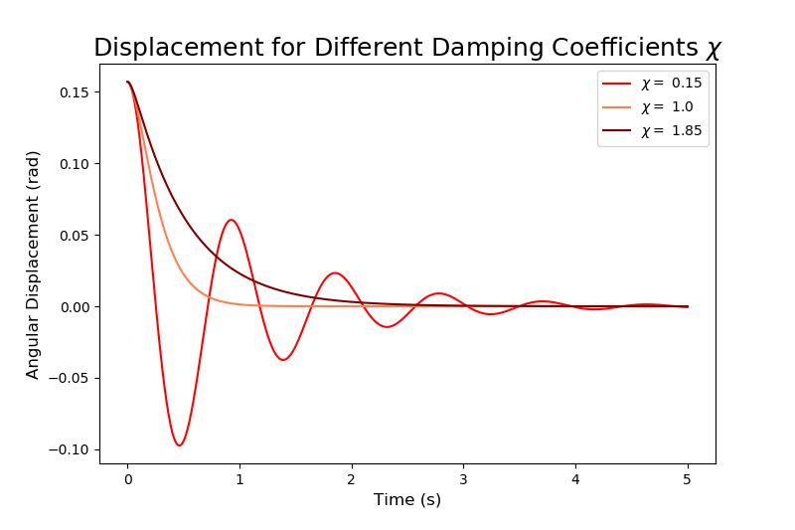
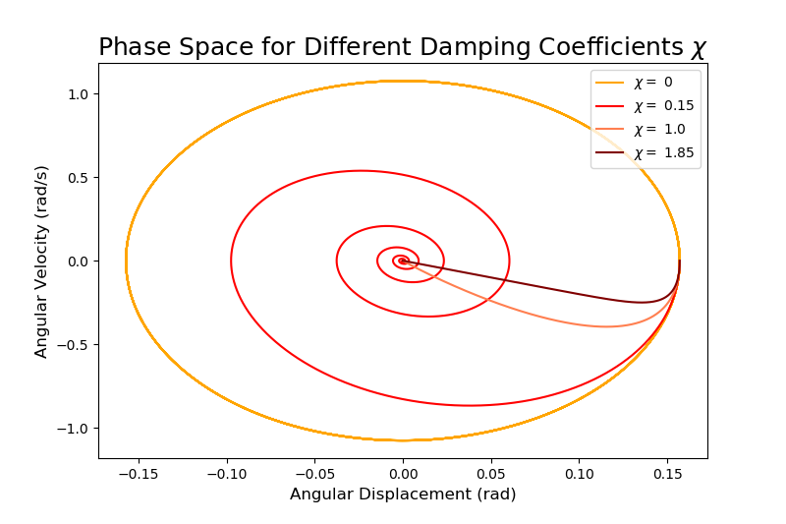
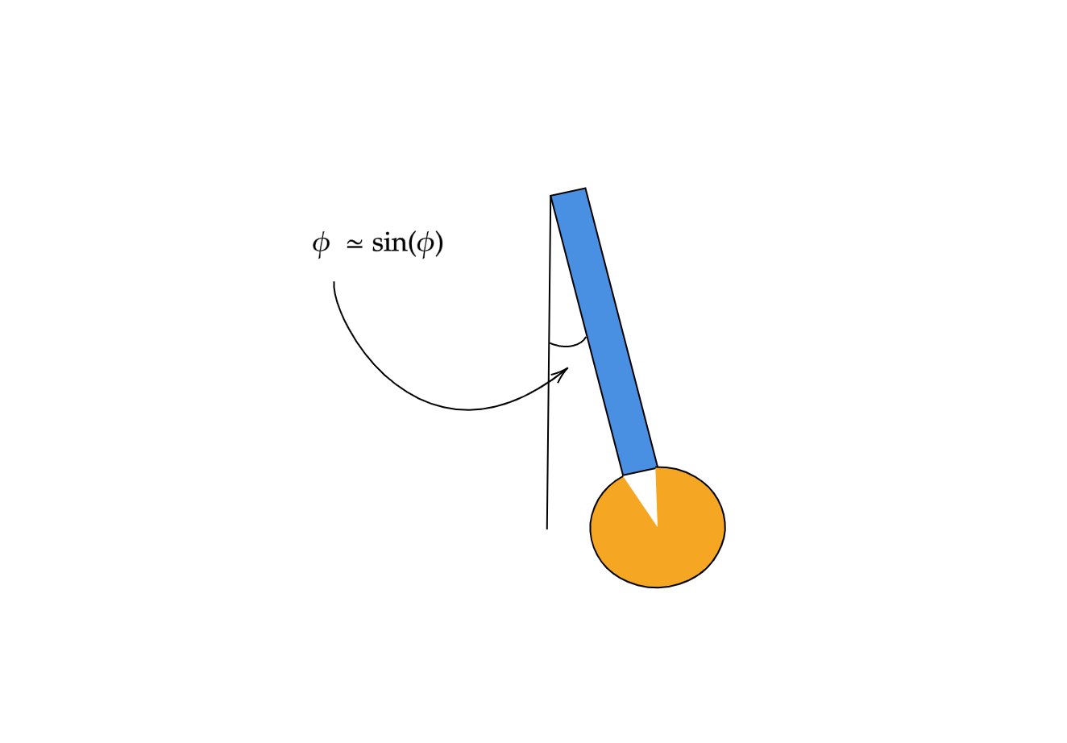
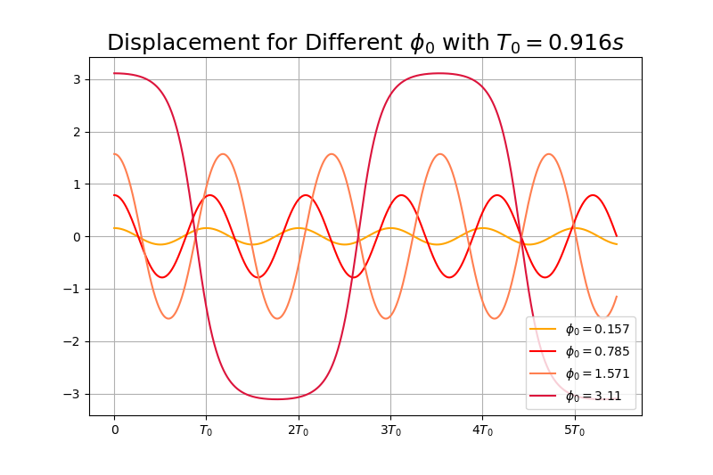
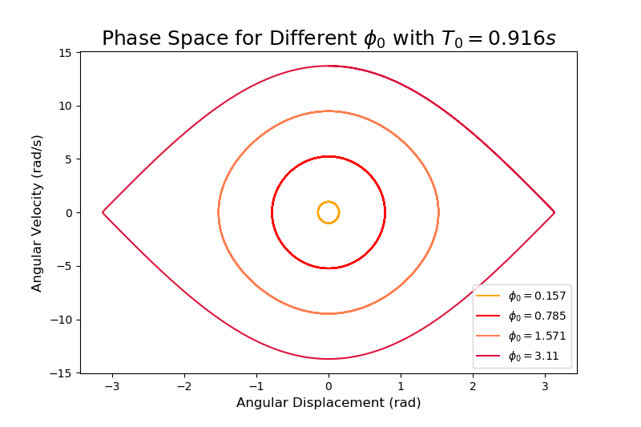
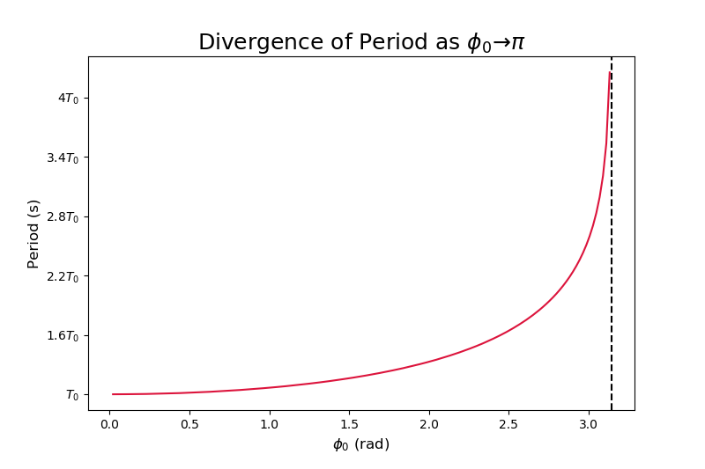
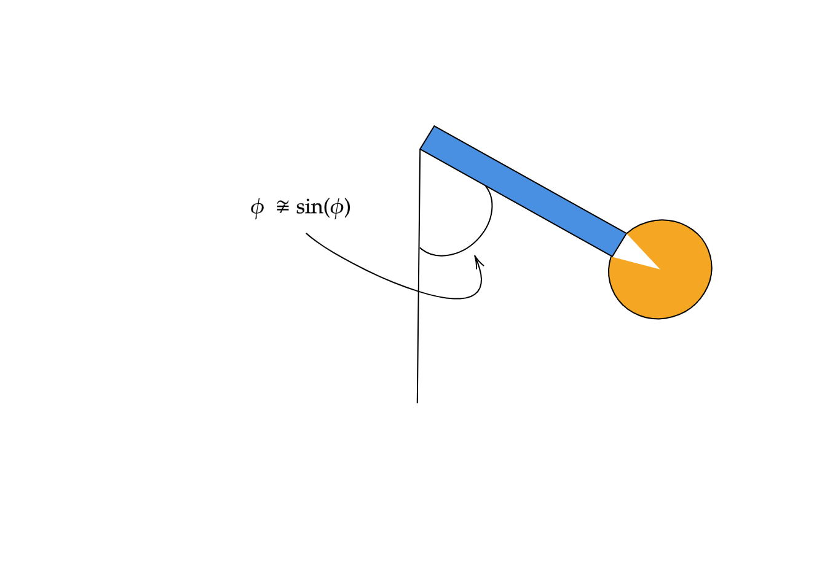
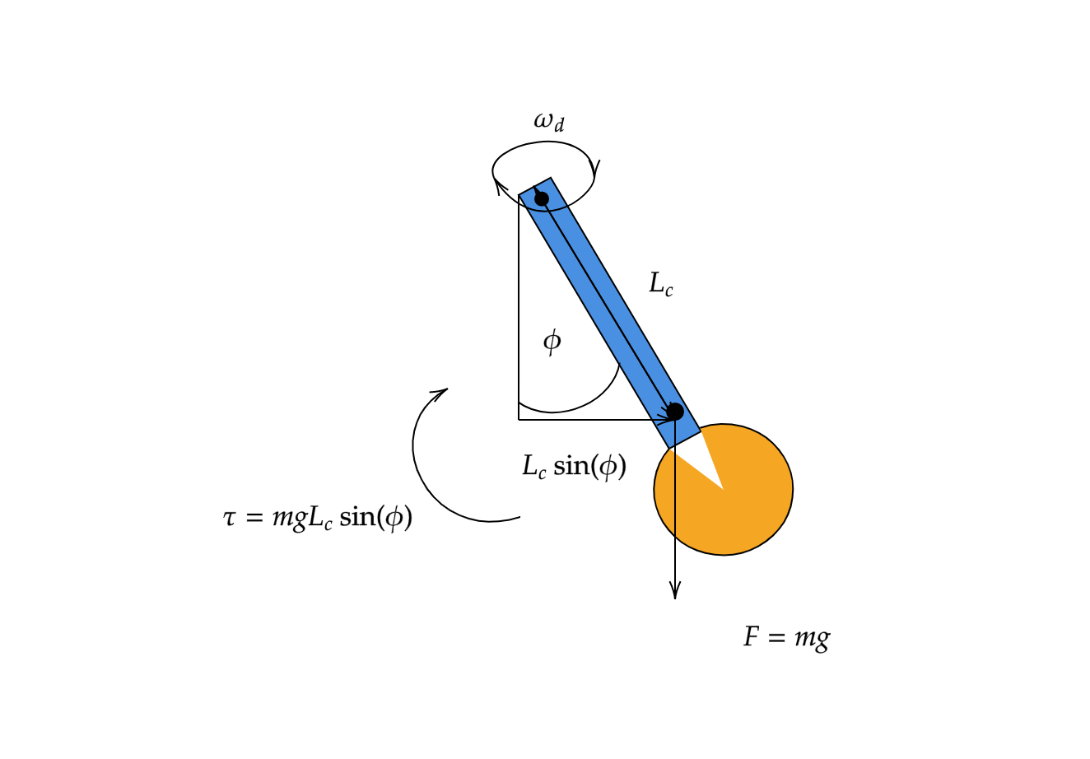

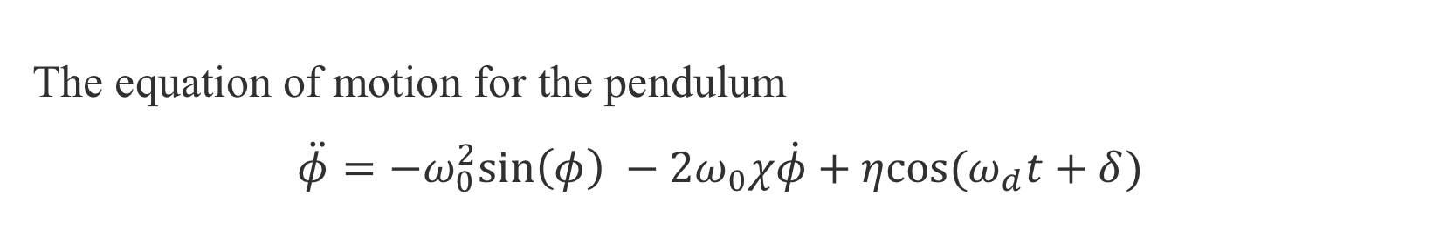
Dynamics of a Pendulum: From Harmony to Chaos
Lucas Baralt Nazario
Department of Physics, The University of Chicago
Introduction
The Simple Harmonic Oscillator
The equation of motion for the pendulum
$$\ddot{φ}=−ω_{0}^{2}\text{sin}\left(φ\right) −2ω_{0}χ\dot{φ}+η\text{cos}(ω_{d}t+δ)$$
l
Three Main Cases
The Anharmonic Oscillator
In this project, I will explore how anharmonic and chaotic behavior progressively arises in pendulum dynamics by simulating the above differential equation. I will do this by manipulating the frictional and driving force parameters, $χ, η, \text{and} ω_{d}$ for a fixed $ω_{0}$.
Simple Harmonic Oscillator:
$$\ddot{φ}=−ω_{0}^{2}φ−2ω_{0}χ\dot{φ} \left(1\right)$$
Anharmonic Oscillator:
$$\ddot{φ}=−ω_{0}^{2}\text{sin}\left(φ\right)−2ω_{0}χ\dot{φ} \left(2\right)$$
Chaotic Oscillator:
$$\ddot{φ}=−\text{sin}\left(φ\right)\left(ω_{0}^{2}+η\text{cos}\left(ω_{d}t+δ\right)\right)−2ω_{0}χ\dot{φ} (3)$$
l
Methods

