Slide 1
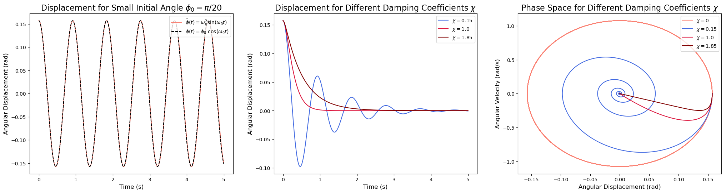
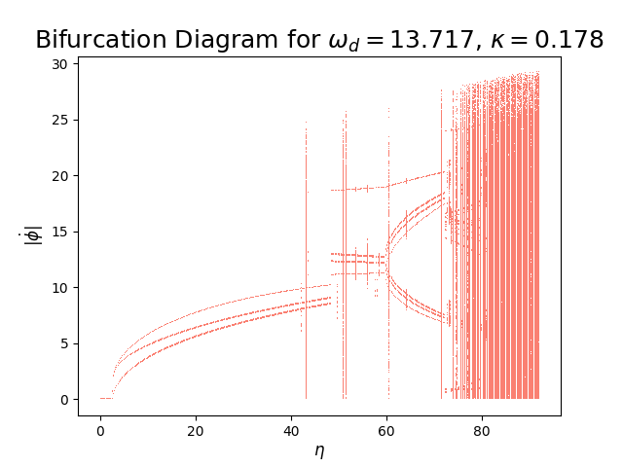
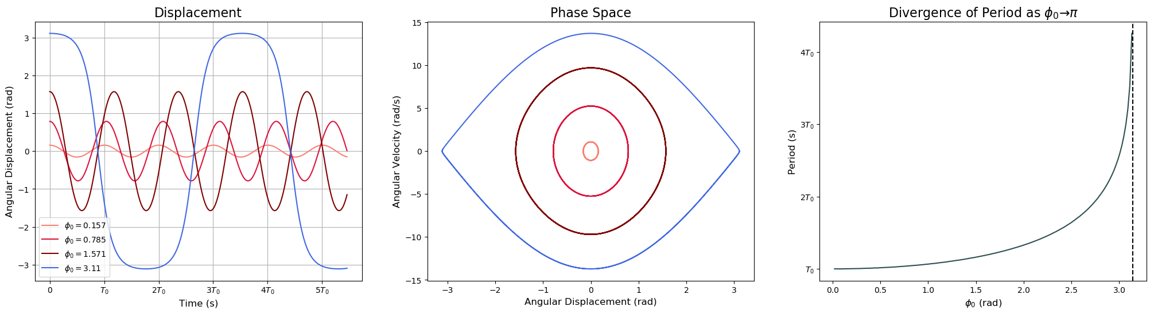
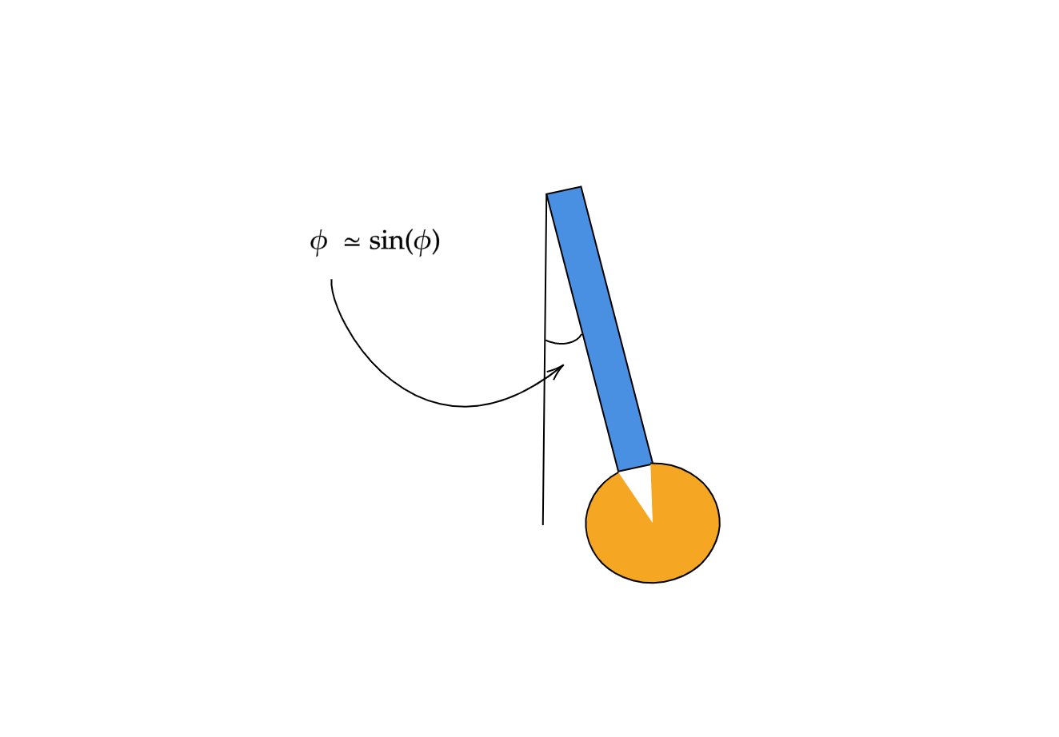
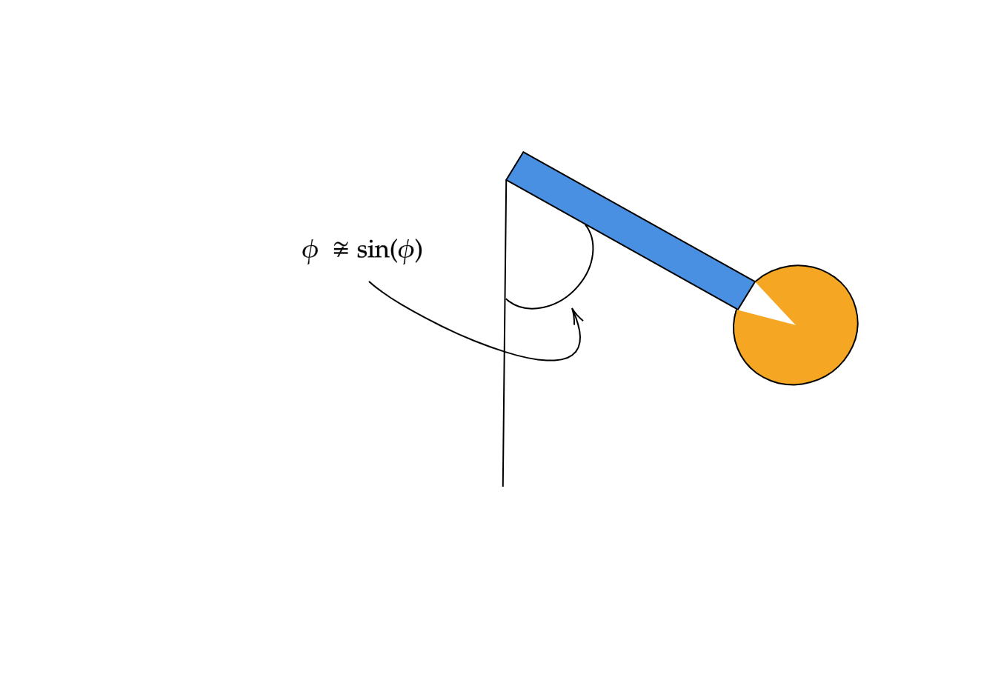
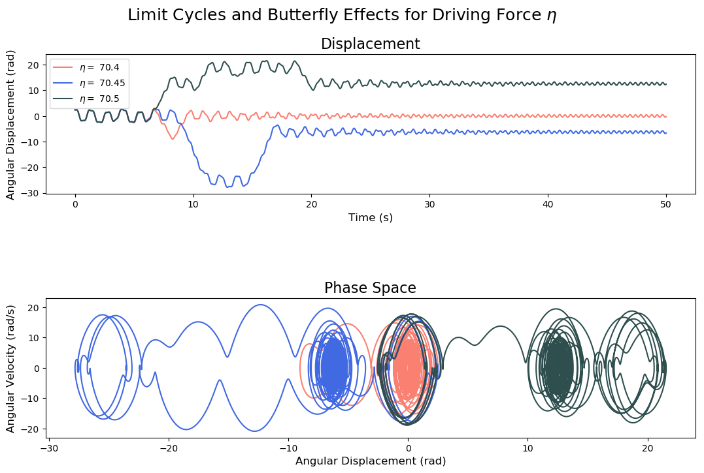
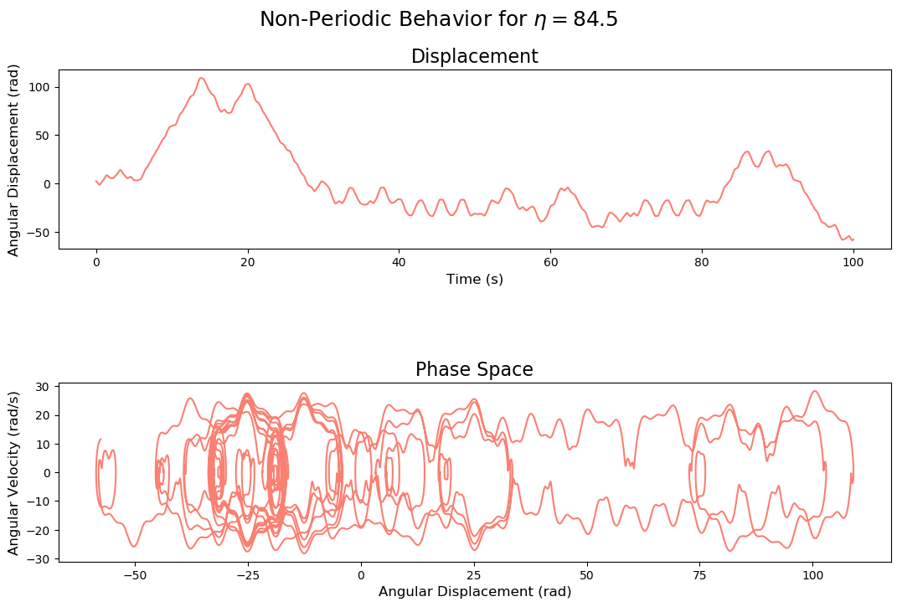
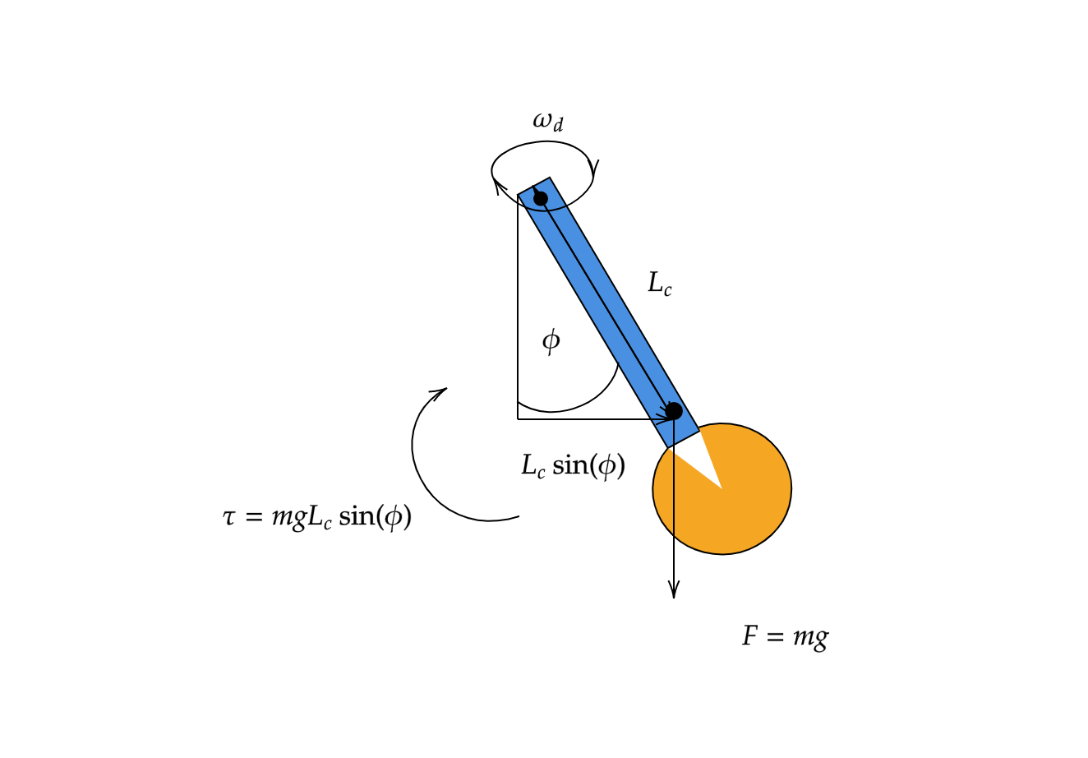

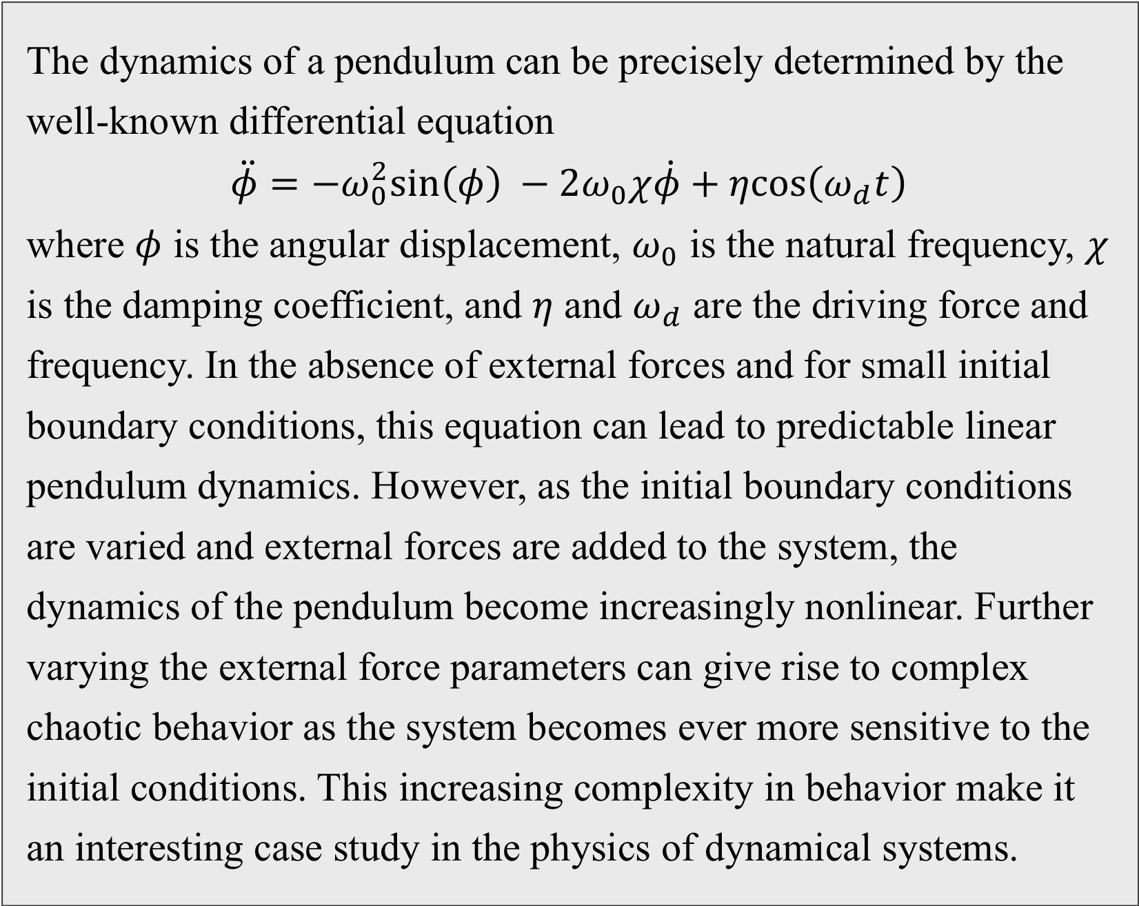
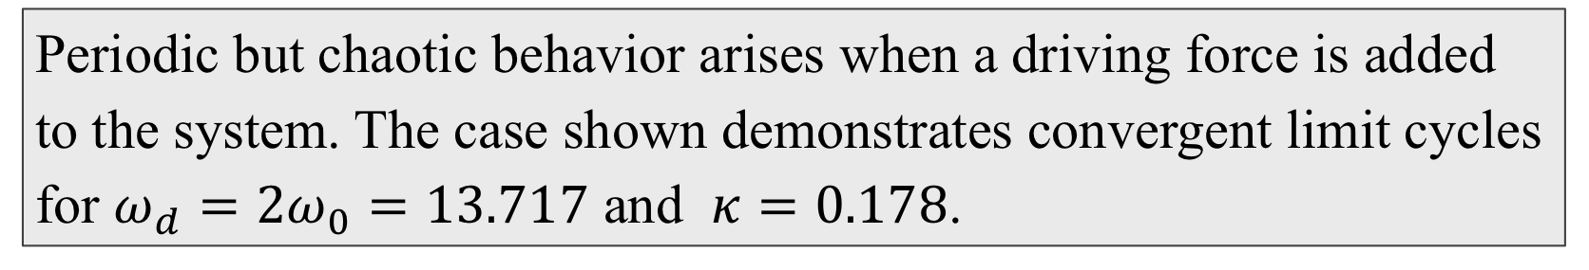
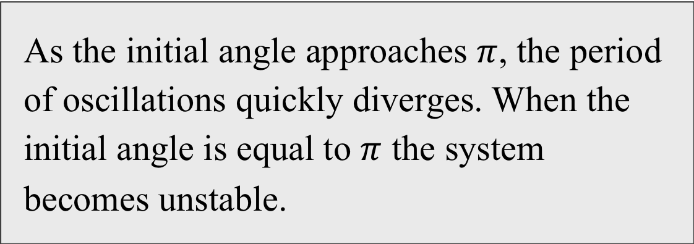
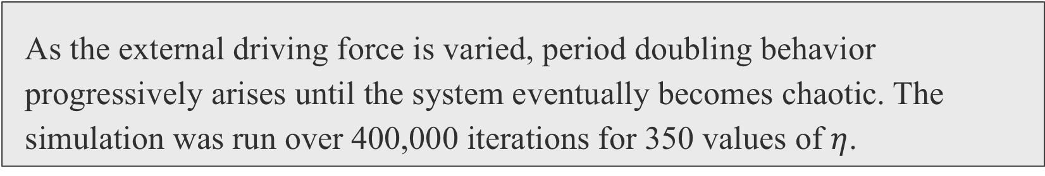
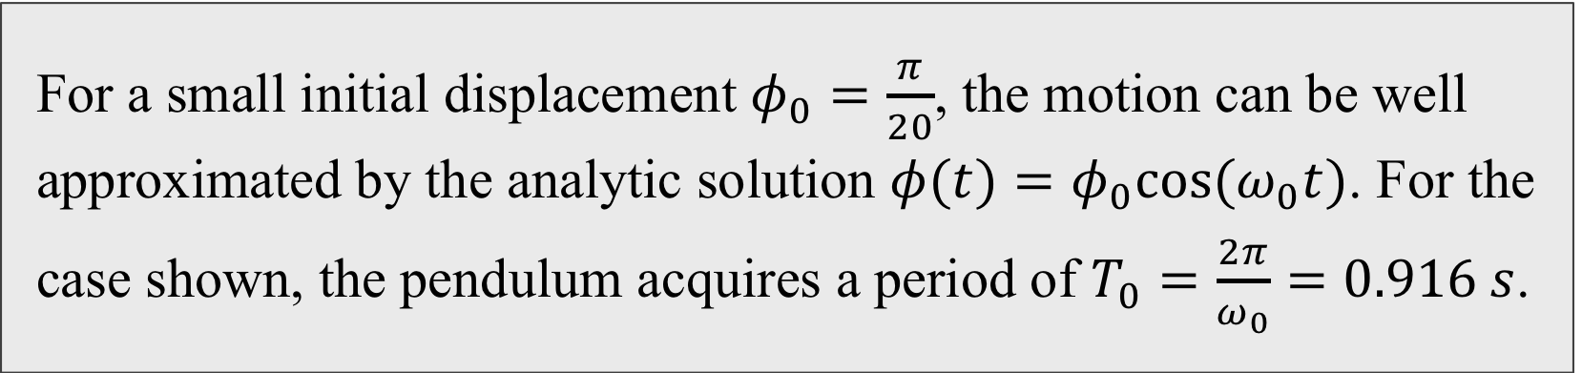
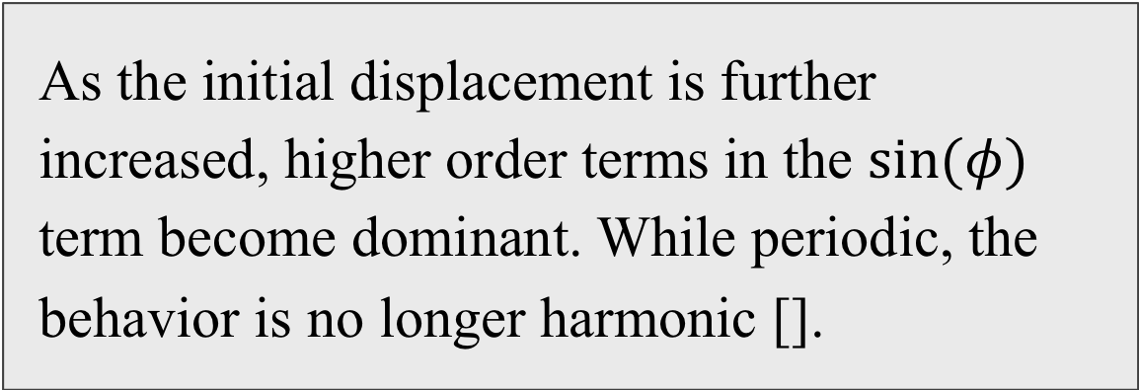
Pendulum Dynamics: From Harmony to Chaos
Lucas Baralt Nazario
Department of Physics, The University of Chicago
Introduction
The Simple Harmonic Oscillator
How Chaos Develops
The dynamics of a pendulum can be precisely determined by the well-known differential equation $$\ddot{φ}=−ω_{0}^{2}\text{sin}\left(φ\right) −2ω_{0}χ\dot{φ}+η\text{cos}\left(ω_{d}t\right)$$ where $φ$ is the angular displacement, $ω_{0}$ is the natural frequency, $χ$ is the damping coefficient, and $η$ and $ω_{d}$ are the driving force and frequency. In the absence of external forces and for small initial boundary conditions, this equation can lead to predictable linear pendulum dynamics. However, as the initial boundary conditions are varied and external forces are added to the system, the dynamics of the pendulum become increasingly nonlinear. Further varying the external force parameters can give rise to complex chaotic behavior as the system becomes ever more sensitive to the initial conditions. This increasing complexity in behavior make it an interesting case study in the physics of dynamical systems.
For a small initial displacement $φ_{0}=\frac{π}{20}$, the motion can be well approximated by the analytic solution $φ(t)=φ_{0}\text{cos}(ω_{0}t)$. For the case shown, the pendulum acquires a period of $T_{0}=\frac{2π}{ω_{0}}=0.916 s$.
Elliptical phase space orbits indicate harmonic pendulum oscillations. Adding a damping force to the system causes the orbits to converge to a single point.
As the external driving force is varied, period doubling behavior progressively arises until the system eventually becomes chaotic. The simulation was run over 400,000 iterations for 350 values of $η$.
Three Main Cases
The Anharmonic Oscillator
Conclusions
In this project, I explore how anharmonic and chaotic behavior progressively arises in pendulum dynamics by simulating the above differential equation. I implement a fourth order Runge-Kutta method in Python, using a time step of 0.001 s for each simulation.
By varying the frictional and driving force parameters, $χ, η, \text{and} ω_{d}$ for a fixed $ω_{0}$, we can study three main cases of oscillations and their corresponding differential equations:
Simple Harmonic Oscillator:
$$\ddot{φ}=−ω_{0}^{2}φ−2ω_{0}χ\dot{φ}$$
Anharmonic Oscillator: $\ddot{φ}=−ω_{0}^{2}\text{sin}\left(φ\right)−2ω_{0}χ\dot{φ}$
Chaotic Oscillator: $\ddot{φ}=−\text{sin}\left(φ\right)\left(ω_{0}^{2}+η\text{cos}\left(ω_{d}t\right)\right)−2ω_{0}χ\dot{φ}$
As the initial displacement is further increased, higher order terms in the $\text{sin}(φ)$ term become dominant. While periodic, the behavior is no longer harmonic [].
The phase space orbits now become pointed ellipses, indicating an elongation of the period.
As the initial angle approaches $π$, the period of oscillations quickly diverges. When the initial angle is equal to $π$ the system becomes unstable.
After exploring these three cases, we can appreciate how the dynamics of the pendulum become more complicated as we increase the influence of external forces in the system. In particular:
For no external driving forces, the system behaves in an easily predictable manner.
Simple linear approximations to nonlinear dynamics begin to break down as the initial conditions are varied considerably.
Adding external forces to the system heightens the system’s sensitivity to initial conditions.
Further increasing the influence of external forces in the system makes the dynamics unpredictable and chaotic.
As with many dynamical systems in nature, from weather patterns and population growth to atomic interactions, the pendulum illustrates how subtle interactions between the system and its environment quickly lead to complex and highly variable behavior.
The Chaotic Oscillator
Periodic but chaotic behavior arises when a driving force is added to the system. The case shown demonstrates convergent limit cycles for $ω_{d}=2ω_{0}=13.717$ and $κ=0.178$.
When the driving force is increased, the oscillations become aperiodic and the system becomes more chaotic.
References
Davidson, Gray (2011). The Damped Driven Pendulum: Bifurcation Analysis of Experimental Data. Reed College.
Bevivino, Josh (2009). The Path From the Simple Pendulum to Chaos. Department of Physics, Colorado State University.
Borkar, V.C. and Kulkarni, P.R. (2015). IJSIMR. 3. ISSN 2347-3142
This project was done as part of the Computational Physics 25000 course for the 2019 autumn quarter at the University of Chicago. For more information, contact me at lbaralt@uchicago.edu or visit the GitHub repository https://github.com/lubar13/Final-Project-Equation-of-Pendulum.

