Slide 1
Basic Reverse Engineering
C.K. Chen

Slide 2
What We Will Do?
Windows Reverse
Write Program in Windows
Compare to Source Code
Reverse/Crack Windows Binary
http://140.113.194.85:3000/problems/18
Linux Reverse
Reverse an unknown Binary
http://140.113.194.85:3000/problems/19

Slide 3
Our Goal
Solve 2 CTF problem
Crack Windows Egg-Level Reversing
Crack Linux Still-Egg-Level Reversing
Step by step teach you to solve it~

Slide 4
Tools
Windows
Linux
Visual Studio
Immunity Debugger
IDA Pro 6.6
GCC
GDB
NASM

Slide 5
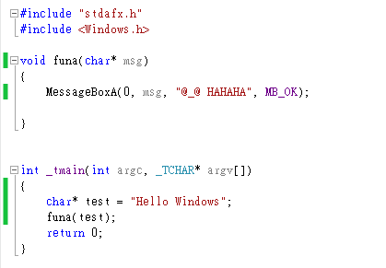
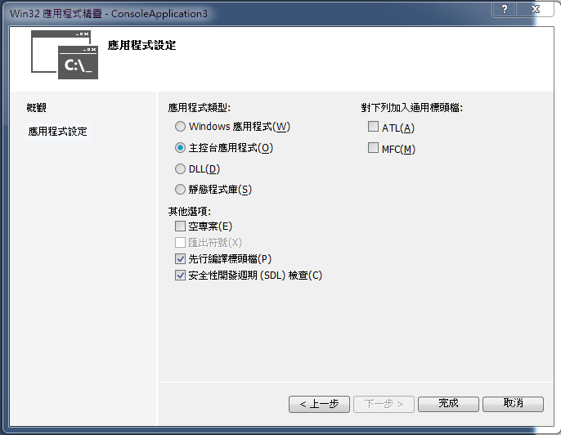
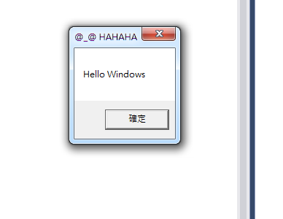
Hello World!!

Slide 6
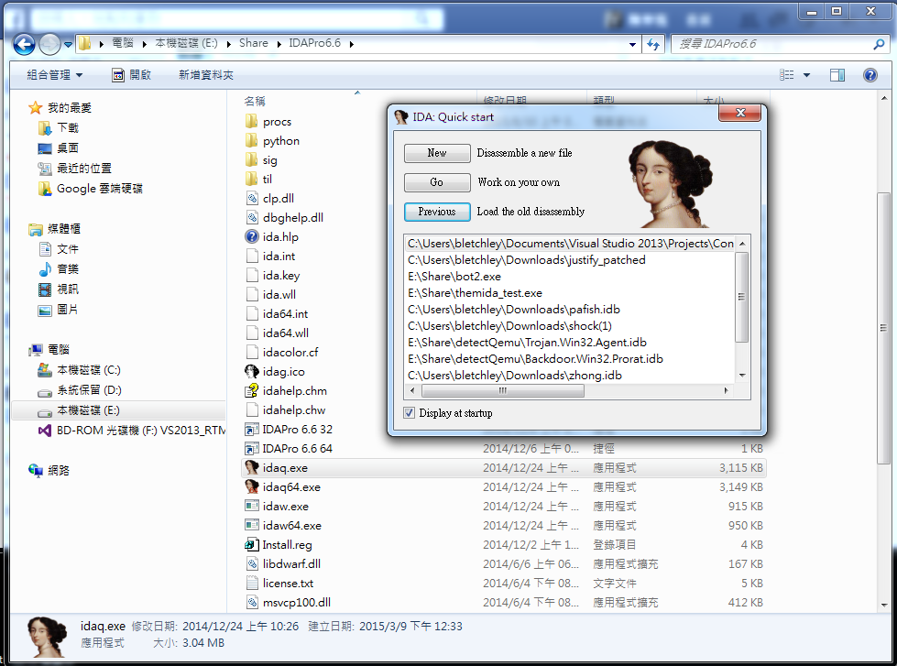
Start Reverse
What’s Reverse ?
Given Binary
What it does?
Reverse to C
Rewriting
IDA Pro 6.6

Slide 7
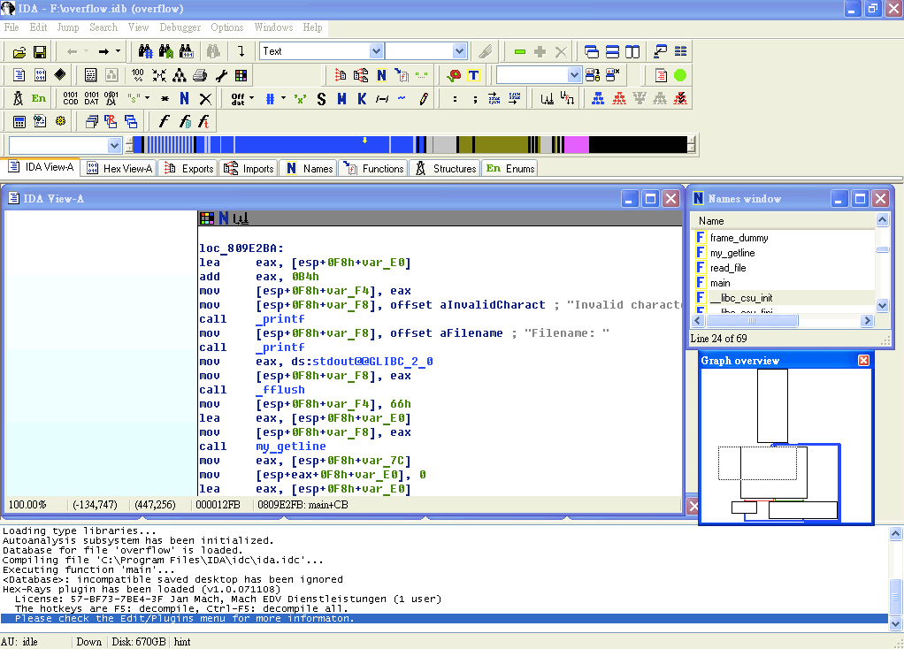
Overview
Assembly and Control Flow View
Control Flow View
Message View

Slide 8
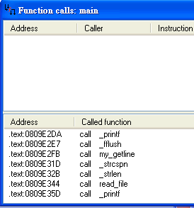
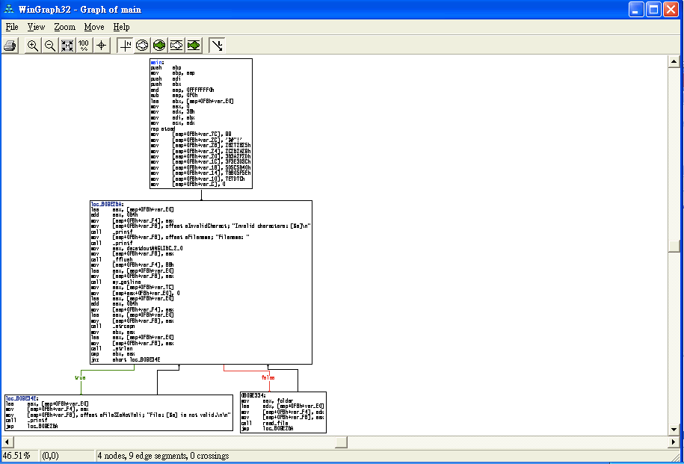

Functionality(1)
Fun Call Window
Graph
Convert Current Location
DATA
Instruction
String
Self-defined Data Structure
Array
Convert Oprand
Offset
Hex/Oct/Dec/Bin
Constant Char
Segment-based Var
Stack-based Var
….
Xref Table
Once The disassemble make mistake, you can fix it yourself

Slide 9
Functionality(2)
Export Function
List functions export to other Binary
DLL, entry point
Import Function
Functions included from other files
Import function can help you to guess the behavior of program
Names
Function Name
Variable Names
Strings
For problem with debugger information inside, names can be useful
Strings
All strings use
For some easy problem, this can help you to get flag
For other problem, it still give you quick look to program

Slide 10
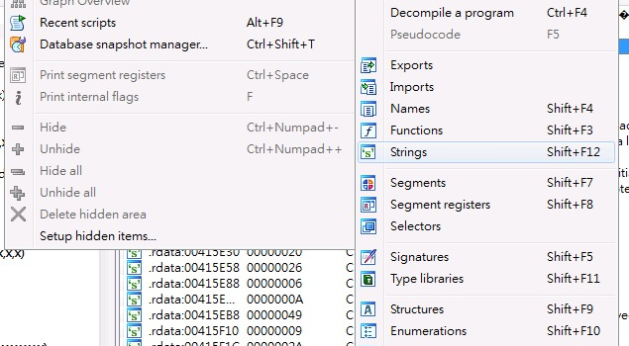
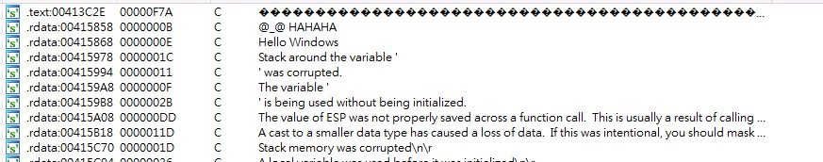
String View

Slide 11
Useful Hotkeys
List of useful hotkeys
 | Function | Hotkey
1 | Strings | Shift+F12
2 | Jump to operand | Enter
3 | Jump to previous position | ESC
4 | Jump to next position | Ctrl+Enter
5 | Jump to address | G
6 | Jump to entry point | Ctrl+E
7 | Sequence of bytes | Alt+B

Slide 12
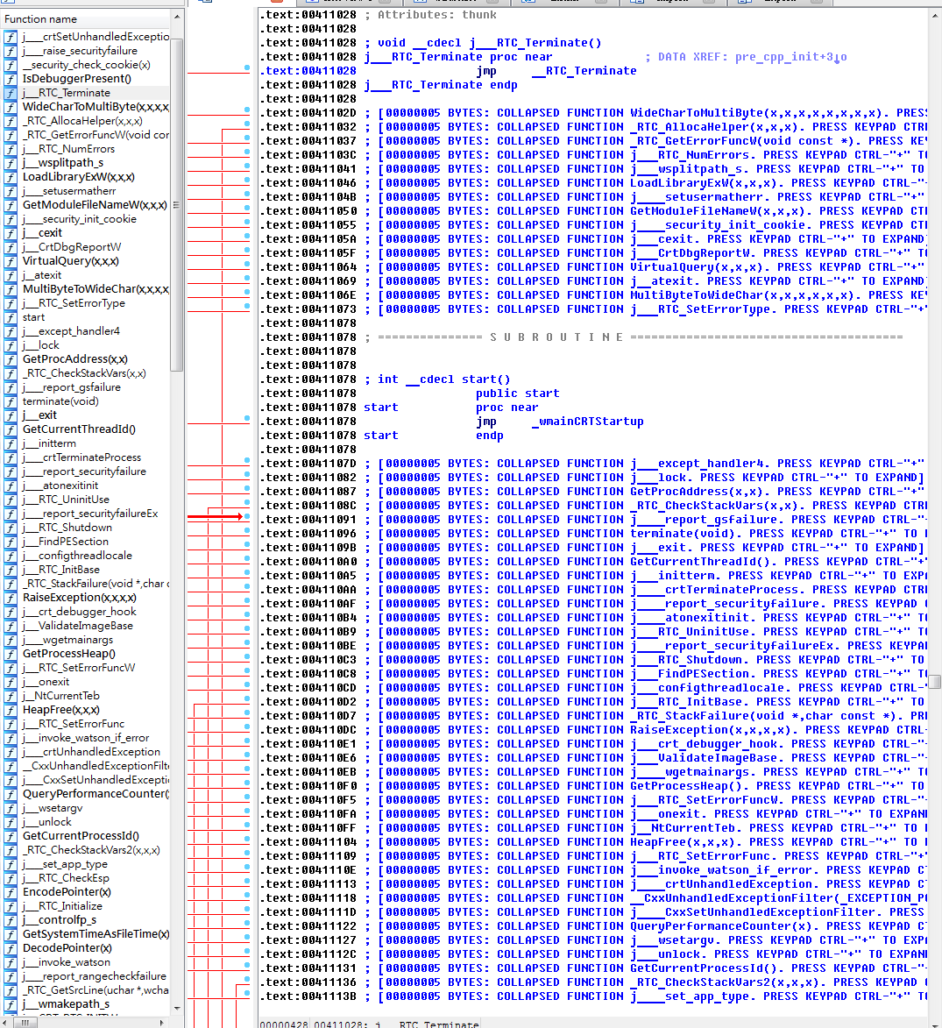

Slide 13
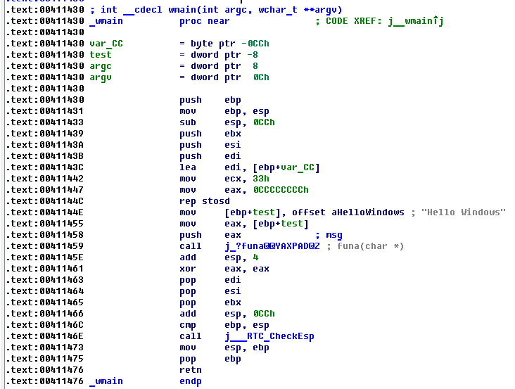

Slide 14
Intr. to Static Analysis
Static analysis
Analysis malware without execution
Dynamic analysis
Execute malware inside controllable environment and monitor it’s behavior

Slide 15
Information from Static Analysis
What information we can get from static analysis
File Structure
Binary Code
Related Module
Suspicious String

Slide 16
Information from Static Analysis
What we cannot get?
Register Value
Memory Value
Packed Code
Encrypted Message

Slide 17

Disassemble
Disassemble is a procedure to convert binary machine code into assembly code

Slide 18
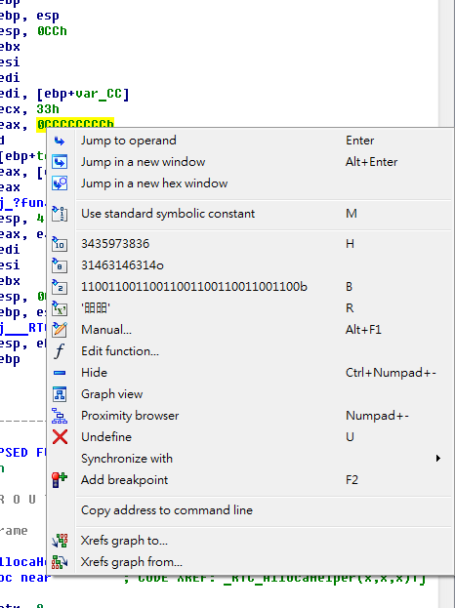
General Purpose Registers
33h ?
0CCCCCCCCh ?
進位方式
二進位 B
十六進位 H
八進位 O

Slide 19
Quiz ?
Which one is different ?
65
041h
1000001
‘B’

Slide 20
General Purpose Registers

Slide 21
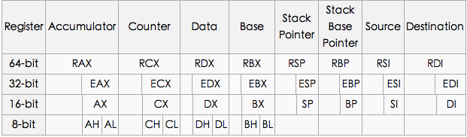
Reverse Assembly to C
Registers Architecture
The EIP register contains the address of the next instruction to be executed if no branching is done.

Slide 22
Data Movement

Slide 23
Data Movement
MOV dst, src
Src <= dst
LEA dst, src
Load effective address of operand into specified register
To calculate the address of a variable which doesn't have a fixed address
Example
mov eax, [ebp - 4] <= get content in [ebp - 4]
mov eax, ebp – 4 <= wrong, no such instruction
lea eax, [ebp - 4] <= get address of [ebp - 4]

Slide 24
Arithmetic Operator

Slide 25
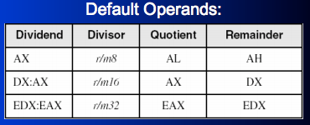
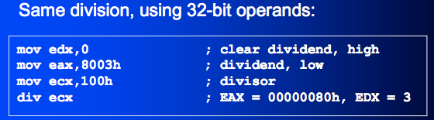
Arithmetic Operator
add dest, src
sub dest, src
mul arg
div
DIV r/m8
DIV r/m16
DIV r/m32
inc
dec

Slide 26
Branch Instruction
JE Jump if Equal ZF=1
JNE Jump if Not Equal ZF=0
JG Jump if Greater (ZF=0) AND (SF=OF)
JGE Jump if Greater or Equal SF=OF
JL Jump if Less SF≠OF
JLE Jump if Less or Equal (ZF=1) OR (SF≠OF)

Slide 27
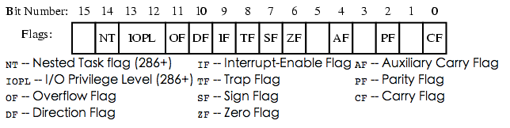
Control Instructions
Flag, each instruction updates some field of flag for future branch
test
Performs a bit-wise logical AND
sets the ZF(zero), SF(sign) and PF(parity) flags
cmp
Performs a comparison operation between arg1 and arg2
Set SF, ZF, PF, CF, OF and AF

Slide 28
Debugger
A debugger or debugging tool is a computer program that is used to test and debug other programs (the "target" program)
Also useful for malware analysis
breakpoint stops your program whenever a particular point in the program is reached
watchpoint stops your program whenever the value of a variable or expression changes
catchpoint stops your program whenever a particular event occurs

Slide 29
Information from Debugger
Runtime information
Memory Address
Register Value
Behavior of Executable
Encrypt/Decrypt

Slide 30
Functionalities of Debugger
Functionalities
Set breakpoints, watchpoint, catchpoint
Fine-grained debugging levels
Step into/over
Memory Manipulate
analyze CPU & environment
Registry
Stack status

Slide 31
Debuggers
Popular Debugger
OllyDebugger
Win debugger
Immunity Debugger
IDA
GDB

Slide 32
Breakpoint
Once breakpoint is set to certain address, program will stop executing and send signal to debugger
After breakpoint hits, we can access registers/memory
Types of breakpoint
Software Breakpoint
Hardware Breakpoint

Slide 33
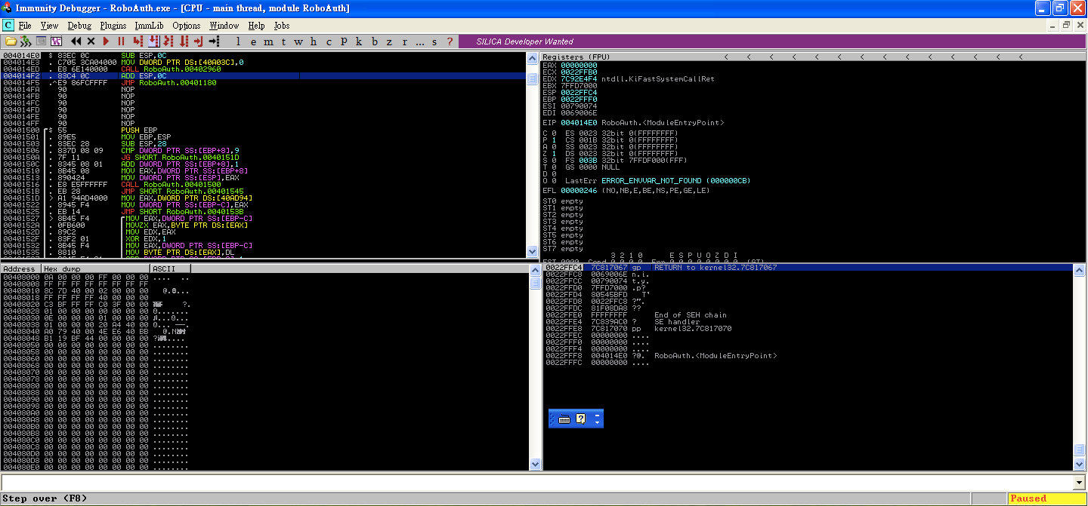
Immunity Debugger
Assembly View
CPU State
Memory State
Stack State

Slide 34
m – memory map
T – show threads
W – show windows
H – Handle List
k – Call Stack

Slide 35
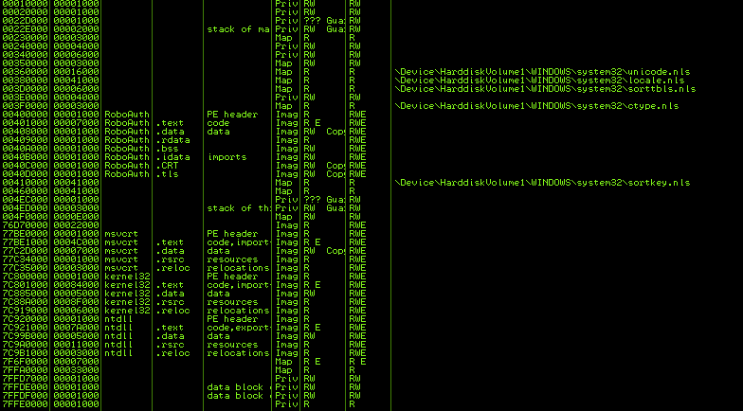
Memory Map
M
List memory mapping
Tell you the information about memory layout
If address inside your target
Suspicious memory sector
Mostly we can ignore system memory

Slide 36
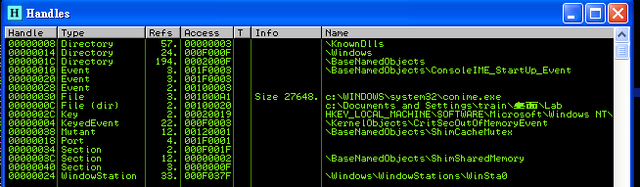
Handle List
Information of used resource
File
Registry
Socket
…….

Slide 37
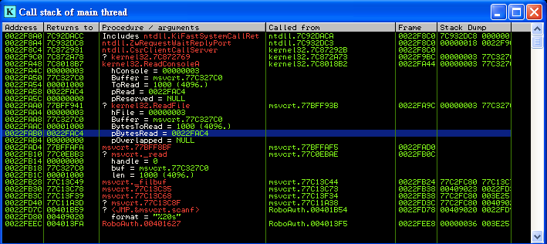
Call Stack
Useful information about which function currently called
Caller, callee dependency
Argument

Slide 38
HOTKEYS
type | hotkey | func
Control Execution | F7 | step in
 | F8 | step over
 | F9 | continue
Breakpoints | F2 | Set breakpoints
 | F4 | Run to the cursor
Location | Ctrl + g | Go to location

Slide 39
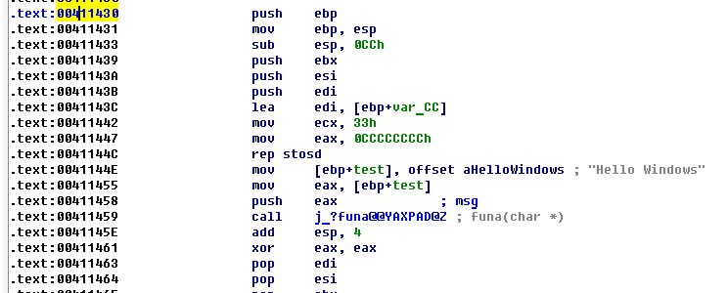
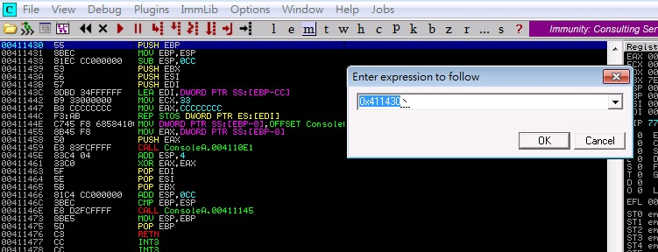
GOTO Address
Ctrl + G goto 0x0411430

Slide 40
Stack Operator

Slide 41
Stack Operation
Stack is the LIFO data structure
PUSH: put data into top of stack
POP: get data from top of stack
ESP = 0x12345678
ESP = 0x12345674
ESP = 0x12345678
Push 1
1
Pop eax

Slide 42

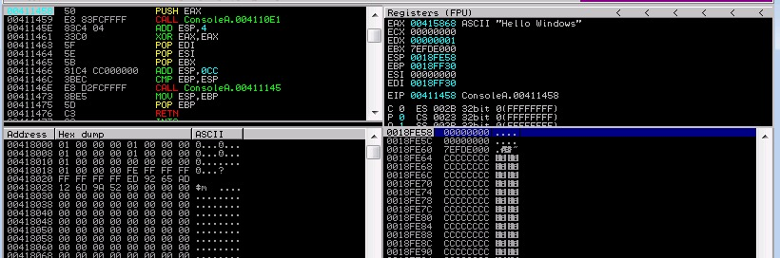
Break Point
F2 on 0x411458
run

Slide 43
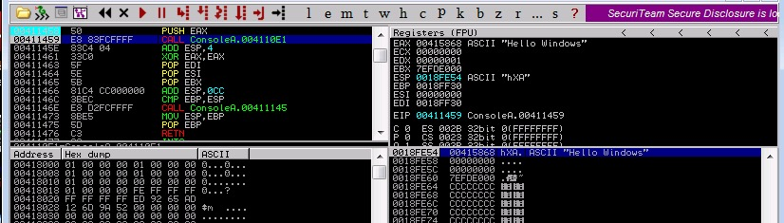
Push
f8

Slide 44
Stack Operator

Slide 45
Function Call
Call
Similar to jmp, but a CALL stores the current EIP on the stack
RET
Load the address in esp, and jump to that address
RET num
Increase esp by num
Load the address in esp, and jump to that address

Slide 46
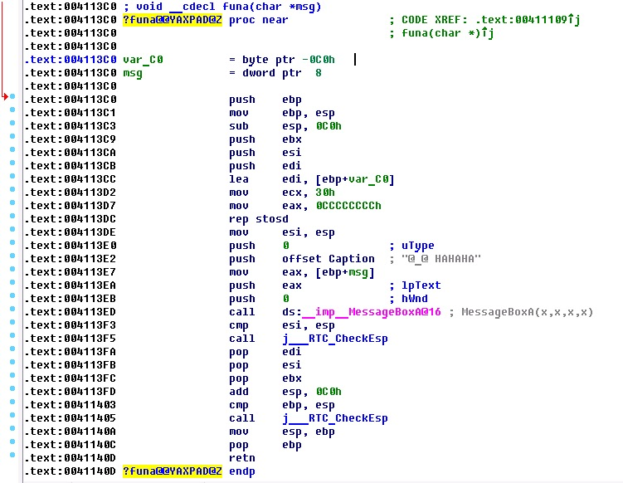
Function Prologue

Slide 47

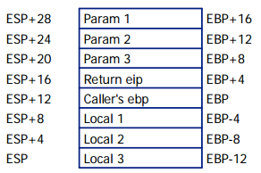

Function Prologue
Function Prologue
Store current EBP
Save ESP
Leave space for local variables
Function Epilogue
Restore ESP
Restore EBP

Slide 48
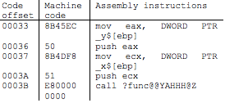

Function Call Structure
Function Call Structure

Slide 49
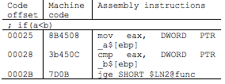
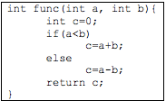
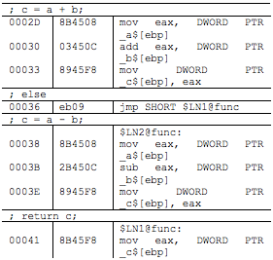
Branch Structure
Branch Structure

Slide 50
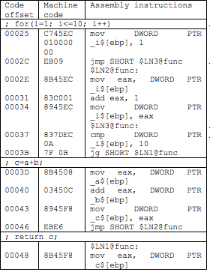

Do-For loop
Do-For loop

Slide 51
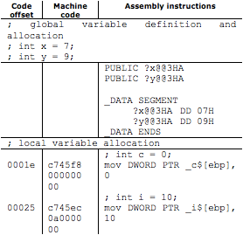
Variables
Disassembled code for local and global variables

Slide 52
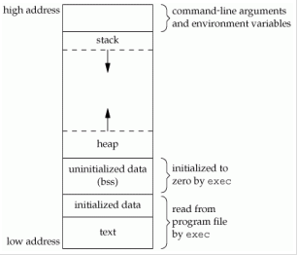
Memory Layout
Stack
Not maintain in Executable
Local Variable
Heap
Not maintain in Executable
Dynamic Allocate Memory
BSS Section
Uninitialized Data
Global variables and static variables that are initialized to zero or do not have explicit initialization in source code
Data Section
Initialized Data
Global variables and static variables
Notes:
未來補充Linux和Windows對照圖

Slide 53
Local Variables/Arguments
Caller push argument into stack
Caller push eip by call instruction
Callee save/push the caller’s ebp
Callee reserve space for local variables
sub
Stack Growing Direction

Slide 54
You’re Time Now
Windows Reverse
Linux Reverse

Slide 55
Reversing Concept
Identify important part of program
Backward tracking user data
Forward tracking interesting API function
Convert back to C code

Slide 56
Identify important part of program
Identify what you interesting
Strings: ‘flag’, ‘key’, ….
Function to read input: scanf(), gets(),…
Function for network communication: recv(), send()
Read/Write file
…..

Slide 57
Backward tracking user data
Most program vulns must be trigger by user input
You can not(or difficult) attack a function independent to your input
Keep track about variables affected by your input
Data Propagate
Data Dependency

Slide 58
Forward tracking interesting API function
Most vulns are cause by some certain functions
strcpy()
memcpy()
scanf()
printf()
strcat()
…..
Try to trigger these functions
Analysis control flow and make strategy to enforce program goto these functions

Slide 59
Convert back to C code
Gather information
IAT
Strings
Dynamic analysis
Identify function of interest
Identify CALLs
Identify algorithms and data structures
Pseudo-code it!
Rename function(s), argument(s), variable(s)

Slide 60
Summary
This course brings the basic idea of reverse
Introduce IDA Pro and Immunity Debugger
Basic ASM
How to reverse asm to c
Function call
Memory

Slide 61
Q&A

Slide 62
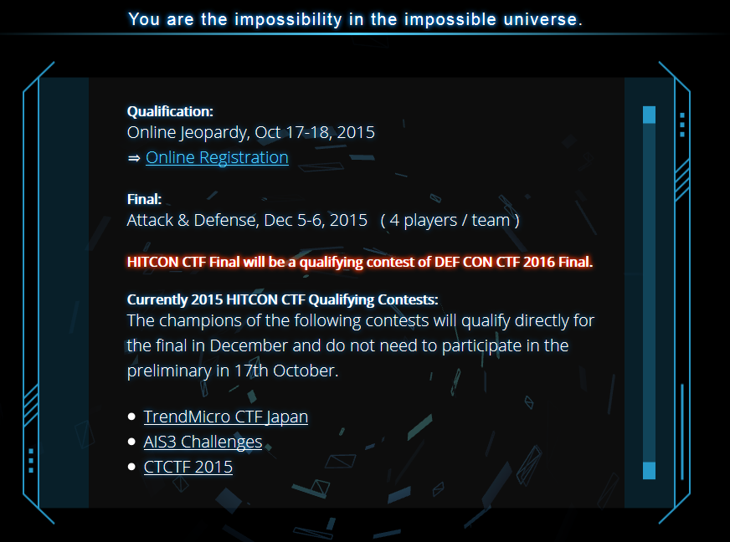
HITCON CTF

