Slide 1
Linux & SA Shell
mangoking

Slide 2
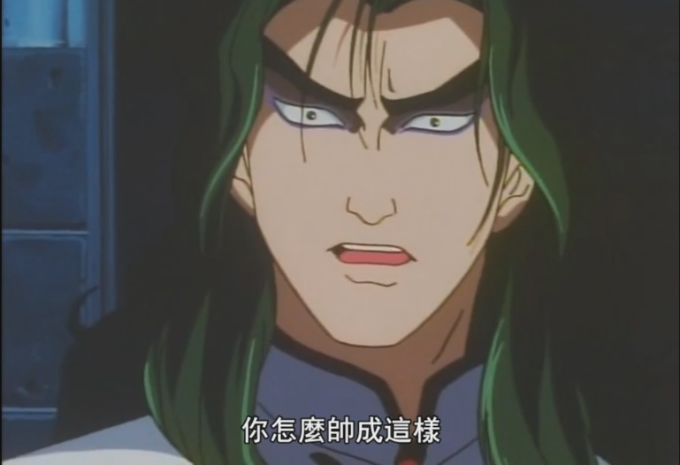
Who am I?
私はマンゴです。
交通大学の学生です。

Slide 3
Kali Linux
A Debian-based Linux distribution
Aimed at advanced Penetration Testing and Security Auditing.
Include 600 penetration testing tools
Single user, root access by design

Slide 4
User
Root (uid 0) – the God of the local host
The most privileged account on a Unix/Linux system.
Execute the initial program
Able to control and modify anything

Slide 5
Shell
The shell is a program that takes your commands to the operating system to perform.
Syntax
[user]@[host]:[directory]$ [command] -[short opt] --[long opt] args
prompt

Slide 6
ls
List directory contents
-a : do not ignore entries starting with “ . ”
-l : use a long listing format
-R : list subdirectories recursively
.
.
.
Too many options!

Slide 7
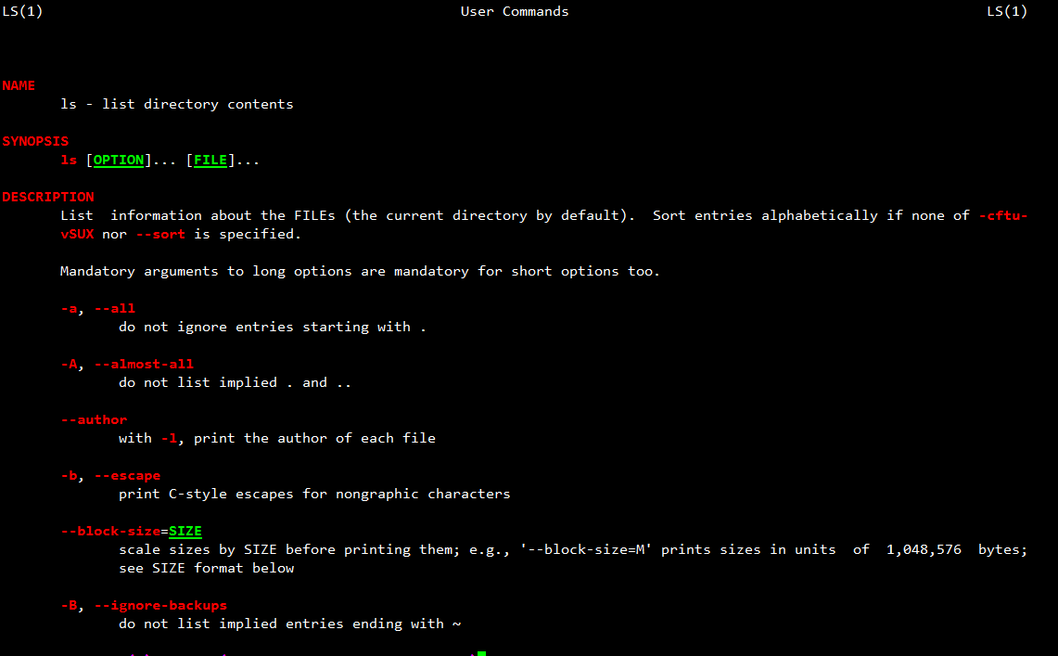
But a command has a lot of options in facts Too hard to remember all of them!!
Let’s welcome the greatest man in the Unix/Linux world
The “man” command - an interface to the reference manuals

Slide 8
Common command
comm | description | example
cd | change the working directory | cd /tmp ; cd - ;
echo | display a line of text | echo “hello world”; echo –e “hello\tworld\n”;
cat | concatenate files and print on the standard output | cat /etc/passwd;
ps | report a snapshot of the current processes | ps auxww;
top | display processes | top;
kill | terminate a process | kill 5566;
nc (netcat) | arbitrary TCP and UDP connections and listens | nc ip/hostname port;
apt-get | APT package handling utility | apt-get install packages;

Slide 9
Common command 2
comm | description | example
su | run a command with substitute user and group ID | su nobody;
touch | create a empty file | touch file;
mkdir | create a directory | mkdir dir;
cp | copy files and directories | cp file file2; cp –r dir/ /otherdir ;
mv | move (rename) files | mv file ooxx; mv dir/ newdir/
rm | remove files or directories | rm file2; rm –r newdir/
chmod | change the privilege of file | chmod 755 file; chmod [u|g|o|a][-|+][r|w|x] file;
chown | change the owner of file | chown nobody test;
exit | exit from shell | exit;

Slide 10
Variables & Quotes
var=value | Assign value to variable | var=“test” ;
$var ${var} | Get shell variable | echo $var;
`cmd` $(cmd) | Substitution stdout | echo `date`; $(bash);
‘string’ | Quote character without substitution | echo ‘This is a $var’;
“string” | Quote character with substitution | echo “This is a $var”;
據說 | 網安期末考很多人被這招打死 | $($0)

Slide 11
Special skill !!
Skill | Purpose | Example
* | Match any string of characters | ls test*
? | Match any single alphanumeric character | ls test?
[…] | Match any single character within […] | ls test[123]
[!…] | Match any single character not in […] | ls test[!234]
~ | Home directory | ls ~

Slide 12
Special skill 2 !!
Skill | Purpose | Example
# | Start a shell comment | # this is a comment
; | Command separator | cd /tmp ; ls
&& | executes the first command, and then executes the second if first command success (exit code=0) | cd /fake/dir && touch test cd /tmp && touch test
|| | executes the first command, and then executes the second if first command fail (exit code≠0) | cp x y || touch y
& | Background execution | yes &
\ | Escape character | touch test\*; ls

Slide 13
Pipe and redirect !!
Skill | Purpose | Example
cmd1 | cmd2 | Pipe stdout of cmd1 as stdin of cmd2 (Note : except stderr) | ls | grep ‘c’
cmd > file | Write stdout of cmd into the file | echo “I love 5566” > lies.txt
cmd >> file | Append stdout of cmd into the file | echo “It’s true” >> lies.txt
cmd < file | Read the file as stdin to cmd | tr ‘ ’ ‘_’ < lies.txt
2>&1 | Redirect stderr to stdout | ls file_not_exist 2>&1 | less

Slide 14
Bash Keyboard Shortcuts
Up (Down) key : Previous (Next) command
Ctrl + C : Send kill interrupt to the current process
Ctrl + Z : Suspend the current process, wake up it with “fg” command
Ctrl + D : Send EOF marker
Ctrl + L : Clear screen
Ctrl + A : Go to the beginning of line
Ctrl + E : Go to the end of line
Alt + B : Backward a word
Alt + F : Forward a word
More detail : http://ss64.com/bash/syntax-keyboard.html

Slide 15
Let’s play a game !!
This game is Can_you _type .
How to play? Just connect to localhost with 5566 port
And type the password to get the shell (pwn).
Source code is already in the project.

Slide 16
How to?
Writing a socket program with Python or Perl?
But I am lazy and just want using built-in command.
Demo time :D

Slide 17
Service
service [services] start|stop|restart|reload|status
Services are located at /etc/init.d/
For example
xinetd
sshd
httpd (apache)
ftpd

Slide 18
Thank you
更多Linux相關知識請勞駕到鳥哥的網站 : http://linux.vbird.org/

