Slide 1
Python
bananaapple

Slide 2

Who am I?
ID : bananaapple
學校科系 : 交通大學資工系
年級 : 大四
目前為 Bamboofox 中的一員
學習資安約一年

Slide 3
Outline
Introduction
Installation
Getting Started
Version
Print
Input
Object
Integer
String
List
Arithmetic
Conditional and Comment
Loop and function
Module
Socket
Struct
Pwntools
Vulnerable
Practice
Reference

Slide 4

Introduction
Easy
Swift
Grace
Object-oriented
Strong module support
Default built in most environment
Script language

Slide 5
Installation
Debian GNU / Linux
apt-get install python
apt-get install python-dev
// install additional header file and static library
Windows
Sorry

Slide 6
Getting Started
From terminal type python
python
Save file with file extension .py and type python print.py
python print.py
Add first line #!/usr/bin/env python
Add executable privilege to file and ./filename execute it
./print.py

Slide 7
Version
Python2 or Python3?
We recommended use Python3
Almost the same
Except for print

Slide 8


Print
End with newline character
Format output
print "%d" % (100)
print "{0}{1}".format('hello', 'world')
If you want to manually control output use sys.stdout.write() instead
Python2
Python3

Slide 9
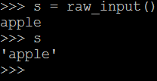
Input
raw_input()
Read a line from stdin and strip a trailing newline
Python2
raw_input()
Python3
input()
Difference:
Python3 will run eval(input())
and return

Slide 10
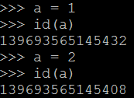
Object
Everything in Python is object
an identity ( use id to observe it )
a value ( immutable and mutable )
Immutable: Integer, String, Tuple
Mutable: List , Dictionary
When immutable value change
id will be different
When mutable value change
id will be the same

Slide 11
Integer
Declare a variable
i = 1 or i = 0x5566
Print integer as hex
i = 0x5566
hex(i)
# '0x5566'
chr(0x61)
# 'a'
Change hex string to integer
s = '0x5566'
i = int(s,16)
print str(i)
# 21862
Convert character to integer
ord('a')
# 97

Slide 12
String
s.strip()
將字串頭尾的newline和space去掉
s.find(‘string’)
return找到string的index
s.replace('old', 'new', [max])
將old字串取代成new
最多取代max次
s[0:len(s)]
s='abcde'
len(s) # 5
s=s[0:2] # s= 'ab'
s='abcde'
s[::2] # 'ace'
s[:-1] # 'abcd'
s[::-1] # 'edcba'
s[:] # 'abcde'

Slide 13
List
Declare with []
lis =[]
lis.append(element)
# lis = [element]
lis.remove(element)
lis.sort()
lis.reverse()
Split string include spaces
s = 'a b c d e'
lis = s.split(' ')
# lis = ['a', 'b', 'c', 'd', 'e']
map( function_name, sequence )
def f(x):
return x**2
map(f,range(10))
[0, 1, 4, 9, 16, 25, 36, 49, 64, 81]

Slide 14
arithmetic
Add
+
Minus
-
Multiply
*
Divide
/
Power
**
Ex: 2**3 = 8
Modulo
%
Ex : 8 % 3 = 2

Slide 15
Conditional and Comment
if condition:
statement
elif condition:
statement
else:
statement
Single line comment begins with # character
#Code to be commented out
Multiple line comment
"""
Code to be commented out
Code to be commented out
"""

Slide 16
Loop and function
for i in range(N):
print I
will print 0 to N-1
for x in string:
print x
will print every character in the string appended with newline
While condition:
statement
in the loop we could use break or continue to control the loop
def function_name ( parameter ):
statement
return

Slide 17
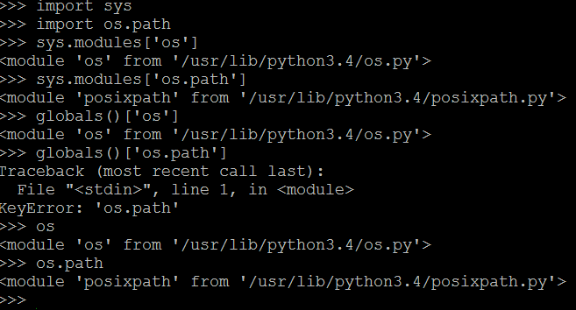
Module
import module
module.name
module.attribute
Imports the module X, and creates a reference to that module in the current namespace. Then you need to define completed module path to access a particular attribute or method from inside the module ( e.g.: X.name or X.attribute )

Slide 18
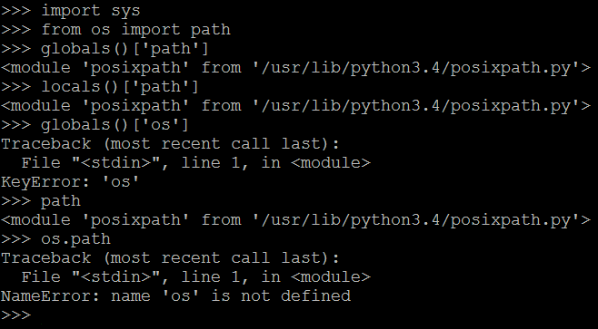
Module
from module import *
name
attribute
Imports the module X, and creates references to all public objects defined by that module in the current namespace (that is, everything that doesn’t have a name starting with _) or whatever name you mentioned.
This makes all names from the module available in the local namespace.

Slide 19
Socket
from socket import *
from telnetlib import *
ip = '140.113.209.24'
port = 10000
s = socket(AF_INET, SOCK_STREAM)
s.connect((ip,port))
t = Telnet()
t.sock = s
t.interact()

Slide 20
Socket
s.recv(buf_size)
收 buf_size 長度的字串
buf = s.recv(4096)
s.send(string)
將 string 送過去
s.send(payload)
s.close()
關閉 socket

Slide 21
Struct
Pack the integer into little-indian or big-indian
import struct
address = 0x0804aabb
payload = struct.pack('<I', address)
#payload = "\xbb\xaa\x04\x08"
address = struct.unpack('<I', payload)[0]
hex(address)
# address = 0x804aabb

Slide 22
Pwntools
Installation
sudo apt-get install python-dev
sudo apt-get install python-setuptools
sudo easy_install pip
sudo pip install pwntools
Getting started
from pwn import *

Slide 23
Pwntools
Context - Setting runtime variables
context.update(arch='i386', os='linux')
i386 is 32bits, amd64 is 64bits
If you don’t want to see the notice
context.log_level = 'error'

Slide 24
Pwntools
ip = '140.113.209.24'
port = 10000
s = socket(AF_INET, SOCK_STREAM)
s.connect((ip,port))
s = remote(ip, port)
t = Telnet()
t.sock = s
t.interact()
s.interactive()

Slide 25
Pwntools
Packing integer
address = 0x0804aabb
payload = struct.pack('<I', address)
Payload = p32(0x0804aabb)
8 bytes?
Payload = p64(0x0804aabb)
Unpack string to integer
payload = "\xbb\xaa\x04\x08"
address = struct.unpack('<I', payload)[0]
address = unpack(payload)
hex(address)
# address = 0x804aabb

Slide 26
Pwntools
Too much to list
Shellcode
Working with elf
Working with gdb
Memory leak
Rop chain
Translate assembly to string
Shellcode

Slide 27
Vulnerable
Pickle
import pickle
import os
class Exploit(object):
def __reduce__(self):
comm="sh"
return (os.system, (comm,))
a = pickle.dumps(Exploit())
b = pickle.loads(a)
shell跑出來啦!!!

Slide 28
Practice
Hackerrank
https://www.hackerrank.com/
Combination
http://ctf.cs.nctu.edu.tw/problems/31
Pickle ( 之後會換 )
nc 140.113.194.85 49167
http://people.cs.nctu.edu.tw/~wpchen/spam.py

Slide 29
Reference
90% of Python in 90 Minutes
http://www.slideshare.net/MattHarrison4/learn-90
From import vs import
http://stackoverflow.com/questions/9439480/from-import-vs-import
Angelboy’s CTF note
http://angelboy.logdown.com/posts/245988-ctf-notes
Pwntools document
https://pwntools.readthedocs.org/en/2.2/about.html

