Slide 1
Module 2
Content – Based recommender system
The long tail principle , Domain–specific challenges in recommender systems. Content based recommender system.

Slide 2
The long tail principle
The long tail refers to the data points at the trailing end of a power-law distribution. A long-tail strategy involves efficiently exploiting these low-impact — but numerous — data points for an aggregated benefit.
The Long Tail is composed of a small number of popular items, the well-known hits, and the rest are located in the heavy tail, those not sell that well.
The Long Tail Principle suggests that while a small number of popular items (the "head") account for most demand, a vast number of niche or less-popular items (the "tail") can collectively generate significant demand when made accessible.

Slide 3
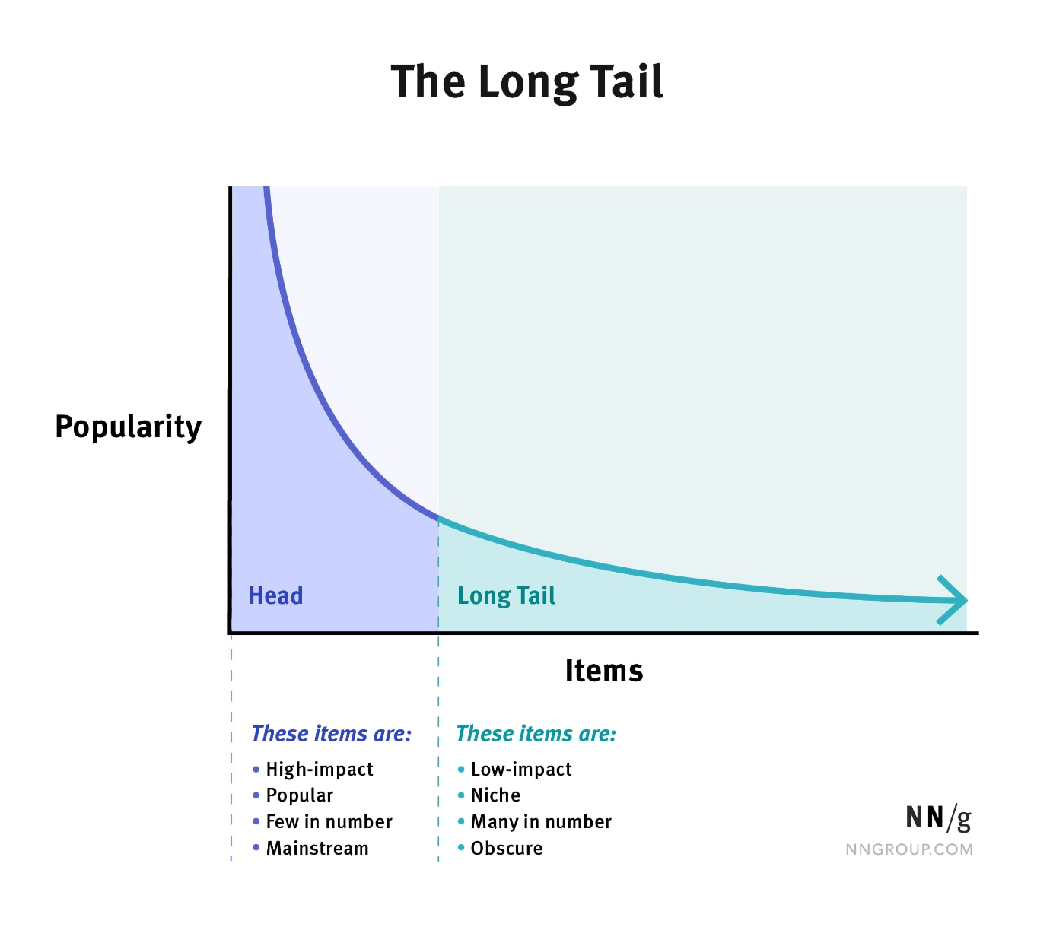

Slide 4
The Long Tail in Recommender Systems
1. Distribution of Demand:
Head: Popular items (e.g., blockbusters, bestsellers).
Tail: Niche items with low individual demand but significant collective demand.
2. Unlocking the Long Tail:
Recommender systems help unlock the long tail by:
Exposing niche items to the right users.
Personalizing experiences to match individual preferences.
Example:
Netflix: Recommends niche films like independent documentaries to users interested in specific genres.
Amazon: Highlights obscure products through features like “Customers who bought this also bought.”

Slide 5
Implications in Recommender Systems
Discovery:
Users discover unique and less-popular items they wouldn’t have found otherwise.
Diversity:
Encourages exploration of the entire catalog rather than just the most popular items.
User Satisfaction:
Catered recommendations enhance user engagement and loyalty.

Slide 6
Challenges
Data Sparsity:
Niche items have fewer interactions, making accurate recommendations difficult.
Solution: Use matrix factorization or deep learning to infer patterns.
Cold Start Problem:
New items lack interaction data.
Solution: Recommend items based on attributes or promote them initially.
Balancing Popularity and Niche Items:
Over-promoting niche items might reduce engagement if users prefer popular ones.
Solution: Introduce a balanced mix of popular and niche items.

Slide 7
Real-Life Examples
Netflix:
Suggests obscure films tailored to individual tastes.
Amazon:
Recommends niche products through collaborative filtering.
Spotify:
Highlights lesser-known songs in personalized playlists like “Discover Weekly.”
Why It Matters
1. Business Perspective:
Generates revenue from niche items and improves inventory utilization.
2. User Perspective:
Provides personalized experiences and encourages exploration.
3. Cultural Impact:
Promotes diversity and inclusion by showcasing lesser-known creators and content.

Slide 8
Domain-Specific Challenges in Recommender Systems
1. Cold Start Problem
Users: New users have no interaction history.
Items: New items lack sufficient data for recommendations.
Solution: Use hybrid approaches, onboard user preferences, or promote new items to gather initial data.
2. Data Sparsity
Problem: Sparse user-item interaction data limits recommendation accuracy.
Solution: Use advanced algorithms like SVD or deep learning, and enrich datasets with external information.
3. Scalability
Problem: Large datasets increase computational cost.
Solution: Implement distributed computing (e.g., Hadoop, Spark) and precompute recommendations offline.

Slide 9
4. Diversity vs. Accuracy
Problem: Overemphasis on accuracy leads to repetitive recommendations (filter bubbles).
Solution: Incorporate diversity metrics and balance accuracy with variety.
5. Ethical Concerns
Problem: Recommenders may reinforce biases, promote harmful content, or violate privacy.
Solution: Use fairness-aware algorithms, anonymize user data, and moderate content.
6. Context-Awareness
Problem: Recommendations need to consider contextual factors like time and location.
Solution: Use context-aware models and dynamically update recommendations.
7. Domain-Specific Requirements
Healthcare: Ensure safety and evidence-based recommendations.
E-commerce: Align recommendations with sales goals and inventory levels.
Education: Tailor recommendations to a student’s curriculum and goals.

Slide 10
A Content-Based Recommender System suggests items to users by analyzing the features of the items they interacted with in the past. It matches these features with the user's profile, which is built from their preferences. The assumption is that if a user liked an item, they are likely to enjoy similar items with overlapping features.
Examples:
A user watching an "Action" and "Thriller" movie will be recommended other movies from these genres.
A user buying a laptop with specifications like an Intel i7 processor and 16GB RAM might be recommended laptops with similar specifications.

Slide 11
Advantages
Personalization:
Recommendations are highly tailored to the user’s preferences.
Example: A user who loves science fiction books will only see books in this genre.
Cold Start for Users:
Works well for new users with minimal interaction history.
Example: Initial preferences (e.g., rating a few items) help kickstart recommendations.
Transparency:
Explains why an item is recommended (e.g., "This movie matches your preference for Action and Thriller genres").
User Control:
Users can influence recommendations by updating their preferences.

Slide 12
Limitations
Limited Exploration:
Focuses only on items similar to what the user already likes.
Example: An Action movie lover may never see Comedy recommendations.
Cold Start for Items:
Items with insufficient feature data cannot be recommended.
Example: Newly released movies with no detailed descriptions may not appear.
Overspecialization:
Repeatedly recommends very similar items.
Example: A "Harry Potter" fan may only see wizard-related books, missing out on other genres they might like.
Dependence on Feature Quality:
The system’s performance relies heavily on the accuracy and richness of item features.

Slide 13
Real-Life Examples
Spotify:
Analyzes song features like tempo, genre, and instruments to recommend similar tracks.
Netflix:
Matches movie features (genres, actors, descriptions) with a user’s viewing history to suggest similar content.
Amazon:
Recommends products based on attributes like brand, price, and specifications.

