Slide 1
Unit-3 collaborative filtering(CF)- based RSs
baseline predictor through least squares.
regularization and overfitting.
temporal models.
step by step solutions of RS problem.
Nearest neughbour collaborative filtering.
user based and item based collaborative filtering comparision,
components of neighbourhood methods (ratings normalization, similarity weight computation, neighborhood selection).
Hybrid recommender systems.

Slide 2
Baseline Predictor through Least Squares
A "baseline predictor through least squares" refers to a method of estimating a baseline trend within a dataset by fitting a line (usually a straight line) to the data using the least squares regression technique, essentially finding the line that minimizes the sum of squared differences between the data points and the line, thus providing a smooth baseline representation of the underlying trend without significant fluctuations or peaks.

Slide 3
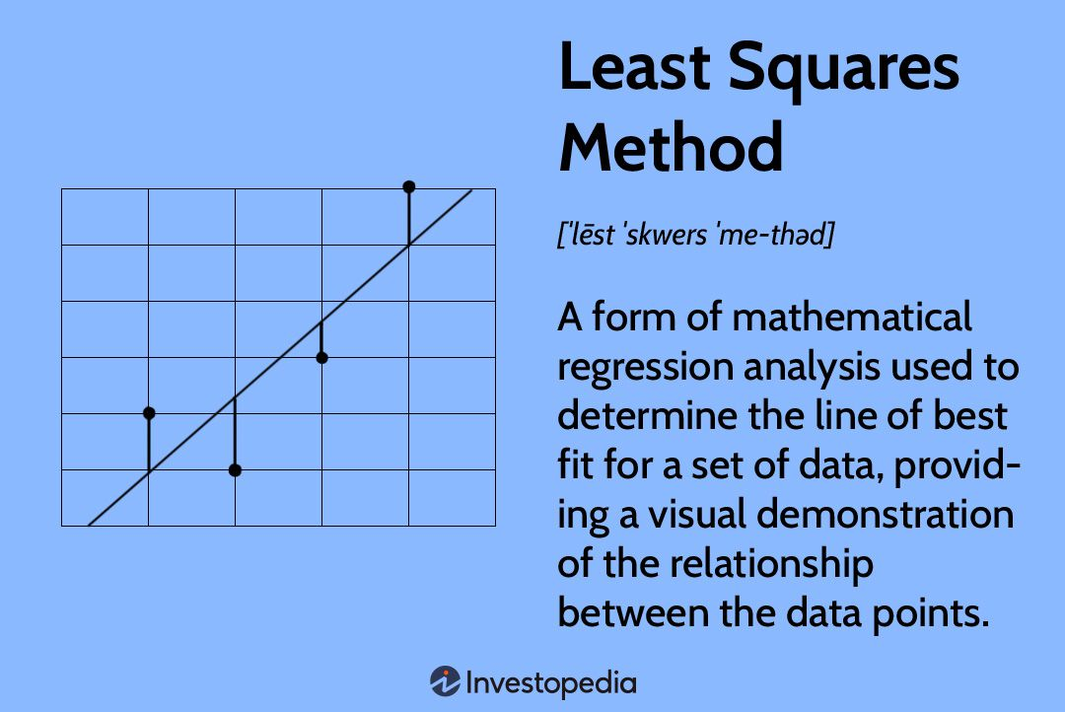

Slide 4
Key points about baseline prediction with least squares:
Least Squares Principle:
This method aims to find the line that minimizes the overall squared errors between the actual data points and the predicted values on the line.
Application Areas:
This approach is commonly used in various fields like spectroscopy, time series analysis, and signal processing where extracting the underlying trend from noisy data is crucial.
Baseline Estimation:
The fitted line represents the "baseline" which can then be subtracted from the original data to isolate the signal of interest (like peaks in a spectrum).

Slide 5
How it works:
Data Preparation:
The data points are organized with the independent variable (usually time or a corresponding measure) on the x-axis and the dependent variable (the signal) on the y-axis.
2. Least Squares Calculation:
A linear equation (y = mx + b) is assumed to represent the baseline trend.
The method calculates the optimal values of slope (m) and intercept (b) by minimizing the sum of squared residuals (differences between actual data points and the predicted values on the line).
3. Baseline Extraction:
Once the best-fit line is determined, it represents the estimated baseline trend which can be used to subtract the baseline component from the original data.

Slide 6
Variations and Considerations:
Penalized Least Squares:
To further smooth the baseline and avoid overfitting, techniques like penalized least squares (e.g., using a smoothing spline) can be applied, which add a penalty term for excessive curvature in the fitted line.
Asymmetric Least Squares (AsLS):
This variation is particularly useful for data with uneven baseline shapes, where different weights are applied to deviations above and below the estimated baseline during the fitting process.

Slide 7
regularization and overfitting.

Slide 8
Regularization is a set of methods for reducing overfitting in machine learning models. Typically, regularization trades a marginal decrease in training accuracy for an increase in generalizability.
Regularization encompasses a range of techniques to correct for overfitting in machine learning models
Regularization provides this increased generalizability at the sake of increased training error. In other words, regularization methods typically lead to less accurate predictions on training data but more accurate predictions on test data.
Regularization differs from optimization. Essentially, the former increases model generalizability while the latter increases model training accuracy. Both are important concepts in machine learning and data science.

Slide 9
Types of regularization with linear models
- Lasso regression (or L1 regularization) is a regularization technique that penalizes high-value, correlated coefficients. It introduces a regularization term (also called, penalty term) into the model’s sum of squared errors (SSE) loss function. This penalty term is the absolute value of the sum of coefficients. Controlled in turn by the hyperparameter lambda (λ), it reduces select feature weights to zero. Lasso regression thereby removes multicollinear features from the model altogether.
- Ridge regression (or L2 regularization) is regularization technique that similarly penalizes high-value coefficients by introducing a penalty term in the SSE loss function. It differs from lasso regression however. First, the penalty term in ridge regression is the squared sum of coefficients rather than the absolute value of coefficients. Second, ridge regression does not enact feature selection. While lasso regression’s penalty term can remove features from the model by shrinking coefficient values to zero, ridge regression only shrinks feature weights toward zero but never to zero.

Slide 10
- Elastic net regularization essentially combines both ridge and lasso regression but inserting both the L1 and L2 penalty terms into the SSE loss function. L2 and L1 derive their penalty term value, respectively, by squaring or taking the absolute value of the sum of the feature weights. Elastic net inserts both of these penalty values into the cost function (SSE) equation. In this way, elastic net addresses multicollinearity while also enabling feature selection

Slide 11
Types of regularization in machine learning
Dataset
Data augmentation is a regularization technique that modifies model training data. It expands the size of the training set by creating artificial data samples derived from pre-existing training data. Adding more samples to the training set, particularly of instances rare in real world data, exposes a model to a greater quantity and diversity of data from which it learns. Machine learning research has recently explored data augmentation for classifiers, particularly as a means of resolving imbalanced datasets.⁷ Data augmentation differs from synthetic data however. The latter involves creating new, artificial data while the former produces modified duplicates of preexisting data to diversify and enlarge the dataset.

Slide 12
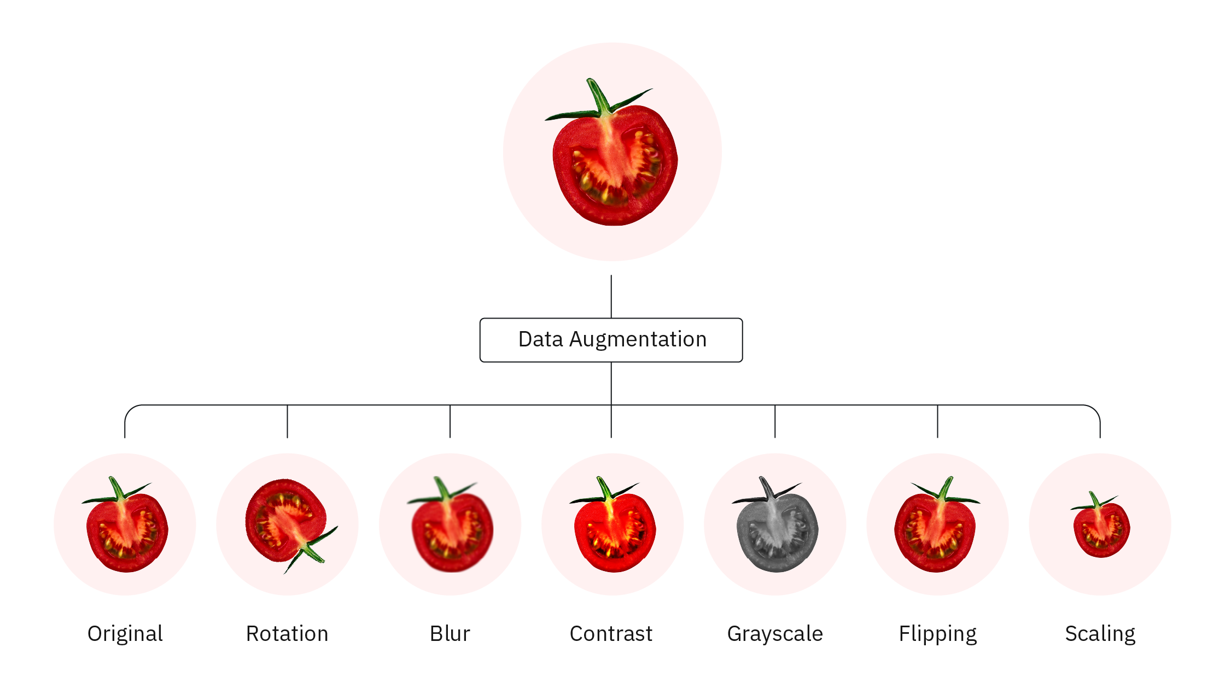

Slide 13
Model training
Early stopping is perhaps the most readily implemented regularization technique. In short, it limits the number of iterations during model training. Here, a model continuously passes through the training data, stopping once there is no improvement (and perhaps even deterioration) in training and validation accuracy. The goal is to train a model until it has reached the lowest possible training error preceding a plateau or increase in validation error

Slide 14
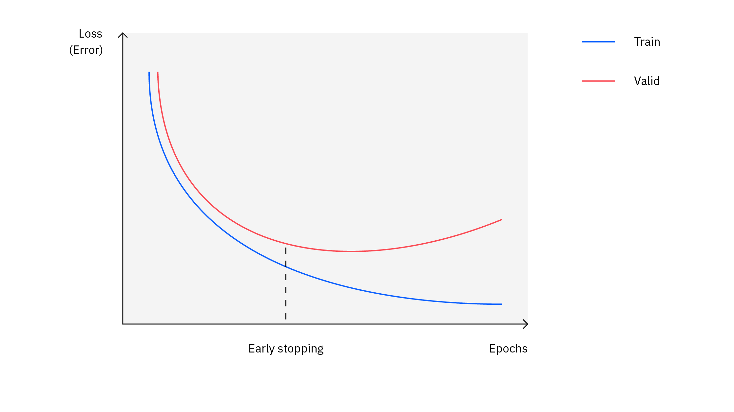

Slide 15
Neural networks
Neural networks are complex machine learning models that drive many artificial intelligence applications and services. Neural networks are composed of an input layer, one or more hidden layers, and an output layer, each layer in turn comprised of several nodes.

Slide 16
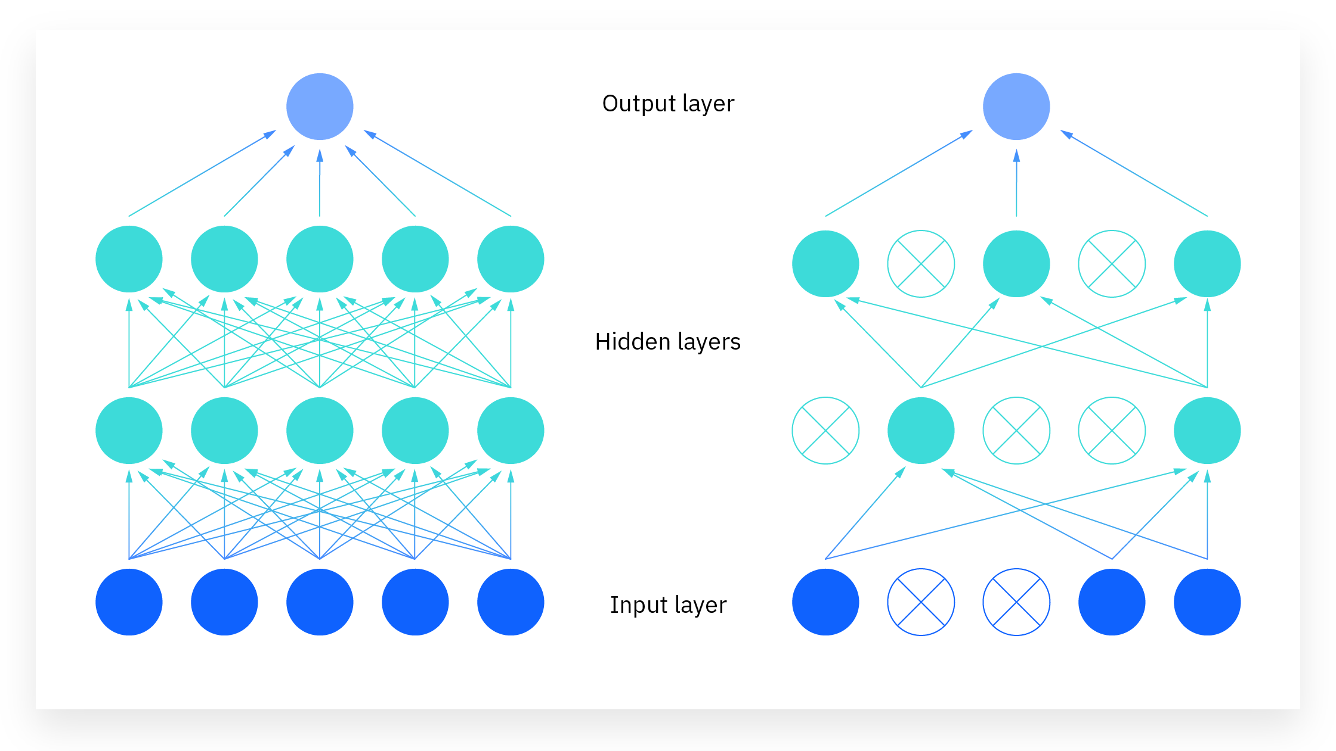

Slide 17
temporal models.
Traditional recommender systems assume that user preferences and item popularity remain static over time. However, in real-world applications, user interests change, and item trends evolve. Temporal models incorporate time-dependent factors to improve recommendation accuracy.

Slide 18
Types of Temporal Models in Recommender Systems
A. Time-Based Weighting
Recent interactions are given higher importance than older ones.
Exponential decay function is commonly used: w(t)=e−λ(T−t)
where:
w(t) is the weight assigned to a rating at time t.
T is the current time.
λ is a decay rate.

Slide 19
Time-Aware Matrix Factorization (TimeSVD++)
Extends SVD++ by adding temporal dynamics to user biases and item biases: r^ui(t)=μ+bu(t)+bi(t)+pu⋅qi
where:
bu​(t) and bi​(t) represent user and item biases that change over time.
pu​ and qi​ are latent factor representations of users and items.

Slide 20
C. Sequence-Aware Models (RNN/LSTM-based)
Captures user behavior patterns over time.
Recurrent Neural Networks (RNNs) and LSTMs track sequential user interactions to predict future preferences.
D. Context-Aware Temporal Models
Incorporate additional contextual factors (e.g., time of day, season, or event).
Example: Spotify suggests different music in the morning vs. at night.

Slide 21
4. Applications of Temporal Models-
Application | Example
Movie Recommendations | Trending vs. old movies
Music Streaming | Seasonal music preferences
E-commerce | Festive or holiday sales impact
News Recommendations | Recent articles are prioritized

Slide 22
Step-by-Step Solution of Recommender System Problems
Step 1: Data Collection
Objective: Gather user-item interaction data.
Recommender systems rely on historical user interactions with items. The type of data collected depends on the application:
Explicit feedback: Users provide direct ratings (e.g., 1–5 stars, thumbs up/down).
Implicit feedback: User behavior data such as clicks, views, purchases, watch time.
Common Datasets:
MovieLens: Movie ratings dataset.
Amazon Reviews: Product recommendations.
Last.fm: Music recommendation dataset.

Slide 23
Step 2: Preprocessing
Objective: Clean and prepare data for modeling.
Key Preprocessing Tasks:
Handle missing values:
Replace missing ratings with the user's average rating.
Use collaborative filtering to estimate missing ratings.
Normalize ratings:
Center ratings around zero to remove user bias.
Example: Convert raw ratings using
z-score normalization: rui′=rui−rˉu /σu
where rˉu​ is the average rating of user u, and σu​ is the standard deviation.
Convert categorical data:
Convert item categories or user demographics into numerical form (One-hot encoding, label encoding).
Reduce sparsity:
Most datasets are sparse (users rate only a few items). Use techniques like:
Matrix factorization (SVD, NMF).
K-Nearest Neighbors (KNN) for imputation.

Slide 24
Step 3: Model Selection
Objective: Choose an appropriate recommendation approach.
Three Main Types of Recommender Systems:
Collaborative Filtering (CF)
Uses user behavior patterns to recommend items.
Types:
User-based CF: Finds users with similar preferences.
Item-based CF: Finds similar items based on user interactions.
Content-Based Filtering (CBF)
Recommends items based on their attributes (e.g., genre, keywords).
Uses TF-IDF for text-based recommendations.
Hybrid Methods
Combines CF and CBF for better accuracy.
Example: Netflix blends CF with content-based filtering.

Slide 25
Step 4: Similarity Computation
Objective: Compute user-user or item-item similarities.
Common Similarity Measures:
Cosine Similarity
Measures the angle between two vectors.
sim(A,B)=A⋅B / ∣∣A∣∣∣∣B∣∣​
2. Pearson Correlation
Measures linear correlation between rating patterns.
sim(A,B)=∑(rA,i−rˉA)(rB,i−rˉB)/̸̷ ∑(rA,i−rˉA)2 ̸̸ ∑(rB,i−rˉB)2 ​
3.Jaccard Similarity
Measures overlap between sets (useful for implicit feedback).
J(A,B)=∣A∪B∣/∣A∩B∣​
Neighborhood Selection:
Keep top-K most similar users/items.

Slide 26
Step 5: Prediction Computation
Objective: Estimate missing ratings.
Common Rating Estimation Methods:
Weighted Sum (User-Based CF)
r^ui=rˉu+∑v∈N(u)sim(u,v)(rvi−rˉv)/ ∑v∈N(u)∣sim(u,v)∣
Uses a weighted sum of ratings from similar users.
2. Item-Based CF Prediction
r^ui=∑j∈N(i)sim(i,j)ruj∑j∈N(i)∣sim(i,j)∣
Uses a weighted sum of ratings from similar items.
3. Matrix Factorization (SVD)
Factorizes the user-item rating matrix into two lower-dimensional matrices:
R≈P×QT
where P represents user features and Q represents item features.

Slide 27
Step 6: Evaluation
Objective: Measure model accuracy and performance.
Common Evaluation Metrics:
Root Mean Squared Error (RMSE)
RMSE= ̸ 1/N∑(rui−r^ui)2
Lower RMSE indicates better prediction accuracy.
2. Mean Absolute Error (MAE)
MAE=1/N∑∣rui−r^ui∣
3.Precision & Recall (for Top-N recommendations)
Precision: How many recommended items are relevant. Precision=∣Relevant∩Recommended∣ / ∣Recommended∣
Recall: How many relevant items were recommended. Recall=∣Relevant∩Recommended∣ / ∣Relevant∣
4. F1-score
Balances precision and recall.
F1=2×Precision×Recall / Precision+Recall

