Slide 1
Cost Estimation
Cost estimation in software engineering is a critical process that involves predicting the resources required to complete a software project. Accurate estimates help in budgeting, resource allocation, and project planning

Slide 2
Key Aspects
Scope Definition: Clearly defining the project's scope helps in understanding what needs to be developed and aids in accurate estimation.
Resource Requirements: Identifying the types and quantities of resources (human, hardware, software) needed.
Timeframe: Estimating the time required to complete various project tasks.
Risk Assessment: Evaluating potential risks that could impact costs and timelines.
Project Complexity: Understanding the technical complexity and unique challenges associated with the project.

Slide 3
Common Estimation Techniques
1. Expert Judgment
Delphi Method: A structured communication technique that gathers expert opinions through rounds of questioning and feedback until a consensus is reached.
2. Analogous Estimating
Historical Data: Use data from previous projects to estimate time and costs. Adjust for differences in scope, complexity, and technology.
3. Parametric Estimating
Formulas and Metrics: Use established metrics (e.g., cost per function point, cost per line of code) to calculate estimates based on project size and characteristics.

Slide 4
4. Three-Point Estimation
Formula Estimate=(O+4M+P)/6​
Where:
O = Optimistic estimate
M = Most likely estimate
P = Pessimistic estimate
5. Function Point Analysis
Function Points: Measure the functionality delivered, which can be translated into estimated development effort based on historical data.
6. Cocomo Model
Cocomo Levels:
Basic: Uses size and effort multipliers for a simple estimation.
Intermediate: Considers factors like team experience and project attributes.
Detailed: A comprehensive model that breaks down tasks and includes more detailed cost drivers.

Slide 5
Tools for Cost Estimation
Project Management Software: Tools like Jira, Trello, or Microsoft Project can help track tasks and timelines.
Estimation Tools: Specialized tools (like Function Point Analysis software) can assist in estimating based on metrics.
Spreadsheets: Often used for custom calculations and tracking estimates against actuals.

Slide 6
Project scheduling
Project scheduling in software engineering is the process of defining and organizing the timeline for a project, ensuring that tasks are completed on time and within budget. An effective schedule helps manage resources, track progress, and communicate with stakeholders.

Slide 7
Key Components of Project Scheduling
Task Definition
Work Breakdown Structure (WBS): Decompose the project into smaller, manageable tasks. Each task should have clear deliverables.
Dependencies: Identify dependencies between tasks (e.g., Task B cannot start until Task A is completed).
Estimating Duration
Use estimation techniques (e.g., expert judgment, analogous estimating) to determine how long each task will take.
Consider factors such as team experience, technical complexity, and resource availability.
Resource Allocation
Assign team members to tasks based on their skills and availability.
Ensure that the workload is balanced and manageable to avoid burnout.
Milestones
Define key milestones that signify major deliverables or phases in the project. This helps in tracking progress.
Critical Path Method (CPM)
Identify the sequence of critical tasks that directly impact the project timeline. Any delay in these tasks will delay the project.

Slide 8
Techniques for Project Scheduling
Gantt Charts
Visual representation of the project schedule showing tasks along a timeline. It illustrates the start and end dates of tasks, dependencies, and milestones.
Network Diagrams
Use PERT (Program Evaluation and Review Technique) or CPM diagrams to visualize task dependencies and critical paths.
Agile Methodologies
In Agile frameworks (like Scrum), scheduling is often done in iterations (sprints). Tasks are prioritized in a backlog and estimated using story points.
Kanban Boards
Visual boards (physical or digital) that show task progress. Tasks move through columns (e.g., To Do, In Progress, Done) to reflect their status.
Timeboxing
Allocating a fixed unit of time for a task, particularly useful in Agile environments. This helps maintain focus and urgency.

Slide 9
Quality management
Quality management in software engineering is a structured approach to ensuring that software products meet specified requirements and are free of defects. It encompasses processes, standards, and practices aimed at delivering high-quality software consistently.

Slide 10
Key Components of Quality Management
Quality Planning:
Defining quality goals and objectives
Identifying quality metrics and standards
Developing a quality assurance plan
Quality Assurance:
Reviewing and auditing software development processes
Conducting code reviews and inspections
Implementing testing strategies (unit, integration, system, acceptance)
Quality Control:
Identifying and correcting defects in the software
Conducting quality checks throughout the development lifecycle
Quality Improvement:
Analyzing quality data to identify areas for improvement
Implementing corrective actions and preventive measures
Continuously refining quality processes

Slide 11
Quality Assurance Techniques
Static Analysis: Examining code without executing it to identify potential errors and vulnerabilities.
Code Reviews: Peer reviews of code to identify defects and improve readability.
Testing: Executing the software to verify its functionality and identify defects.
Metrics: Measuring software quality attributes such as reliability, maintainability, and performance.

Slide 12
Quality Management Standards
ISO 9001: A generic standard for quality management systems that can be applied to software development.
CMMI (Capability Maturity Model Integration): A framework for process improvement that can be used to assess and improve software development organizations.
Six Sigma: A methodology for improving quality and reducing defects.

Slide 13
Benefits of Quality Management
Improved customer satisfaction: High-quality software meets user expectations and provides a positive experience.
Reduced costs: Preventing defects early in the development process can save time and money.
Enhanced reputation: A reputation for delivering high-quality software can lead to increased business and customer loyalty.
Increased productivity: Efficient quality management processes can streamline development and improve productivity.

Slide 14
Testing:
Unit testing: Testing individual components or modules of the software.
Integration testing: Testing the interaction between different components of the software.
System testing: Testing the entire software system as a whole.
Acceptance testing: Testing the software against user requirements and acceptance criteria.
Performance testing: Testing the software's performance under various load conditions.
Security testing: Testing the software's vulnerability to security threats.

Slide 15
Quality Metrics
Defect density: The number of defects per unit of code.
Mean time between failures (MTBF): The average time between failures of the software.
Mean time to repair (MTTR): The average time it takes to repair a defect.
Customer satisfaction: Feedback from users on the quality of the software.

Slide 16
Quality Improvement Techniques
Root cause analysis: Identifying the underlying causes of defects.
Process improvement: Implementing changes to improve the software development process.
Continuous integration: Integrating code changes into a shared repository frequently to detect defects early.
Continuous delivery: Automatically deploying software changes to production environments.

Slide 17
Challenges in Quality Management
Balancing quality with time-to-market: Ensuring high-quality software while meeting tight deadlines.
Managing complexity: Dealing with large and complex software systems.
Evolving requirements: Adapting to changing user needs and market conditions.
Team collaboration: Coordinating the efforts of different team members and stakeholders.

Slide 18
Project Scheduling
Using
PERT and Gantt Charts
PERT (Program Evaluation and Review Technique) and Gantt charts are two popular tools used in project management for planning, scheduling, and tracking project activities.

Slide 19
PERT (Program Evaluation and Review Technique)
PERT is a network diagram technique used to plan and schedule tasks in a project. It consists of nodes (activities) and arrows (dependencies). Each activity has an estimated duration and a probability distribution.

Slide 20
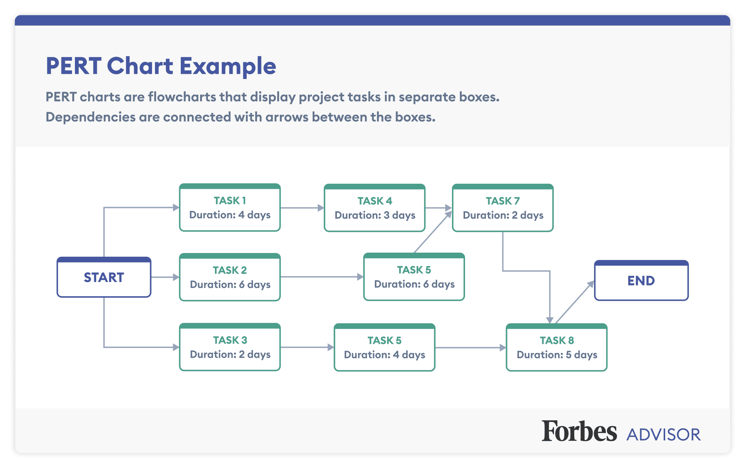

Slide 21
PERT uses three time estimates for each activity:
Optimistic time (O): The shortest possible time to complete the activity.
Most likely time (M): The most probable time to complete the activity.
Pessimistic time (P): The longest possible time to complete the activity.
The expected time (TE) for an activity is calculated using the formula:
TE = (O + 4M + P) / 6
PERT also calculates the variance (σ²) for each activity using the formula:
σ² = [(P - O) / 6]²
The critical path is the longest path through the network diagram. It determines the project's expected duration and identifies the activities that must be completed on time for the project to be finished on schedule.

Slide 22
Steps to Create a PERT Chart
Define activities: Break down the project into smaller, manageable tasks or activities.
Determine dependencies: Identify the relationships between activities. Some activities might need to be completed before others can start.
Estimate durations: For each activity, estimate the optimistic time (shortest possible), most likely time, and pessimistic time.
Calculate expected time and variance: Use the following formulas:
Expected time (TE) = (Optimistic time + 4 * Most likely time + Pessimistic time) / 6
Variance (σ²) = [(Pessimistic time - Optimistic time) / 6]²
Create the network diagram: Draw nodes (activities) and arrows (dependencies) to represent the project's structure.
Identify the critical path: The critical path is the longest path through the network diagram. It determines the project's expected duration and identifies activities that must be completed on time for the project to finish on schedule.

Slide 23
Advantages of PERT
Visual representation: PERT provides a clear and concise overview of the project's structure and dependencies.
Risk assessment: It helps identify activities with high uncertainty and potential risks.
Resource allocation: PERT can be used to allocate resources effectively.
Decision-making: It provides a basis for informed decision-making about project schedules and resource allocation.
Project control: PERT can be used to monitor project progress and identify potential delays.

Slide 24
Limitations of PERT
Assumption of normality: PERT assumes that activity durations follow a beta distribution. This assumption may not always be accurate.
Subjectivity: Estimating durations can be subjective and may not always reflect reality.
Complexity: For large projects, creating and analyzing PERT charts can be complex and time-consuming.
Changes: PERT can be difficult to update if project requirements or activities change.

Slide 25
Gantt Chart
A Gantt chart is a popular project management tool that provides a visual representation of a project schedule. It is a horizontal bar chart that displays the timeline of project activities, their duration, and their dependencies.

Slide 26
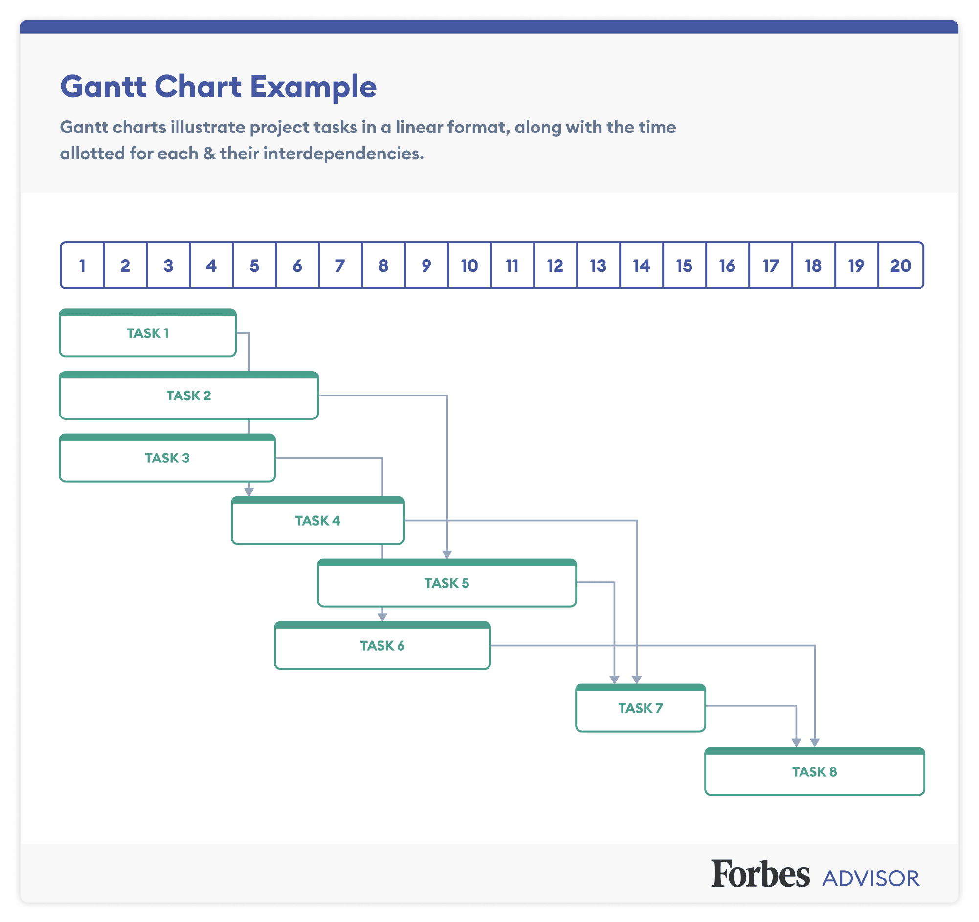

Slide 27
The Purpose of a Gantt Chart:
• To illustrate the relationship between project activities & time.
• To show the multiple project activities on one chart
• To provide a simple & easy to understand representation of project scheduling

Slide 28
Creating a Gantt Chart:
There are two methods to creating a Gantt Chart (Maylor, 2005).
Using a Forward Schedule: starting with the list of activities and a given start date (6th Sept in previous example) follow them forwards in time until you hit given deadline.
Using a Backward Schedule: look at the deadline, from that date work in the logical list of activities. Both of these methods allow you to ensure that all necessary activities can possibly be completed within the given project time frame.

Slide 29
Steps to Creating a Gantt Chart:
Determine Project start date and deadline.
Gather all information surrounding the list of activities within a project – the Work Breakdown Structure may be useful for this.
Determine how long each activity will take
Evaluate what activities are dependant on others
Create Graph shell including the timeline and list of activities.
Using either Forward Scheduling or Backward Scheduling, Begin to add bars ensuring to include dependencies and the full duration for each activity.

Slide 30
The Advantages:
• A useful tool for displaying time-based information within a project.
• Very simple to create
• They provide a useful overview of project activities, a good starting point for project planning.
• The charts are widely used and understood. • There exists several PC software packages that allow you to build Gantt Charts.

Slide 31
The Limitations:
• The Gantt Chart does not explain the reasoning behind the chosen duration of each activity. (Maylor, 2001)
• The Gantt Chart is very difficult to update when changes to the project plan take place. This makes it time consuming and results in long-term planning being very difficult. (Goldratt, 1997)

Slide 32
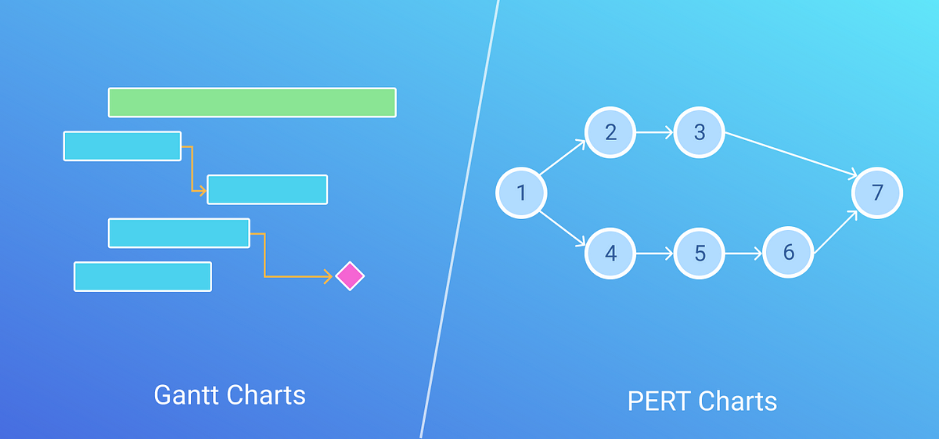

Slide 33
Gantt chart | PERT chart
Gantt chart is defined as the bar chart. | PERT chart is similar to a network diagram
Gantt chart was developed by Henry L. Gantt. | PERT chart was developed by the United States navy.
Gantt chart is often used for Small Projects | PERT chart can be used for large and complex Projects
Gantt chart focuses on the time required to complete a task | PERT chart focuses on the dependency of relationships.
Gantt chart is simpler and more straightforward | PERT chart could be sometimes confusing and complex but can be used for visualizing critical path

