Slide 1
Unit -5
Software Engineering

Slide 2
ISO
and
SEI CMMI

Slide 3
ISO (International Organization for Standardization)
ISO is a global organization that develops and publishes international standards.
In the context of software engineering, ISO provides a framework of standards that organizations can adopt to improve their quality management systems.

Slide 4
Key ISO standards related to software engineering:
ISO 9001: This is a generic standard for quality management systems that can be applied to various industries, including software development. It provides a framework for organizations to establish, implement, maintain, and continuously improve their quality management system.
ISO 27001: This standard focuses on information security management. It provides a framework for organizations to establish, implement, maintain, and continuously improve their information security management system.
ISO 25000: This family of standards provides guidance on software product quality. It includes standards for software quality requirements, software product quality planning, software product quality assurance, and software product quality control.

Slide 5
ISO 9001:2015 is the most widely used standard in the ISO 9000 family. It provides a framework for a quality management system (QMS) that can be applied to any organization, regardless of its size or industry.
Key elements of ISO 9001:
Customer focus: Understanding and meeting customer requirements.
Leadership: Strong leadership from top management is essential.
Engagement of people: Involving employees at all levels in quality improvement.
Process approach: Managing activities as interrelated processes.
Continuous improvement: Continuously striving to improve performance.
Evidence-based decision-making: Making decisions based on data and analysis.
Relationship management: Managing relationships with suppliers and external providers.

Slide 6
ISO 27001 is a standard for information security management. It provides a framework for organizations to establish, implement, maintain, and continuously improve their information security management system (ISMS).
Key elements of ISO 27001:
Risk assessment: Identifying and assessing information security risks.
Information security controls: Implementing measures to protect information assets.
Continuous improvement: Regularly reviewing and updating the ISMS.

Slide 7
SEI CMMI
(Software Engineering Institute Capability Maturity Model Integration)
SEI CMMI is a framework developed by the Software Engineering Institute (SEI) at Carnegie Mellon University. It provides a model for assessing and improving the capability of software organizations. CMMI focuses on process improvement and provides a structured approach to process definition, implementation, and measurement.

Slide 8
Key levels of CMMI:
Initial: The organization has no defined processes.
Repeatable: Basic processes are established and consistently followed.
Defined: Processes are standardized and documented.
Managed: Processes are quantitatively measured and controlled.
Optimizing: Continuous process improvement is focused on innovation.

Slide 9
Why Choose ISO or SEI CMMI?
Both ISO and SEI CMMI offer frameworks for improving organizational processes, particularly in the context of software engineering. The choice between them often depends on specific organizational needs, goals, and the nature of the software development process.
Key Considerations:
Scope: ISO 9001 is a generic standard applicable to any organization, while CMMI is specifically focused on software engineering.
Focus: ISO emphasizes quality management, while CMMI focuses on process improvement.
Level of detail: CMMI provides a more granular level of detail and guidance for process improvement.
Industry requirements: Some industries may have specific requirements for certification in ISO or CMMI.

Slide 10
Main Features of ISO and SEI CMMI
ISO 9001:
Customer focus: Prioritizes understanding and meeting customer needs.
Leadership: Emphasizes strong leadership from top management.
Engagement of people: Encourages employee involvement in quality improvement.
Process approach: Focuses on managing activities as interrelated processes.
Continuous improvement: Promotes a culture of continuous improvement.
SEI CMMI:
Process maturity: Assesses the organization's level of process maturity.
Process areas: Defines specific areas for process improvement, such as project planning, requirements management, and configuration management.
Capability levels: Provides a framework for assessing and improving organizational capabilities.

Slide 11
Benefits of using ISO and SEI CMMI:
Improved quality: Both ISO and CMMI can help organizations improve the quality of their products and services.
Increased efficiency: By following standardized processes, organizations can become more efficient and reduce waste.
Enhanced customer satisfaction: Higher quality products and services can lead to increased customer satisfaction.
Improved risk management: Both ISO and CMMI can help organizations identify and mitigate risks.
Enhanced market competitiveness: Organizations that can demonstrate compliance with ISO or CMMI standards may have a competitive advantage in the marketplace.

Slide 12
Advantages of ISO and SEI CMMI
ISO 9001:
Widely recognized: Recognized globally as a standard for quality management.
Applicable to any organization: Can be applied to various industries and organizations.
Customer satisfaction: Can improve customer satisfaction through better quality products and services.
SEI CMMI:
Process improvement: Provides a structured approach for process improvement.
Risk management: Helps identify and manage risks in software development.
Competitive advantage: Can provide a competitive advantage in the marketplace.

Slide 13
Limitations of ISO and SEI CMMI
ISO 9001:
Generic nature: Can be less specific to software engineering compared to CMMI.
Can be perceived as bureaucratic: May require significant documentation and process implementation.
SEI CMMI:
Complexity: Can be complex and time-consuming to implement, especially at higher maturity levels.
Cost: Certification and maintenance can be costly.

Slide 14
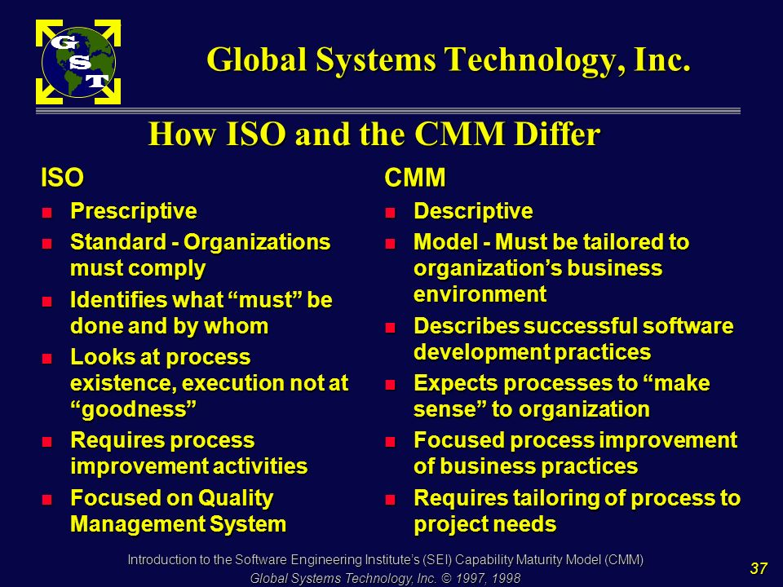

Slide 15
PSP
and
Six Sigma

Slide 16
PSP (Personal Software Process)
PSP is a structured approach to software development that focuses on individual productivity and quality. It involves a set of activities that developers can use to plan, track, and improve their work.
Key components of PSP:
Planning: Developers create a detailed plan for their work, including estimates of effort and time.
Tracking: Developers track their progress against their plan and identify areas for improvement.
Reporting: Developers report on their work, including metrics such as defects found and time spent.
Defect analysis: Developers analyze the defects they find and identify root causes to prevent similar problems in the future.

Slide 17
Six Sigma
Six Sigma is a data-driven methodology for improving process quality. It aims to reduce defects to a level of 3.4 defects per million opportunities (DPMO).
Key components of Six Sigma:
Define: Identify the process to be improved and define the goals.
Measure: Collect data on the current performance of the process.
Analyze: Analyze the data to identify root causes of defects.
Improve: Implement changes to the process to eliminate defects.
Control: Monitor the process to ensure that improvements are maintained.

Slide 18


Slide 19
Characteristics of Six Sigma
The Characteristics of Six Sigma are as follows:
Statistical Quality Control: Six Sigma is derived from the Greek Letter ? which denote Standard Deviation in statistics. Standard Deviation is used for measuring the quality of output.
Methodical Approach: The Six Sigma is a systematic approach of application in DMAIC and DMADV which can be used to improve the quality of production. DMAIC means for Design-Measure- Analyze-Improve-Control. While DMADV stands for Design-Measure-Analyze-Design-Verify.
Fact and Data-Based Approach: The statistical and methodical method shows the scientific basis of the technique.
Project and Objective-Based Focus: The Six Sigma process is implemented to focus on the requirements and conditions.
Customer Focus: The customer focus is fundamental to the Six Sigma approach. The quality improvement and control standards are based on specific customer requirements.
Teamwork Approach to Quality Management: The Six Sigma process requires organizations to get organized for improving quality.

Slide 20
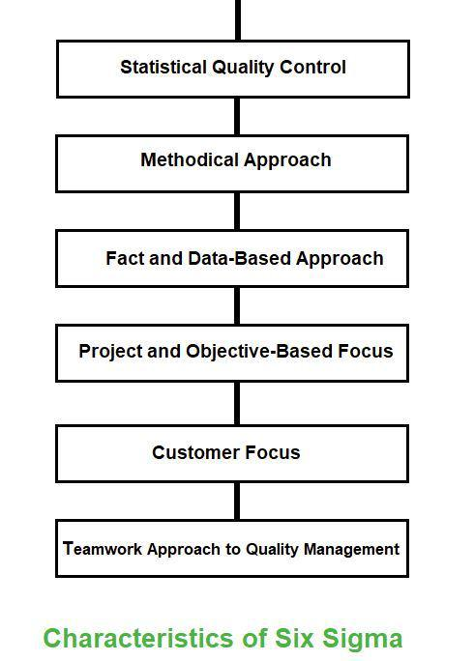

Slide 21
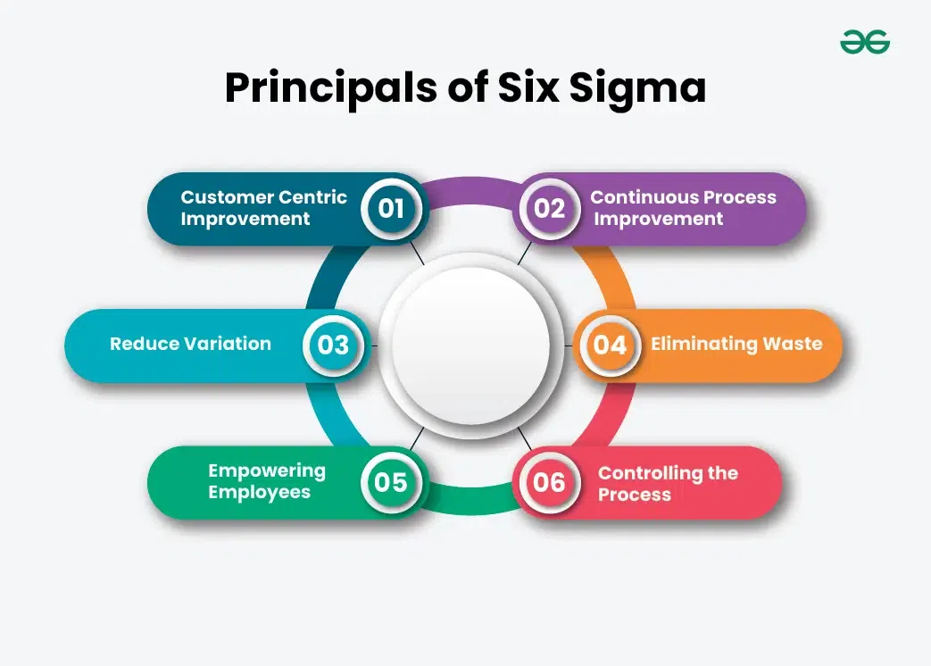

Slide 22
1. Customer Centric Improvement
The primary principal of six sigma methodology is to focus on customer. Voice of the Customer (VoC) and methods for determining what the customer truly want from a product or process. Organizations can boost customer happiness by combining that knowledge with measurements, analytics, and process improvement approaches, resulting in higher profits, client retention, and loyalty.
2. Continuous Process Improvement
The Six Sigma approach requires constant process improvement. An organization that fully implements the Six Sigma technique never stops improving. It continuously discovers and priorities opportunities. Once one area has been improved, the organization will move on to another. The organization continuously find ways to increase the signa level because the goal is to achieve the level of 99.99966 accuracy for all processes inside an organization while also making sure other essentials like financial stability.

Slide 23
3. Reduce Variation
A method to continuously improve a process is to reduce its variation. Every process has an inherit variation. Variation in processes can lead to errors, these errors can lead to product defect and product defect can leads to poor customer satisfaction. By reducing variation and errors six sigma can reduce process cost and increase customer satisfaction. Suppose there are some developers developing web application, variation will exist as every developer have different coding styles, expertise levels, environment factors and project requirement. By adopting strategies like coding standards and guideline, code reviews, automated testing and documentation variation can be reduce to some extent.
4. Eliminating Waste
Waste is a major problem in the six sigma methodology. Eliminating waste means removing items, procedures or people that are not required for the process’s outcome or removing anything that does not add value to customer. Eliminating waste can reduce processing time, errors in process and lowers overall costs.

Slide 24
5. Empowering Employees
Until organizations provide employees with the tools they need to monitor and sustain improvements, implementing improved processes is only a temporary solution. Process improvement usually involves two approaches in most organizations. An improvement is first defined, planned, and carried out by a process improvement team consisting up of project managers, methodology specialists, and subject matter experts. The employees that deal with the process on a daily basis are then equipped by that team to supervise and handle it in its improved condition.
6. Controlling the Process
Six Sigma improvements are frequently used to handle uncontrolled processes. Out-of-control processes meet certain statistical conditions. The purpose of improvement is
to bring a process back under statistical control. Then, after the improvements are implemented, measurements, statistics, and other Six Sigma tools are utilized to keep the process under control. Implementing controls and training people on how to apply them is a key component of continuous improvement.

Slide 25
The Six Sigma Methodology
The Two Six Sigma methodologies used in the Six Sigma projects are DMAIC and DMADV. Six Sigma teams usually use DMAIC or DMADV approaches to achieve process improvements and establish process control.

Slide 26
DMAIC Six Sigma Methodology
DMAIC is used to enhance an existing business process. A DMAIC project involves identifying important problem that are creating the problem, verifying those problem , brainstorming solutions, implementing them, and designing a control plan to maintain the improved state. The DMAIC methodology is designed for the team who are responsible for improving a project. DMAIC phases allow flexibility, that helps the team to fit their activities. If a process need to completely replaced or redesigned for user experience in such case team can use DMADV method.

Slide 27
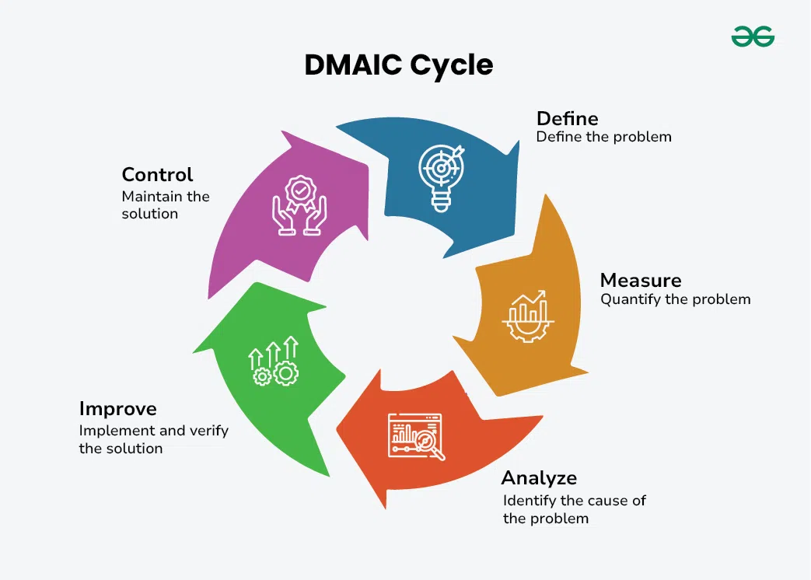

Slide 28
1. Define
The Define phase of a DMAIC project involves identifying problems, establishing project requirements, and setting success goals. Six Sigma leaders can use tools inside the phase to create flexibility for different project types, depending on factors such as leadership advice and budgets.
2. Measure
During the DMAIC Measure phase, teams use data to validate assumptions about the process and problem. Validation of assumptions also makes it into the analysis step. The measurement phase focuses on collecting and arranging data for analysis. Measuring in a Six Sigma project might be challenging without proper data collection. To gather data, teams may need to build tools, create queries, filter through large amounts of information, or use manual processes.

Slide 29
3. Analyze
Analyze phase is a critical stage where the root causes of problems or inefficiencies within a process are identified and understood. During the Analyze phase of a DMAIC project, teams develop predictions about relationships between inputs and outputs, use statistical analysis and data to validate the prediction and assumptions they’ve made thus far. In a DMAIC project, the Analyze phase leads to the Improve phase, where hypothesis testing can confirm assumptions and potential solutions.
4. Improve
During the Improve phase of a project, Six Sigma teams begin developing the concepts that came from the Analyze phase. They employ statistics and real-world observations to test assumptions and solutions. As teams select and start implementing solutions, hypothesis testing keeps going throughout the enhance phase. It starts in the analyse phase.
5. Control
In DMAIC Phase Controls and standards are established so that improvements can be maintained, but the responsibility for those improvements is transitioned to the process owner.

Slide 30
DMADV Six Sigma Methodology
DMADV is used to create new product designs or process designs. Six Sigma teams use DMADV in the following scenario:
The organization wants to launch a new service or product.
Business leaders decide to replace a process to meet upgrade requirements or to align business processes, machinery, or workers with future goals.
A Six Sigma team learns that upgrading a process is unlikely to result in the expected project outcomes.

Slide 31
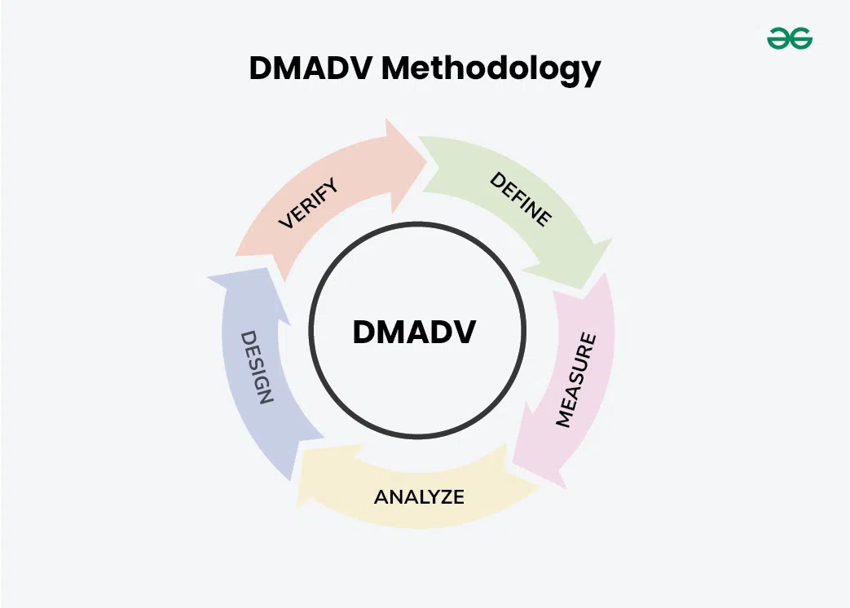

Slide 32
1. Define
In a DMADV project, the Define stage is slightly more strict. Teams must identify problems and define requirements within a change management environment. When an organization has a change management program in place, Six Sigma teams must include all program needs in the DMADV stages.
2. Measure
During the DMADV Measure phase, teams use data to validate assumptions about the process and problem. Validation of assumptions also makes it into the analysis step. The measurement phase focuses on collecting and arranging data for analysis.
3. Analyze
Analyze phase is a critical stage where the root causes of problems or inefficiencies within a process are identified and understood. They priorities identifying best practices and standards for measuring and designing new processes.

Slide 33
4. Design
The fourth phase is when DMADV projects start to vary significantly from DMAIC projects. The team designs a new process that includes solution testing, mapping, workflow principles, and infrastructure development.
5. Verify Phase
The Verify phase in DMADV checks if the designed solutions work as intended, measuring their success against initial goals, ensuring improvements are effective and sustainable.

Slide 34
Six Sigma Tools & Techniques
Tools and Technique used in six sigma are:
5’S
Seven Wastes
Value stream mapping
Visual Workspace
Voice of Customer (VOC)
Kaizen
Regression Analysis

Slide 35
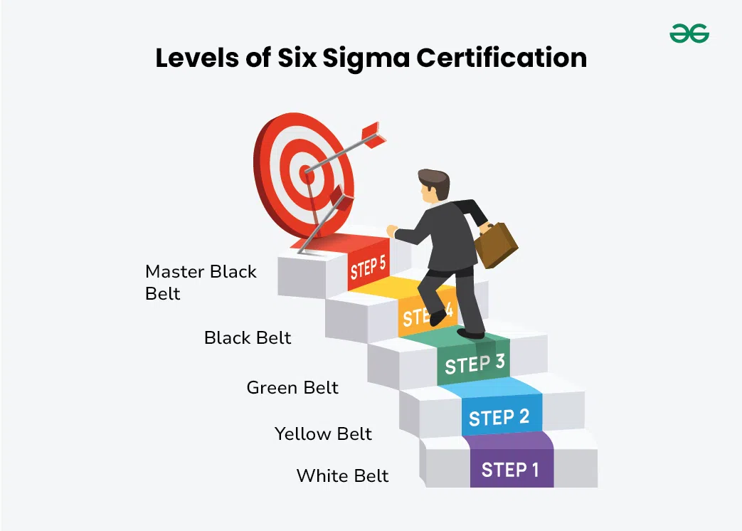

Slide 36
White Belt: A Certified Six Sigma White belts are conversant with the fundamentals of the Six Sigma technique, although they are not typically members of process improvement teams. White belt training introduces auxiliary staff members to Six Sigma and helps them understand why project teams work as they do.
Yellow Belt: Yellow belt certification is a step up from white belt and provides a basic introduction to Six Sigma concepts, including the DMAIC method used for process improvement.
Green Belt: Certified green belts work in Six Sigma teams, typically under the direction of a black or master black belt. In other situations, green belts may lead or manage minor projects on their own. Green belts typically have intermediate statistical analysis skills; they may address data and analysis issues, assist Black Belts in applying Six Sigma tools to a project, or teach people inside an organization about the overall Six Sigma process.
Black Belt: A certified Six Sigma Black Belt typically serves as the project manager on process improvement projects. They may also work in management, analysis, or planning jobs across a corporation.
Master Black Belt: Six Sigma’s highest degree of certification is Master Black Belt. Within a commercial organization, Master Black Belts typically supervise Black Belts and Green Belts, consult on particularly tough project issues, provide advice and education on complex statistical concepts, and teach people in Six Sigma technique.

Slide 37
PSP and Six Sigma in Software Engineering
Both PSP and Six Sigma can be used to improve software quality and efficiency. PSP focuses on individual productivity and quality, while Six Sigma focuses on process improvement.
How PSP and Six Sigma can be used together:
Individual level: Developers can use PSP to improve their own productivity and quality, while Six Sigma can be used to improve the overall software development process.
Team level: Teams can use PSP and Six Sigma to improve their collective productivity and quality.
Organizational level: Organizations can use PSP and Six Sigma to create a culture of quality and continuous improvement.

Slide 38
Advantages of using PSP and Six Sigma:
Improved quality: Both PSP and Six Sigma can help reduce defects and improve the quality of software products.
Increased efficiency: By improving processes and individual productivity, PSP and Six Sigma can help organizations deliver software faster and more efficiently.
Reduced costs: By reducing defects and improving efficiency, PSP and Six Sigma can help organizations save money.
Improved customer satisfaction: Higher quality software can lead to improved customer satisfaction.

Slide 39
Computer aided software engineering

Slide 40
Computer-Aided Software Engineering (CASE) is a set of software tools and methodologies that automate various stages of the software development lifecycle (SDLC). These tools help software engineers and project managers increase productivity, improve quality, and streamline the development process.
Key Components of CASE:
Diagram editors: Used to create and edit various diagrams, such as UML (Unified Modeling Language) diagrams, flowcharts, and data flow diagrams.
Code generators: Automatically generate code from design models, reducing manual coding efforts.
Version control systems: Manage changes to source code and other project artifacts.
Configuration management tools: Track and control changes to software components and their dependencies.
Testing tools: Automate testing processes, including unit testing, integration testing, and system testing.
Project management tools: Help plan, track, and manage project activities and resources.

Slide 41
Benefits of Using CASE Tools:
Increased productivity: CASE tools can automate many repetitive tasks, freeing up developers to focus on more creative work.
Improved quality: CASE tools can help ensure consistency and accuracy in the development process, leading to higher quality software.
Better documentation: CASE tools can generate comprehensive documentation automatically, reducing the need for manual effort.
Enhanced collaboration: CASE tools can facilitate collaboration among team members by providing a central repository for project artifacts.
Reduced costs: By improving efficiency and reducing errors, CASE tools can help organizations save money.

Slide 42
Challenges and Considerations:
Learning curve: CASE tools can have a steep learning curve, especially for organizations that are new to using them.
Cost: CASE tools can be expensive, particularly for large organizations.
Integration: Integrating CASE tools with existing development environments can be challenging.
Vendor lock-in: Relying heavily on a single vendor's CASE tools can create vendor lock-in.

Slide 43
Popular CASE Tools:
Enterprise Architect: A comprehensive modeling and design tool.
IBM Rational Software Architect: A powerful tool for software development and architecture.
Visual Paradigm: A versatile CASE tool with support for various modeling languages.
Microsoft Visual Studio: A popular integrated development environment (IDE) with built-in CASE features.
Eclipse: A free and open-source IDE with a wide range of plugins for CASE tools.

Slide 44
Advantages of the CASE approach:
Improved Documentation: Comprehensive documentation creation and maintenance is made easier by CASE tools. Since automatically generated documentation is usually more accurate and up to date, there are fewer opportunities for errors and misunderstandings brought on by out-of-current material.
Reusing Components: Reusable component creation and maintenance are frequently facilitated by CASE tools. This encourages a development approach that is modular and component-based, enabling teams to shorten development times and reuse tested solutions.
Quicker Cycles of Development: Development cycles take less time when certain jobs, such testing and code generation, are automated. This may result in software solutions being delivered more quickly, meeting deadlines and keeping up with changing business requirements.
Improved Results: Code generation, documentation, and testing are just a few of the time-consuming, repetitive operations that CASE tools perform. Due to this automation, engineers are able to concentrate on more intricate and imaginative facets of software development, which boosts output.
Achieving uniformity and standardization: Coding conventions, documentation formats and design patterns are just a few of the areas of software development where CASE tools enforce uniformity and standards. This guarantees consistent and maintainable software development.

Slide 45
Disadvantages of the CASE approach:
Cost: Using a case tool is very costly. Most firms engaged in software development on a small scale do not invest in CASE tools because they think that the benefit of CASE is justifiable only in the development of large systems.
Learning Curve: In most cases, programmers’ productivity may fall in the initial phase of implementation, because users need time to learn the technology. Many consultants offer training and on-site services that can be important to accelerate the learning curve and to the development and use of the CASE tools.
Tool Mix: It is important to build an appropriate selection tool mix to urge cost advantage CASE integration and data integration across all platforms is extremely important.

Slide 46
What are use CASE tools?
Improve the quality of systems developed
Increase speed of development and design
Ease and improve the testing process through automated checking
Improve integration of development activities via common methodologies
Improve quality and completeness of documentation
Help standardize the development process
Improve project management
Simply program maintenance
Promote reusability
Improve software portability

Slide 47
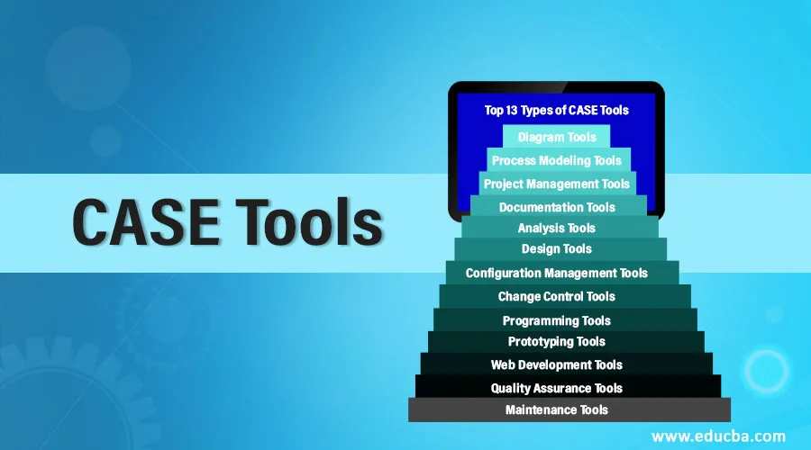

Slide 48
Types of CASE Tools:
Diagramming Tools: It helps in diagrammatic and graphical representations of the data and system processes. It represents system elements, control flow and data flow among different software components and system structures in a pictorial form. For example, Flow Chart Maker tool for making state-of-the-art flowcharts.
Computer Display and Report Generators: These help in understanding the data requirements and the relationships involved.
Analysis Tools: It focuses on inconsistent, incorrect specifications involved in the diagram and data flow. It helps in collecting requirements, automatically check for any irregularity, imprecision in the diagrams, data redundancies, or erroneous omissions. For example:
(i) Accept 360, Accompa, CaseComplete for requirement analysis.
(ii) Visible Analyst for total analysis.

Slide 49
Central Repository: It provides a single point of storage for data diagrams, reports, and documents related to project management.
Documentation Generators: It helps in generating user and technical documentation as per standards. It creates documents for technical users and end users. For example, Doxygen, DrExplain, Adobe RoboHelp for documentation.
Code Generators: It aids in the auto-generation of code, including definitions, with the help of designs, documents, and diagrams.
Tools for Requirement Management: It makes gathering, evaluating, and managing software needs easier.
Tools for Analysis and Design: It offers instruments for modelling system architecture and behaviour, which helps throughout the analysis and design stages of software development.
Tools for Database Management: It facilitates database construction, design, and administration.
Tools for Documentation: It makes the process of creating, organizing, and maintaining project documentation easier.

Slide 50
Software Maintenance
Software maintenance is a critical phase of the software development lifecycle (SDLC) that involves modifying existing software after it has been delivered to the customer. It ensures that the software continues to meet changing user needs, adapts to new technologies, and addresses defects.

Slide 51
Types of Software Maintenance:
Corrective Maintenance:
Fixing defects or bugs that are discovered after the software is deployed.
Aim is to restore the software to its original functionality.
Adaptive Maintenance:
Modifying the software to adapt to changes in the operating environment, hardware, or other external factors.
Examples include porting software to a new platform or integrating with new systems.
Perfective Maintenance:
Enhancing the software's functionality, performance, or usability beyond its original specifications.
Includes adding new features, improving performance, or optimizing the user interface.
Preventive Maintenance:
Making changes to the software to prevent future problems or improve its maintainability.
This can involve refactoring code, updating documentation, or improving the software's architecture.

Slide 52
Challenges in Software Maintenance:
Evolving requirements: Software needs to adapt to changing user needs and market conditions.
Legacy systems: Maintaining old software systems can be challenging due to outdated technologies and lack of documentation.
Technical debt: Poorly designed or implemented code can create technical debt, making maintenance more difficult and expensive.
Limited resources: Organizations often have limited resources allocated for software maintenance.

Slide 53
Strategies for Effective Software Maintenance:
Regular updates: Keep the software up-to-date with the latest patches and security updates.
Version control: Use version control systems to track changes and manage different versions of the software.
Documentation: Maintain clear and up-to-date documentation to help developers understand the software's architecture and functionality.
Refactoring: Regularly refactor the code to improve its readability, maintainability, and efficiency.
Automated testing: Use automated testing tools to ensure that changes to the software do not introduce new defects.
Prioritization: Prioritize maintenance tasks based on their impact on the software's functionality and user satisfaction.

Slide 54
Software Reuse
Software reuse is the practice of using existing software components, such as code modules, libraries, or frameworks, in new software development projects. It is a fundamental principle in software engineering that can significantly improve productivity, quality, and time-to-market.

Slide 55
Types of Software Reuse:
Application reuse: Reusing entire applications or significant portions of them.
Component reuse: Reusing individual software components, such as modules, libraries, or frameworks.
Domain-specific reuse: Reusing components that are specific to a particular domain or industry.
Off-the-shelf (OTS) reuse: Reusing commercially available software products.

Slide 56
Benefits of Software Reuse:
Increased productivity: Reusing existing components can save time and effort, as developers don't have to create everything from scratch.
Improved quality: Reusing well-tested components can reduce the risk of defects and improve the overall quality of the software.
Reduced costs: Reusing existing components can lower development costs by reducing the amount of new code that needs to be written.
Faster time-to-market: By leveraging existing components, organizations can bring new products to market more quickly.
Enhanced consistency: Reusing common components can help ensure consistency across different software products.

Slide 57
Challenges of Software Reuse:
Legal and licensing issues: Reusing components may involve legal and licensing considerations.
Compatibility issues: Reused components may not be compatible with the new project's environment or requirements.
Maintenance issues: Reusing components can make it more difficult to maintain the software over time.
Cultural barriers: Reusing components from different teams or organizations can introduce cultural or organizational challenges.

Slide 58
Strategies for Effective Software Reuse:
Create a reusable asset library: Maintain a central repository of reusable components.
Define clear reuse policies: Establish guidelines for when and how to reuse components.
Ensure compatibility: Verify that reused components are compatible with the new project.
Provide adequate documentation: Document reused components to help developers understand and use them effectively.
Consider licensing and legal issues: Address any legal or licensing concerns associated with reusing components.

Slide 59
Component based
software development

Slide 60
Component-Based Software Development (CBD) is a software engineering approach that focuses on building software systems by assembling pre-existing, independent components. These components are self-contained units of software that provide specific functionalities and can be reused in different applications.
Key Principles of CBD:
Modularity: Breaking down software systems into smaller, independent components.
Encapsulation: Each component encapsulates its data and behavior, providing a well-defined interface.
Standardization: Using standardized interfaces and protocols to ensure interoperability between components.
Reusability: Designing components that can be reused in multiple projects.

Slide 61
Benefits of CBD:
Increased productivity: Reusing existing components can significantly reduce development time and effort.
Improved quality: Using well-tested components can improve the overall quality of the software.
Enhanced maintainability: Components can be modified and updated independently, making it easier to maintain the software over time.
Faster time-to-market: By leveraging existing components, organizations can bring new products to market more quickly.
Reduced costs: Reusing components can lower development costs by reducing the amount of new code that needs to be written.

Slide 62
Challenges of CBD:
Component discovery: Finding suitable components that meet the project's requirements can be challenging.
Component composition: Integrating components into a cohesive system can be complex.
Component evolution: Managing the evolution of components over time can be difficult.
Licensing and legal issues: Reusing components may involve legal and licensing considerations.

Slide 63
Types of Components:
Software libraries: Collections of reusable code modules.
Frameworks: Reusable software architectures that provide a foundation for building applications.
Web services: Self-contained units of software that can be accessed over a network.
Microservices: Small, independent services that can be developed, deployed, and scaled independently.

Slide 64
CBD Tools and Technologies:
Component modeling languages: Used to describe and model components.
Component repositories: Centralized repositories for storing and managing components.
Component integration frameworks: Tools for integrating components into software systems.

Slide 65
Syllabus
Completed
…………

