Slide 1
8085 Processor

Slide 2
The 8085 microprocessor, developed by Intel, is an 8-bit processor introduced in 1976. It is known for its simplicity and effectiveness, making it a popular choice for educational purposes and early computing applications.
Key Features-
Data and Address Buses: The 8085 is an 8-bit processor with a 16-bit address bus, allowing it to address up to 64 KB of memory.
Clock Speed: It operates at clock speeds of 3, 5, or 8 MHz, which determines how quickly it executes instructions.

Slide 3
Registers: It includes an accumulator, five general-purpose registers (B, C, D, E, H, L), and a flag register that provides status information about the result of operations.
Instruction Set: The 8085 has a diverse set of instructions for arithmetic, logic, data transfer, and control operations, allowing it to perform a wide range of tasks.
Interrupt System: It features a set of interrupt lines for handling external events, including one non-maskable interrupt (TRAP) and several maskable interrupts (RST7.5, RST6.5, RST5.5, INTR).
Stack Operations: The 8085 supports stack operations for managing subroutines and local data, enhancing its ability to handle complex programming tasks.

Slide 4
Pin Diagram
of
8085 Processor

Slide 5
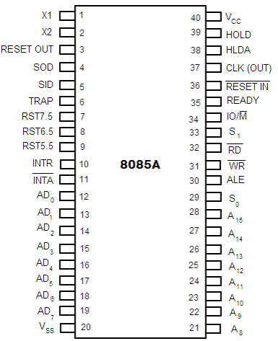

Slide 6
Power Supply and Clock Pins –
Vcc (Pin 40): This pin is the +5V power supply input for the microprocessor.
Vss (Pin 20): This is the ground pin, used as the reference for all voltages in the system.
X1 and X2 (Pins 1, 2): These pins are connected to an external crystal oscillator to generate the clock signal. X1 and X2 are the input and output pins for the oscillator, respectively. The clock frequency is internally divided by 2 to get the operating frequency of the microprocessor.
CLK (OUT) (Pin 37): This pin provides the clock output signal to synchronize other peripherals in the system.

Slide 7
Address and Data Buses-
A15 - A8 (Pins 21 to 28): These are the higher-order address lines. They are used to address memory locations and I/O ports in the system. These pins carry the most significant 8 bits of the memory address or the I/O port address.
AD7 - AD0 (Pins 12 to 19): These pins are multiplexed to serve as both the lower-order address bus and the data bus. During the first part of the machine cycle, they carry the lower 8 bits of the address (A7 - A0). During the second part, they are used as the data bus to transfer data between the microprocessor and memory or I/O devices.

Slide 8
Control and Status Signals-
ALE (Address Latch Enable) (Pin 30): ALE is a control signal that is used to demultiplex the lower-order address bus and data bus. It indicates that the AD7 - AD0 lines are carrying the lower-order address during the first part of the machine cycle.
IO/M (Pin 34): This signal differentiates between memory and I/O operations. When IO/M = 0, it indicates a memory operation, and when IO/M = 1, it indicates an I/O operation.
RD (Read) (Pin 32): This is an active low signal that indicates the microprocessor is performing a read operation. It signals the selected memory or I/O device to place data on the data bus.

Slide 9
Control and Status Signals-
WR (Write) (Pin 31): This is an active low signal that indicates the microprocessor is performing a write operation. It signals the selected memory or I/O device to capture the data on the data bus.
S0, S1 (Pins 33, 29): These are status signals used to indicate the type of operation being performed (fetch, memory read/write, I/O read/write, etc.).

Slide 10
Interrupts and Externally Initiated Signals-
INTR (Interrupt Request) (Pin 10): This pin is used to request an interrupt. The microprocessor acknowledges this request via the INTA pin. The INTR pin is maskable.
INTA (Interrupt Acknowledge) (Pin 11): This is an active low signal that indicates the microprocessor has acknowledged the interrupt request.
TRAP (Pin 6): This is a non-maskable interrupt with the highest priority. It cannot be disabled and is usually used for critical events like power failure.
RST 7.5, RST 6.5, RST 5.5 (Pins 7, 8, 9): These are maskable interrupts with decreasing priority. They can be enabled or disabled using software instructions.

Slide 11
Interrupts and Externally Initiated Signals-
RESET IN (Pin 36): This is an active low input signal that resets the microprocessor, clearing the program counter and registers. The microprocessor starts execution from address 0000H when RESET IN is activated.
RESET OUT (Pin 3): This pin indicates that the microprocessor is being reset. It can be used to reset external devices.

Slide 12
Serial I/O Ports-
SID (Serial Input Data) (Pin 5): This pin is used to receive serial data bit by bit. It is typically used for serial communication in embedded systems.
SOD (Serial Output Data) (Pin 4): This pin is used to send serial data bit by bit.

Slide 13
Direct Memory Access (DMA) Control Signals-
HOLD (Pin 39): This signal indicates that an external device is requesting control of the address and data buses. The microprocessor completes its current operation and relinquishes control of the buses when HOLD is asserted.
HLDA (Hold Acknowledge) (Pin 38): This signal is used by the microprocessor to acknowledge the HOLD request. Once the buses are relinquished, HLDA is asserted.

Slide 14
Ready and Control Signals-
READY (Pin 35): This signal indicates whether a peripheral is ready for data transfer. If READY is low, the microprocessor waits for the peripheral to be ready, effectively inserting wait states into the machine cycle.
S0, S1 (Pins 33, 29): These status lines are used to indicate the type of machine cycle in progress.
ALE (Pin 30): Address Latch Enable, as described earlier, is used to latch the lower-order address during the first phase of the machine cycle.
RESET IN (Pin 36): Used to reset the microprocessor.

Slide 15
Internal Architecture
of
8085 processor

Slide 16
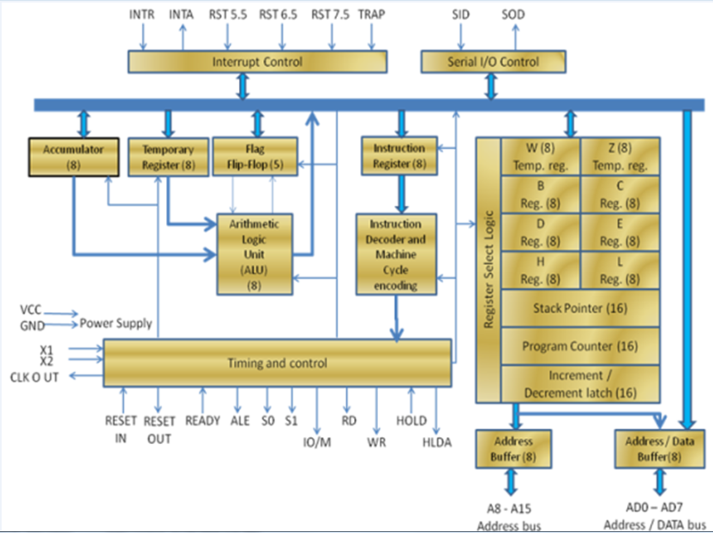

Slide 17
Accumulator (8-bit)
The accumulator is a crucial 8-bit register within the 8085 microprocessor. It is designated to store intermediate results during arithmetic and logic operations.
The accumulator acts as a central hub for most operations. When an arithmetic or logic operation is performed, one operand is typically stored in the accumulator, and the result of the operation is also stored back in the accumulator. For instance, if you add two numbers, the first number might be in the accumulator, the second number could come from another register, and after addition, the result is placed back into the accumulator. This allows the microprocessor to chain operations together efficiently.

Slide 18
Temporary Register (8-bit)
The temporary register is an internal, non-addressable register used by the microprocessor during processing. It holds data temporarily while operations are being carried out.
This register is used mainly by the Arithmetic Logic Unit (ALU) for holding the operands or the intermediate results of operations. For example, during a complex operation that involves multiple steps, the temporary register may hold data temporarily before passing it back to the accumulator or another register.

Slide 19
Flag Register (Flip-Flops)
The flag register is an 8-bit register containing five flip-flops that represent five flags: Sign, Zero, Auxiliary Carry, Parity, and Carry.
These flags are set or reset (turned to 1 or 0) based on the result of the operation performed by the ALU.
Sign Flag (S): Set if the result is negative (most significant bit is 1).
Zero Flag (Z): Set if the result is zero.
Auxiliary Carry Flag (AC): Set if there’s a carry out from the lower nibble (used in BCD arithmetic).
Parity Flag (P): Set if the number of 1s in the result is even.
Carry Flag (CY): Set if there’s a carry out from the most significant bit or borrow in subtraction.
These flags are essential for making decisions within programs, such as in conditional branching (e.g., "jump if zero").

Slide 20
Arithmetic and Logic Unit (ALU)
What is it?
The ALU is the heart of the microprocessor where all arithmetic (addition, subtraction, etc.) and logical (AND, OR, NOT, etc.) operations are performed.
Working:
The ALU receives inputs from the accumulator, temporary register, and sometimes directly from memory or other registers. It performs the specified operation and sends the result back to the accumulator or another register. The ALU also interacts with the flag register to set or reset the relevant flags based on the result of the operation.

Slide 21
Instruction Register (8-bit)
What is it?
The instruction register temporarily holds the current instruction that is being executed by the microprocessor.
Working:
When an instruction is fetched from memory, it is placed in the instruction register. The microprocessor then decodes this instruction to understand what action is required. This could be an arithmetic operation, data movement, or control operation. The instruction remains in this register until it has been fully executed.

Slide 22
Instruction Decoder and Machine Cycle Encoding
What is it?
The instruction decoder interprets the instruction stored in the instruction register, converting it into a series of control signals needed to execute the instruction.
Working:
Once an instruction is loaded into the instruction register, the instruction decoder analyzes the opcode (the part of the instruction that specifies the operation). It then generates a series of control signals that are distributed to various parts of the microprocessor, orchestrating the correct sequence of operations to complete the instruction. This includes generating timing signals that correspond to the different phases of execution (fetch, decode, execute).

Slide 23
Register Array
The register array consists of several general-purpose and special-purpose registers used for various operations.
General-Purpose Registers (B, C, D, E, H, L): These are 8-bit registers used for temporary data storage, arithmetic, or logical operations. They can also be paired (e.g., B-C, D-E, H-L) to perform 16-bit operations.

Slide 24
Special-Purpose Registers:
Stack Pointer (SP) (16-bit): This points to the top of the stack in memory, which is a reserved area used for storing return addresses, local variables, and intermediate data during subroutine calls.
Program Counter (PC) (16-bit): This holds the memory address of the next instruction to be executed, ensuring the microprocessor fetches instructions sequentially.
Increment/Decrement Latch: Used during operations that involve modifying memory addresses (like incrementing a pointer).

Slide 25
Timing and Control Unit
The timing and control unit generates timing signals to synchronize operations within the microprocessor and manage communication with external devices.
Control Signals: These include signals like RD (Read), WR (Write), IO/M (to distinguish between I/O and memory operations), and ALE (Address Latch Enable). These control the flow of data between the microprocessor and memory or I/O devices.
Status Signals (S0, S1): Indicate the current operation status (e.g., fetch, execute, etc.) to external devices.
Timing: This unit ensures that all operations within the microprocessor happen in a coordinated manner, with each operation occurring at the right time.

Slide 26
Interrupt Control
What is it?
The interrupt control manages the microprocessor’s response to external interrupts, which are signals that temporarily halt the current process to handle a more urgent task.
Working:
Interrupt Signals (INTR, INTA, RST 5.5, 6.5, 7.5, TRAP): These are used by external devices to interrupt the microprocessor's current operations. The microprocessor acknowledges the interrupt via INTA (Interrupt Acknowledge), pauses the current task, and executes an Interrupt Service Routine (ISR) based on the interrupt type.
Priority: Some interrupts have higher priority (e.g., TRAP) and cannot be ignored, while others can be masked or disabled as needed.

Slide 27
Serial I/O Control
This control manages serial communication via the microprocessor's serial input (SID) and output (SOD) lines.
SID (Serial Input Data): Used to receive serial data.
SOD (Serial Output Data): Used to transmit serial data.
This control allows the microprocessor to interact with serial peripherals, like serial communication devices, in a bit-by-bit manner.

Slide 28
Address Buffer (8-bit)
The address buffer is used to temporarily hold the higher byte of the memory address during an operation.
The microprocessor uses a 16-bit address bus to communicate with memory. The higher 8 bits (A8-A15) are placed in the address buffer while the operation is carried out, ensuring that the correct memory location is accessed.

Slide 29
Address/Data Buffer (8-bit)
This is a multiplexed buffer that holds both the lower 8 bits of the address and the 8-bit data during memory or I/O operations.
During the address phase, this buffer holds the lower 8 bits of the memory address (A0-A7). During the data phase, it switches to hold the data being read from or written to memory or an I/O device. The same physical lines are used for both address and data, with control signals determining the current role.

Slide 30
Power Supply and Clock Inputs
The power supply and clock inputs provide the necessary power and timing signals for the microprocessor to operate.
VCC/GND: These pins connect to the power supply (typically +5V) and ground.
X1/X2: Connected to an external crystal oscillator to provide the clock signal that drives the timing of the microprocessor's operations.
CLK OUT: Provides the clock signal to synchronize external devices with the microprocessor.

Slide 31
Control Signals –
RESET IN/OUT:
RESET IN: This input signal is used to reset the microprocessor. When a high signal is applied to the RESET IN pin, the microprocessor's internal state is cleared, all registers are set to zero, and the program counter (PC) is set to zero, which means that the microprocessor will start executing instructions from the memory location 0000H once the reset is removed.
RESET OUT: This output signal indicates that the microprocessor is being reset. It can be used to reset other devices in the system to ensure that they are in sync with the microprocessor. When the microprocessor is reset by the RESET IN signal, it sends out a RESET OUT signal to other peripherals to reset them as well.

Slide 32
RD (Read):
The RD signal is an active-low output signal, which means it is active when it is low (0). It is used to indicate that the microprocessor is performing a read operation. When RD is activated, the microprocessor is reading data from memory or an I/O device. The data is then placed on the data bus for the microprocessor to use.
WR (Write):
Similar to RD, the WR signal is also an active-low output signal. When WR is low, it indicates that the microprocessor is performing a write operation, meaning that the data on the data bus is being written to a memory location or an I/O device.

Slide 33
IO/M (Input/Output or Memory):
The IO/M signal is an output signal used to differentiate between memory and I/O operations. When IO/M is high (1), the microprocessor is performing an I/O operation (reading from or writing to an I/O port). When IO/M is low (0), it indicates that the operation involves memory (reading from or writing to memory).
S0, S1 (Status Signals):
These are status signals that are output by the microprocessor to indicate the current operation being performed. They help external devices understand the microprocessor's current state.
S0 = 0, S1 = 0: Indicates a halt state (Halt).
S0 = 0, S1 = 1: Indicates a write operation (WR).
S0 = 1, S1 = 0: Indicates a read operation (RD).
S0 = 1, S1 = 1: Indicates an opcode fetch operation (the microprocessor is fetching the next instruction to execute).

Slide 34
HOLD:
The HOLD signal is an input to the microprocessor that indicates that another device (like a DMA controller) is requesting control of the system bus (address bus, data bus, and control bus). When the HOLD signal is high, the microprocessor finishes its current operation, places the buses in a high-impedance state (effectively disconnecting itself from the buses), and then asserts the HLDA (Hold Acknowledge) signal.
HLDA (Hold Acknowledge):
HLDA is an output signal from the microprocessor that acknowledges the HOLD request. When HLDA is high, it means that the microprocessor has granted control of the buses to the requesting device. The microprocessor will only regain control of the buses once the HOLD signal is deasserted (goes low).

Slide 35
Uses of the 8085 Microprocessor –
Embedded Systems: The 8085 microprocessor is often used in small electronic devices like industrial machines, car electronics, and medical devices to control their operations.
Computer Accessories: It's used in gadgets connected to computers, like printers and disk drives, to help them work properly.
Communication Devices: The 8085 is found in devices that help computers and phones communicate, like modems.

Slide 36
Uses of the 8085 Microprocessor -
Measurement and Control Devices: It controls instruments that measure things like temperature and pressure.
Home Appliances: Common household devices, such as washing machines and microwaves, use the 8085 microprocessor for their functions.
Education: Because it’s simple and affordable, the 8085 is popular in schools and universities for teaching about microprocessors.

Slide 37
Advantages of the 8085 Microprocessor
Simple Architecture: The 8085 microprocessor has a straightforward design, making it easy to understand and work with, especially for beginners in microprocessor programming and design.
Low Cost: Due to its simplicity and the widespread availability of its components, the 8085 is relatively inexpensive, making it a cost-effective solution for various applications.
Easy to Interface: The 8085 microprocessor can easily be interfaced with other peripherals and devices, thanks to its well-documented architecture and widespread use.

Slide 38
Advantages of the 8085 Microprocessor
Adequate for Basic Applications: For simple control tasks and basic processing needs, the 8085 provides sufficient computing power, making it suitable for small-scale embedded systems.
Wide Educational Use: Its simplicity and availability make it a popular choice for teaching microprocessor fundamentals in educational institutions.
Reliable and Robust: The 8085 microprocessor is known for its reliability and durability, performing well under various operating conditions.

Slide 39
Disadvantages of the 8085 Microprocessor
Limited Processing Power:
Being an 8-bit microprocessor, the 8085 has limited processing capabilities, which makes it unsuitable for more complex and high-speed computing tasks.
Limited Memory Addressing:
The 8085 can only address up to 64KB of memory, which is a significant limitation for applications requiring larger memory spaces.
Lack of Modern Features:
The 8085 lacks advanced features found in more modern microprocessors, such as floating-point arithmetic, advanced interrupt handling, and multi-core processing.

Slide 40
Disadvantages of the 8085 Microprocessor
Low Clock Speed:
The 8085 operates at a lower clock speed compared to modern microprocessors, which limits its performance in time-critical applications.
Outdated Technology:
The 8085 is based on older technology, and while it’s excellent for learning and basic applications, it’s not suitable for modern computing needs that require high efficiency and advanced processing capabilities.
Limited Instruction Set:
The instruction set of the 8085 is relatively small and lacks the complexity and versatility of those found in newer microprocessors, limiting its ability to perform complex operations efficiently.

Slide 41
Thank you

