Slide 2

What is Flutter?
Open-source UI software development kit by Google.
Used for developing natively compiled applications for mobile (iOS, Android), web, and desktop from a single codebase.
First released in May 2017.

Slide 3
History of Flutter
Origins:
Developed by Google: Flutter began as an internal project at Google aimed at creating a tool for faster app development across multiple platforms.
Initial Release (2015): The project was first known as "Sky" and ran on Android. It focused on delivering 120 frames per second (FPS) for smooth UIs.
Flutter Alpha (May 2017):
First Public Release: Flutter was announced at Google I/O 2017, as a mobile-focused UI toolkit.
Primary Goal: Allow developers to build cross-platform apps for iOS and Android using a single codebase.

Slide 4
3. Flutter 1.0 (December 2018):
Stable Release: Official launch of Flutter 1.0 during the Flutter Live event in London.
Significant Features:
Dart Language: Uses Google’s Dart language for high-performance apps.
Widgets: Provides a rich set of customizable widgets for building modern UIs.
Hot Reload: Enables fast development and iteration by instantly applying changes in the app without a full restart.
4. Flutter for Web (2019):
Flutter 1.5: Google announced experimental support for web applications, expanding Flutter beyond mobile.
“Hummingbird”: This project later evolved into what is now known as Flutter for Web.
5. Flutter 2.0 (March 2021):
Full Web Support: Flutter 2.0 added stable support for web apps, further broadening its cross-platform capabilities.
Desktop Support (Beta): Introduced experimental support for building desktop applications for Windows, macOS, and Linux.
Sound Null Safety: Introduced null safety in Dart, reducing null reference exceptions in applications.

Slide 5
6. Flutter 3.0 (May 2022):
Desktop Support (Stable): Full stable support for desktop platforms including Windows, macOS, and Linux.
Performance Improvements: Optimizations in rendering engine and developer tools.
Material You Design: Introduced support for Google’s Material You design language.
7. Present & Future:
Growing Ecosystem: As of 2023, Flutter has a rapidly expanding ecosystem with millions of developers, third-party libraries, and packages.
New Platforms: Google continues to explore support for other platforms like embedded systems and beyond mobile, web, and desktop.

Slide 6
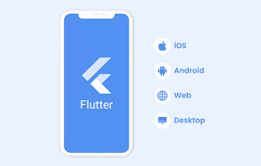
Scope of Flutter
Cross-platform Development:
Develop apps for Android, iOS, Web, and desktop from a single codebase.
Fast Development:
Hot reload feature helps developers quickly test and see results.
Growing Community:
Strong community support and frequent updates from Google.

Slide 7



Basic Requirements for Flutter Development
Hardware:
A system running macOS, Windows, or Linux.
Minimum 4 GB RAM (8 GB recommended).
Software:
Flutter SDK (available from flutter.dev).
Android Studio or VS Code as the code editor.
Android SDK, Xcode (for iOS development).

Slide 8
Usage of Flutter
Mobile App Development:
Used by companies like Google, Alibaba, and eBay for mobile apps.
Web Applications:
Create web apps using the same codebase as mobile.
Desktop Applications:
Develop Windows, macOS, and Linux applications.

Slide 9
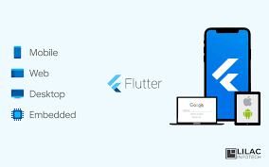
Why Choose Flutter?
Single Codebase:
Write once, run on multiple platforms.
High Performance:
Uses Dart language and compiles to native machine code.
Beautiful UIs:
Rich set of customizable widgets for building appealing UIs.

Slide 10
Future of Flutter
Expanding Platforms:
More support for desktop and embedded systems.
Community Growth:
Increasing number of libraries and packages.
Adoption by Enterprises:
Increasing adoption by companies for production-level apps.

Slide 11
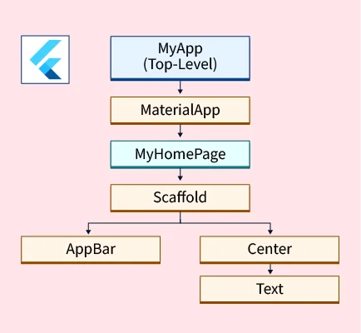
Flutter
Architecture

Slide 12
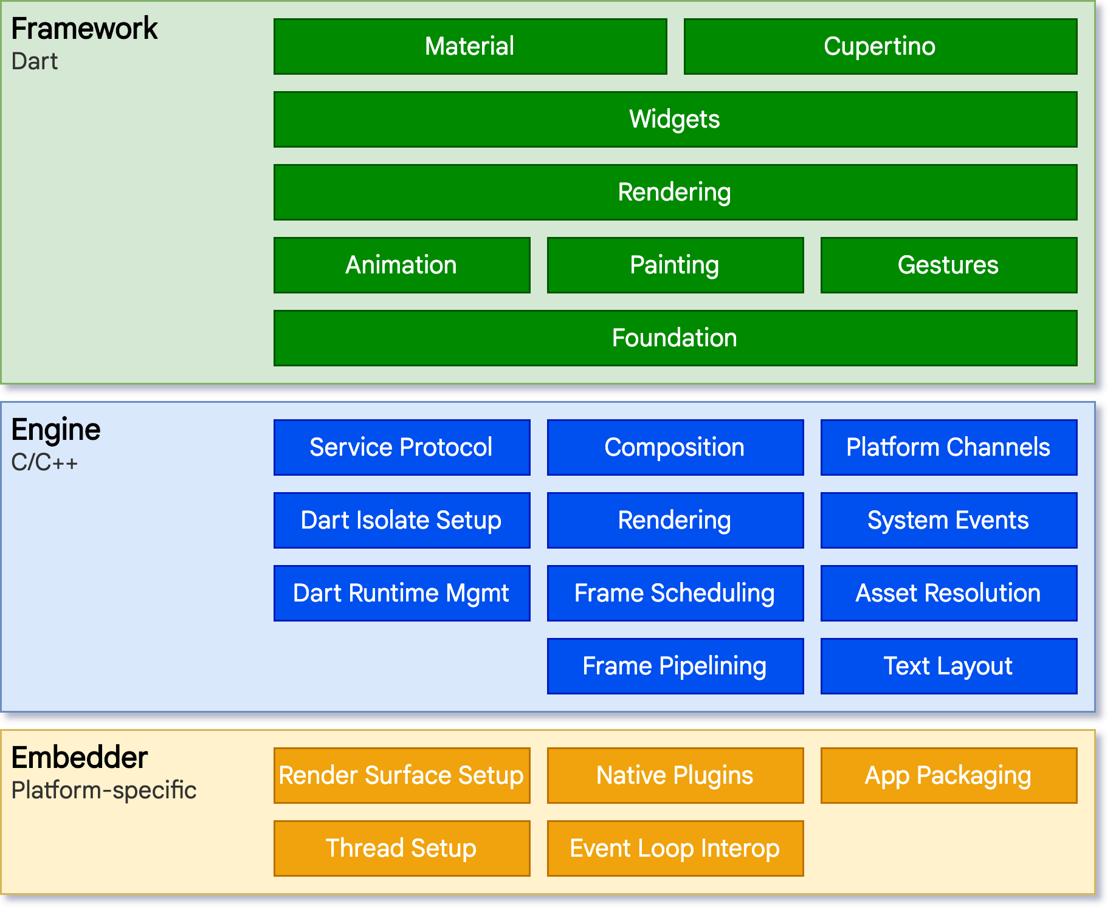

Slide 13
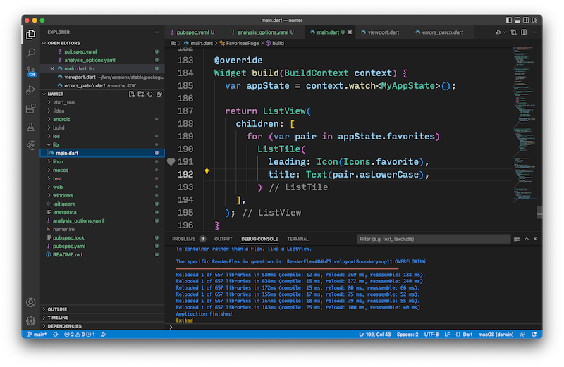
Flutter
Sample
Code

Slide 14
import 'package:flutter/material.dart';
import 'package:flutter/services.dart’;
void main() => runApp(const MyApp());
class MyApp extends StatelessWidget {
const MyApp({super.key}
);
@override
Widget build(BuildContext context) {
return MaterialApp(
home: Scaffold(
appBar: AppBar(
title: const Text('My Home Page’),
),
body: Center(
child: Builder(
builder: (context) {
return Column(
children: [
const Text('Hello World'),
const SizedBox(height: 20),
ElevatedButton(
onPressed: () {
print('Click!’);
},
child: const Text('A button'),
),
],
);
},
),
),
),
);
}
}

Slide 15
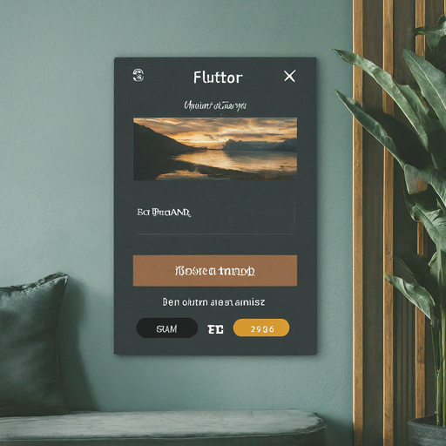
Widgets
in
Flutter

Slide 16
Key characteristics of Flutter widgets:
Composed of other widgets: Flutter widgets are often composed of smaller, simpler widgets. This allows for a hierarchical structure and easy customization.
State management: Widgets can manage their own state, allowing them to update their appearance based on user interactions or data changes.
Customizable: Flutter widgets can be highly customizable, allowing developers to create unique and tailored user interfaces.
Efficient: Flutter uses a high-performance rendering engine that provides smooth animations and fast updates.

Slide 17
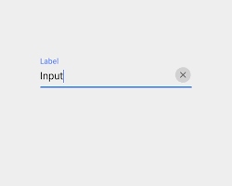
1. Layout Widgets
These widgets control the arrangement of other widgets on the screen.
Row: Arranges widgets horizontally.
Column: Arranges widgets vertically.
Stack: Overlays widgets on top of each other.
Expanded: Expands a widget to fill available space.
Container: A general-purpose layout widget that provides padding, margin, alignment, and decoration.

Slide 18
import 'package:flutter/material.dart';
class MyWidget extends StatelessWidget {
@override
Widget build(BuildContext context) {
return Column(
children: [
Row(
children: [
Text('Hello, world!'),
ElevatedButton(
onPressed: () {},
child: Text('Click me'),
),
],
),
Image.network('https://example.com/image.jpg'),
],
);
}
}
Sample
code
for
layout
widget

Slide 19
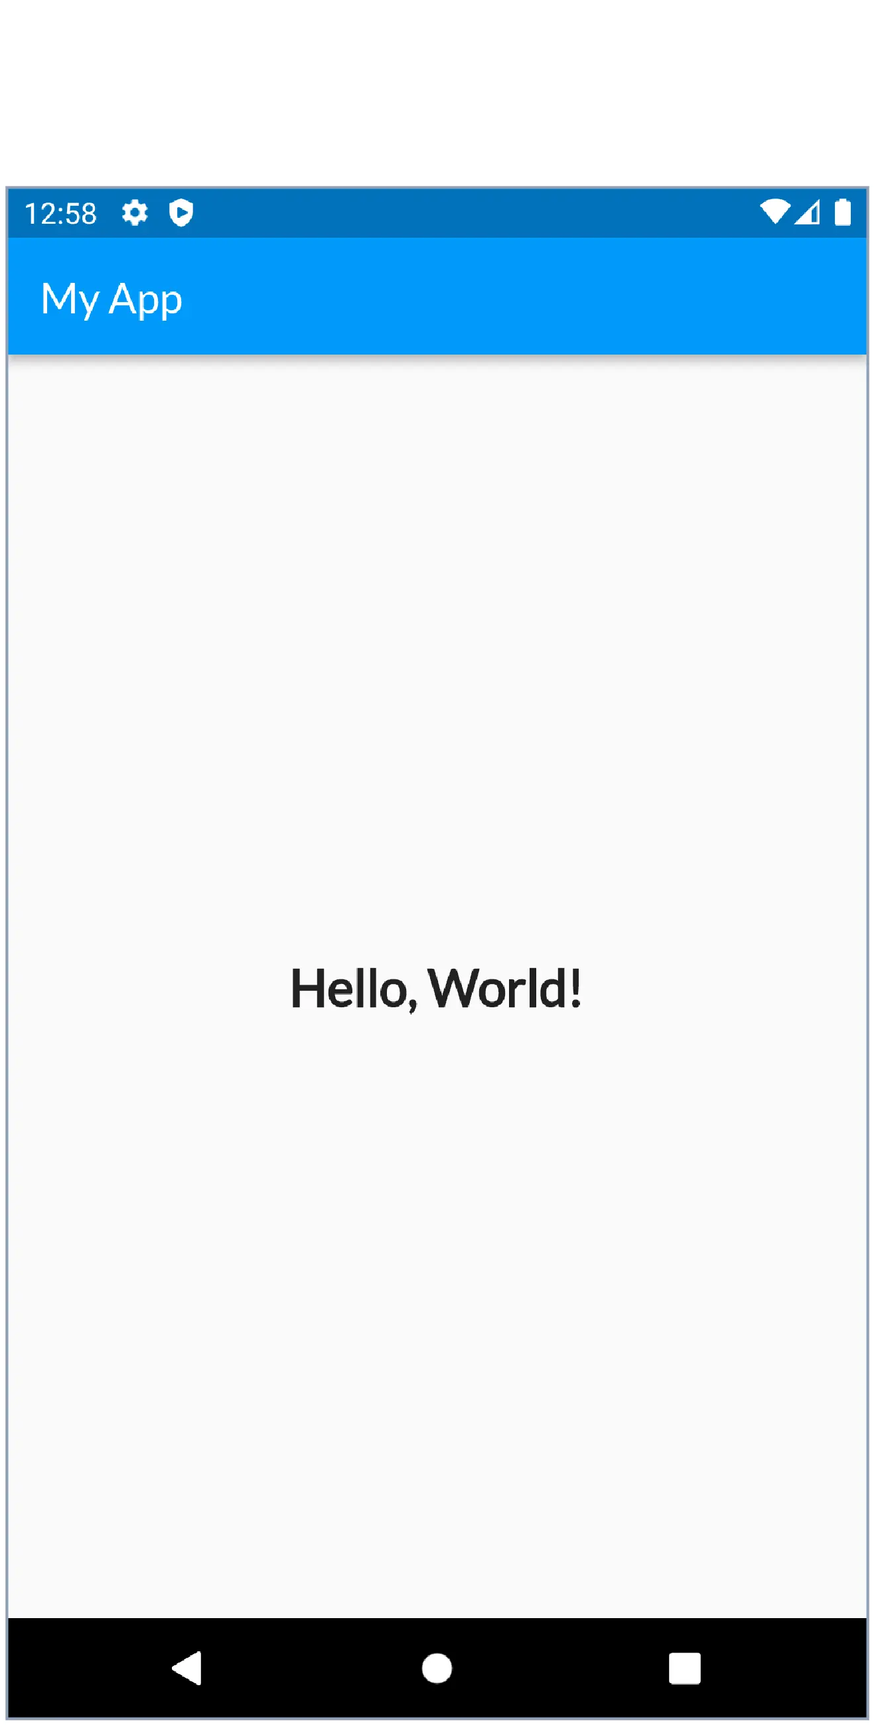
2. Text Widgets
Used to display text.
Text: Displays plain text.
TextField: Allows users to input text.
RichText: Displays formatted text with different styles and formatting.

Slide 20
import 'package:flutter/material.dart';
class MyTextWidget extends StatelessWidget {
@override
Widget build(BuildContext context) {
return Text(
'This is a simple Text widget.',
style: TextStyle(
fontSize: 20,
fontWeight: FontWeight.bold,
color: Colors.blue,
),
);
}
}

Slide 21
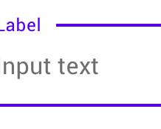
import 'package:flutter/material.dart';
class MyTextFieldWidget extends StatelessWidget {
@override
Widget build(BuildContext context) {
return TextField(
decoration: InputDecoration(
labelText: 'Enter your name',
border: OutlineInputBorder(),
),
);
}
}

Slide 22
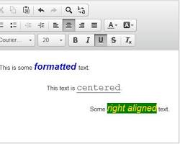
import 'package:flutter/material.dart';
class MyRichTextWidget extends StatelessWidget {
@override
Widget build(BuildContext context) {
return RichText(
text: TextSpan(
text: 'This is a ',
style: TextStyle(color: Colors.black),
children: <TextSpan>[
TextSpan(text: 'RichText', style: TextStyle(fontWeight: FontWeight.bold)),
TextSpan(text: ' widget.'),
],
),
);
}
}

Slide 23
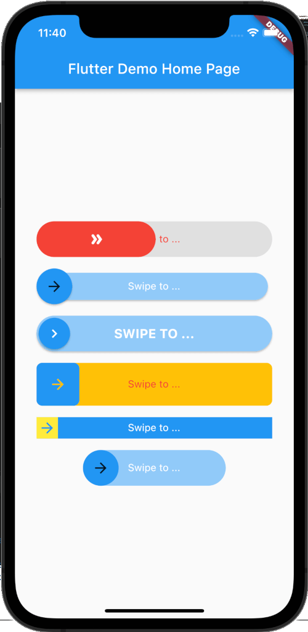
3. Button Widgets
Used to create interactive buttons.

Slide 24
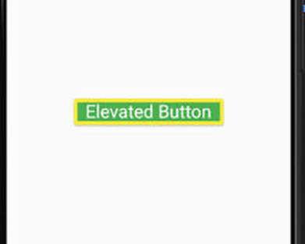
ElevatedButton
A raised button with a material design style.
ElevatedButton(
onPressed: () {
// Button press action
},
child: Text('Click me'),
)

Slide 25
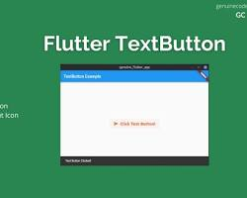
TextButton: A flat button with a material design style.
TextButton(
onPressed: () {
// Button press action
},
child: Text('Click me'),
)

Slide 26

IconButton: A button with an icon.
IconButton(
onPressed: () {
// Button press action
},
icon: Icon(Icons.favorite),
)

Slide 27
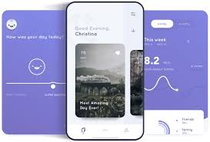
4. Image Widgets
Used to display images.
Image.asset('images/my_image.png')

Slide 28
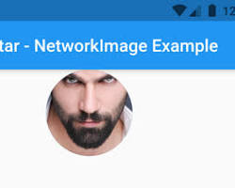
NetworkImage: Loads an image from a network URL.
NetworkImage('https://example.com/image.jpg')

Slide 29
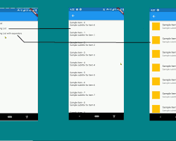
5. List Widgets
Used to display lists of items.
Displays items in a vertical list.
ListView.builder(
itemCount: items.length,
itemBuilder: (context, index) {
return ListTile(
title: Text('Item ${index + 1}'),
);
},
)

Slide 30
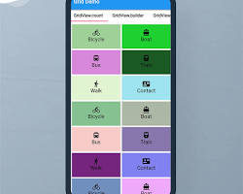
GridView: Displays items in a grid layout.
GridView.builder(
gridDelegate: SliverGridDelegateWithFixedCrossAxisCount(
crossAxisCount: 2,
mainAxisSpacing: 10,
crossAxisSpacing: 10,
),
itemCount: items.length,
itemBuilder: (context, index) {
return Container(
color: Colors.blue,
child: Center(
child: Text('Item ${index + 1}'),
),
);
},
)

Slide 31
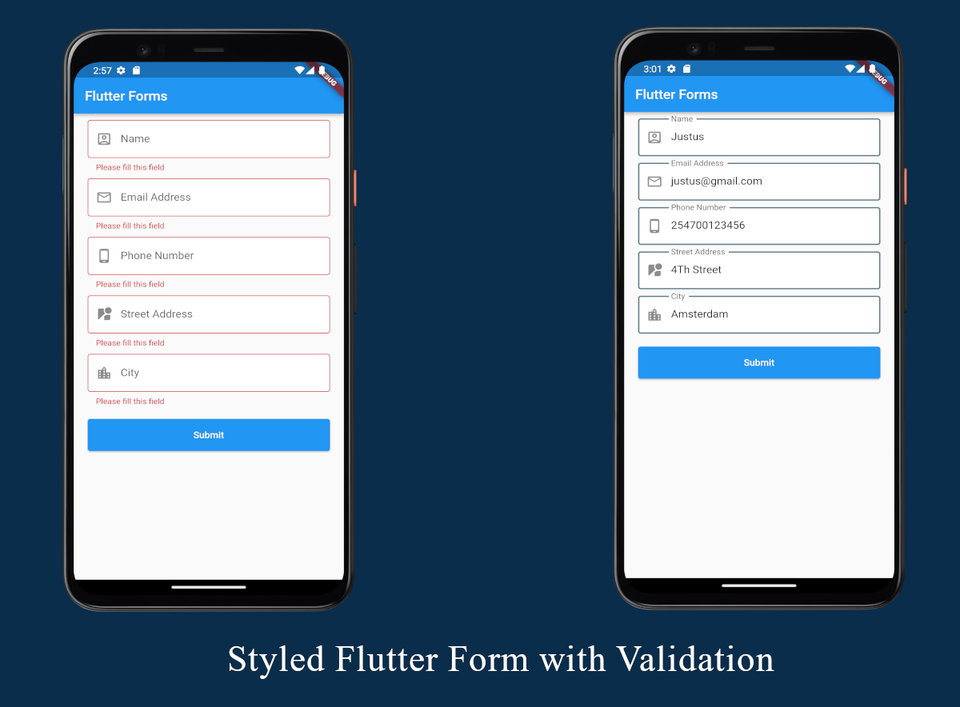
6. Form Widgets
Used to create forms for data input.

Slide 32
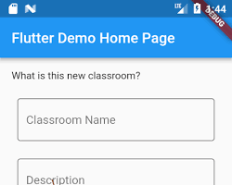
TextFormField: A text field for user input.
TextFormField(
decoration: InputDecoration(
labelText: 'Enter your name',
),
onChanged: (value) {
// Handle text input
},
)

Slide 33
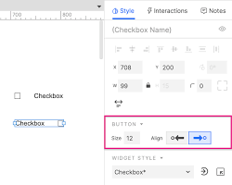
Checkbox:
Checkbox(
value: isChecked,
onChanged: (value) {
setState(() {
isChecked = value!;
});
},
)

Slide 34
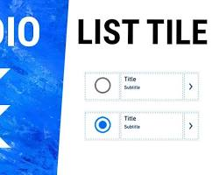
RadioListTile:
RadioListTile(
title: Text('Option 1'),
value: 1,
groupValue: selectedOption,
onChanged: (value) {
setState(() {
selectedOption = value;
});
},
)

Slide 35
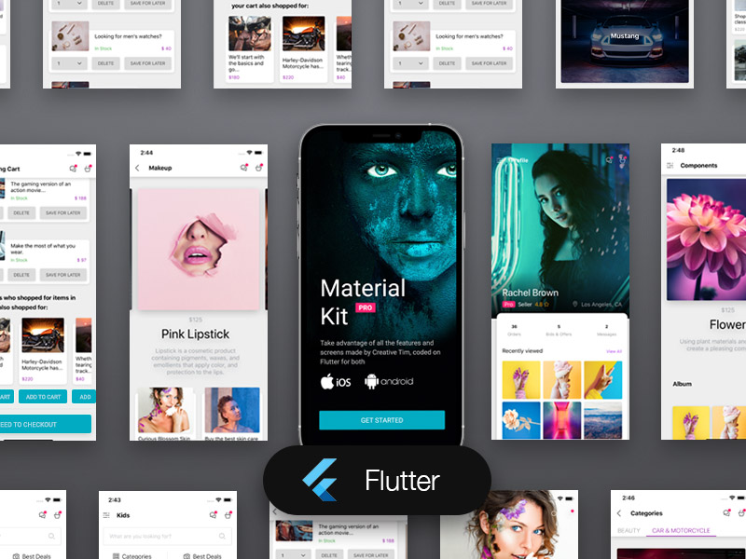
S
A
M
P
L
E
U
S
E
R
I
N
T
E
R
F
A
C
E

