Slide 1

Capstone Project-1 Hotel booking Analysis Team Members Rakesh Sahoo ,Mahesh Patki Lubna Zarin

Slide 2

Contents :
Data Understanding
Data Cleaning
Correcting Data Type
EDA
Missing/Null Value

Slide 3










1
Project Recap
4 Process
Agenda
2
Problem
5 Insights
3
Analytics Team

Slide 4

Project Recap
Hotel Booking analysis

Slide 5

challenges
Handling Duplicate data
Data presented in unwanted Datatype
Choosing appropriate visualization techniques to was difficult
A lot of null values were there in dataset
Problem

Slide 6
Insights/Story

Slide 7
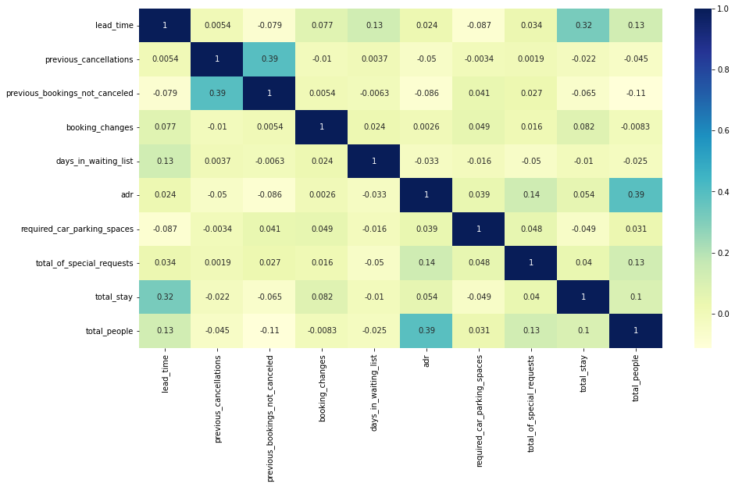
Observation-1
The best time of year to book a hotel room :
1)From corelation we can say when total peoples is greater then the price of average daily price is high
So this period of time is not good for booking
Fig of Relations
First the correlation between the numerical data
1-'total_people' and 'adr' has slight correlation. It means more number of people means, more adr which in turns more revenue.
2-’lead_time' and 'total_stay' has slight correlation, which indicates usually people with longer stay plans earlier than the actual arrival.

Slide 8
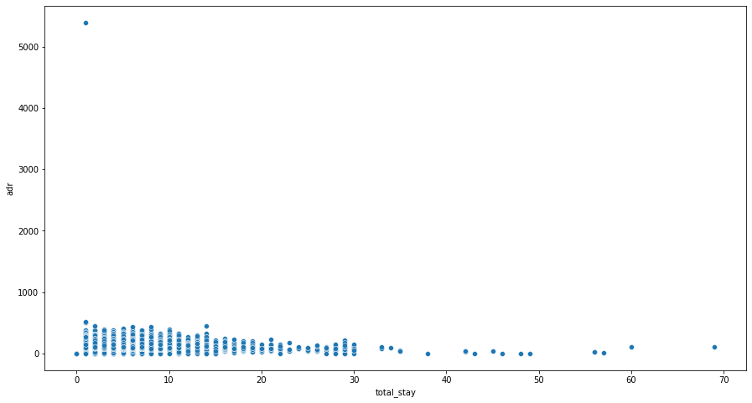
Observation-2
Lets see does length of stay affects the adr.
1)The pricing of hotel is also depending of day of stay
for example- If adr for one day stay 2000rs if we stay
2 days in hotel then its 1600 and similarly if we stay 3 days then the adr is lowest means 1500rs
So this is best length of staying duration
Fig of length of staying and adr
From the scatter plot we can see that as length of 'total_stay' increases the 'adr' decreases.
This means for longer stay, the better deal for customer can be finalized.

Slide 9
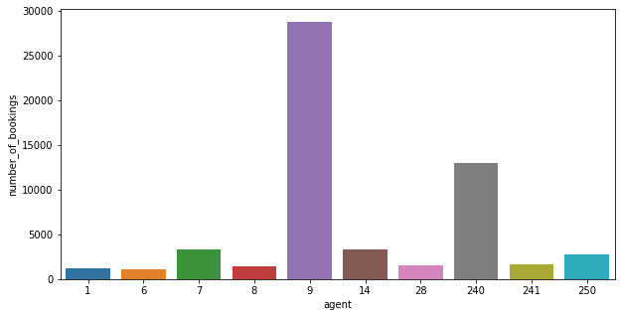
Observation-3:
Univariate Analysis
AS shown in fig number of booking and agent are plotted here we can see agent no. 9 makes maximum bookings.
Which agent makes most no. of bookings

Slide 10
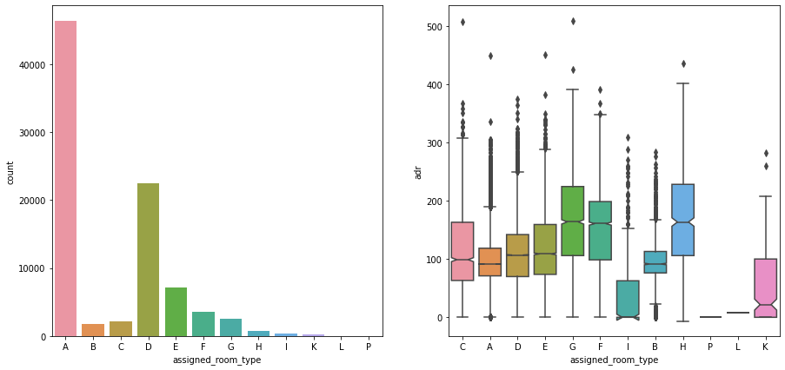
Observation-4
room type is in most demand and which room type generates highest adr
Fig of Analysis Room Demand
As shown in fig Most demanded room type is A, but better adr rooms are of type H, G and F also. Hotels should increase the no. of room types A and H to maximize revenue

Slide 11
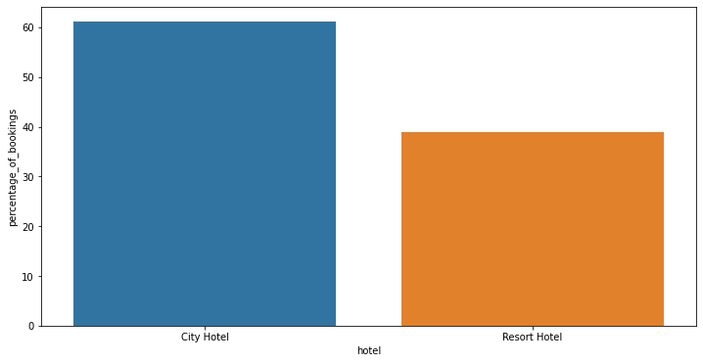
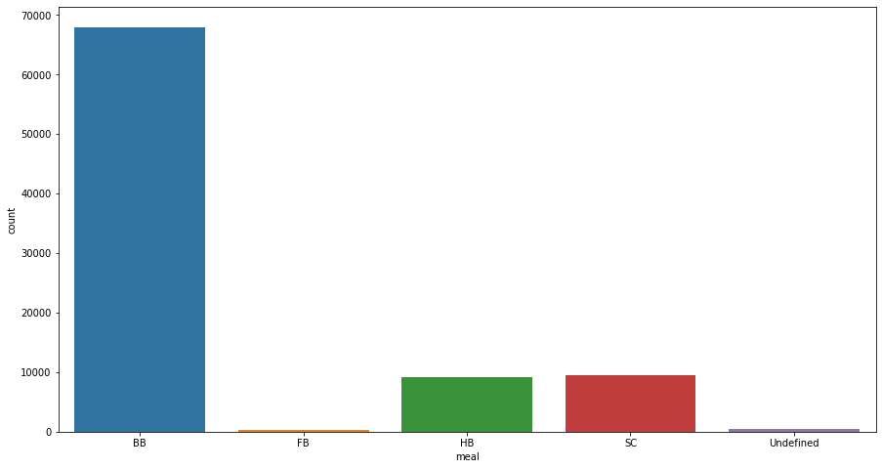
Observation-5
meal type is most preferred meal of customers:
Here we will use count plot to plot the chart
Observation-6
Hotel wise analysis
What is percentage of bookings in each hotel?
As we seen in fig most of the peoples choose city hotel then Resort around 60% bookings
are done in 'City Hotel' nd 40 % bookings are done in 'Resort Hotel'.
Form this we can also say 'City Hotel' has more avg adr as compared to 'Resort Hotel’,
hence 'City Hotel' is having more revenue than 'Resort Hotel'
Fig. of meal preferred
As shown in fig Most preferred meal type is BB (Bed and breakfast).

Slide 12
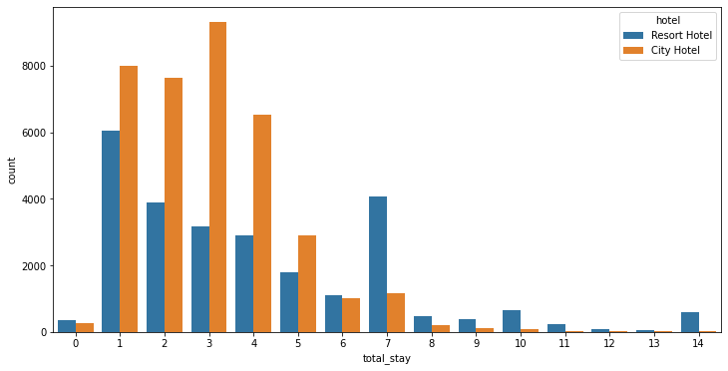
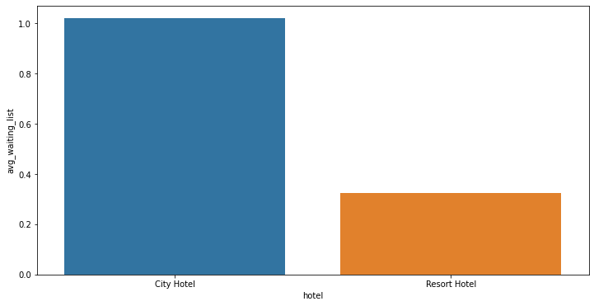
Observation-7
What is preferred stay length in each hotel?
Observation-8
Which hotel has longer waiting time?
Fig. total stay and count
Most common stay length is less than 4 days and generally
people prefer City hotel for short stay, but for long stays, Resort Hotel is preferred.
City hotel has significantly longer waiting time, hence City Hotel is much busier than Resort Hotel.

Slide 13
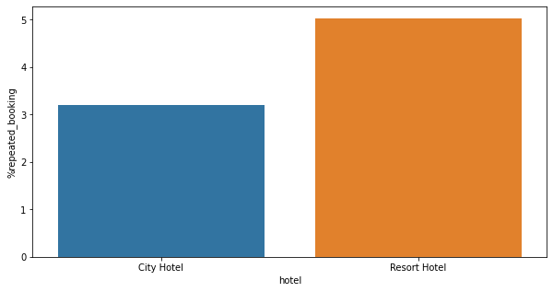
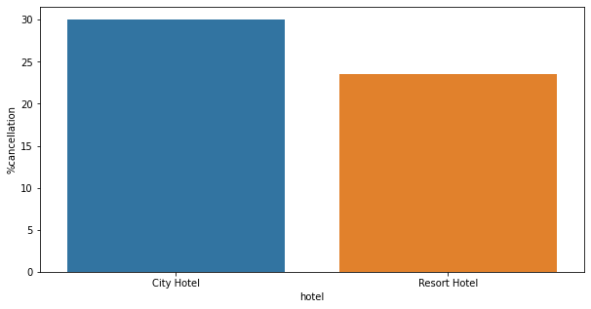
Observation-10:
Distribution Channel wise Analysis
Both hotels have very small percentage that customer will repeat,
but Resort hotel has slightly higher repeat % than City Hotel.
Observation-9:
Which hotel has higher bookings cancellation rate.
Selecting and counting number of cancelled bookings for each hotel.
Counting total number of bookings for each type of hotel
Calculating cancel percentage
The after plotting this in table here we can seen that
Fig Hotel cancelation rate
Almost 30 % of City Hotel bookings got canceled.

Slide 14
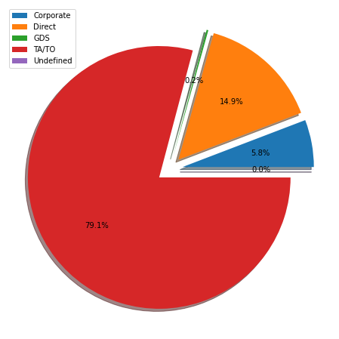
Observation-11:
the most common channel for booking hotels
As shown in fig the TA/TO has most commonly booking channel

Slide 15
CONCLUSION AND FUTURE WORK
The dataset contains immense possibilities to improve business values and have a positive impact. It is not limited to the problem taken into consideration for this project.
If it has user-friendly front-end user interface then on The base of data set is one of the use full
Data analysis system

Slide 16
ACKNOWLEDGEMENT
This project was completed by Rakesh Sahoo, Mahesh Patki, Lubna Zarin, Amir. We are extremely grateful to the celebrated authors whose precious works have been consulted and referred in our project work. We also wish to convey our appreciation to our peers who provided encouragement and timely support in the hour of need.

