Slide 1
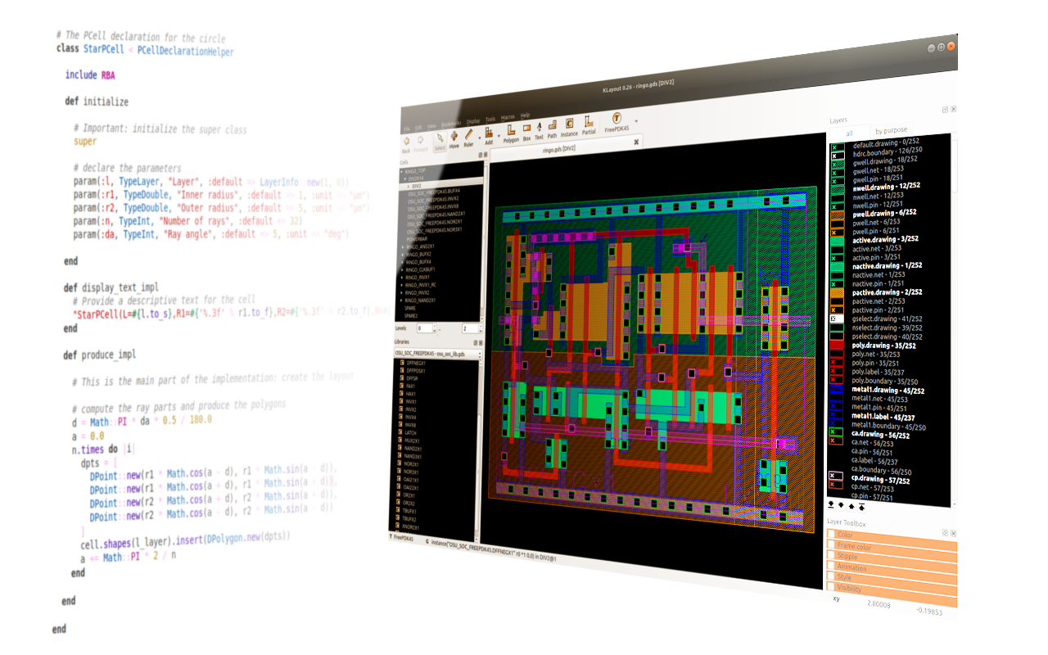
Klayout Training v0.1
October 05, 2022
Bo LU
EEE Department, HKU

Slide 2
1. Intro and Installation of Klayout
2. Design with Klayout
3. Collaborate with Python (Not Necessary)

Slide 3

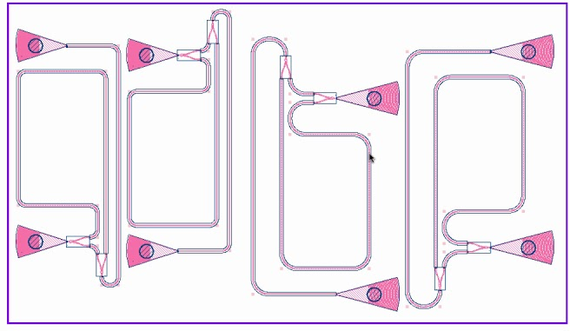
1. What is Klayout
Intro to CAD: Computer Aided Design
Technology CAD(TCAD): NEMO5, Silvaco, Synopsys Sentaurus, Lumerical, etc…
EDA: Sinopsis, Mentor, Cadence, Lumerical, Altium Designer, Tanner L-edit, Klayout, etc…
For optoelectronics: LED/Laser/HEMT/GaN-Based Device
Classic tool: L-edit
Friendly to new user with lots of reference materials
Lack of lic
Use tool from Silicon Photonics: Klayout
Free, Open Source
Easy to layout manually
Active Author in forum
Be able to layout with ONLY CODE
Layout of Silicon Photonics
Gratings and Bends

Slide 4
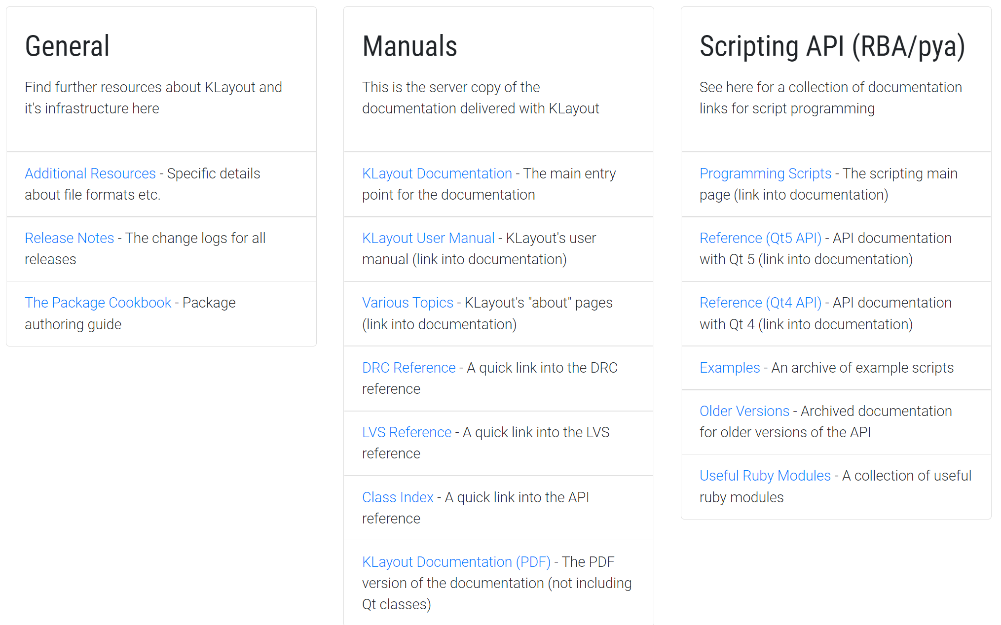
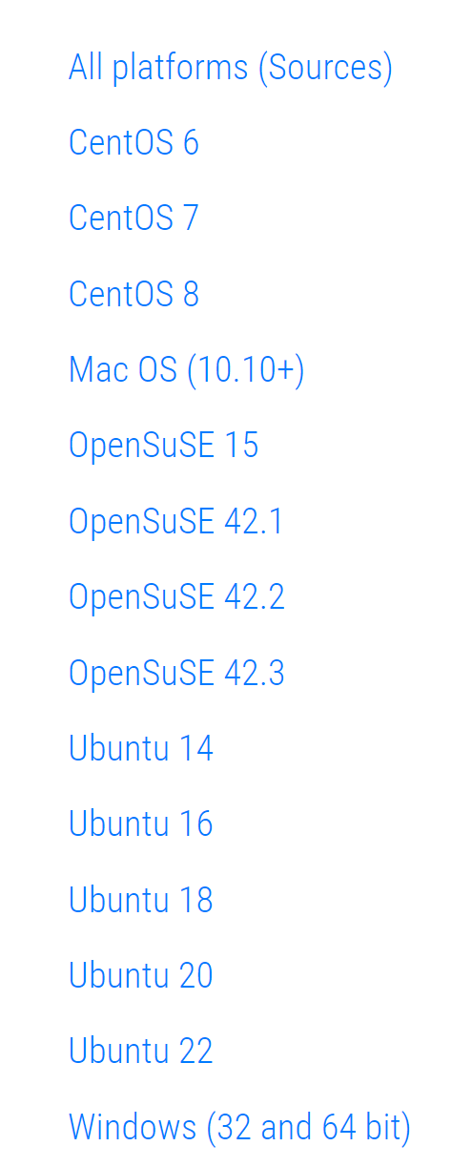
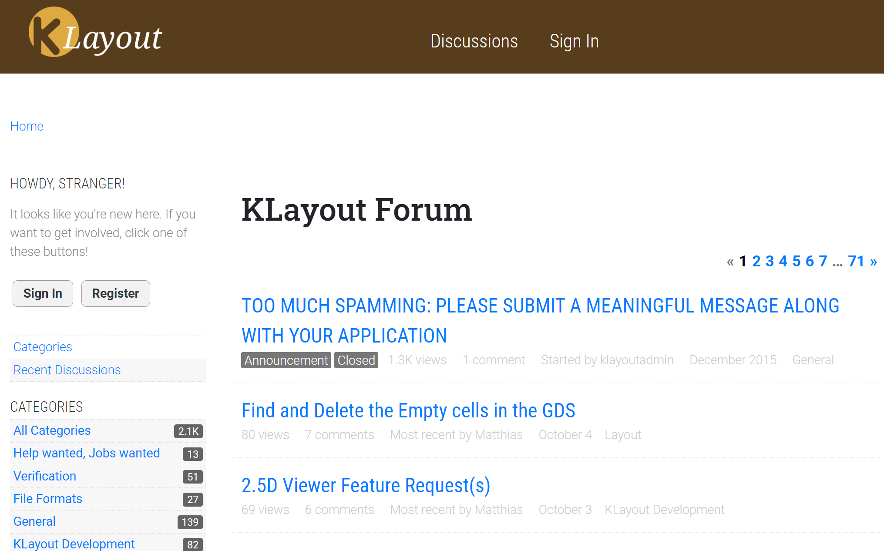
1. Installation of Klayout
Klayout: https://www.klayout.de/
Author: Matthias Köfferlein (German)
Download:
Available for Linux, Windows, MacOS
Documentation:
User Manual
Introduction to Script
API for Code
Forum:
Leave message to author
Ask questions in Forum
Google bugs and get result in Forum

Slide 5
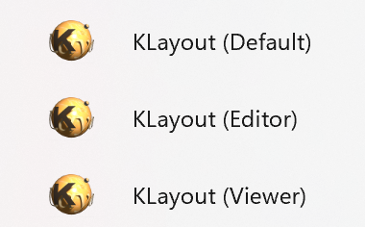
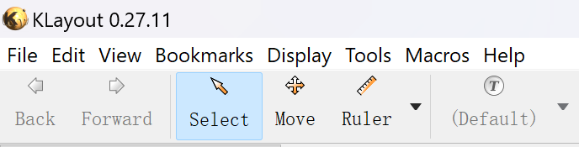
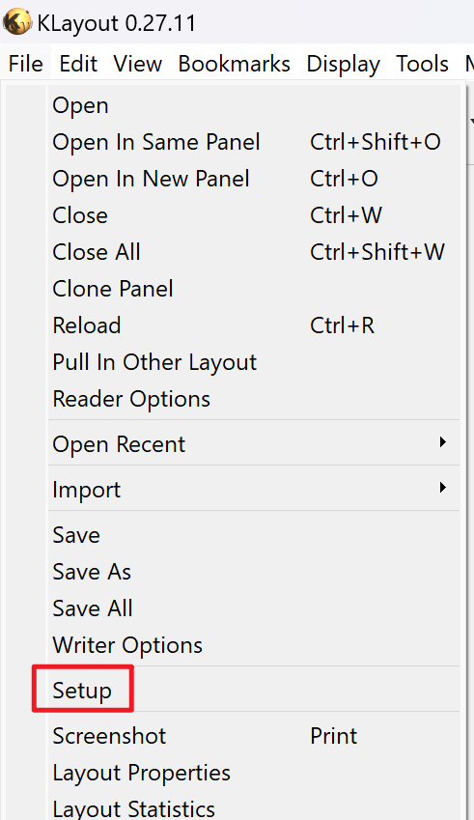
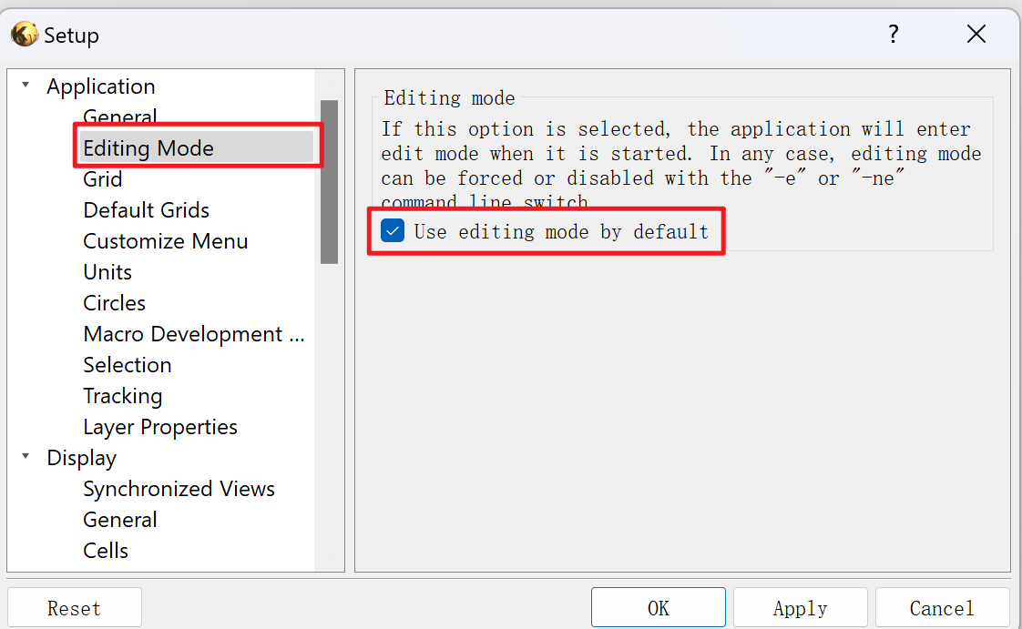
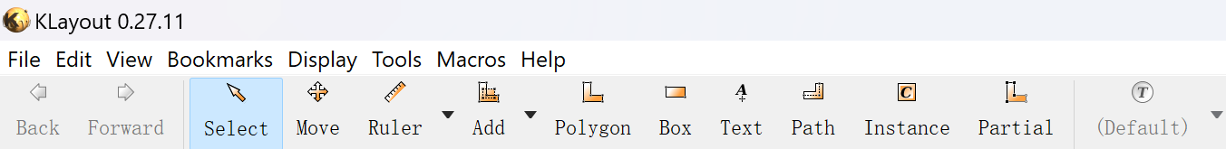
2. Introduction of Layout
After installing Klayout: 3 icons
Default mode will be Viewer
Only for view
Automatically open *.gds file in this mode
Editor mode
View, edit and generate
Viewer mode
Only for view
Change Default to Editor mode:
Caution !!! Be careful with your design
Open Klayout, File --> Setup
Setup --> Editing mode
tick Use editing mode by default
icons
Viewer mode
Setup 1
Setup 2
Editor mode

Slide 6
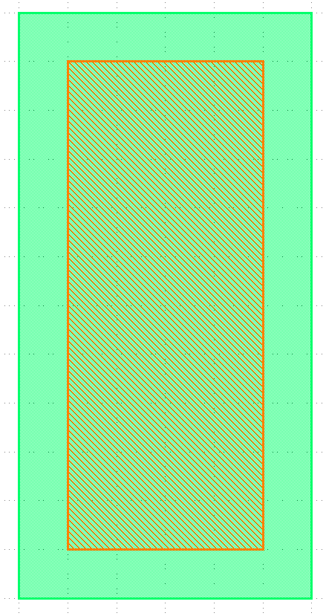
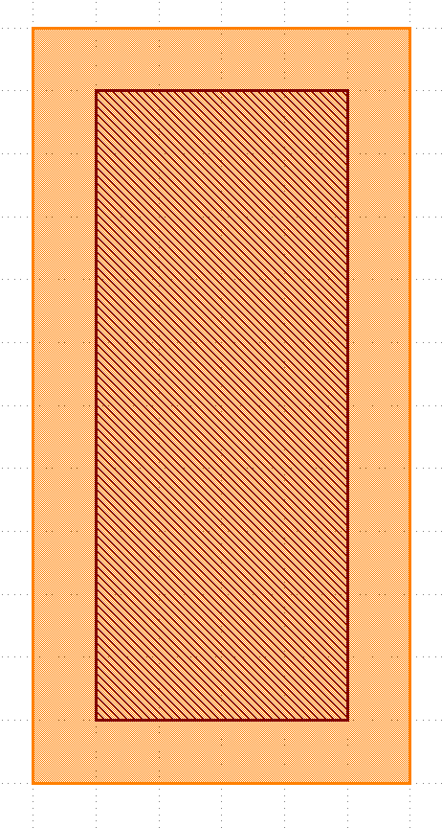
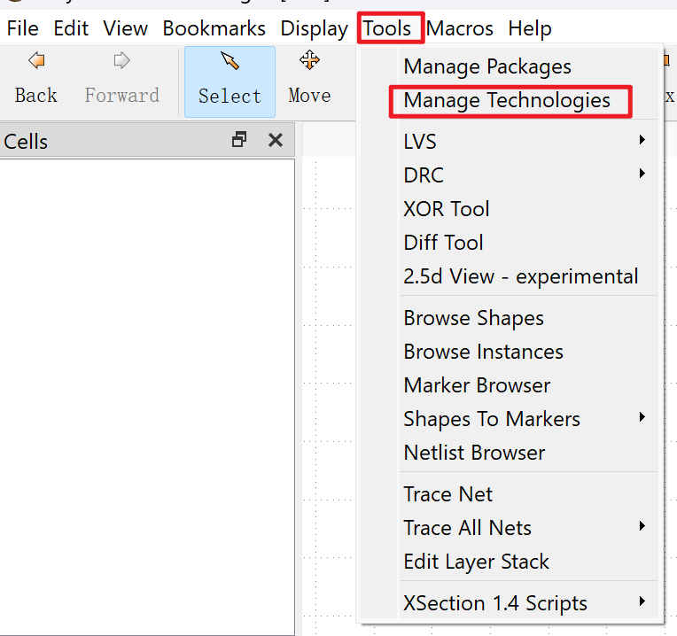
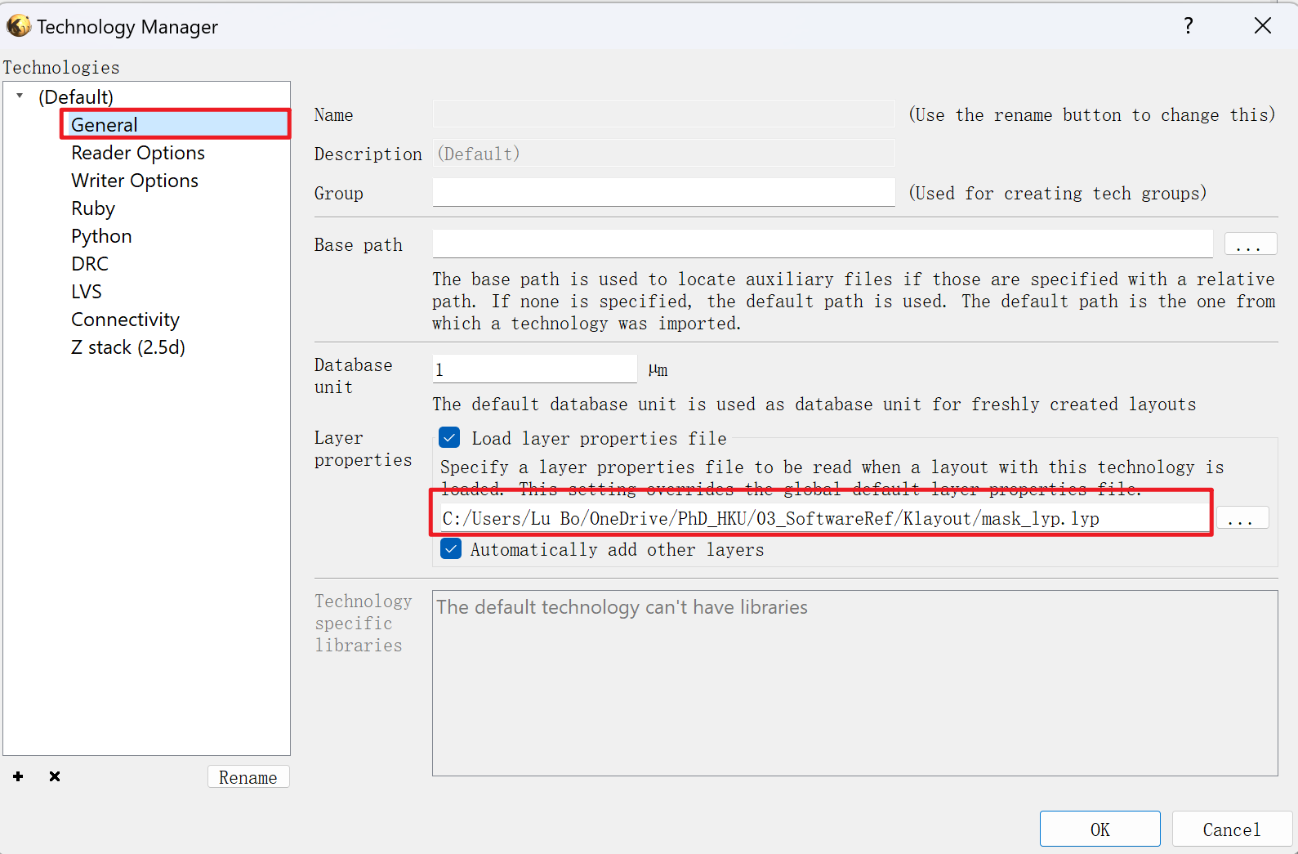
2. Introduction of Layout
Before Using Klayout:
Before Layout
Setup Universal Layer property (Strongly recommend in Group)
e.g. For Mesa Etch Mask, LU Bo use Green Color in layout, Others use Yellow Color. The layout could still be recognized but need more time.
Tools --> Manage Technologies
Technology Manager --> General --> Layer Properties
Load file here
More readable file (Excel) will be released for everyone editing soon.
Mesa
Mesa
CSL
CSL
Excel fig insert here soon

Slide 7
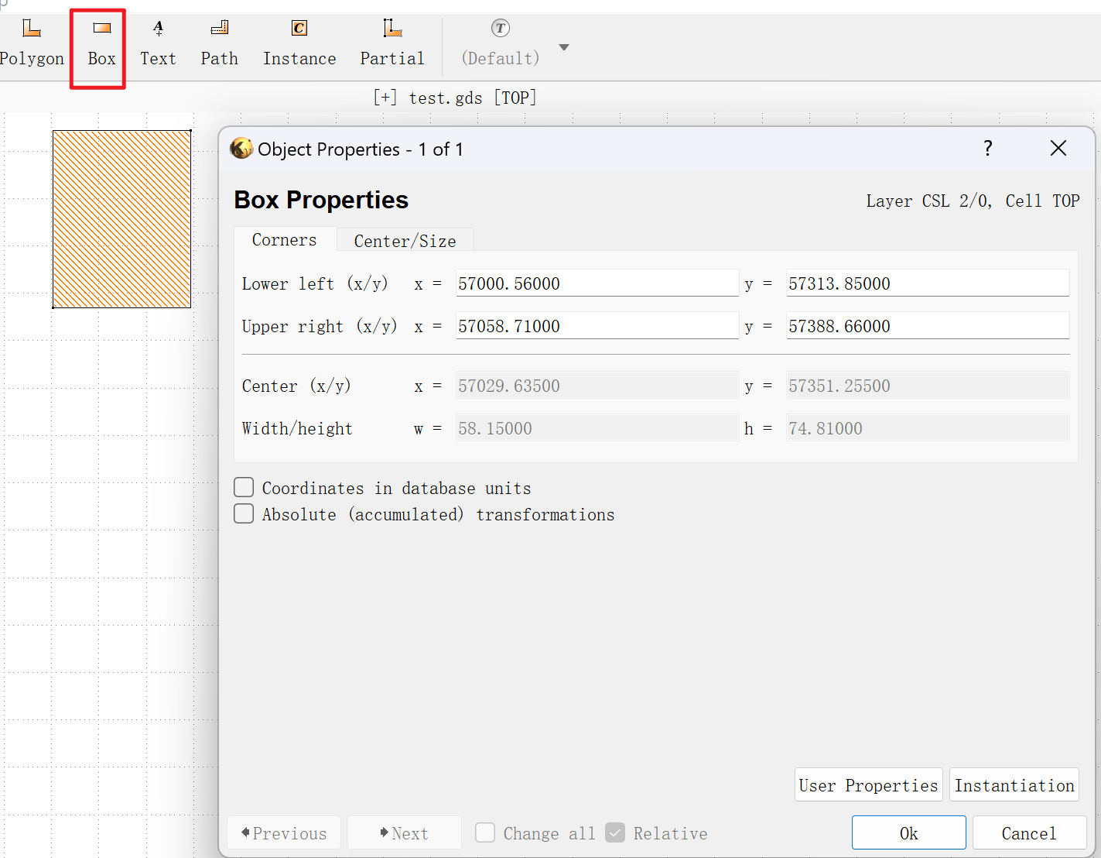
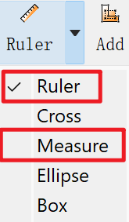
2. Introduction of Layout
Start Using Klayout:
Layout Tools
Select: select for an object. e.g. Cell, Box, Device you draw
Press ESC back to select. F2 back to main filed (Fn+F2 if hotkey is occupied)
Move: Move the object you select. Strongly recommend:
Select Object First
Then click Move Button
Finally, use keyboard to move the object
Ruler: Measure the length
Ruler mode: Use your mouse determining the length
Measure mode: Automatically get the length
Ctrl+K clear all rulers in the layout
Box: Create object
Select a layer first, Click Box Button and Draw in the area you want
ESC, Double click the Object you created, view and edit the properties

Slide 8
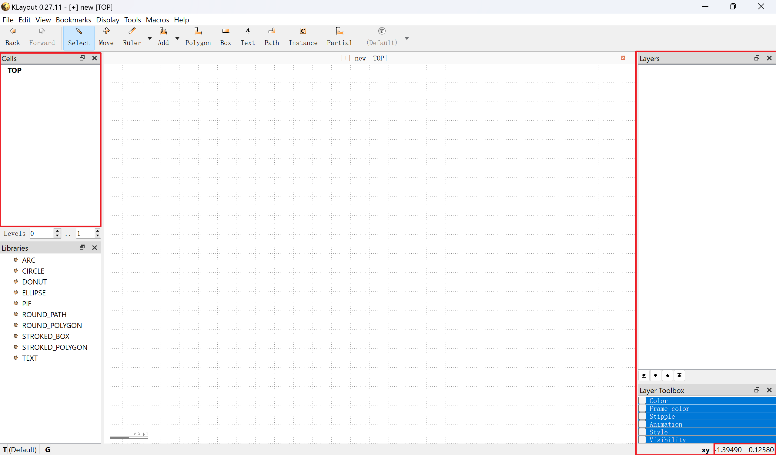
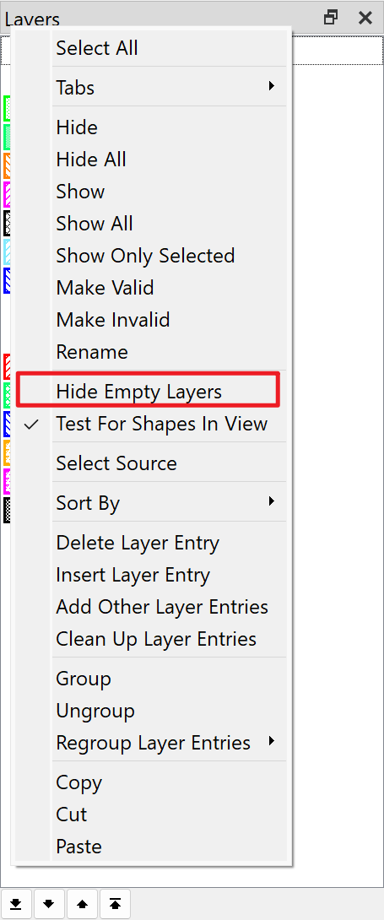
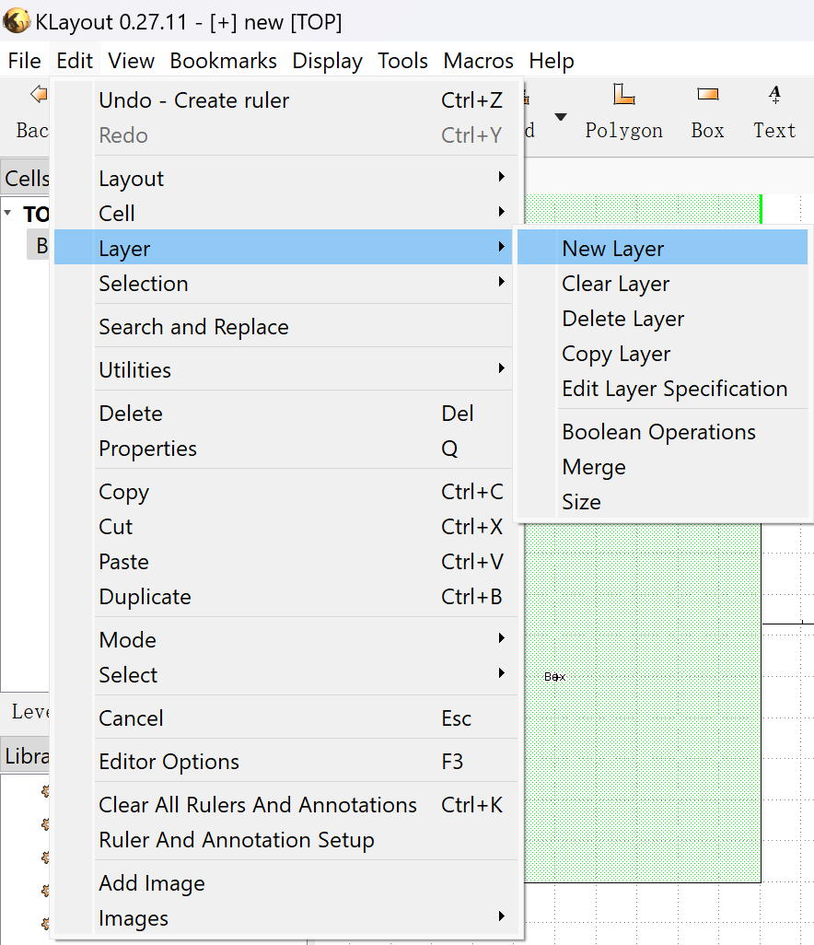
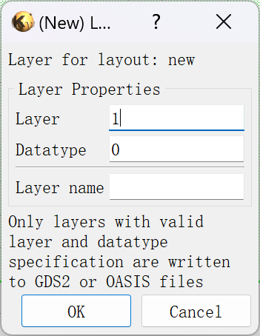
2. Introduction of Layout
Start Using Klayout:
Layout Panel
Create a New File
File --> New Layout, then OK
Cells Hierarchy in left panel
Layer Properties in right panel
If no layer shows here, right click in layer panel
Untick Hide Empty layers
Need to add new layer:
Add in the layer properties file
Everyone can share the new layer you setup
If need to add new layer manually:
Edit --> Layer --> New Layer
Input Layer and Datetype
File --> save layer properties, then you can share it
Coordinate at right bottom

Slide 9
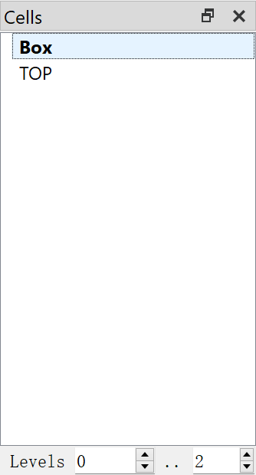
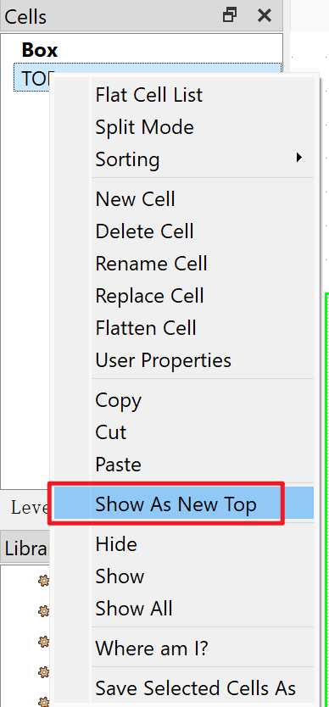
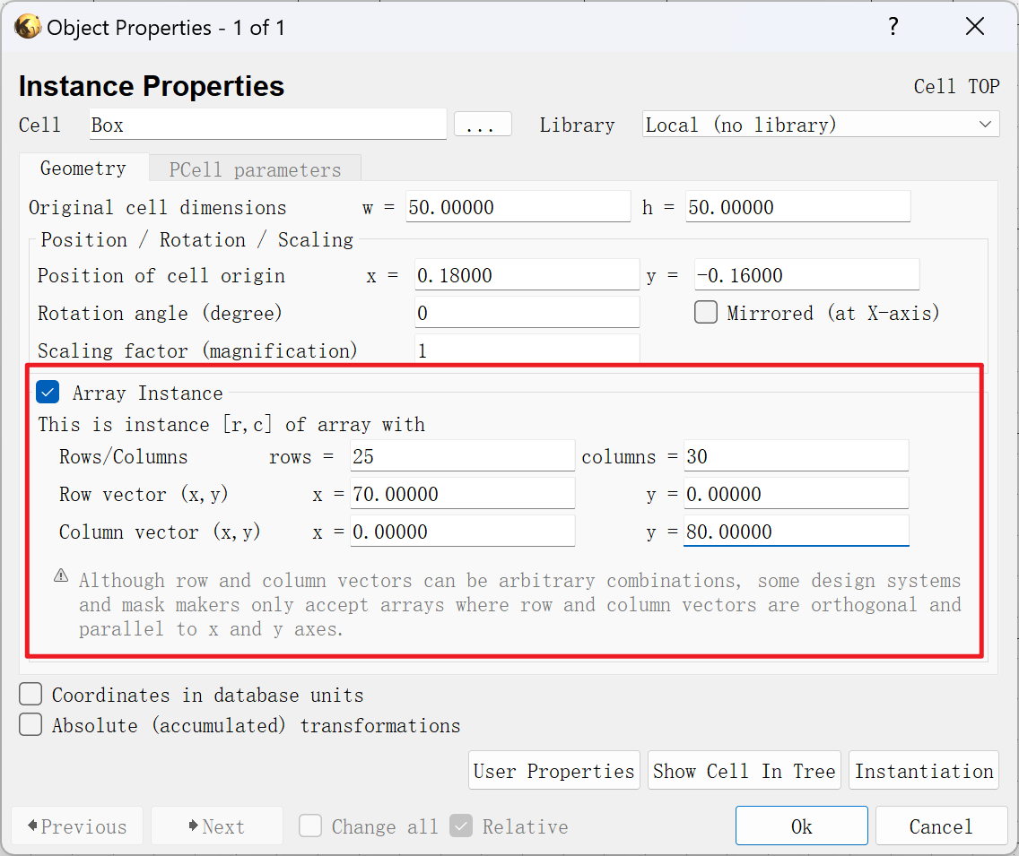
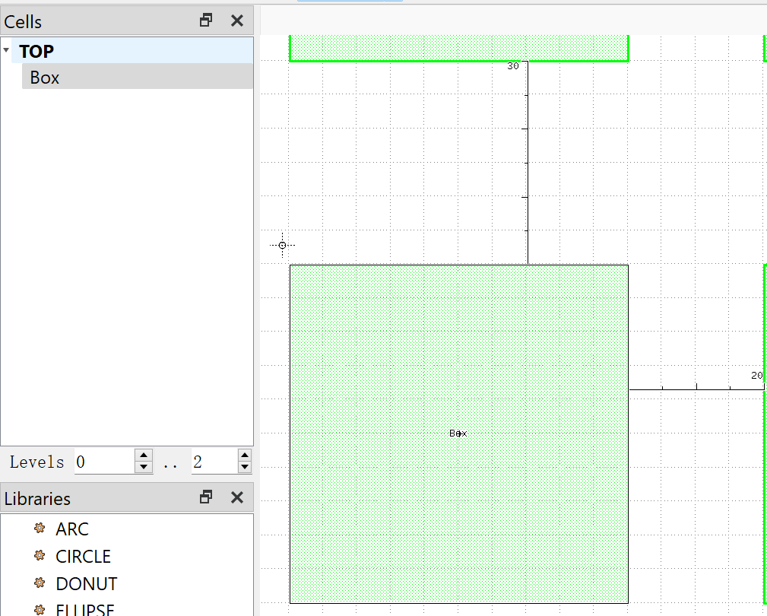
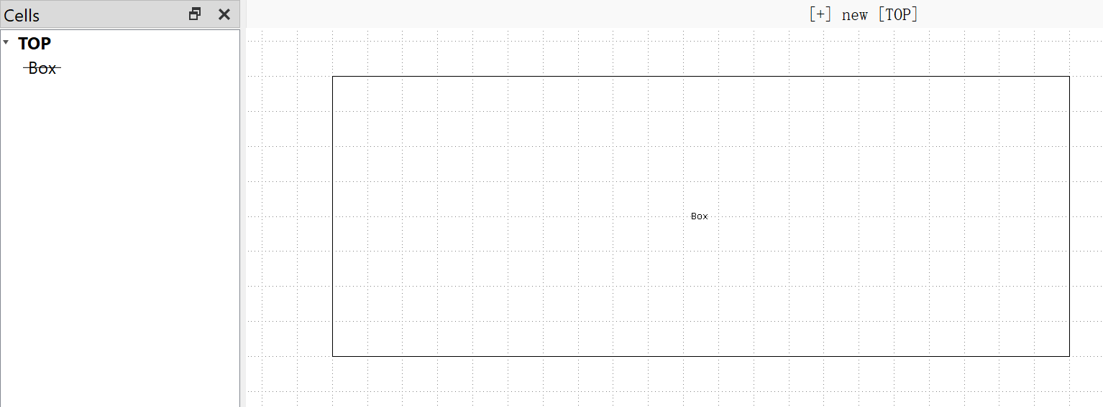
2. Introduction of Layout
Start Using Klayout:
Layout Panel
Cell Array (important)
Only [TOP cell] at the beginning
Edit --> New cell [Box]
Draw 50x50 rectangle in [Box] (Reminder: Use Box in Page6), then back to [TOP], right click --> Show As New Top
To insert [Box] in [TOP], [TOP] Show As New Top, double click [Box] to hide it, drag it into the draw panel of [TOP]
Double click the object in [TOP], set properties, e.g. array
Double click [Box] to unhide it

Slide 10
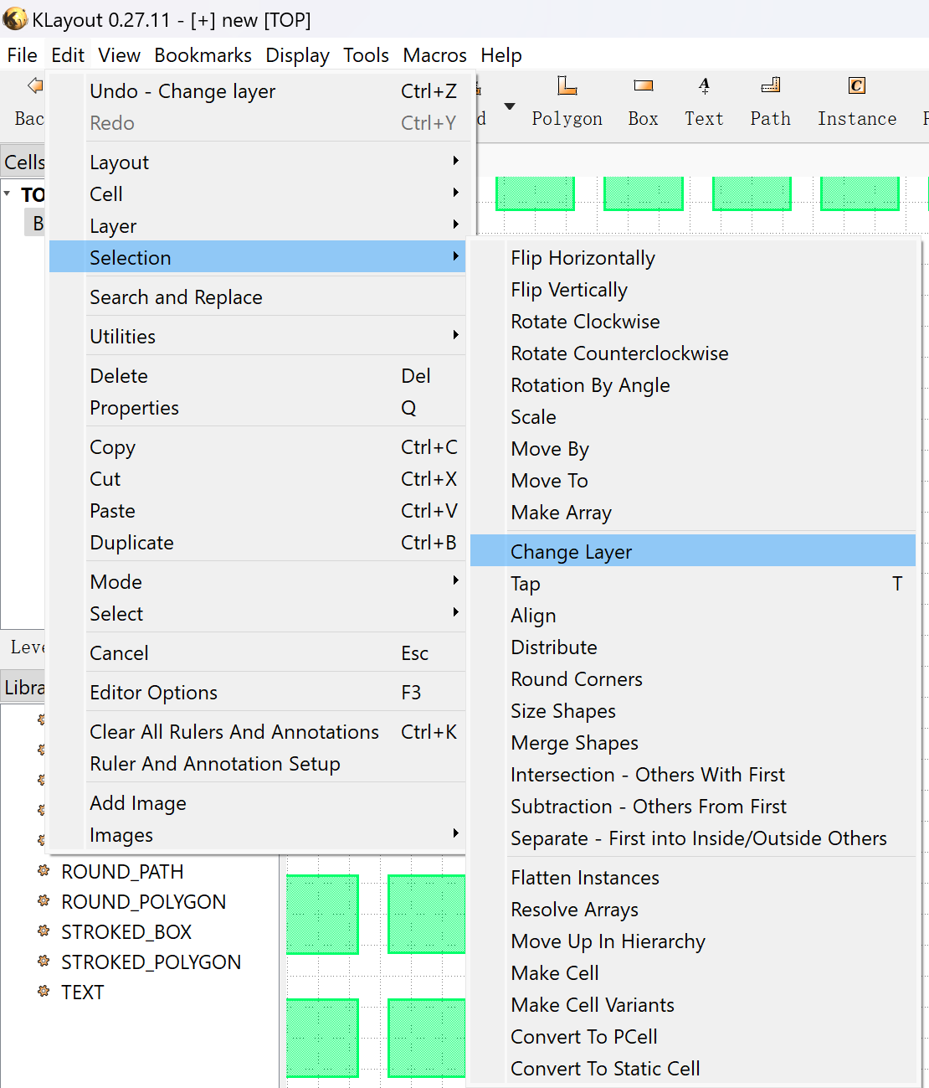
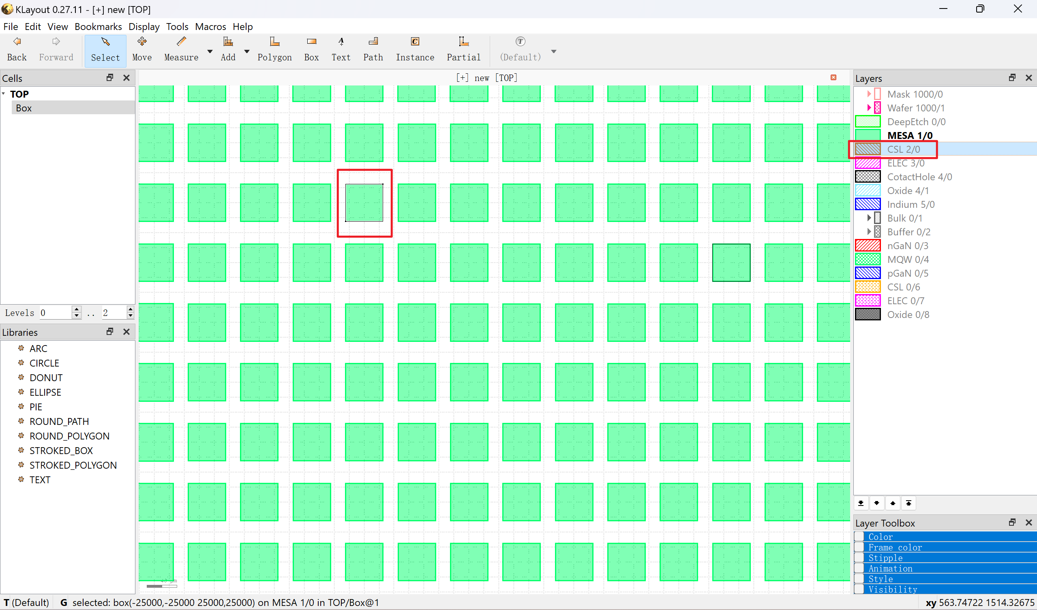
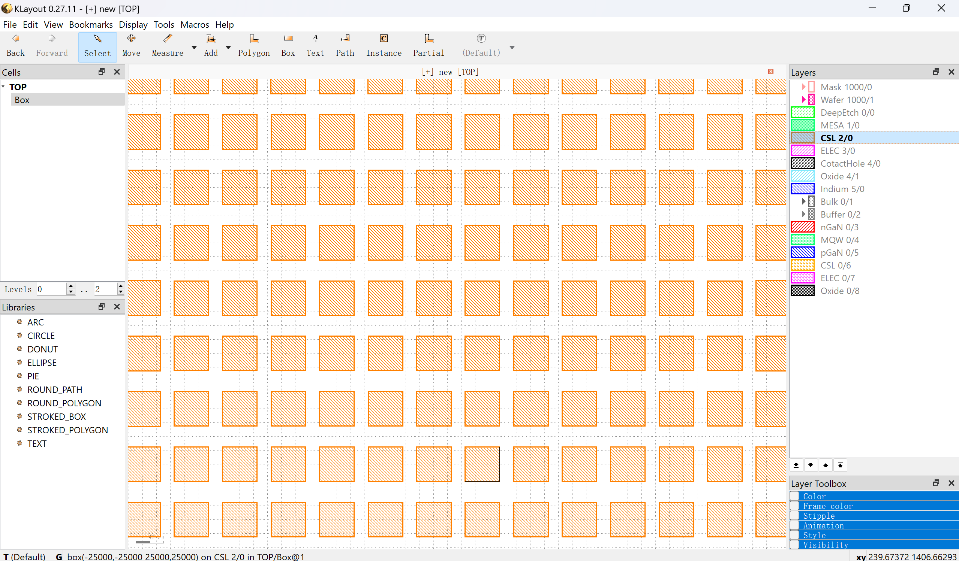
2. Introduction of Layout
Start Using Klayout:
Change Layer of Object
Select Object
Select the layer will be transferred
Edit --> Selection --> Change Layer

Slide 11
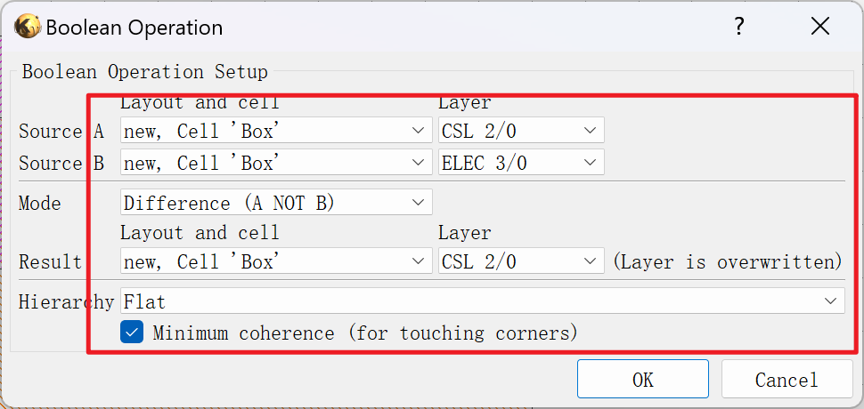
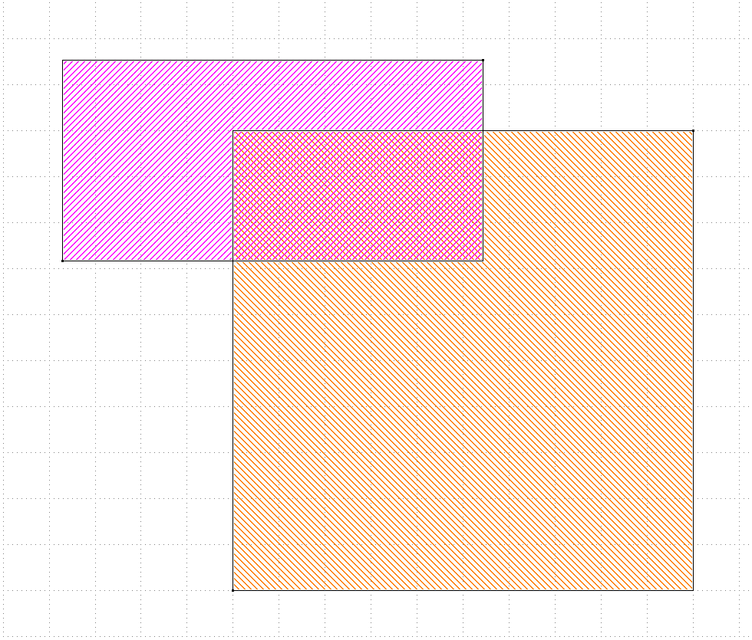
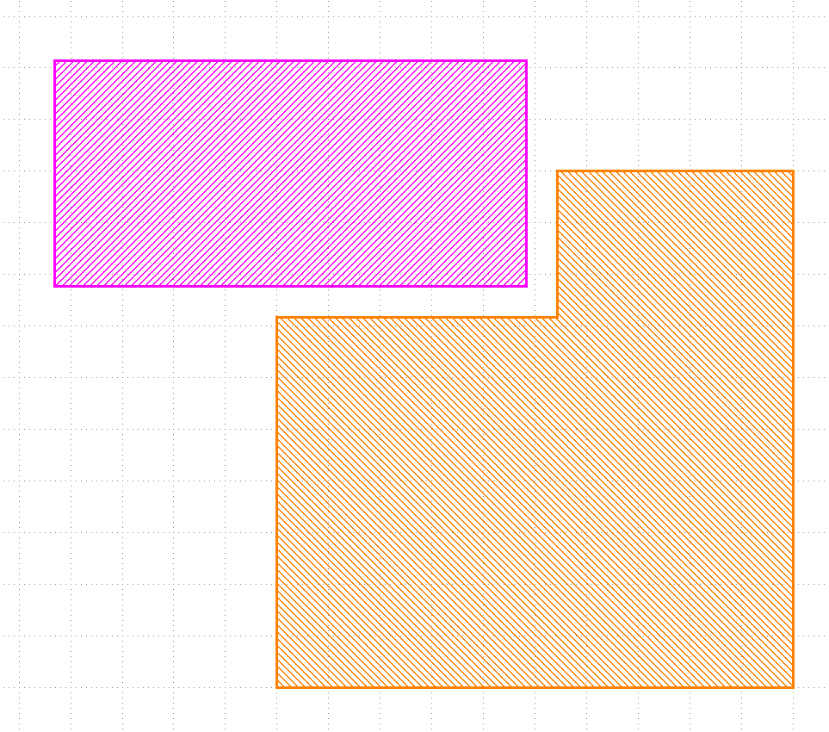
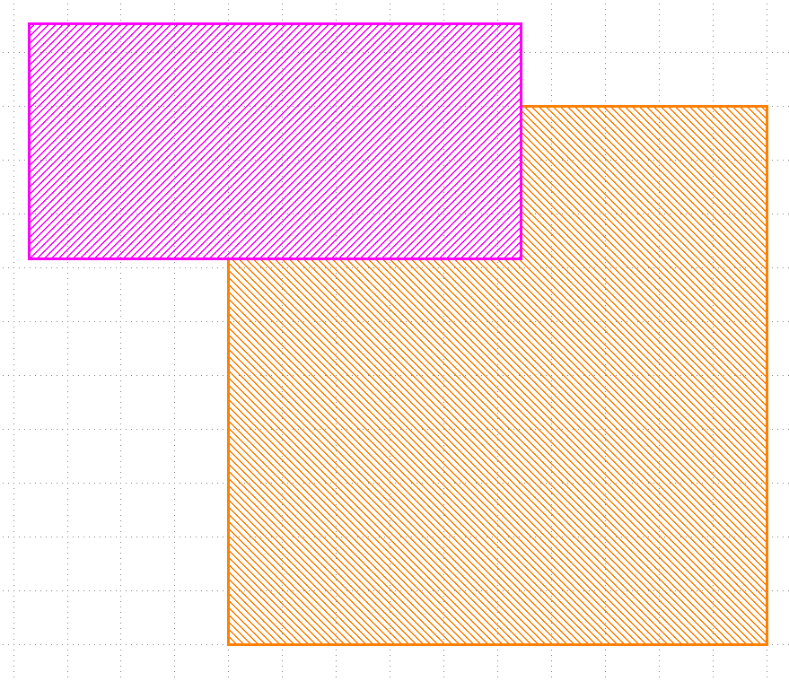
2. Introduction of Layout
Start Using Klayout:
Boolean Operation
Select Objects in different layers
Edit --> Layer --> Boolean Operations
Moved apart

Slide 12
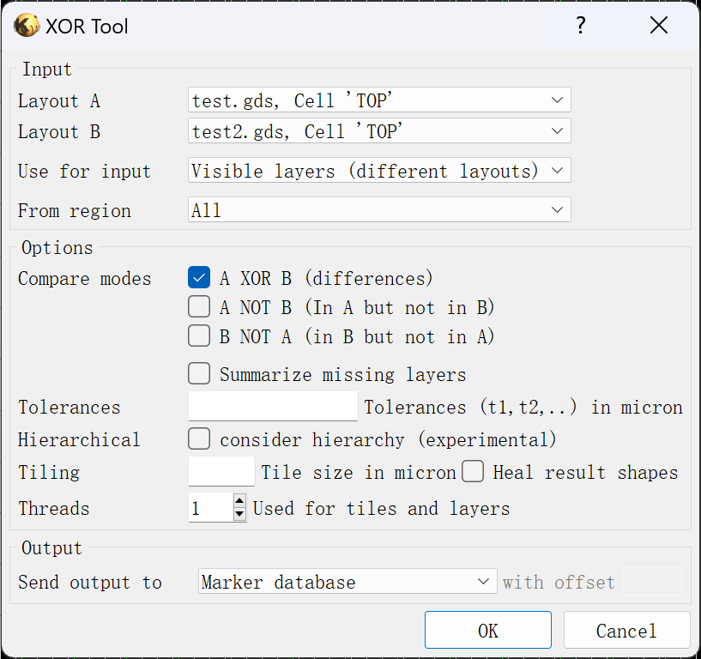
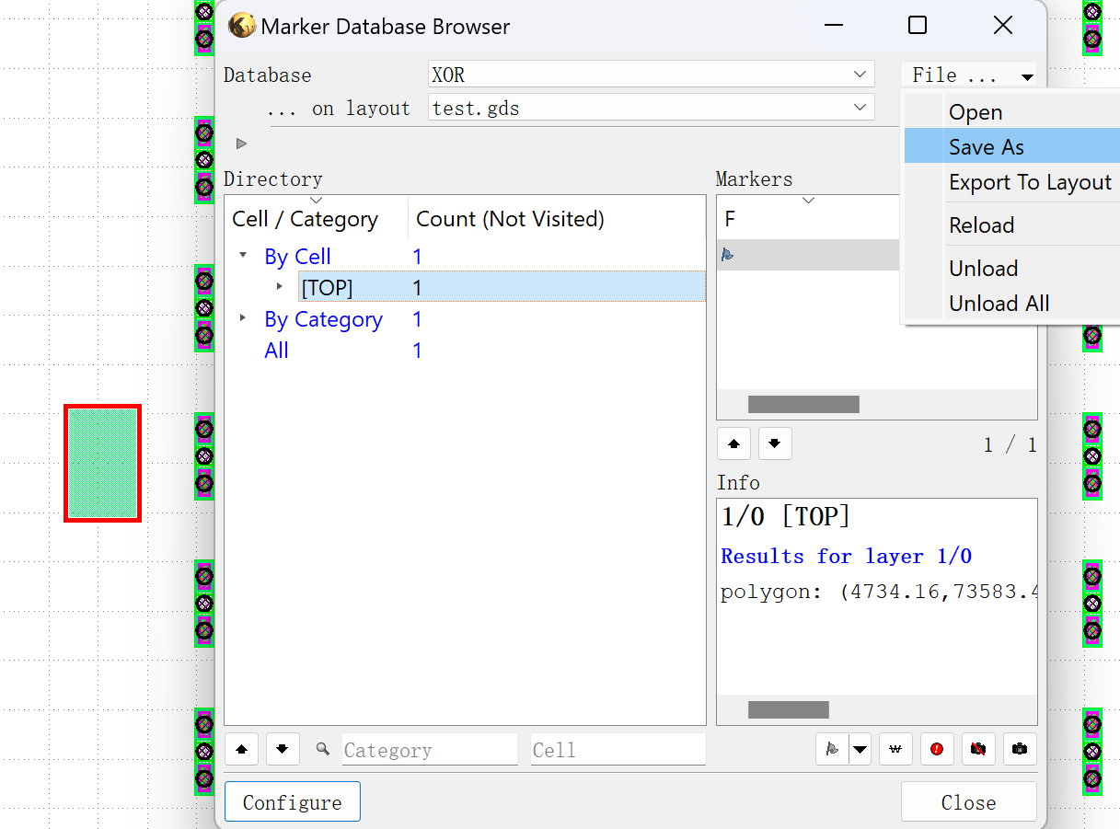
2. Introduction of Layout
Start Using Klayout:
XOR tool
File --> Open in same panel
Tool --> XOR tool
Save as file and share to others

Slide 13
2. Introduction of Layout
Conclusion:
Change Default Mode to Editor if you like, just be careful with your design
Setup layer properties first for convenient group communication
ESC back to select, F2 back to main field
Coordinate at right bottom
Move function: Select --> Move --> Keyboard moving
Ctrl+K clear all rulers in the layout
Show, Hide and Add layer properties
Create Cell Array follow the guidance
Readable file (Excel) for managing the layer properties will be released soon
everyone can access this excel file and then execute the run.bat file to generate a new file for group use.
Bugs/Issues about the Slides/lyp file can be reported and updated in Wechat group or Github here

Slide 14
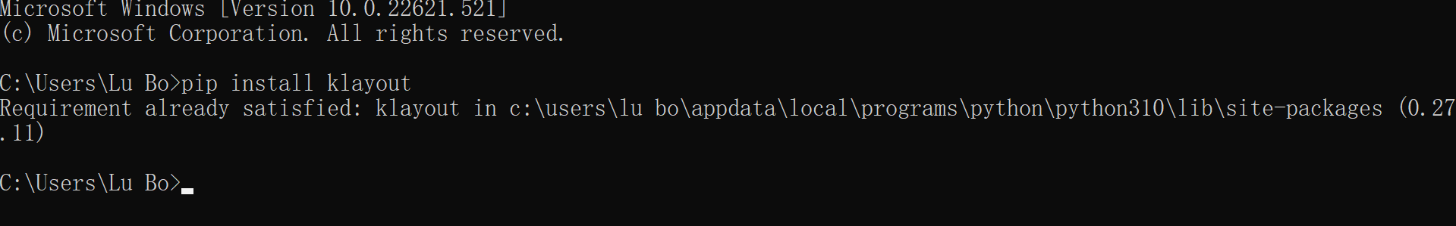
3. Collaborate with Python
Klayout has 2 modes for Coding:
Python code individually
Ruby code embedded
Here introducing Python only, go to official website for ruby
Install Python
Install Package Klayout
Start using Python Script
Example by LU Bo
More details about this part will be released if needed, contact in Wechat group or Github here

Slide 15
Thank You!

