Slide 1
Unit Testing In WP7. Tips and Tricks.
MOBILE DEVELOPER DAY
Alexander Liubushyn, August 16th, 2012

Slide 2
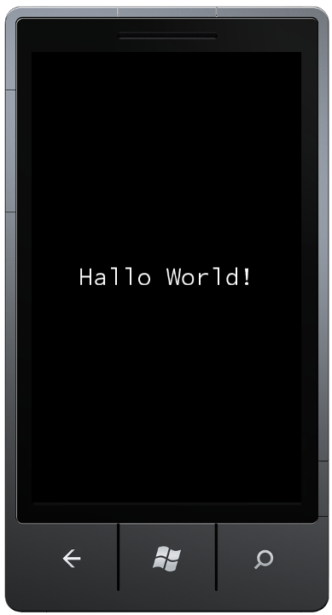
План
Юнит тестирование
Введение что и как.
Кодирование
Настройка окружения
Создание юнит тестов
Advanced topics
Limitations
Outside the Box
Q&A

Slide 3
Unit Testing (1)
Unit tests can
reassure code works as expected
facilitate code changes
detect defects early (bug fixing costs!)
be (part of) the documentation and design (esp. TDD)
But unit tests
can only show the presence of errors
have to test the right things in the right way
must be maintained (failure reviews)

Slide 4
Unit Testing (2)
Write unit tests that:
test a single piece of code (a "unit")
test a single functionality
test your own code (no testing .NET or libs)
result in the most benefit => test what is important to the project => test what contains most logic or is complex => test what changes frequently => state machines, calculations, nested conditions etc.

Slide 5
Live Coding

Slide 6
Summary
Setup: not straight-forward, limitations
Writing tests: pretty much the same as on the desktop and in other projects, the most challenging part especially for beginners
Mocking/Isolation: not available at all, makes everything harder or requires additional setup/more manual coding

Slide 7
Outside the Box
Live demo of BDD

Slide 8
Resources
Windows Phone Unit Testing Resources
Jeff Wilcox WP7 Unit Testing bits: http://www.jeff.wilcox.name/2011/06/updated-ut-mango-bits/
Roger Peter WP7 Unit Testing cheat sheet: http://smartypantscoding.com/a-cheat-sheet-for-unit-testing-silverlight-apps-on-windows-phone-7
Silverlight compatible isolation framework "Moq": http://code.google.com/p/moq
BDD related resources
Behavior Driven Development, explained with SpecFlow and WatiN (ASP.NET MVC, but nicely explains the workflow and theory too): http://msdn.microsoft.com/en-us/magazine/gg490346.aspx
SpecFlow: http://specflow.org/specflow/getting-started.aspx
A quick introduction to the Gherkin language: https://github.com/cucumber/cucumber/wiki/Gherkin
An explanation of the semantics behind Given-When-Then(-And-But): https://github.com/cucumber/cucumber/wiki/Given-When-Then
The Windows Phone Test Framework by Stuart Lodge: https://github.com/Expensify/WindowsPhoneTestFramework
Unit testing in general
Roy Osherove on Unit Testing best practices: http://osherove.com/videos/2009/8/25/unit-testing-best-practices.html

Slide 9
Q&A

Slide 10

Thank you for attending.
Please leave your feedback in the survey displayed after the webinar.
Feel free to contact me on Twitter (@Mister_Goodcat)
or through my blog (http://www.pitorque.de/MisterGoodcat)

