Slide 1
P
P
P
P
u[nx,ny]
jmax
u[1,ny]
u
u
u
v[nx,ny]
v[1,ny]
v
v
v
P
P
P
P
P
u
u
u
u
u
jmax-1
v
v
v
v
v
......
P
P
P
P
P
u
u
u
u
u
v
v
v
v
v
P
P
P
P
P
u
u
u
u
u
jmin+1
v
v
v
v
v
P
P
P
P
P
u[1,1]
v[1,1]
u
u[nx,1]
u
u
v[nx,1]
jmin
v
v
v
......
imin
imin+1
imax-1
imax

Slide 2
j+2
j+1
v[i-1,j+1]
u[i,j+1]
v[i,j+1]
j
u[i-1,j]
u[i,j]
u[i+1,j]
v[i,j]
v[i-1,j]
u[i,j-1]
j-1
i-2
i-1
i
i+1

Slide 3
j+1
v[i,j+1]
v[i-1,j]
u[i,j]
u[i+1,j]
j
v[i,j]
v[i+1,j]
J-1
u[i,j-1]
u[i+1,j-1]
v[i,j-1]
j-2
i-2
i-1
i
i+1

Slide 4
j+2
j+1
v[i,j+1]
v[i-1,j+1]
u[i,j+1]
v[i-1,j]
u[i,j]
u[i+1,j]
j+1
v[i,j+1]
j
v[i,j]
v[i+1,j]
j
u[i-1,j]
u[i,j]
u[i+1,j]
j-1
u[i,j-1]
u[i+1,j-1]
v[i,j]
v[i,j-1]
v[i-1,j]
u[i,j-1]
j-1
j-2
i-2
i-1
i
i+1
i-2
i-1
i
i+1
u-momentum
v-momentum

Slide 5
Ghost
cell
u[i,jmax+1]
Top
boundary
u_top
Top
cell
u[i,jmax]

Slide 6
Ghost
cell
P[i,jmax+1]
Top
boundary
P_top
Top
cell
P[i,jmax]

Slide 7
u=1,v=0
u=0,v=0
u=0,v=0
u=0,v=0

Slide 8
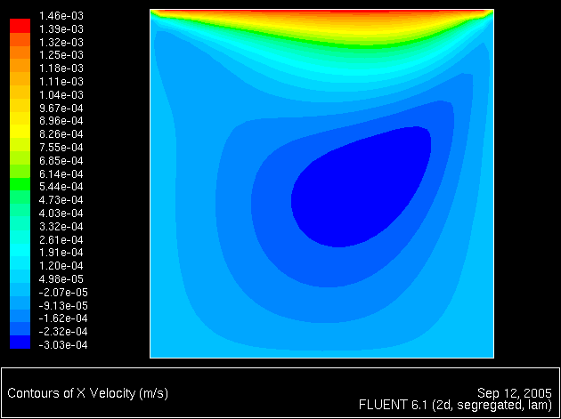
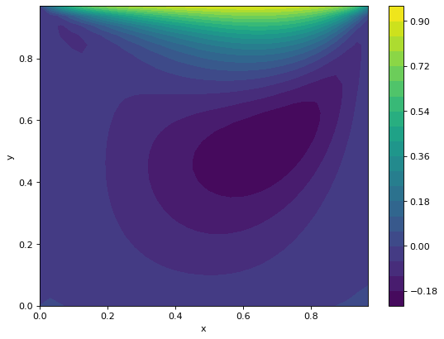
Fluent results for u velocity
Our results for u velocity

Slide 9
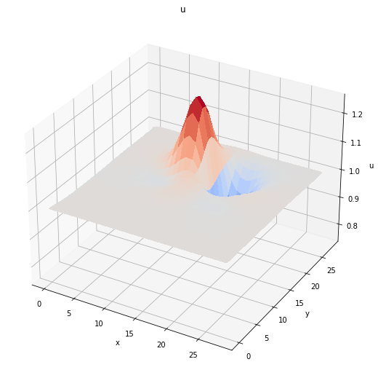
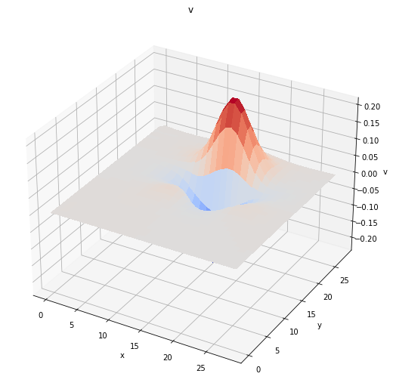
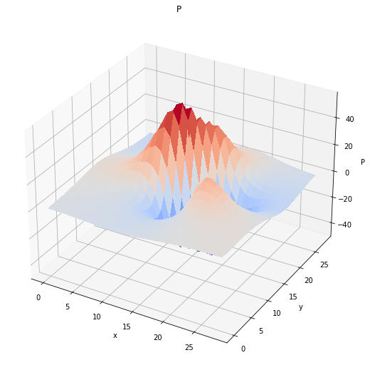
u velocity
v velocity
pressure velocity

Slide 10
