Slide 1
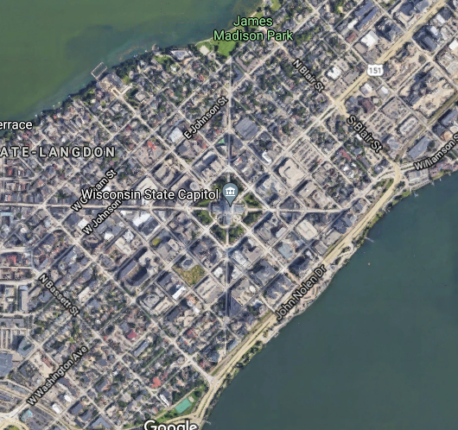
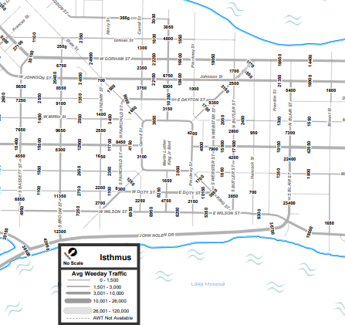
(a)
(b)

Slide 2
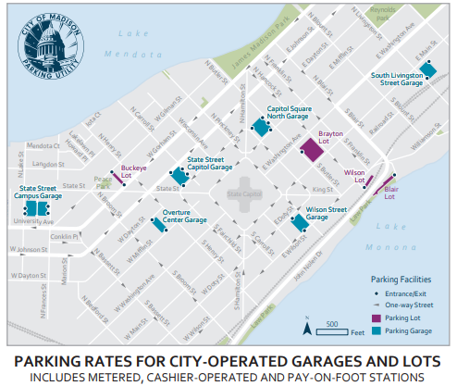
T
One-direction lane
Bi-direction lane
Dummy source/terminal
37
36
Intersection node
24
38
35
25
23
39
26
11
34
22
27
21
12
33
40
10
28
13
S
32
29
14
9
31
20
15
30
8
1
19
16
7
2
18
17
6
3
5
4

Slide 4
T
One-direction lane
2500
Bi-direction lane
7450
3100
Dummy source/terminal
37
36
1000
7450
Intersection node
6450
4950
2500
24
Min-cut
38
4950
600
1500
35
25
1700
1000
7450
23
39
4950
26
4200
11
1500
34
22
350
1500
3100
5750
3850
27
21
12
7900
33
1800
40
1500
1500
1500
3100
10
28
1300
32
13
3850
S
29
14
5350
31
9
20
3200
5350
15
2150
30
8
1
19
16
3200
3200
7
2
18
17
6
3
5
4

Slide 5
1
3
2
4

