Slide 1
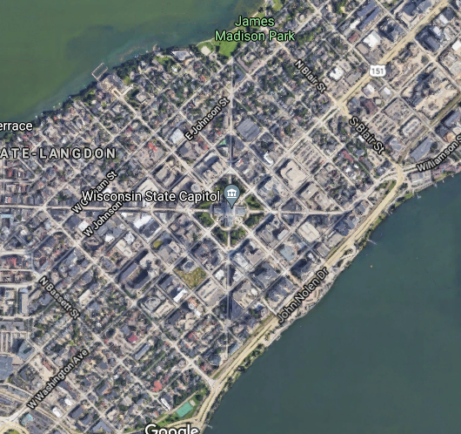
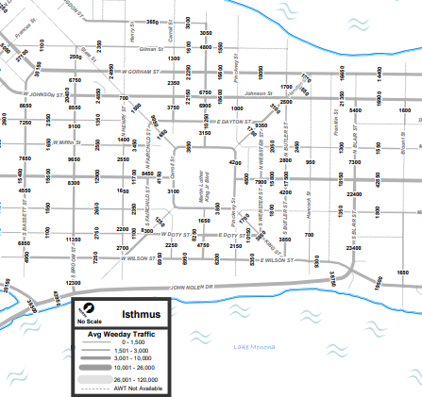
(a)
(b)

Slide 2
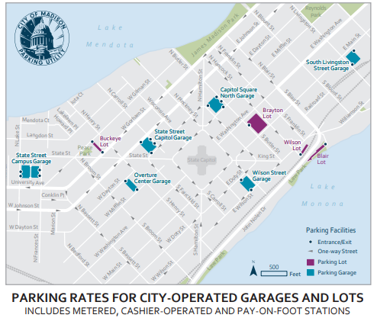
T
One-direction lane
Bi-direction lane
Dummy source/terminal
37
36
Intersection node
24
38
35
25
23
39
26
11
34
22
27
21
12
33
40
10
28
13
S
32
29
14
9
31
20
15
30
8
1
19
16
7
2
18
17
6
3
5
4

Slide 5
1
3
2
4

