Slide 1


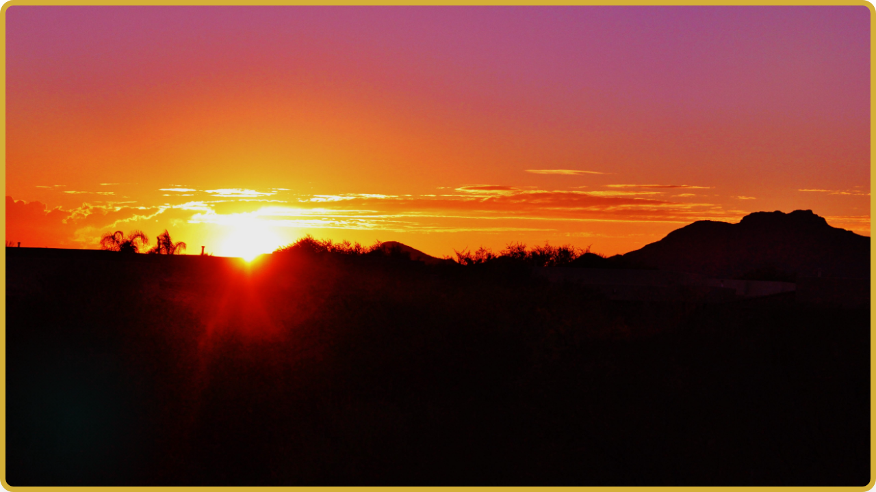

Lighting the
UAE Heritage

Slide 2


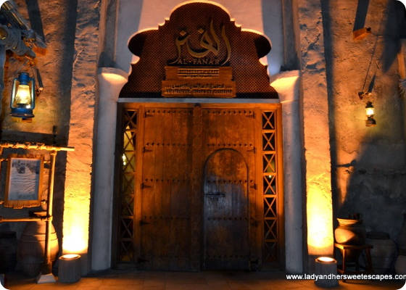
Light in Emirati History
Before modern electricity, the Fanar (traditional lantern) was the heart of every Emirati home. It lit up late-night stories of the desert and pearl diving.
Today, we carry this tradition forward by making our own candles, blending modern science with ancient scents.

Slide 3
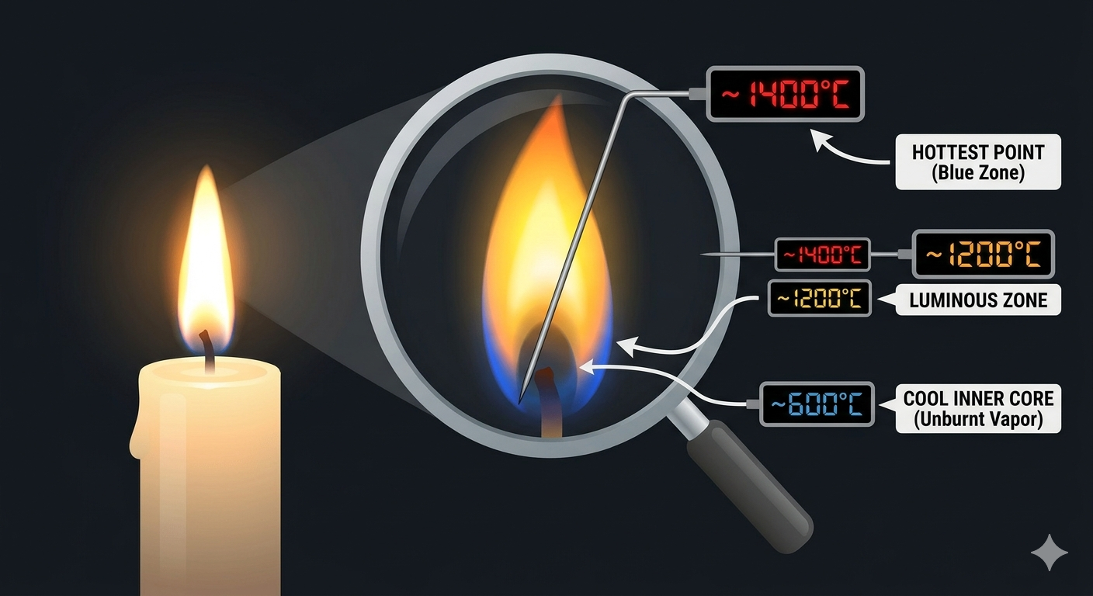

Slide 4
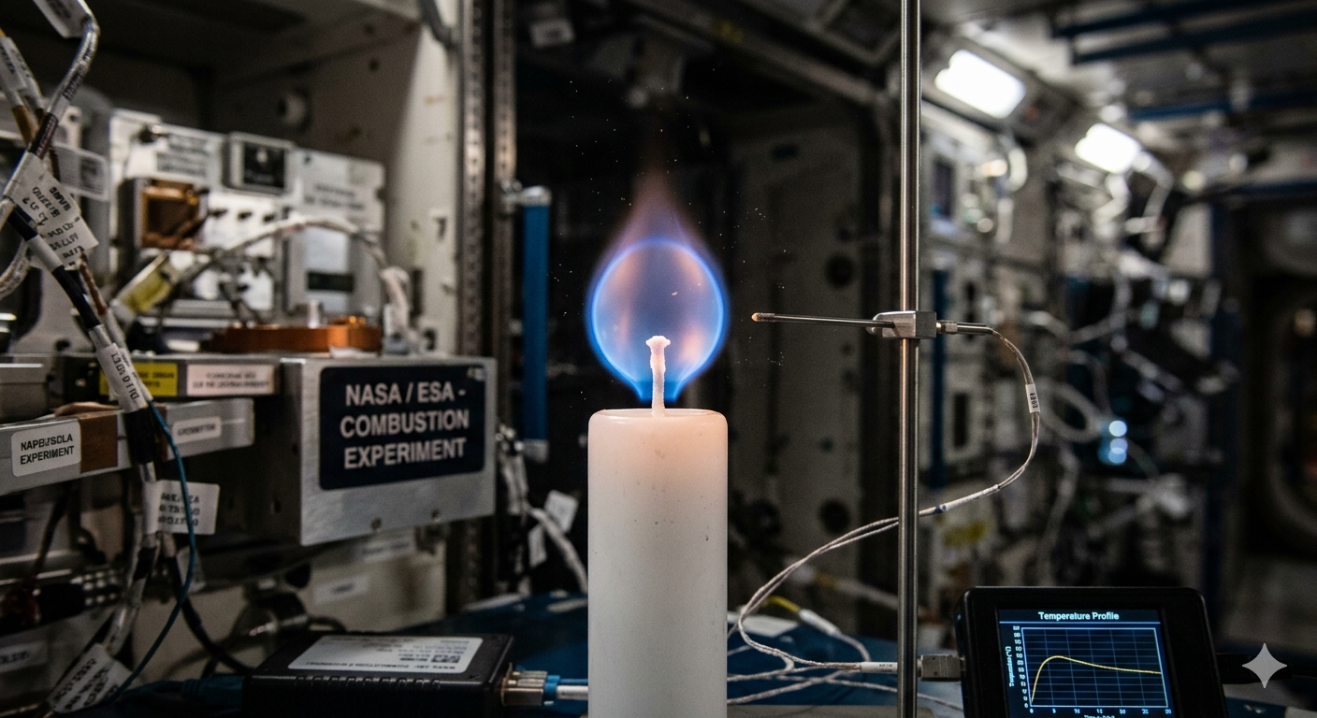

Slide 5






What's in our Maker Kit?
Wax
Fragrance
Colors
We use Paraffin and Bee wax for a clean, long-lasting burn.
Traditional scents like Oud, Musk, Amber, and Rose to fill the air.
Safe dyes to create flag patterns.

Slide 6
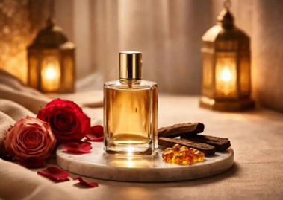
A Journey for the Senses
Signature Aromas
Oud: The "Wood of the Gods," known for its deep, smoky warmth. It is a symbol of hospitality.
Musk & Rose: Soft, floral notes that reflect the beauty of UAE gardens and heritage luxury.

Slide 7
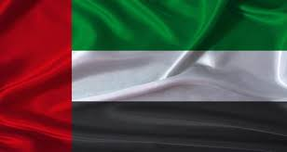
The National Day Palette
Symbolic Colors
Red: Bravery and strength.
Green: Hope and prosperity.
White: Peace and honesty.
Black: Resilience of the mind.

Slide 8
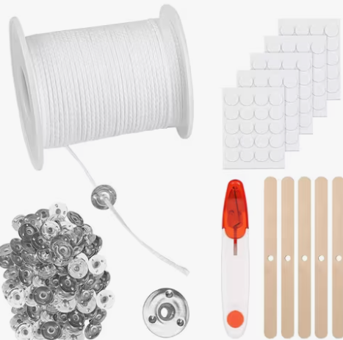
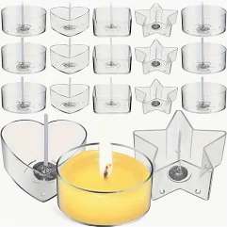
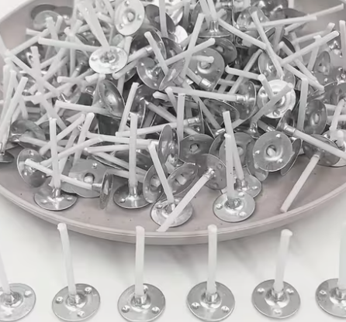
Precision Setup
The Needle & Cork Method
To make a perfect pillar candle, we must secure the wick in the center. Here is our expert trick:
1. Needle: Pierce the bottom of the silicone mould to pull the wick through.
2. Cork: Use a cork at the bottom to seal the hole and stop wax from leaking!
3. Tension: Keep the wick straight for an even burn.

Slide 9
How it's Made
Melt the Magic: Heat the wax flakes in a double boiler until they turn into clear liquid.
Scent & Style: Add your chosen fragrance oil and color dye. Stir gently for 2 minutes!
The Perfect Pour: Slowly pour the wax into your mould, then put the wick.
Patience is Key: Let it cool before removing it from the mould.

Slide 10
Candle Making: Step-by-Step Flow
1. Gather Materials
Wax, wick, mould, scent
2. Melt the Wax
Double boiler, 75-80C
3. Add Scent & Color
Oud, Musk or Amber + dye
4. Set the Wick
Needle + cork method
➡
➡
➡
↴
Your UAE Candle!
Ready to display!
6. Unmould Candle
Gently pop from mould
5. Cool & Solidify
Wait 1 hour at room temp
4b. Pour into Mould
Slow & steady pour
⬅
⬅
⬅
Workshop: Lighting the UAE Heritage | Candle Making Flow Diagram

Slide 11
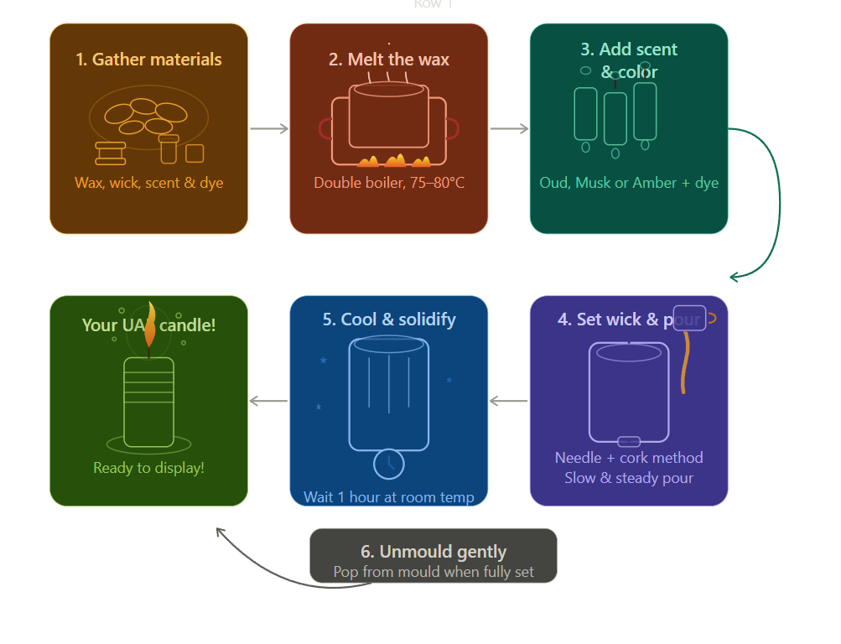
10 Hours

Slide 12
Did You Know? Candle Fun Facts!
🍰
Ancient Candles!
The first candles were made over 5,000 years ago in Ancient Egypt from reeds dipped in animal fat!
🫙
Oud: Worth More Than Gold!
Oud (agarwood) is one of the most expensive natural ingredients in the world. 1kg can cost up to $100,000!
🐢
Slow Burn Science!
A candle flame burns at approximately 1400 degrees Celsius at its hottest point!
🌊
UAE Pearl Diving Legacy!
Before oil, the UAE economy depended on pearl diving. Divers used lanterns and candles to navigate the dark seas at night!
🧪
Beeswax is Brilliant!
Beeswax candles are the cleanest burning candles. They release negative ions that actually purify the air around you!
💡
Scent Memory!
Smell is the strongest sense linked to memory. That is why UAE homes use Oud incense to create warm, lasting memories for guests!

Slide 13
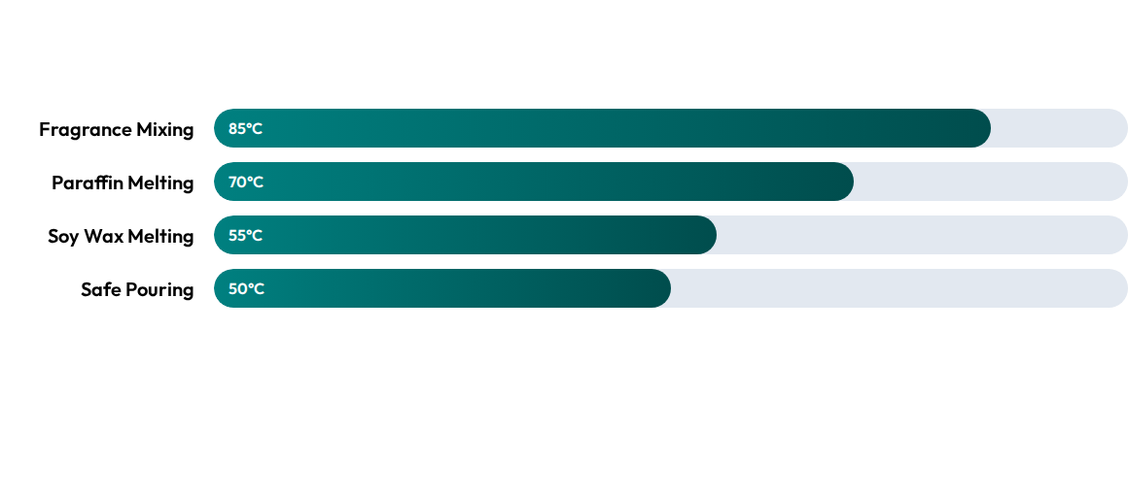
The Temperature Guide
Precision ensures your candle doesn't crack and holds its scent perfectly!

Slide 14
Workshop Timeline
0-20m
60-90m
Intro & History
Cooling & Cleanup
20-60m
Next Session
Melting & Pouring
Branding & Packaging

Slide 15






Maker Rules
Hot Wax
Supervision
Clean Space
Always use gloves and never touch the liquid wax directly.
When pouring the hot liquid, students must be under instructor supervision.
Cover your table with paper. Dried wax is hard to clean!

Slide 16
🧠 Quiz Time! Test Your Candle Knowledge
Q1: What temp should wax reach for fragrance mixing?
Q2: What does the Cork do in candle making?
A) 40-50°C B) 65-70°C C) 75-80°C D) 100°C
Answer: C) 75-80°C - perfect for locking in the fragrance!
A) Adds fragrance B) Seals hole to stop leaks C) Colors the wax D) Stirs the mixture
Answer: B) It seals the bottom hole to stop wax from leaking!
Q3: What scent is known as the Wood of the Gods?
Q4: What color on the UAE flag means Peace?
A) Rose B) Amber C) Musk D) Oud
Answer: D) Oud - the most precious scent in Emirati culture!
A) Red B) Green C) Black D) White
Answer: D) White - symbolizes peace and honesty!
🌟 BONUS: Name 3 traditional UAE scents used in candle making! (Hint: check slide 4!)
Answer: Oud, Musk, Amber (and Rose!) - discuss with your neighbor!

Slide 17
🎨 Activity Corner: Design Your Candle!
📋
My Candle Recipe
Fill in your own candle creation:
🔸 Scent I Choose: ___________
🔸 My UAE Color: ___________
🔸 Candle Name: ___________
🔸 Who is it a gift for? ___________
🧭
Scent Guessing Game
With a partner, close your eyes and smell each fragrance. Can you guess which is which?
🌶️ Sniff #1: Was it Oud or Musk?
🌶️ Sniff #2: Was it Amber or Rose?
🌶️ Which smell reminds you of UAE?
Share your answer with the class!
🤝
Team Safety Check
Before we start - your team checklist:
✅ Table is covered with paper
✅ Everyone has gloves on
✅ Instructor is nearby
✅ Mould and wick are ready
✅ Team name chosen!
🕯️ Every candle you make carries the light of Emirati heritage into the world! 🌍

Slide 18
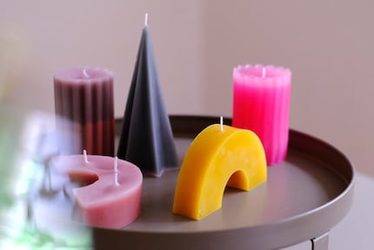
Workshop Creations

Slide 19

Ready to Create?
Any questions before we start the fire?
Workshop: Lighting the UAE Heritage | Grade 5-7

Slide 20
Its Quiz Time

