Slide 1

This Photo by Unknown Author is licensed under CC BY-NC

Slide 2


SAFETY FIRST

Slide 3

Workshop Safety Guidelines
Safety is our top priority
Rules must be followed at all times
Zero tolerance for safety violations
All students are responsible for their own safety

Slide 4











10 Skills in 2 Workshops
Students rotate through these skills across Grades 4–8
1
2
3
4
5
Candle
Making
Soap
Making
Logo Design
& Branding
Badge
Making
Coding &
Robotics
6
7
8
9
10
3D Design &
Printing
Laser
Cutting
Cool Tools
(Woodwork)
Pottery
Making
Jewellery
Design

Slide 5

General Workshop Conduct
No food or drinks inside the workshop
No running or playing inside the workshop
Students are required to clean their workstations and tools at the end of each session.
All tools must be properly returned to their designated storage locations after use
PPE (Personal Protective Equipment) must be worn whenever instructed

Slide 6

Leaving the Workshop
Only 1 student allowed to leave at a time (non-emergency cases)
Reasons: washroom / water / clinic
Must carry a hall pass when leaving
Emergency cases will be handled accordingly

Slide 7
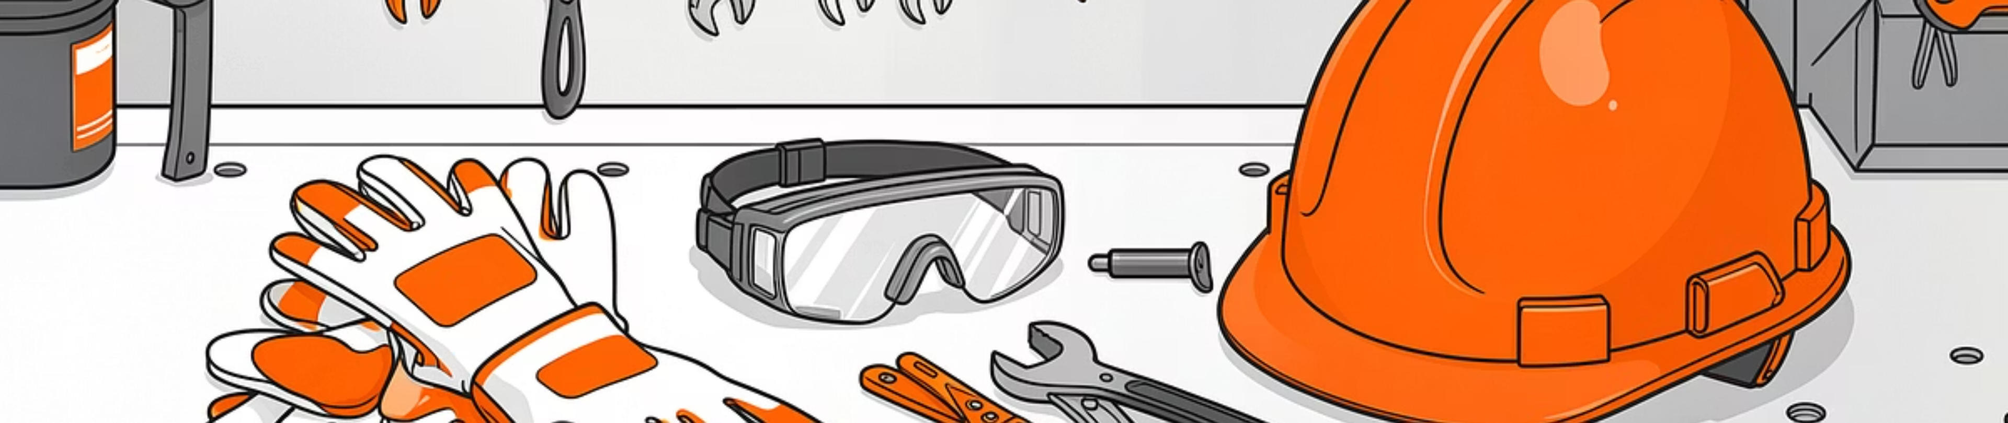
Tools, Equipment & Devices
Do not touch any tools/equipment/devices without instructor permission
Improper use of tools is strictly prohibited
Safety compliance is mandatory before any hands-on activity
PPE must be used as required for specific tasks

Slide 8

Session Structure & Safety Commitment
Each session is 1 hour 30 minutes
Hands-on, project-based learning will be conducted
Full attention and compliance required throughout
Safety FIRST – always follow instructions
No compromise on rules or safety procedures

